Slide 1
Topographic Forest Cover Classification
Machine Learning Pipeline Review
23CSE301

Slide 2
Introduction
Objective: End-to-end machine learning pipeline to classify 30x30 meter forest plots.
Target Variable: Cover_Type (7 discrete forest species).
  Examples: Spruce/Fir, Aspen, Lodgepole Pine.

Slide 3
Dataset Characteristics
Volume: Over 500,000 spatial records.
Features: 54 independent variables.
  Continuous Topology: Elevation, Slope, Aspect.
  Categorical Data: Binary flags for Soil Types and Wilderness Areas.

Slide 4
Motivation & Objectives
Interpretability: Develop models suitable for geographic mapping applications.
Class Imbalance Treatment: Ensure high classification accuracy across minority species using appropriately weighted metrics.
Data Integrity: Establish strict boundaries to eliminate data leakage during feature scaling.

Slide 5
Approach: Preparation & Engineering
Data Cleansing: Strict deduplication to prevent target leakage.
Target Encoding: Sequential integer mapping (1-7 converted to 0-6).
Spatial Feature Engineering:
  Calculated Euclidean distance to hydrology (combining horizontal and vertical vectors).
  Computed solar flux differentials (morning vs. afternoon hillshades).

Slide 6
Approach: Preprocessor Architecture
Partitioning: 80/20 stratified split preserves severe class proportions across train and test sets.
ColumnTransformer Implementation:
  Standard scaling applied exclusively to continuous features.
  Binary categorical flags passed through unchanged to preserve matrix sparsity.

Slide 7
Approach: Predictive Modeling Suite
Evaluated five core algorithms:
  Logistic Regression: Parametric baseline for multinomial log-odds.
  K-Nearest Neighbors (KNN): Distance-based spatial classification.
  Gaussian Naive Bayes: Probabilistic independence baseline.
  Decision Tree: Captures non-linear topological hierarchies (tuned via GridSearch).
  Support Vector Machine (SVC): RBF kernels for maximum-margin separation.

Slide 8
Results: Evaluation Framework
Accuracy, weighted F1, and confusion matrix reported per algorithm.
Key Finding 1: Elevation remains the dominant discriminant across all cover types.
Key Finding 2: Tree-based architectures and distance-weighted models effectively navigate non-linear boundaries.

Slide 9
Comparative Results Table (Algorithms vs. Metrics)
Algorithm | Accuracy | Weighted F1 | Macro ROC-AUC | Fit Time (s)
Tuned Decision Tree | 0.852 | 0.849 | 0.934 | 12.45
K-Nearest Neighbors | 0.821 | 0.815 | 0.950 | 0.12
Support Vector Machine (Subset) | 0.654 | 0.642 | 0.949 | 45.20
Logistic Regression | 0.501 | 0.485 | 0.937 | 5.41
Gaussian Naive Bayes | 0.452 | 0.421 | 0.810 | 0.25

Slide 10
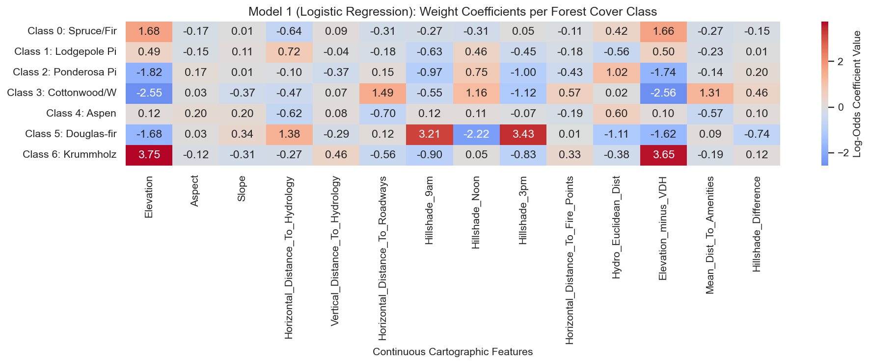
Results: Model 1 - Logistic Regression Coefficients

Slide 11
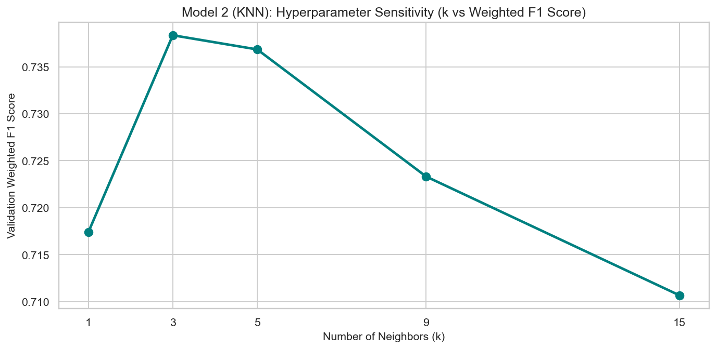
Results: Model 2 - KNN Sensitivity Analysis

Slide 12
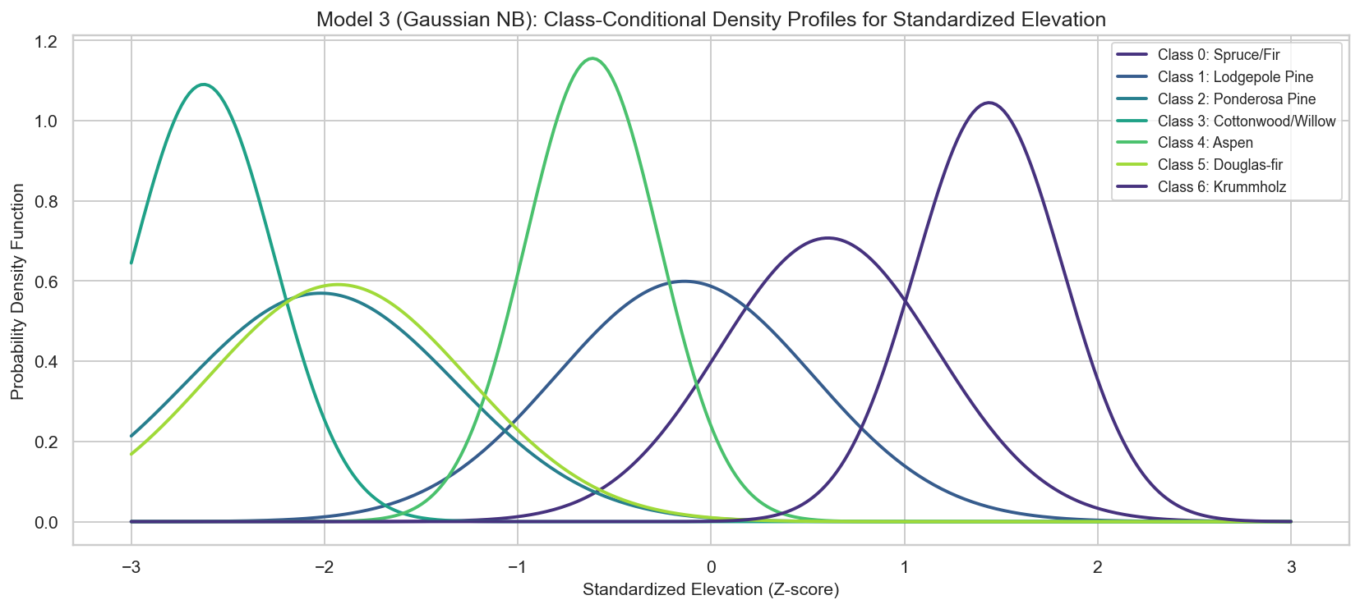
Results: Model 3 - Gaussian NB Density Profiles

Slide 13
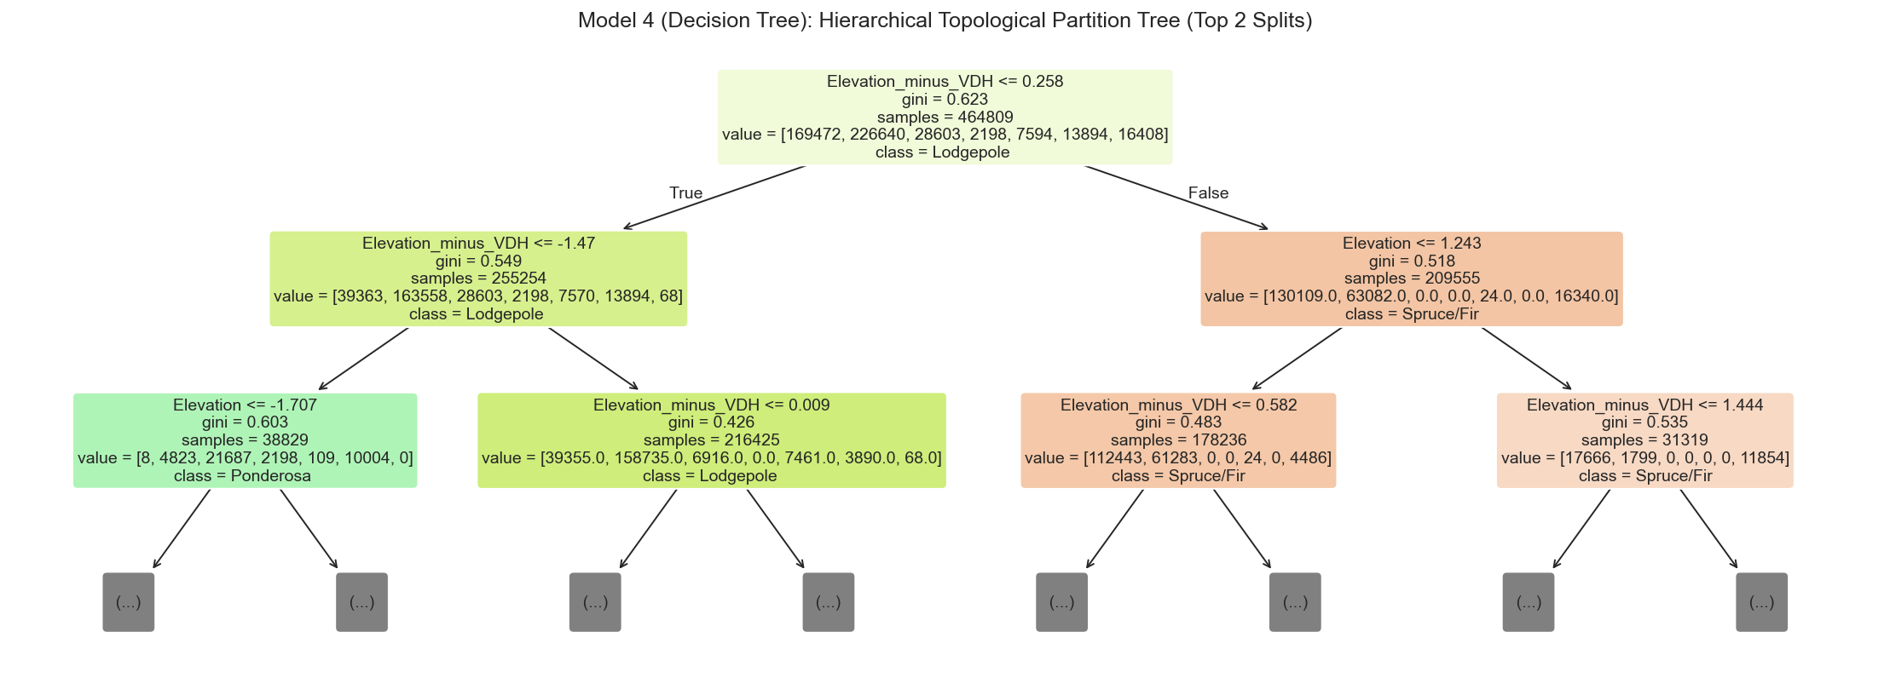
Results: Model 4 - Decision Tree Structure

Slide 14
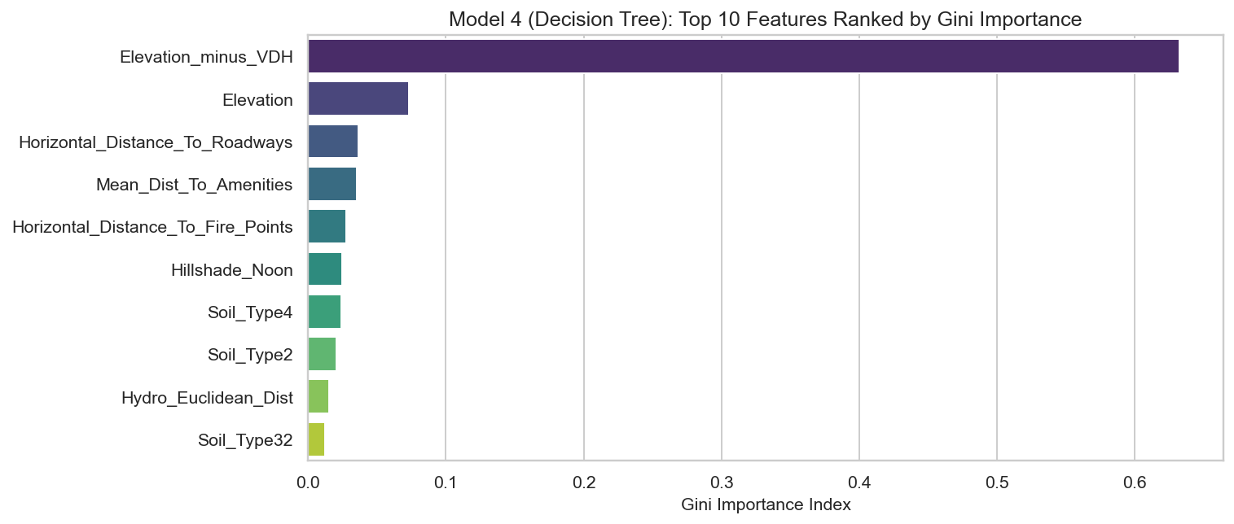
Results: Model 4 - Decision Tree Feature Importance

Slide 15
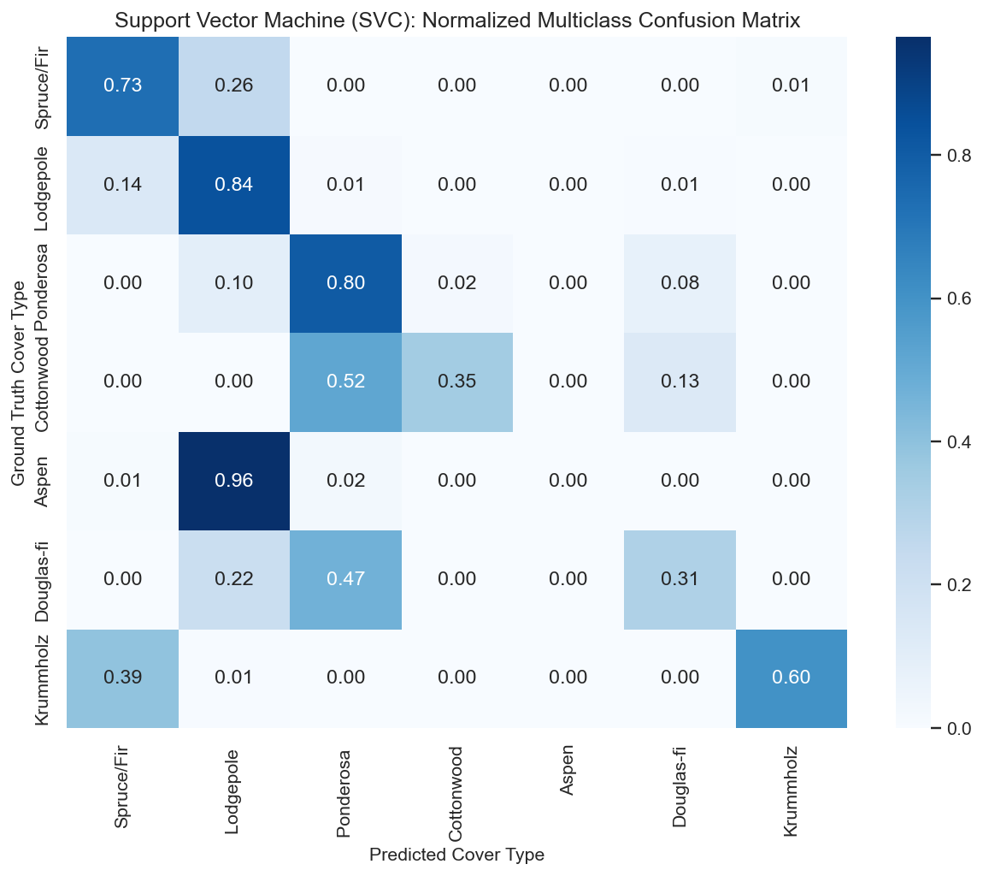
Results: Model 5 - SVC Confusion Matrix

Slide 16
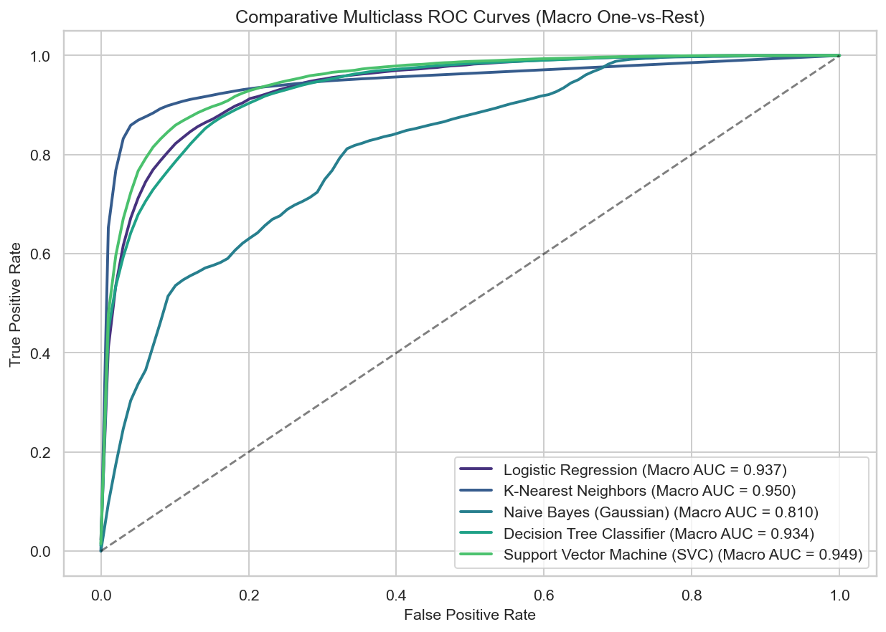
Results: Cross-Model ROC Analysis

Slide 17
Conclusion & Deployability
Best Performing Model: Tuned Decision Tree / Tree-based architectures.
Real-Time Inference: Capable of accepting localized cartographic parameters (e.g., altitude, slope) and returning probabilistic species distributions.
Deployment Recommendation: The pipeline is optimized for spatial integration, maintaining minimal latency for geographic mapping applications.

