Slide 1
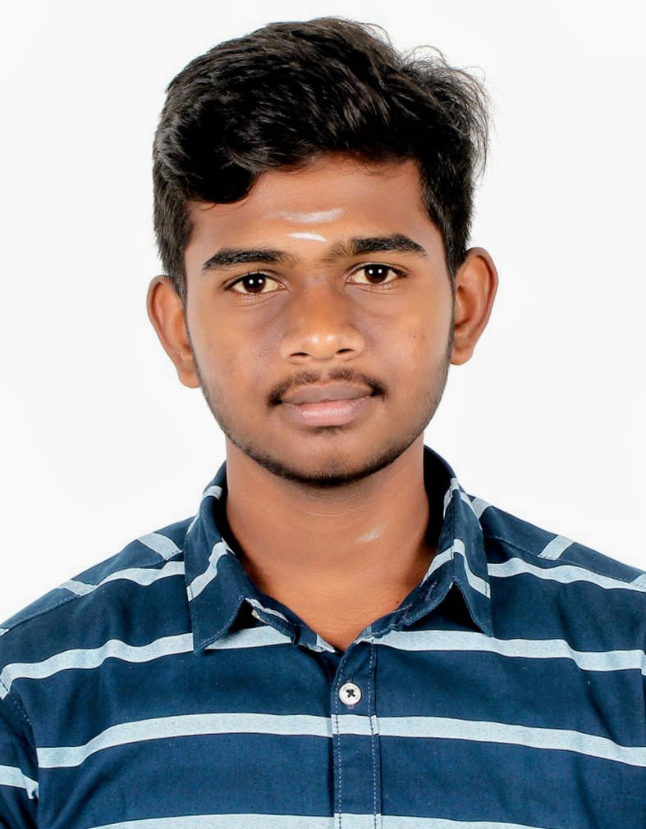
My profile
Name : Sanjith S J
Roll No. : CSE24544
Official Email : cb.sc.u4cse24544@cb.students.amrita.edu
Personal Email : sanjith120806@gmail.com
Work Email : Sanjith@bettim.tech

Slide 2
About me
I’m a Computer Science Undergraduate at Amrita Vishwa Vidyapeetham, with strong interests in Backend Engineering, Distributed Systems and Scalable Software Designs.
I enjoy building systems and solutions that solve real-world problems using clean architecture and modern development practices.
My experience ranges from building Event-Driven SaaS applications and building embedded telemetry systems using advanced data structures.
Currently, I work as an Undergraduate Teaching Assistant in Amrita Vishwa Vidyapeetham, Coimbatore.

Slide 3
Online presence
GitHub
https://github.com/BETTlM
LinkedIn
https://www.linkedin.com/in/sanjithsj/
LeetCode
https://leetcode.com/u/BETTlM/
https://leetcode.com/u/BettimIsUnemployed/

Slide 4
Academic performance
Current CGPA : 8.4/10
Relevant Coursework :
Data Structures and Algorithms
Object Oriented Programming
Operating Systems
Database Management Systems
Computer Hardware

Slide 5
Participations
Participated in VISA IIT Hackathon 2026, Finalist top 50 among 3000+ teams.
Participated in Amrita’s Build2Break Hackathon 2026.
Selected as Undergraduate Teaching Assistant in Amrita School of Computing.
Contributed to Flowgorithm Application.

Slide 6
Research papers
Currently exploring research opportunities in System Performance Optimization, Event-driven Architectures and Artificial Intelligence.

Slide 7
Key projects
Title | Role | Collaborators | Project URL | GitHub URL | Outcomes
SaaS Event Sync Engine | Developer | None | https://bettim.tech | https://github.com/BETTlM/Secretary | Projected increase in efficiency of 50%
High Performance Skip List Engine | Developer | Lohit G, Madan M, Nitin Pranav | Local project | https://github.com/BETTlM/APMDashboard | Projected time savings of around 30H/Week
Embedded Telemetry System | Developer | Lohit G, Madan M, Nitin Pranav | Local Project | https://github.com/BETTlM/BlackBoxMotorcycle | Projected reduction in road accidents of 70%
Android UI Bot | Developer | None | Local Project | https://github.com/BETTlM/BlackBoxMotorcycle | Increased visual flairs with less wastage of time

Slide 8
Subjects Of Interest
Subjects of Interest :
Distributed Systems
Computer Networks
Neural Networks
Machine Learning
Web Architecture
Certifications :
IBM Python Developer – IBM – 2022
Machine Learning with Python – Coursera – 2024
Oracle cloud Infrastructure Developer – Oracle – 2024
AWS Certified Cloud Practitioner – AWS – 2026

Slide 9
Research Internships
Currently seeking research opportunities in Distributed Systems, Full Stack Development, Cloud Architecture, Performance Engineering and Scalable Architecture

Slide 10
Product internships
Currently seeking product internship opportunities in Backend Infrastructure, Systems Design, Cloud Native Applications, Scalable API Platforms and Distributed Network Systems.

