Slide 1
图标素材6大类220个

Slide 2











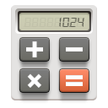








































Slide 3
























































Slide 4
30 emoticon.
30 social.

Slide 5
30 business.
30 transport.

