Slide 1
AJAX BASICS

Slide 2
AJAX
Asynchronous JavaScript and XML (AJAX) provides a way for JavaScript to send data to and receive data from a server.

Slide 3
Behind the scenes ?!

Slide 4

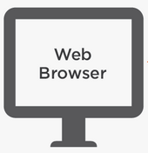


Behind the scenes ?!
Web Browser formats the request and communicate with the server about the client’s request
User entering URL in the Web Browser
Web Server locates the user request, formats it and send it as a response to the Web Browser.
Web Browser interprets the server’s response and renders the webpage to the user.

Slide 5
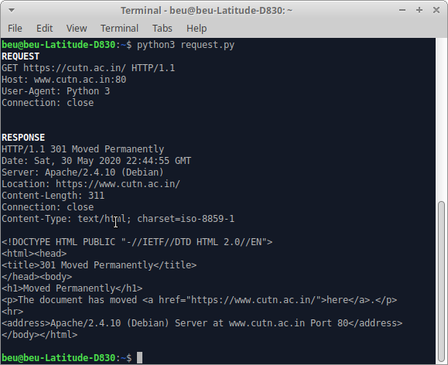
HTTP REQUEST- PACKET
REQUEST LINE
REQUEST HEADERS
REQUEST BODY

Slide 6
HTTP RESPONSE
CLIENT
SERVER
HTTP Request
HTTP Response
An HTML browser uses the header information to process the HTML page
HTTP RESPONSE HEADER
An HTML browser uses the header information to process the HTML page
HTTP BODY

Slide 7
HTTP RESPONSE

Slide 8
EXAMPLE OF AJAX
GOOGLE SEARCH ENGINE

Slide 9
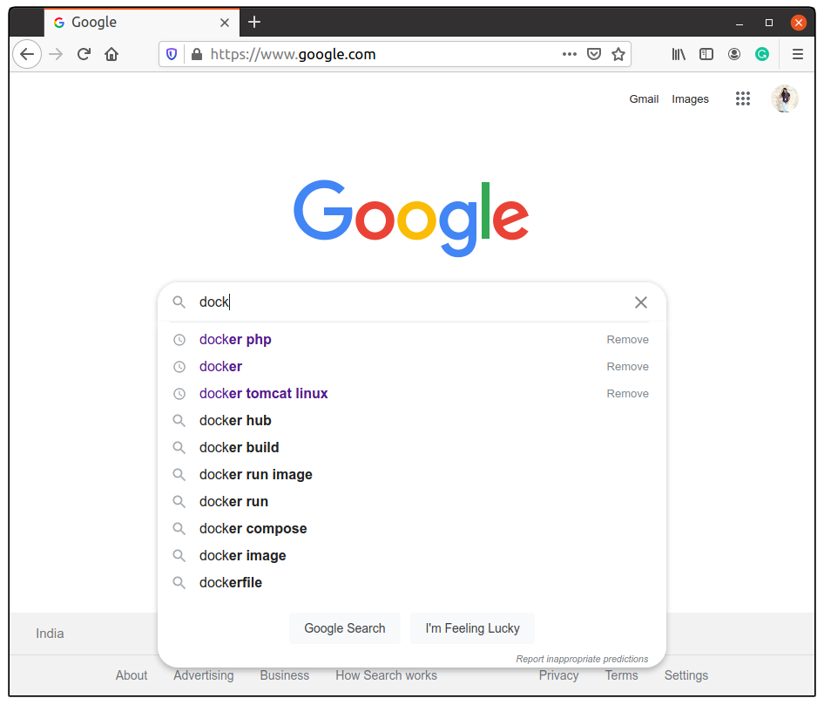
GOOGLE SEARCH ENGINE

Slide 10
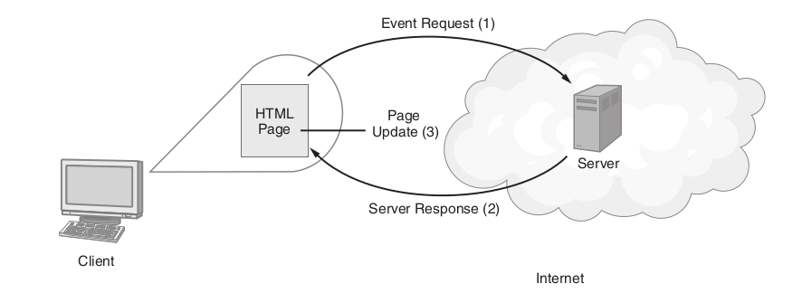
AJAX processes
The Three-step AJAX Process
First, something happens on the page to trigger the need for an AJAX operation, such as a keyboard input or a mouse-click operation in other words, an event.
The page, in turn, uses JavaScript to send a message to a remote server.
The server, in turn, processes the request and sends back a response to the page.

Slide 11
How AJAX works ?
SERVER
XML / JSON
XMLHttpRequest
AJAX ENGINE
COMMON REQUEST AND RESPONSE
HTML RESPONSE
JS call
CLIENT

Slide 12
AJAX
It is extremely important technology in web development.
It is not a language
It is not a framework
And it is not even a library
It is just a simple set of web technologies to send and receive data from client to the server asynchronously.
It is all done behind the page without having to explicitly reload the web page.

Slide 13
AJAX
In order to improve webpage processing capabilities and functionality, we use JavaScript to send data and request content to or from a remote server.
Asynchronous JavaScript and XML, or AJAX, is a technique that we use to perform JavaScript-based interactions with a server.
Asynchronous means “not occurring at the same time”
Example: An exchange of letters through postal mail, for instance, is an example of asynchronous communication, unlike, say, a conversation in person or over the phone.

