Slide 1
IOT PROJECT
Kamil Khan
Afari Jesse
Beulah Evanjalin

Slide 2
IOT Based Smart Parking System
Parking Lots over the years have become a very crowded due to the rising use of vehicles. Organization and institutions tend to need some management in terms of available slots and occupied slots. To avoid a lot of collision and mess in the parking environment proper information on occupied slots and available slot should be given to incoming vehicles.

Slide 3
Objective
To do this we hope to implement an IOT based smart parking system that will first of all notify incoming vehicles of available slots and also inform if that particular section has no free slot available

Slide 4
Architecture
In
Sensor
s1
s4
Display
Display
s2
s5
s3
s6
Out
Sensor

Slide 5
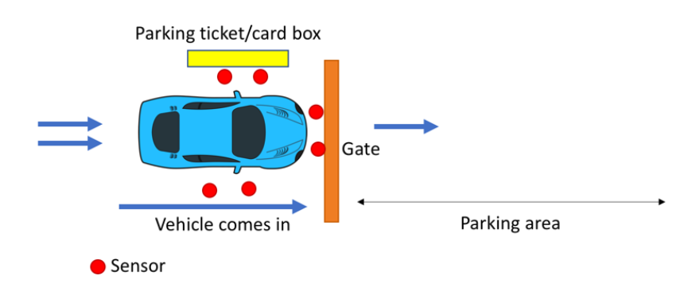

Slide 6
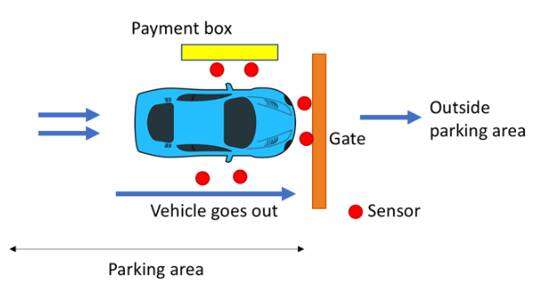

Slide 7
Materials
PIR sensors
Adruino uno or Raspberry Pi
Connectors
display screen
Ultrasonic sensor - HC-SR04
BreadBoard
Toys (other demo things)

Slide 8
Reference
https://circuitdigest.com/microcontroller-projects/iot-based-smart-parking-system-using-nodemcu
https://www.researchgate.net/publication/303842610_IoT_based_Smart_Parking_System

