Slide 1
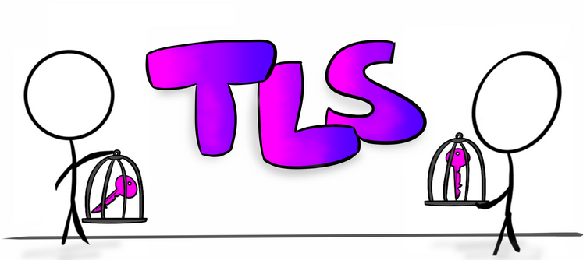
TRANSPORT LAYER SECURITY

Slide 2
What do you know / think about TLS?

Slide 3
What do you know / think about TLS?
Suppose you want to have a confidential conversation with someone you know.
What will you do for that?

Slide 4
What do you know / think about TLS?
Suppose we want to have a confidential conversation with someone we know.
What we may do for that?
We might meet up in person and find a private place to talk.

Slide 5
What do you know / think about TLS?
Suppose If we want to send data confidentially over the Internet ?
What will be the case then?
Now we should have few more things to consider.

Slide 6
TLS
TLS, or Transport Layer Security, refers to a protocol.
Refers to host-to-host communication, such as how a client and a server interact, in the Internet protocol suite model
“Rules”;
“The way we’ve agreed to do things around here,”

Slide 7
Why TLS?
The TLS protocol attempts to solve these fundamental problems:
How do I know you are who you say you are?
How do I know this message from you hasn’t been tampered with?
How can we communicate securely?

Slide 8
TLS handshake
CLIENT HELLO MESSAGE
It involves a client (web browser) and a server, such as one hosting a website, establishing some set of ground rules for communication. It begins with the client saying hello. Literally. It’s called a ClientHello message.
The ClientHello message tells the server which TLS protocol version and cipher suites it supports.
Cipher suites refers to a set of algorithms that can be used to secure communications.

Slide 9
TLS handshake
SERVER HELLO MESSAGE
The server, chooses the protocol version and cipher suite to use from the choices offered. Other data may also be sent, for example, a session ID if the server supports resuming a previous handshake.
Depending on the cipher suite chosen, the client and server exchange further information in order to establish a shared secret. Often, this process moves the exchange from asymmetric cryptography to symmetric cryptography with varying levels of complexity.

Slide 10
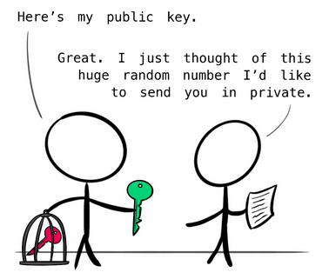
Asymmetric Cryptography
Asymmetric cryptography is one method by which you can perform authentication.
In an asymmetric cryptographic system, we use a pair of keys in order to achieve authentication. These keys are asymmetric. One key is our public key. The other is our private key.
Typically, during the TLS handshake, the server will provide its public key via its digital certificate. Digital certificates are provided and verified by trusted third parties known as Certificate Authorities (CA)

Slide 11
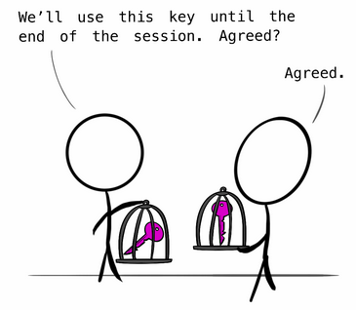
Symmetric Cryptography
When a TLS handshake begins with an asymmetric exchange, the client and server will use this initial communication to establish a shared secret, sometimes called a session key. This key is symmetric, meaning that both parties use the same shared secret and must maintain that secrecy for the encryption to be secure.

Slide 12
CONCLUSION
The TLS protocol serves a very important purpose in our everyday life. It helps to secure our emails, our online activities especially things invloves more security like banking, and the connection by which we are listening to this class via webex.
Also the HTTPS communication protocol is encrypted using TLS. Every time when we see that little lock icon in your URL bar, which means we are in a secured connection.
I hope Now you know the answer to the question: “How can we communicate securely?”

