Slide 1
ILLUSTRATION OF
A PARALLEL AND DISCRETE EVENT SIMULATION
USING SCALA
Guided by,
Dr. R. Saranya
Presented by,
Ms. A. Beulah Evanjalin

Slide 2
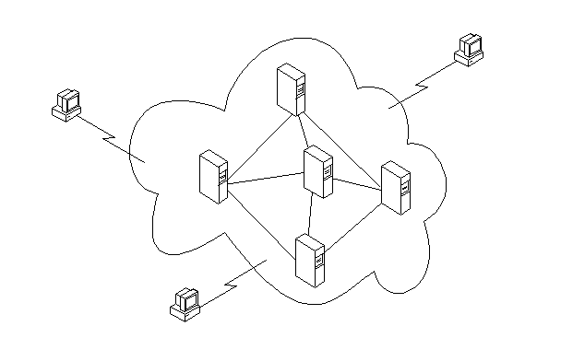


AREA OF MY WORK :
Block Chain
Distributed System
Operating System
Practices of OOP
PROCESS 1
PROCESS 2
Thread 1
Thread 2
Thread 1
Thread 1
Thread 1
Thread 2
THREAD 2
THREAD 1
RACE CONDITION
FINISH

Slide 3
INTRODUCTION
Nowadays, a lot of critical infrastructures (like blockchain) out there is built of Distributed Systems.
Why?
    High Performance
    Parallelism
    To Tolerate Faults
    Replicated Systems
    To get rid of Inconsistency

Slide 4
INTRODUCTION (cont..)
THREADS :
Threads are the sort of main tool to manage concurrency in program.
CHALLENGES IN USING THREADS :
    Race Condition : Threads share the same address space. If one thread creates and object in memory, it’s possible for us to let other threads to use it. We can solve this by using Locks.
    Co-ordination : Probably, we have no idea whether we have any other threads exits when we’re doing locking. So we want different threads to interact with eachother.
    Dead-Lock : Threads waiting for eachother forever. Neither they can proceed nor release the lock.

Slide 5
DISCRETE EVENT SIMULATION (DES)
Events happens in discrete time.
Simulating independent objects co-ordinating together to form a system.
Why need for DES :
Simulation needed to test systems/subsystems what will happen in certain scenarios while the system is running. It is to test the "what if" scenarios that might crop up, and what the effect of the those situations on the whole system

Slide 6
PARALLEL DISCRETE EVENT SIMULATION
(PDES)
Why need for PDES : DES need to be run 1000s of times to get enough data to get a good estimate of the dynamic functioning of the whole system/subsystem. This consumes a lot time while running sequentially on a single processor. PDES can parallelise the process of simulation and cut down time required to simulate drastically

Slide 7
PARALLEL DISCRETE EVENT SIMULATION (cont..)
This parallelization is mainly to take advantage of multiple cores in the system.
While utilizing multiple cores, the simulation time is drastically cut, especially when the simulation runs are usually done in 100s or 1000s of times.
This also allows for more room to include more details in the simulation parameters.

Slide 8
PARALLEL DISCRETE EVENT SIMULATION (cont..)
But parallelisation is tough to design and implement as it's not intuitive for a developer or designer to divide a program into to parallel running pieces of code while also taking into account the race conditions and synchronisation issues
This is an attempt at parallelising a simple scenario with multiple lifts and floors
Using threads in Scala language to parallelise the simulation process

Slide 9
Working Model
Each thread is considered as an independent object (Discrete-events).
I have created two threads, viz.., Floor & Lift
Floor make request to lift for service & Lift provides service as neccessary.
Now two threads have to communicate with eachother (Inter-thread communication)
Inter-thread communication can be done in two ways, viz.., Global memory read/write permission or Giving permission for thread 1 to read/write thread2’s private memory.
I made Floor thread to communicate with Lift thread in Lift’s memory.

Slide 10
FUTURE ENHANCEMENTS :
Using Actor Model (Akka Framework) to simulate DES.
  Multi-threading is Scala is beneficial but has side effects if synchronization is not done properly.
  Actor model presents a better concurrency model and easier implementation of PDES. Akka framework of Scala provides the Actor model services.
DES for Raft Consenses
  Toleration of faults amongs multiple threads
  Leader election

Slide 11
References :
R. M. Fujimoto, Parallel and distributed simulation systems , vol. 300. Citeseer, 2000.
M. Hybinette, E. Kraemer, Y. Xiong, G. Matthews, and J. Ahmed, “SASSY: a design for a scalable agent-based simulation system using a distributed discrete event infrastructure,” Proceedings of the 2006 Winter Simulation Conference . pp. 926--933, 2006.
S. Jafer, Q. Liu, and G. Wainer, “Synchronization methods in parallel and distributed discrete-event simulation,” Simulation Modelling Practice and Theory , vol. 30, pp. 54--73, 2013.
E. A. Lee, “The problem with threads,” Computer , vol. 39, Art. no. 5, 2006.

Slide 12
THANK YOU !

