Slide 1
Temporally qualified continuants for BFO 2 OWL A bottom-up view
Stefan Schulz, Janna Hastings, Fabian Neuhaus
25 Oct 2013

Slide 2
Relations between continuants
Binary relations between occurrents non-ambiguous:
partOf² (Battle_of_Stalingrad, Second_World_War)
Binary relations between continuants ambiguous:
partOf² (Montreal, Canada)
Ternary relations between continuants non-ambiguous:
partOf³ (Montreal, British Empire, 1860)
partOf³ (Montreal, Canada, 2013)

Slide 3
Problem: restriction to binary relations in OWL
Instantiation ambiguous:
Montreal rdf:type City
Canada rdf:type Country
Relations ambiguous:
Montreal partOf BritishEmpire
Montreal partOf Canada
Conflicts with the axiom (partOf value BritishEmpire) and (partOf value Canada) subClassOf Nothing

Slide 4
Class level axioms
How to interpret standard OWL axioms like:
City subClassOf partOf some Country ?
Temporary relatedness: every city is part of some country at least at some time ∀a∀t₁ ∃ t₂: inst³ (a, A, t₁) ∧ inst³ (a, A, t₂) → ∃b: (inst³ (b, B, t₂) ∧ rel³ (a, b, t₁))
Permanent generic relatedness: at all times, every city is part of some country ∀a∀t: inst³ (a, A, t)→ ∃b: inst³ (b, B, t) ∧ rel³ (a, b, t)
Permanent specific relatedness: at all times, every city is part of the same country ∀a∀t₁: [inst³ (a, A, t) → ∃b: (inst³ (b, B, t) ∧ rel³ (a, b, t)
∀t: (inst³ (a, A, t) → (rel³ (a, b, t) ∧ inst³ (b, B, t))))]

Slide 5
Importance of expressing permanent generic relatedness
Every mammal has some portion of blood as part at all times (but not always the same portion)
Every material entity is always located at some place (but not always the same place)
Every pdf file generically depends on some hardware but not always on the same hardware
Every cell nucleus is part of some cell but not always the same cell
Every animal cell has some ribosome as part but not always the same

Slide 6
Possible solutions
Use binary relations and interpret them as permanent generically related (as most of DL community has done for decades): may be acceptable as long no non-rigid classes and no instances are used (?)
Reify ternary relations: (n-ary relations ODP) Complicated, user-unfriendly and difficult to get transitivity into it
Use temporalized relations (as in BFO 2 OWL Graz version): works only for temporary relatedness and permanent specific relatedness, but not for permanent generic relatedness.
Use temporally qualified continuants. See following slides

Slide 7
ContinuantTQ
Continuants in OWL ontology can be referred to in the context of a time frame: Continuant TQ = continuant, temporally qualified
"façon de parler" – way of speaking
Examples:
London during the First World War
Mr. X's heart transplant, occupying an operation room at May 20th, 2013, 1pm
my left thumb now
my heart, since my birth
the HD of my laptop during the whole day of July 6th, 2013

Slide 8
ContinuantTQ
ContinuantTQs are specific DL constructs
ContinuantTQs in DL axioms translate into a sequence of FOL statements with ternary relations
ContinuantTQs are ontological neutral: c@t1 = c at time t1 is not a different individual than c@t2. It is only referred to at a different time
In OWL, a ContinuantTQ class can be instantiated by any kind of (contiguous) temporal references at any time

Slide 9
Examples for continuantTQs
1980
1994
1998
2013
John
John@[1980;1994]
John@[1994;1998]
John rfd:type Human
John@[1980;1994] rfd:type Child
John@[1994;1998] rfd:type Teenager
John@[1998;2013] rfd:type Adult
John@[201305201000; 201305201100] rdf:type patientOf some (Appendectomy and hasAgent value DrSmith@[201305201000; 201305201100]
"Phased Sortals"

Slide 10
Relations hasMax, maxOf, atSomeTime, spans
hasMax (inverse maxOf) relates a ContinuantTQ instance to its related instance with the maximal temporal extension
atSomeTime relates a ContinuantTQ with each other a ContinuantTQ related to the same continuant
atSomeTime ≡ hasMax • maxOf
maxOf subPropertyOf atSomeTime (not necessary if hasMax is reflexive)
spans relates a continuantTQ with its defining time interval

Slide 11
Relations: hasMax, maxOf, atSomeTime, spans
1980
1994
1998
2013
John@[1980;2013]
John@[1980;1994]
John@[1994;1998]
John@[1980;2013] maxOf John@[1994;1998]
John@[1998;2013] atSomeTime John@[201305201000; 201305201100]
John@[1998;2013] spans [1998; 2013]

Slide 12
Translations FOL, ternary → DL, binary
partOf³ (Montreal, BritishEmpire, 1860)
partOf³ (Montreal, Canada,1925)
instanceOf³ (Montreal, Settlement, 1700)
instanceOf³ (Montreal, City, 1925)
partOf (Montreal@1860, BritishEmpire@1860) spans (Montreal@1860, 1860) hasMax (Montreal@1860, Montreal@max) spans (BritishEmpire@1860, 1860) hasMax (BritishEmpire@1860, BritishEmpire@max)
partOf (Montreal@1925, Canada@1925) spans (Montreal@1925, 1925) hasMax (Montreal@1925, Montreal@max) spans (Canada@1925, 1925) hasMax (Canada@1925, Canada@max)
Montreal@1700 rdf:Type Settlement spans (Montreal@1700, 1700) hasMax (Montreal@1700, Montreal@max)
Montreal@1925 rdf:Type City spans (Montreal@1925, 1925) hasMax (Montreal@1925, Montreal@max)

Slide 13
Examples, Class level
Permanent generic parthood
"Each city is always part of some country" ∀a, t: inst³ (x, City, t)→ ∃b: inst³ (b, Country, t) ∧ part of³ (x, y, t)
"Each medieval city has had a gate at some time" ∀x, t₁: inst³ (x, MCity, t₁) → ∃t₂,∃y: inst³ (x, MCity, t₂) ∧ inst³ (y, Gate, t₂) ∧ hasPart³ (x, y, t₂)
City subClassOf partOf some Country
partOf eq inverse(hasPart)
partOf Domain ContinuantQC or Occurrent
partOf Range ContinuantQC or Occurrent
MCity subClassOf atSomeTime some (hasPart some Gate)
Temporary parthood

Slide 14
Examples
City subClassOf partOf some Country
Country subClassOf partOf some Continent
City subClassOf partOf some Continent
Not necessarily always the same country
CityGate subClassOf atSomeTime some (partOf some City)
CityGateDoor subClassOf partOf some CityGate
Does not entail that CityGateDoor is part of a city at some time (door built in after destruction of city)
CellNucleolus subClassOf partOf some CellNucleus
CellNucleus subClassOf partOf some Cell
CellNucleolus subClassOf partOf some Cell (not necessary that the cell is always the same, e.g. after division)
Apple subClassOf atSomeTime some (partOf some AppleTree)
AppleSeed subClassOf atSomeTime some (partOf some Apple)
Does not entail that part Apple seeds are parts of apple trees
Permanent generic relatedness
Temporary relatedness
Permanent generic relatedness
Permanent generic relatedness
Permanent generic relatedness
Temporary relatedness
Temporary relatedness

Slide 15
Consistency of A-boxes
r0: partOf³ (Montreal, BritishEmpire, 1860)
One ternary relation rel (a, b, t) is translated into a set of five binary relations.
r1: partOf (Montreal@1860, BritishEmpire@1860) r2: spans (Montreal@1860, 1860) r3: hasMax (Montreal@1860, Montreal) r4: spans (BritishEmpire@1860, 1860) r5: hasMax (BritishEmpire@1860, BritishEmpire)
r1: rel (a@t, b@t) r2: spans (a@t, t) r3: hasMax (a@t, a@max) r4: spans (b@t , t) r5: hasMax (b@t, b@max)
OWL Rule for consistency checking:
TemporallyQualifiedContinuant(?x), TemporallyQualifiedContinuant(?y), spans (?x,?t1), spans(?y,?t2), topObjectProperty(?x,?y) - > equal(?t1,?t2)

Slide 16
Participation of TQCs in Processes
Temporal extension of C@max included in temporal extensions of Process P →all TQCs of C participate in P: C subclassOf participatesIn some P Example: Organism subClassOf participatesIn some Life
Temporal extension of C@max larger → some TQCs participate C subclassOf atSomeTime some (participatesIn some P) Example: Human subClassOf (atSomeTime some (participatesIn some BirthProcess))
Process P has at all time some participant of type C: all temporal parts of a process have some TQC of type C as participant temporalPartOf some P subClassOf hasParticipant some C Example: Breathing subClassOf hasParticipant some PortionOfAir
Process P has at some time a participant of type C: P subClassOf hasParticipant some C
Example: Fecundation subClassOf hasParticipant some Spermatozoon

Slide 17
Adaptation of BFO2Graz
removal of TRs
"rel at some time" -> "rel"
checking of axioms that use rel
restitution of transitivity if necessary
Special cases:
has continuant part at all times that part exists
part of continuant at all times that whole exists
Attached axioms need to be analyzed one by one

Slide 18
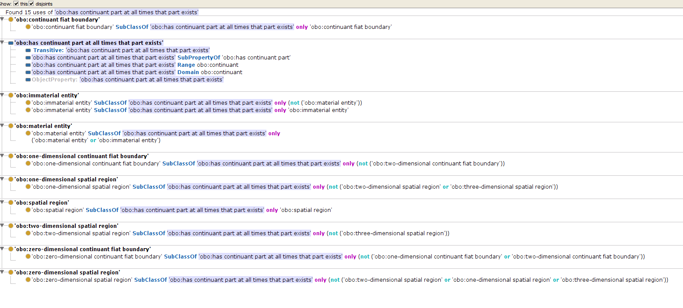

Slide 19
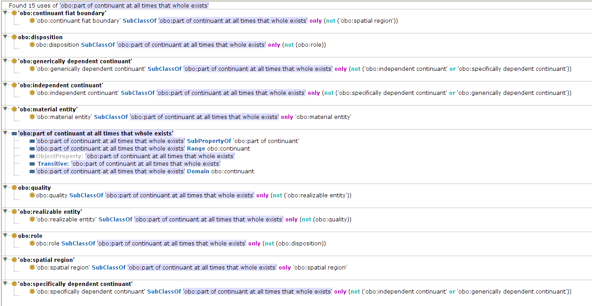

Slide 20
TQCs and temporal granularity
Problem: if we have spatially extended temporal regions, there may be competing temporal interpretations of relations between TQCs
Example: I am now in Mannheim, e.g. Mannheim@201310251400 locationOf Stefan@201310251400
But what about less granular temporal regions like
Mannheim@20131025 locationOf Stefan@201310201425
Mannheim@2013 locationOf Stefan@2013 If the latter also holds, then Graz@2013 locationOf Stefan@2013 would be equally true, but it would conflict with the (plausible) axiom Graz@2013 type not ('location of' some ('located in' value Mannheim@2013))
What if the temporal span of a TQC instance is not included in the span covered by its "max"?, e.g.
Mannheim@21thCentury locationOf Stefan@21thCentury

Slide 21
Solution1: relation between temporal extended TQCs holds for all included TQCs
for the TQCs a and b that span over t, related by rel: for every a₁ which is a sibling of a and which spans over t₁, which is included in t, there is some b₁ related that spans over the same t₁
Drawback of this solution: generic permanent relatedness no longer expressible.
Example: Human hasContinuantPart some BloodCell As the class Human has all TQCs of all humans as members, it also includes the instance Stefan@max. None of my blood cells has the same timespan, therefore the universal quantification would no longer hold.
As we understand TQCs as façon de parler, it is questionable whether this strict interpretation is really meant when we refer to a continuant in a temporal context

Slide 22
Solution2: relation between temporal extended TQCs holds for some included TQC
for the TQCs a and b that span over t, related by rel: for some a₁ which is a non-time-extended sibling of a and which spans over the time point (minimal time interval) t₁, which is included in t, there is some b₁ related that spans over the same t₁
Example: Human hasContinuantPart some BloodCell As the class Human has all TQCs of all humans as members, it also includes the instance Stefan@max. There is a given t1 within the extension of my life, where there is the parthood relation holds between me a this blood cell. As this can be said about all TQCs of all humans, the generic permanent relatedness can be asserted
Drawback: there is no easy way to express that a relation between a given pair of instances holds constantly during an extended time span, which would be important to detect contradictions like in the Graz / Mannheim example.

Slide 23
Solution3: differentiation between "rigid" and "non-rigid" relatedness
It should be possible to distinguish between statements of the kind
a is related to b at the exact time interval t ("rigid")
a is related to b at some time during the exact time interval t ("non-rigid")
rigidness between "max" entities could then be used to distinguish permanent specific from permanent generic
to be better elaborated
possible drawback: complicated models

