Slide 1
ro.owl and shortcut relations
Chris Mungall
Lawrence Berkeley Laboratory

Slide 2
History: RO-2005
Prehistoric RO in original OBO, 2002-2004
Smith et al, Genome Biology, 2005
Method
instance level binary/ternary
part_of(john, john’s spleen, t1)
type-level binary relations
part_of(spleen,body) ➔ ∀x,t : instance_of(x,spleen,t) →∃y : instance_of(y,spleen,t), part_of(x,y,t)
Incarnations
‘Canonical’ paper/PDF
FOL
E.g. Isabella
Common Logic (2008)
OBO Format (2005) OBO_REL
OWL translation
ad-hoc extensions (RO_proposed)

Slide 3
Issues
Domain boundaries
Most RO-2005 relations are applicable outside biology
Demand from users of bfo1.0.owl and bfo1.1.owl
include core relations in BFO
Semantics
Users require obo/owl
Oboformat1.3 attempted to take RO-2005 semantics seriously
distinct type/instance relations, ternary instance relations
Common Logic specification (‘Obolog’)
translation to OWL unclear
extensions difficult
obof1.3 abandoned 2009
Oboformat1.4 is a subset of OWL2-DL

Slide 4
A new hope
Announcement on obo-relations and bfo-lists (2010-05-27)
https://groups.google.com/forum/#!topic/obo-relations/KfxhbrVw99w
bfo.owl
http://purl.obolibrary.org/obo/bfo.owl
includes core relations (originally construed as instance level relations in RO-2005). E.g
BFO_0000050 part_of
BFO_0000051 has_part
BFO_0000066 occurs_in
These are of course binary instance relations (ObjectProperties)
ro.owl
http://purl.obolibrary.org/obo/ro.owl
Biological relations
Relations that can be defined in terms of bfo.owl relations
Liberal write permissions in repository
http://code.google.com/p/obo-relations/
Reception
well-received by users and community
but status of this version of bfo.owl unclear

Slide 5
A new hope…?
bfo.owl is a prototype – more of a model than an candidate. It isn't yet aligned with BFO reference and that is the eventual intention. It doesn't have definitions, it is subject to change, though classes and relations that are present in the final version will retain the same URIs -- Alan
Announcement on obo-relations and bfo-lists (2010-05-27)
https://groups.google.com/forum/#!topic/obo-relations/KfxhbrVw99w
bfo.owl
http://purl.obolibrary.org/obo/bfo.owl
includes core relations (originally construed as instance level relations in RO-2005). E.g
BFO_0000050 part_of
BFO_0000051 has_part
BFO_0000066 occurs_in
These are of course binary instance relations (ObjectProperties)
ro.owl
http://purl.obolibrary.org/obo/ro.owl
Biological relations
Relations that can be defined in terms of bfo.owl relations
Liberal write permissions in repository
http://code.google.com/p/obo-relations/
Reception
well-received by users and community
but status of this version of bfo.owl unclear
where does this leave ro.owl?

Slide 6
GO and other ontologies have committed to the new bfo.owl relation URIs
http://purl.obolibrary.org/obo/go.owl
Class: GO_0000050
Annotations: label ‘urea cycle’
SubClassOf: BFO_0000051 /* has_part */
some GO_0004055 /* argininosuccinate synthase activity */
…
Class: GO_0097153
Annotations: label ‘caspase activity’
EquivalentTo: GO_0004197 /* cysteine-type endopeptidase activity */ and
BFO_0000050 /* part_of */ some GO_0006915 /* apoptosis */
…
Class: GO_0006264
Annotations: label ‘mitochondrial DNA replication’
EquivalentTo: GO_0006264 /* DNA replication */ and
BFO_0000066 /* occurs in */ some GO_0005739 /* mitochondrion */

Slide 7
Shortcut relations
Strategy originally agreed upon at Denver RO meeting
Allow shortcut relations rather than using complex expressions with a restricted set of primitive relations
Draft specification
Mungall, Osumi-Sutherland and Ruttenberg
OWLED 2010
Implementation
prototype: Thea-prolog (2010)
java version: (2011)
included in Obo-format 1.4 spec and translator
http://purl.obolibrary.org/obo/oboformat/spec.html#7
(but use is not limited to obo-owl translation)

Slide 8
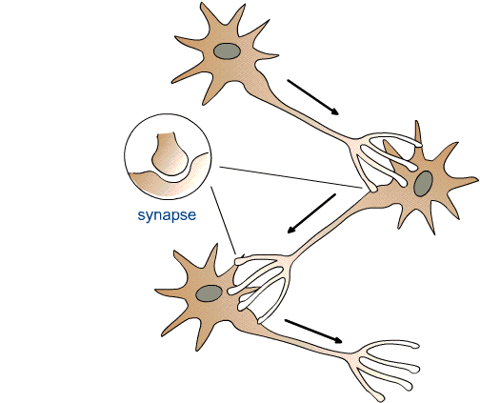
Use case: neuron relations
N_ABC
ObjectProperty: synapsed_to
Annotations: definition “Relation between a neuron and an anatomical structure it forms a chemical synapse to”
N_DEF
N_JKL
N_GHI
Class: N_ABC
SubClassOf:
synapsed_to some N_DEF

Slide 9
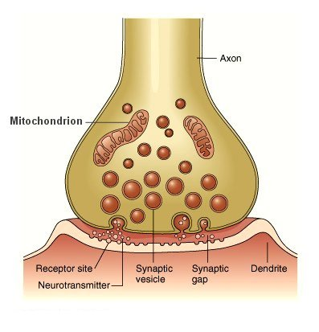
A more detailed representation
We can model chemical synapsing in detail using
Gene Ontology classes:
pre-synaptic membrane
post-synaptic membrane
properties:
part_of & has_part
pre-synaptic membrane; GO_0042734
post-synaptic membrane; GO_0045211

Slide 10
Modeling in more detail
We can model chemical synapsing in detail using
Gene Ontology classes:
pre-synaptic membrane
post-synaptic membrane
properties:
part_of & has_part
pre-synaptic membrane; GO_0042734
Class: N_ABC
SubClassOf:
has_part some
(‘pre-synaptic membrane ; GO_0042734’ and
part_of some
(‘synapse ; GO_0045202’ and
has_part some (
‘post-synaptic membrane ; GO_0045211’ and
part_of some N_DEF)))
post-synaptic membrane; GO_0045211

Slide 11
Shortcut relation example
ObjectProperty: RO_0002120
Annotation: label ‘synapsed to’
‘expand_expression_to’ “
has_part some (
‘pre-synaptic membrane ; GO_0042734’ that
part_of some (
‘synapse ; GO_0045202’ that
has_part some (
‘post-synaptic membrane ; GO_0045211’ that
part_of some ?Y)))”
(note syntax is slightly modified for readability)

Slide 12
Example (from Drosophila anatomy ontology)
Ontology: fbbt.owl
Imports: fbbt-aux.owl
Class: ‘lamina monopolar neuron L1’
SubClassOf: ‘lamina monopolar neuron’ and
synapsed_to some ‘centrifugal neuron C2’ and
synapsed_to some ‘centrifugal neuron C3’ and
synapsed_to some ‘lamina monopolar neuron L5’ and
synapsed_by some ‘photoreceptor cell R8’ and
…
Strategies:
macro expansion
vs generation of GCIs
Entailments still valid without aux import.
Entailments from core ontology
may be incomplete, but in practice this is
rare so expansions act more as documentation
than necessary reasoning component
Ontology: fbbt-aux.owl
synapsed_to some ‘centrifugal neuron C2’
EquivalentTo has_part some (
‘pre-synaptic membrane’ that
part_of some (
‘synapse’ that
has_part some (
‘post-synaptic membrane’ that
part_of some
‘centrifugal neuron C2’

Slide 13
Use in Cell Ontology
capable_of
bearer_of some (realized_by only ?Y)
has_plasma_membrane_part
has_part some (plasma_membrane and has_part some ?Y)
lacks_plasma_membrane_part
has_part some (plasma_membrane and has_part exactly 0 ?Y)

Slide 14
Relations for GO
Many relations of a form similar to results_in_transport_from
Can be defined in terms of roles/functions/some kind of DC
E.g
realizes some (‘initial location’ and inheres_in some ?Y)
Not yet in ro.owl
earlier prototype in ro_proposed

Slide 15
Relations for phenotype ontologies
Dependent on outcome of discussion of heart rate etc
Need a generalized relation (e.g. property_of) for process profiles and ‘true’ qualities
BFO_0000052 ‘inheres in’ is currently uses for everything in PATO
May be beyond capabilities of current macro system

Slide 16
Moving forward
ro.owl is now dependent on bfo.owl
status of bfo.owl is extremely unclear
temporal relations?
community needs to be kept informed
engagement on mail lists
governance
regular official versioned releases

