Slide 1
BFO 2 relations/strategy
Alan Ruttenberg
Chris Mungall
Barry Smith
Bjoern Peters

Slide 2
Core assumptions/nonassumptions
Sites are immaterial continuants
Inclusion of regions in BFO2 is under question
All relations are based on instance-level – just define those
We will have a “relation macro” facility to build relations out of simpler relations.
Relations core to BFO move to BFO
RO is a larger set, for which we make subsets for domain specific use

Slide 3
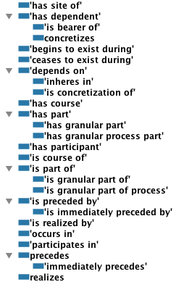
Core BFO2 Relations

Slide 4
begins-to/ceases-to -exist-during
Relating a continuant to a process
The continuant comes into or goes out of existence at some time during the process.
Covers many cases – cell division, molecular reactions, production/destruction of goods

Slide 5
Continuant/it’s life
course-of relation relates a continuant to its life process – a process that always includes the continuant as participant.
Issue: There is a sense in which this is the minimal such process, but how to define that is not worked out
Issue: WC says only ICs participate in processes, so what about course-of quality such as temperature?

Slide 6
Granular part relations
is-granular-part-of – relating material continuants to material continuants
  Removing a granular part does not change identity of individuals
is-granular-part-of-process
  The larger process is made of many small processes of constrained types – bridge to statistical mechanics
  Issue: The sense in which the types are constrained is not well defined now

Slide 7
Sites
Can sites overlap material entities?
Independent continuants can have parts that are immaterial continuants
Some processes take place in sites
occurs-in relates a process to a continuant that has part the site the process takes place in

Slide 8
Missing currently
Location/projection
  Pending site/spatial region discussion
  located_in
  contained_in
Time-curried part-of-relations –
  Pending discussion
    part-of-at-some-time,
    part-of-at-all-times
  The biggest problem we have in the OWL rendering of RO is reasoning about time.

Slide 9
Other proposals
Schulz – locus-of -> inheres in, or occurs in, or part of
Hohendorf– has-phene/phene-of

Slide 10
Macro relations
x has_function_realized_in_process y
=>
x has_function some (r and realized in some process)
This transformation is implemented as a preprocessing step, from specifications represented in RO.

Slide 11
Topics for discussion
BFO2 relations
What is a BFO process?
Process “Qualities” and roles
Fields/Energy
Relativity friendly
Qualities of generic dependence
Dependence

Slide 12
What is a BFO process?
A ball is thrown and moves, while spinning in the air. How many processes are there?
What is participation – what participates

