Slide 1

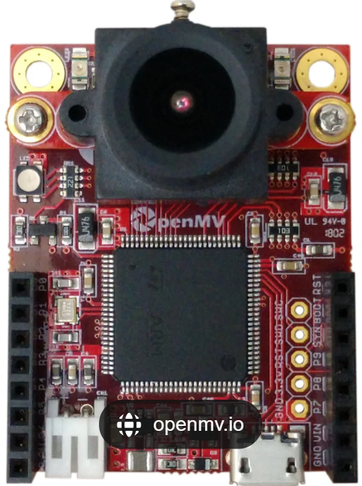
PCB of OpenMv
H7 R2

Slide 2
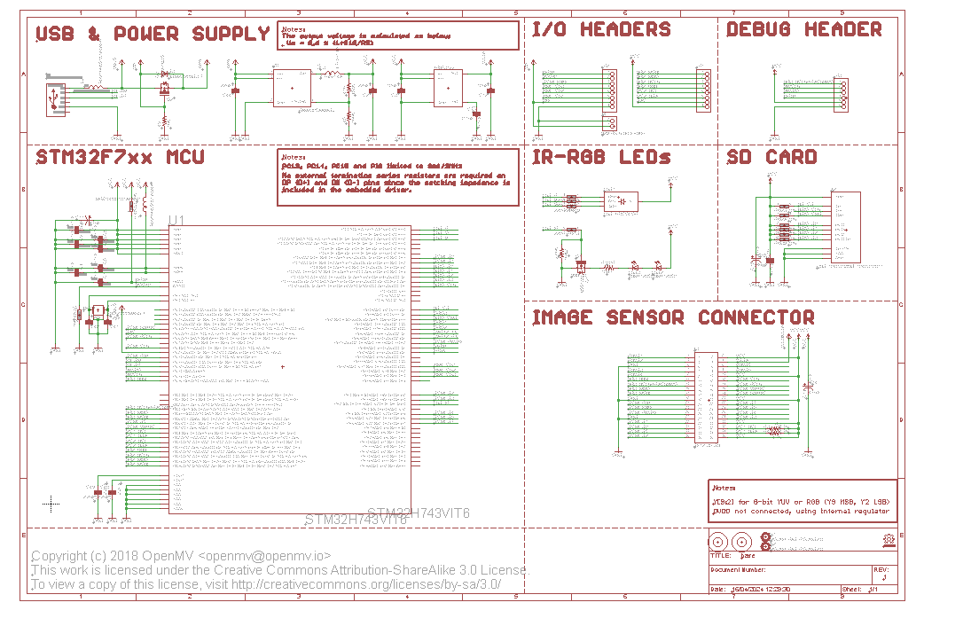
Schematic of the openMB board from github without any modification

Slide 3
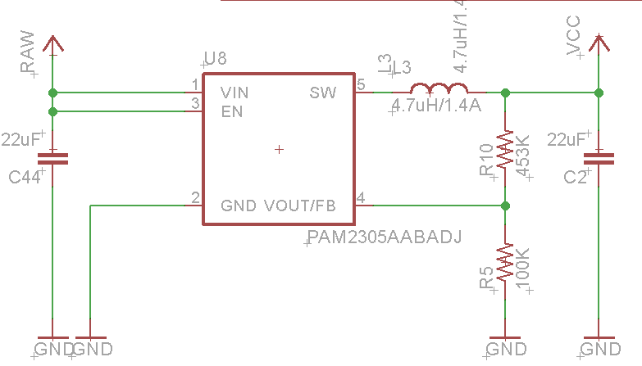
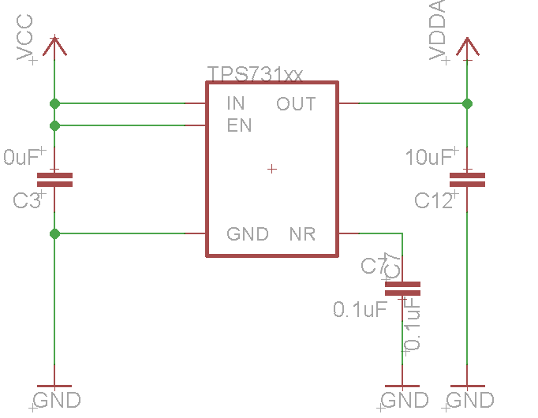



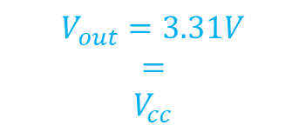
The PAM2305 is a step-down current-mode, DC-DC converter.
supports a range of input voltages from 2.5V to 5.5V
$$V_{RAW}=5V$$
2. The TPS731 is a low-dropout (LDO) regulator with reverse current protection
$$V_{out}=3.31V$$
$$=$$
$$V_{cc}$$
$$V_{cc}=3.31V$$
$$V_{DDA}$$

Slide 4




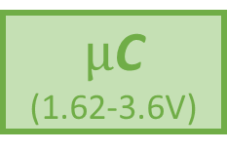




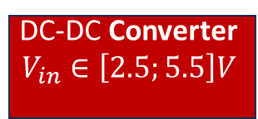
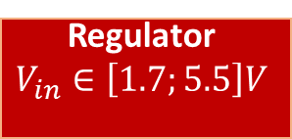
Connector for DCMI/TIM/
NRST
8 pins
$$V_{DDA}= 3.31V$$
Sensor for the camera (3.3$±$0.3)V
Connector for SPI/I2C/DAC
8 pins
$$V_{cc}= 3.31V$$
36 pins
Connector for DCMI/SPI/RSVD
Regulator
$$V_{in}∈\left[1.7;5.5\right]V$$
$µ$C
(1.62-3.6V)
Connector for the battery
(3.6-5.5V)
$$V_{BAT}= 3.7V$$
$$SD Card$$
DC-DC Converter
$$V_{in}∈\left[2.5;5.5\right]V$$
USB-C connector
$$V_{cc}= 3.31V$$
$$RGB LED$$
$$IR LED$$
Jumper
6 pins
Connector for SPI/SW

Slide 5
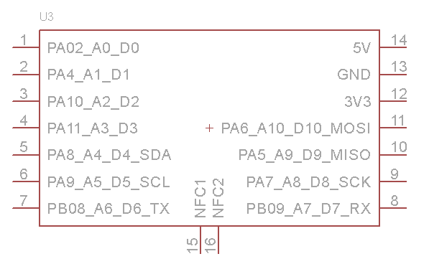
Legend of Xiao nRF52840 module
GPIO / Analog input
GPIO
GPIO / Analog input
GPIO / Analog input
GPIO / SPI
GPIO / Analog input / I2C
GPIO / SPI
GPIO / Analog input / I2C
GPIO / SPI
GPIO / UART
GPIO / UART
NFC
NFC

Slide 6
Links :
Github : openmv/openmv: OpenMV Camera Module (github.com)
Datasheet : OpenMV-H7 Datasheet (sparkfun.com)

Slide 7



Board
2,8mm
$$Bluetooth module$$
2,8mm
$$RGB LED$$
DC-DC Converter
$µ$C
Programming pins
2 pads
Battery
3 pads (GPIO unused)
Regulator
USB-C connector
Sensor for the camera
2,8mm
2,8mm

Slide 8
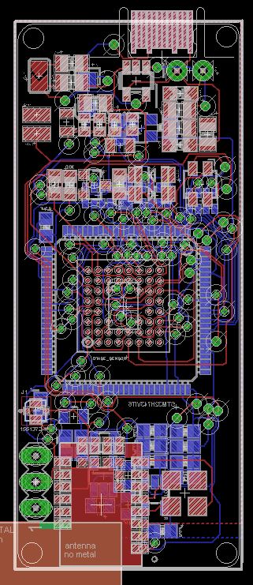
USB-C Port
Battery
LED
Bottom layer components
Top layer components
STM32
STM32
Image sensor
Bluetooth Module
Converter
GPIO unused
Antenna connector
Regulator

