Slide 1


Generic Attribute Profile
(GATT)
Generic ATTribute Profile, and it defines the way that two Bluetooth Low Energy devices transfer data back and forth using concepts called Services and Characteristics.

Slide 2
Definition :
GATT : → Defines the way that two Bluetooth devices transfer data
→ GATT server = pulse sensor
→ GATT client = board
Connection procedure for unbonded devices :
General Connection Establishment procedure : →Measurements from one or more sensors (without using the white list)
Direct Connection Establishment procedure : →Measurements from one or more sensors
Auto Connection Establishment procedure : →Measurements from one or more sensors (using the white list)

Slide 3
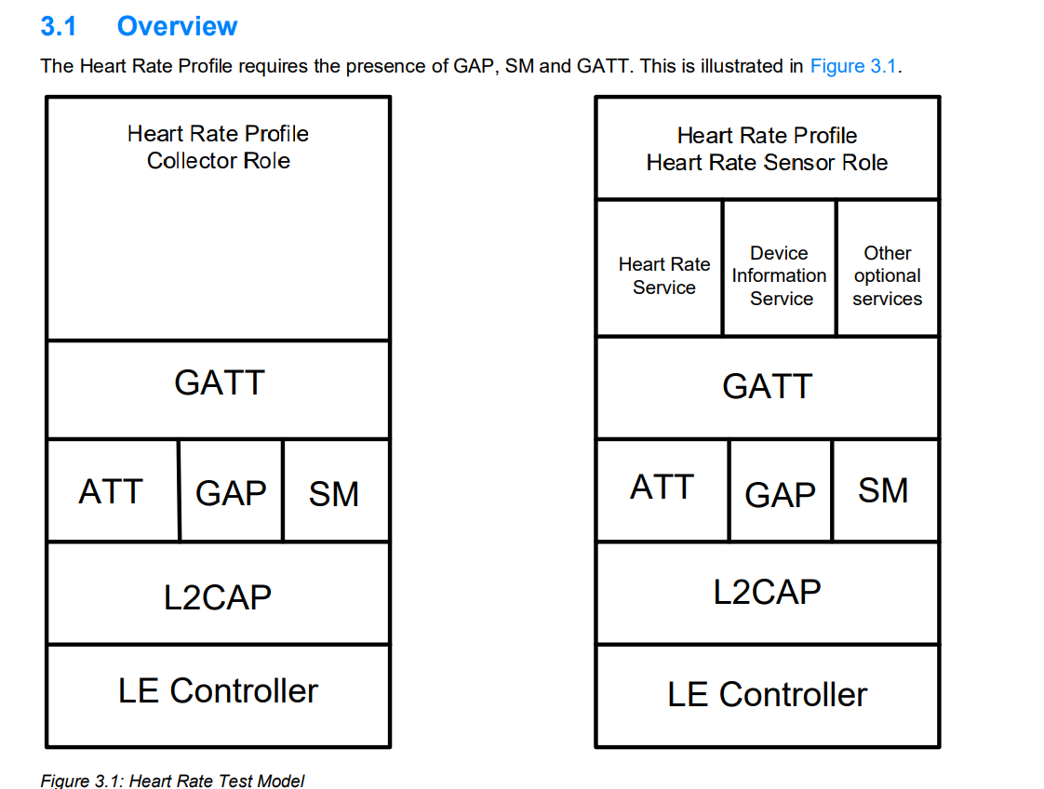
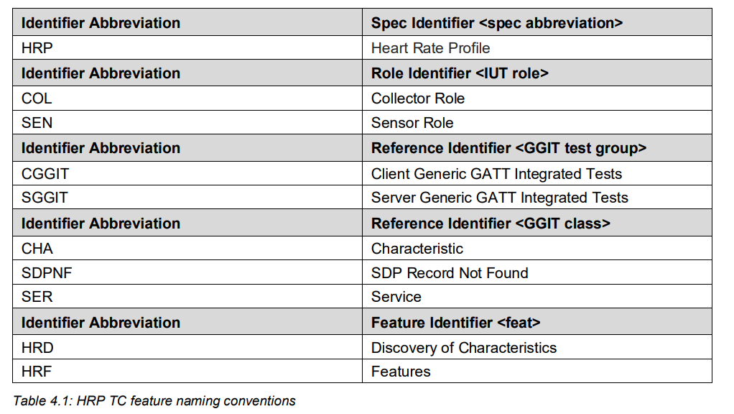
Overview TSS (Test Suite Structure) :

