Slide 1

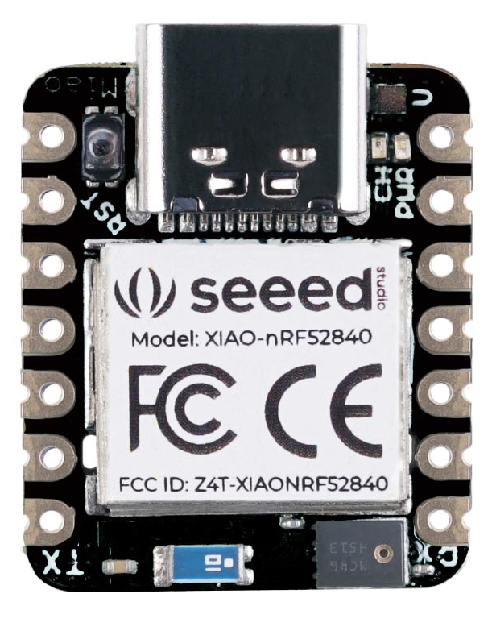
Module Programming

Slide 2
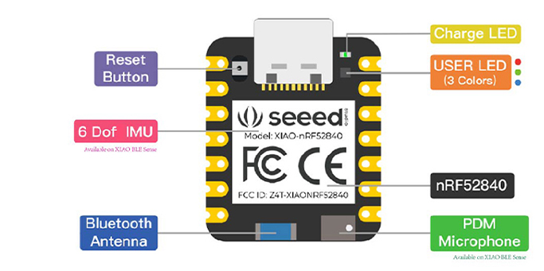
How to program the Bluetooth module :
Tutorials can be find thanks to the following link:
Bluetooth low energy Services, a beginner's tutorial - Bluetooth low energy - nRF5 SDK guides - Nordic DevZone (nordicsemi.com)

Slide 3
What we need to know :
Types of Advertising :
→ Connectable undirected advertising
→ Connectable directed advertising
→ Scannable undirected advertising
→ Non-connectable undirected advertising
→ Advertise with Whitelist

Slide 4
Programs:
http://infocenter.nordicsemi.com/topic/com.nordic.infocenter.s110.api.v8.0.0/group___b_l_e___g_a_p___f_u_n_c_t_i_o_n_s.html#gaddbb12e078d536ef2e93b41d77ff6243
sd_ble_gap_adv_start(ble_gap_adv_params_t const *p_adv_params)

Slide 5
Links :
Development kit : nRF52840 Dongle - nordicsemi.com
Development kit : nRF52 DK - Development kit for Bluetooth Low Energy and Bluetooth mesh - nordicsemi.com
Tutorial : Bluetooth Smart and the Nordic's Softdevices - Part 1 GAP Advertising - Bluetooth low energy - nRF5 SDK guides - Nordic DevZone (nordicsemi.com)

