Slide 1

Databases
Relational and Non-Relational Databases and MySQL
SoftUni Team
Technical Trainers
Software University
https://about.softuni.bg

Slide 2
Table of Contents
Databases – Introduction
Relational Databases: Tables and Relationships
Non-Relational (NoSQL) Databases
Database Management Systems (DBMS)
SQL Commands: SELECT, INSERT, UPDATE, DELETE
JSON Data Format
Working with MySQL + Workbench
Working with MongoDB + Compass
2
Notes:
2

Slide 3
Have a Question?
sli.do
#qa-fund
Notes:
3

Slide 4

Databases
Introduction
Notes:
4

Slide 5
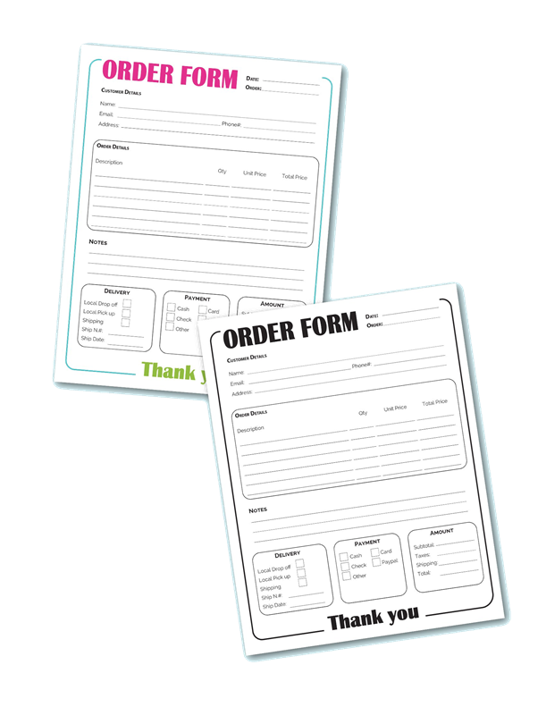
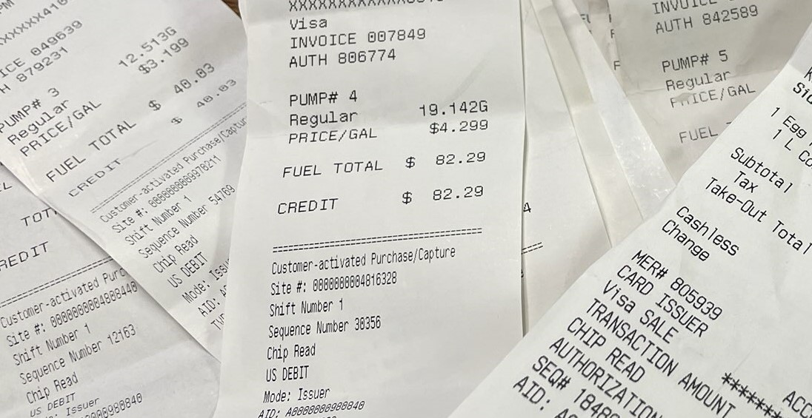
Data in the Real World
Conventional (paper-based) data storage
Orders
Receipts
5

Slide 6
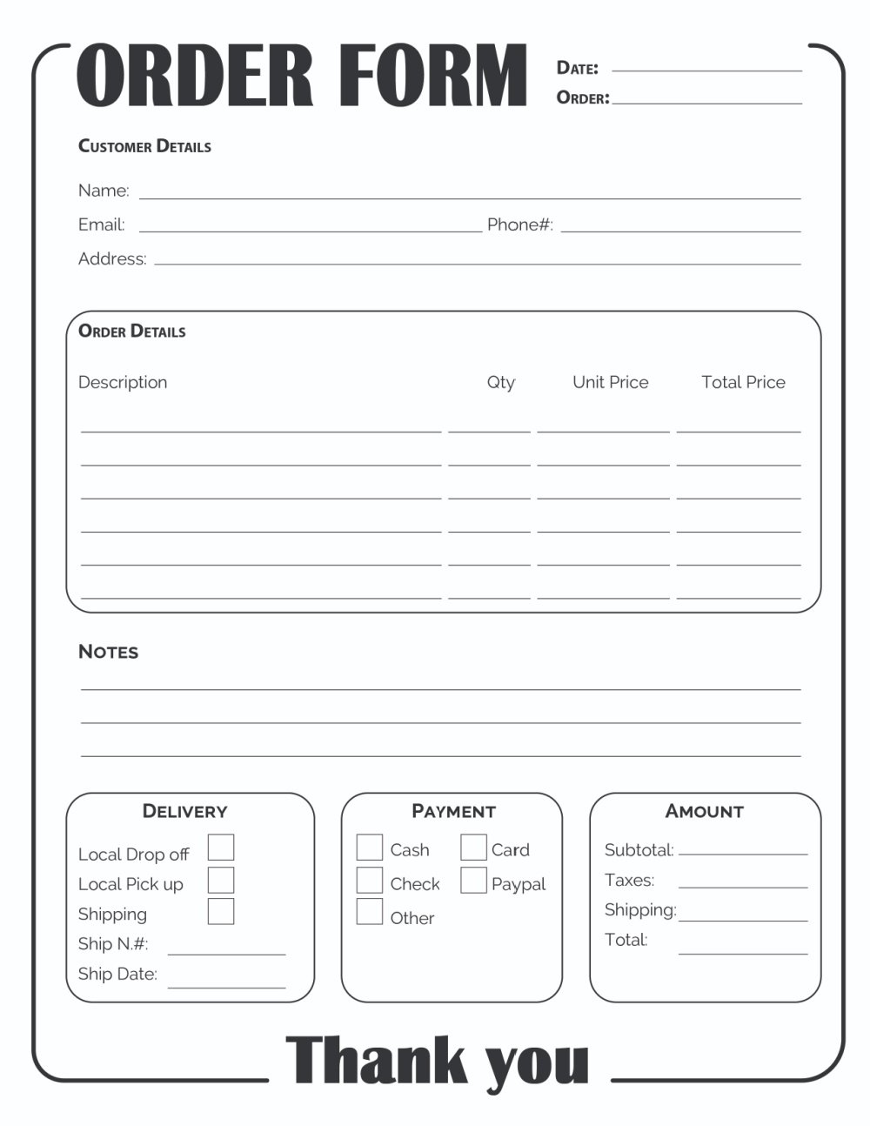
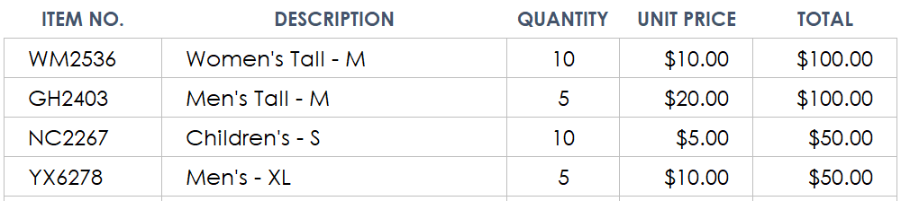
From Data Storage to Databases
We can group related pieces of data into separate columns:
Thus, we keep data in tables (like in Excel)
Tables may be related (e. g. Products and Orders)
6

Slide 7

Why Do We Need Databases?
Data storage and processing is a common need in the tech industry
Data storage needs:
Ease of searching
Ease of updating
Performance
Accuracy and consistency
Security and access control
Redundancy
7

Slide 8

What is а Database?
A database is a collection of data, organized to be easily accessed, managed and updated
Modern databases are managed by Database Management Systems (DBMS)
Define database structure, e. g. tables, collections, columns, relations, indexes
Create / Read / Update / Delete data (CRUD operations)
Execute queries (filter / search data)
8

Slide 9

Relational and NoSQL Databases
Databases hold and manage data in the back-end systems
Relational databases (RDBMS)
Hold data in tables + relationships
Use the SQL language to query / modify data
Examples: MySQL, PostgreSQL, Web SQL in HTML5
NoSQL databases
Hold collections of documents or key-value pairs
Examples: MongoDB, IndexedDB in HTML5
9

Slide 10

Relational Databases
Tables, Relationships and SQL
Notes:
10

Slide 11
SQL Databases (Relational Databases)
Relational (SQL) databases organize data in tables
Tables have strict structure (columns of certain data types)
Can have relationships to other tables
Relational databases use the structured query language (SQL) for defining and manipulating data
Extremely powerful for complex queries
Relational databases are the most widely used data management technology
SQL
11

Slide 12
Database Tables
Tables are the main building block of relational databases
Each row is called a record or entity
Columns (fields) define the type of data they contain
Column
CustomerID | FirstName | BirthDate | CityID
1 | Brigitte | 03/12/1975 | 101
2 | August | 27/05/1968 | 102
3 | Benjamin | 15/10/1988 | 103
4 | Denis | 07/01/1993 | 104
Row
Cell
Notes:
The table is the main unit of data storage. It has rows, columns and cells. Cells contain stored data. Each column has a data type. Types can be VARCHAR(String), INT, DATE etc.

Slide 13


The Relational DB Model
Relational data is stored into one or more tables with a unique key identifying each row and foreign keys defining relationships
Items
Customers
ID | Order ID | Name | Quantity | Price
5 | 1 | Table | 1 | 200.00
6 | 1 | Chair | 1 | 123.12
ID | Name | Email
5 | Peter | peter@gmail.com
6 | Jayne | jayne@gmail.com
Orders
ID | Customer ID | Date | Total Price
1 | 5 | 11/1/17 | 323.12
2 | 1 | 11/15/17 | 13.99
13

Slide 14

Non-Relational Databases
NoSQL Databases and JSON Documents
Notes:
14

Slide 15
NoSQL (Non-Relational) Databases
A NoSQL databases have dynamic schema for unstructured data
Data may be stored in several ways:
Document-oriented (JSON store)
Column-oriented (table store)
Graph-based
Key-value store
NoSQL
15

Slide 16
NoSQL Databases
NoSQL databases don't use tables and SQL
Instead, use document collections or key-value pairs
More scalable and high performance
Examples: MongoDB, Cassandra, Redis, etc.
Example of JSON document in MongoDB
{
"_id": ObjectId("59d3fe7ed81452db0933a871"),
"email": "peter@gmail.com",
"age": 22
}
16

Slide 17


Database Management Systems
Database Servers
Notes:
17

Slide 18
Database Management Systems (DBMS)
A Database Management System (DBMS) is a software, used to define, manipulate, retrieve and manage data in a database
DBMS stores and manages the data itself, the data format, field names and data types, record structure and file structure
DBMS examples (database servers):
MySQL, MS SQL Server, Oracle, PostgreSQL
MongoDB, Cassandra, Redis, HBase
Amazon DynamoDB, Azure Cosmos DB

Slide 19



DBMS Systems and Data Flow
DBMS servers use the client-server model:
DBMS server
Clients
Query
Engine
Access
Storage
Data
Data

Slide 20







DBMS Server Architecture
Server Instance
Logical Storage
Database (Schema)
Table Table
Table Table
Database
(Schema)
Database (Schema)
Physical Storage
Data
Logs

Slide 21
DBMS Systems: Examples
SQL databases examples:
MySQL
PostgreSQL
Oracle
Microsoft SQL Server
SQLite and Web SQL
NoSQL databases examples:
MongoDB
Redis
Google BigTable
Amazon DynamoDB
Azure Cosmos DB
Cassandra

Slide 22

Structured Query Language
SQL Language

Slide 23
Structured Query Language (SQL)
SQL == query language designed for managing data in
relational databases (RDBMS)
Used to communicate with the database engine
Logically, SQL is divided into four sections:
Data definition: describe the structure of data
Data manipulation: store and retrieve data
Data control: define who can access the data
Transaction control: bundle operations
together and perform commit / rollback

Slide 24

Structured Query Language (1)
Query language designed for managing data in a relational database
Developed at IBM in the early 1970s
To communicate with the DB engine we use SQL

Slide 25
Structured Query Language (2)
Subdivided into several language elements
Queries
Clauses
Expressions
Predicates
Statements
Update command
Expression
UPDATE employees
SET salary = salary * 1.1
WHERE job_title = "Cashier";
Statement
Predicate

Slide 26
Structured Query Language (3)
Logically divided in four sections
Data Definition – describe the structure of our data
Data Manipulation – store and retrieve data
Data Control – define who can access the data
Transaction Control – bundle operations and allow rollback

Slide 27
SQL Commands
We can communicate with the database engine via SQL
SQL commands provide greater control and flexibility
To create a database in MySQL:
CREATE DATABASE employees
Database name
Display all databases in MySQL:
SHOW DATABASES

Slide 28


SQL – Example
Example of SQL query:
SELECT * FROM people
The query is executed by the DBMS system
It returns a sequence of data rows, e.g.
 | id | email | first_name | last_name
 | 1 | smith@yahoo.co.uk | John | Smith
 | 2 | pwh@gmail.com | Peter | White
 | 3 | anne@anne.com | Anne | Green
 | 4 | jason.jj@gmail.com | Jason | Anderson

Slide 29
SELECT – Example
Selecting all columns from the "Departments" table
Selecting specific columns
SELECT * FROM Departments
DepartmentID | Name | ManagerID
1 | Engineering | 12
2 | Tool design | 4
3 | Sales | 273
… | … | …
DepartmentID | Name
1 | Engineering
2 | Tool design
3 | Sales
… | …
SELECT DepartmentId, Name
FROM Departments
Notes:
Selecting All Columns of All Rows
You can display all columns of data in a table by following the SELECT keyword with an asterisk (*). In the example on the slide, the department table contains five columns: DepartmentID, Name, GroupName, ModifiedDate and rowguid. The table contains 16 rows, one for each department.
You can also display all columns in the table by listing all the columns after the SELECT keyword. For example, the following SQL statement, like the example on the slide, displays all columns and all rows of the Departments table:
SELECT DepartmentID, Name, GroupName, ModifiedDate, rowguid
FROM department;
Selecting Specific Columns of All Rows
You can use the SELECT statement to display specific columns of the table by specifying the column names, separated by commas. The example on the slide displays all the department numbers and location numbers from the Departments table.
In the SELECT clause, specify the columns that you want, in the order in which you want them to appear in the output. For example, to display location before department number going from left to right, you use the following statement:
SELECT DepartmentID, Name
FROM Departments

Slide 30
SQL – Examples
SELECT FirstName, LastName, JobTitle FROM Employees
SELECT * FROM Projects WHERE StartDate = '1/1/2006'
INSERT INTO Projects(Name, StartDate)
VALUES('Introduction to SQL Course', '1/1/2006')
UPDATE Projects
SET EndDate = '8/31/2006'
WHERE StartDate = '1/1/2006'
DELETE FROM Projects
WHERE StartDate = '1/1/2006'

Slide 31
Filtering the Selected Rows
Use DISTINCT to eliminate duplicate results
Filter rows by specific conditions using the WHERE clause
Other logical operators can be used for greater control
SELECT DISTINCT DepartmentID
FROM Employees
SELECT LastName, DepartmentID
FROM Employees
WHERE DepartmentID = 1
SELECT LastName, Salary FROM Employees
WHERE Salary <= 20000
Notes:
In the example, the SELECT statement retrieves the name and department number of all employees whose department is 1.
Character strings and dates in the WHERE clause must be enclosed in single quotation marks (''). Number constants, however, should not be enclosed in single quotation marks.

Slide 32

Sorting Result Sets
Sort rows with the ORDER BY clause
ASC: ascending order, default
DESC: descending order
LastName | HireDate
Gilbert | 1998-07-31
Brown | 1999-02-26
Tamburello | 1999-12-12
… | …
SELECT LastName, HireDate
FROM Employees
ORDER BY HireDate
LastName | HireDate
Valdez | 2005-07-01
Tsoflias | 2005-07-01
Abbas | 2005-04-15
… | …
SELECT LastName, HireDate
FROM Employees
ORDER BY HireDate DESC
Notes:
The ORDER BY Clause
The order of rows returned in a query result is undefined. The ORDER BY clause can be used to sort the rows. If you use the ORDER BY clause, it must be the last clause of the SQL statement. You can specify an expression, or an alias, or column position as the sort condition.

Slide 33
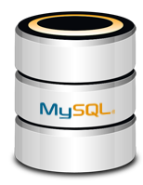
MySQL
Working with Relational Database

Slide 34

MySQL
Open-source relational database management system
Used in many large-scale websites like including Google, Facebook, YouTube etc.
Works on many system platforms – macOS, Windows, Linux
Download MySQL Community Server
Windows:
Ubuntu/Debian:
https://dev.mysql.com/downloads/mysql/
https://dev.mysql.com/downloads/repo/apt/

Slide 35
MySQL Server Architecture
Logical Storage
Instance
Database/Schema
Table
Physical Storage
Data files and Log files
Data pages
Instance
Database(Schema)
Database(Schema)
Table
Table
Database(Schema)
Table
Table
Data
Logs
☰
☰
☰
☰
☰
☰
☰
☰

Slide 36
Database Table Elements
The table is the main building block of any database
Each row is called a record or entity
Columns (fields) define the type of data they contain
Column
customer_id | first_name | birthdate | city_id
1 | Brigitte | 03/12/1975 | 101
2 | August | 27/05/1968 | 102
3 | Benjamin | 15/10/1988 | 103
4 | Denis | 07/01/1993 | 104
Row
Cell
Notes:
The table is the main unit of data storage. It has rows, columns and cells. Cells contain stored data. Each column has a data type. Types can be VARCHAR(String), INT, DATE etc.

Slide 37
Why Split Related Data?
Empty records
first | last | registered | email
David | Rivers | 05/02/2016 | drivers@mail.cx
Sarah | Thorne | 07/17/2016 | sarah@mail.cx
Michael | Walters | 11/23/2015 | walters_michael@mail.cx
email2
NULL
NULL
walters_michael@abv.bg
Redundant information
order_id | date | customer | product | s/n | price
00315 | 07/16/2016 | David Rivers | Oil Pump | OP147-0623 | 69.90
00315 | 07/16/2016 | David Rivers | Accessory Belt | AB544-1648 | 149.99
00316 | 07/17/2016 | Sarah Thorne | Wiper Fluid | WF000-0001 | 99.90
00317 | 07/18/2016 | Michael Walters | Oil Pump | OP147-0623 | 69.90

Slide 38
Related Tables
We split the data and introduce relationships between the tables to avoid repeating information
Connection via Foreign Key in one table pointing to the Primary Key in another
user_id | first | last | registered
203 | David | Rivers | 05/02/2016
204 | Sarah | Thorne | 07/17/2016
205 | Michael | Walters | 11/23/2015
user_id | email
203 | drivers@mail.cx
204 | sarah@mail.cx
205 | walters_michael@mail.cx
203 | david@homedomain.cx
Primary Key
Foreign Key

Slide 39
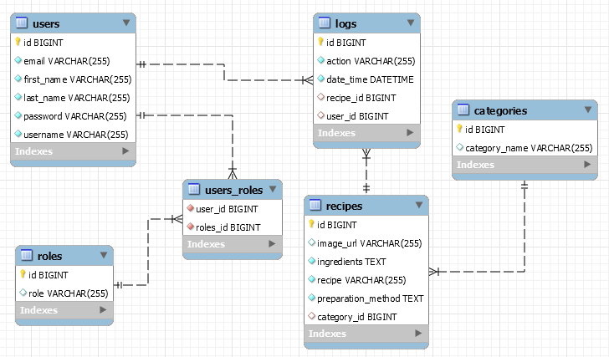
E/R Diagrams

Slide 40

JSON Data Format
Definition and Syntax

Slide 41
JSON Data Format
JSON (JavaScript Object Notation) is a lightweight data format
Human and machine-readable plain text
Based on JavaScript objects
Independent of development platforms and languages
JSON data consists of:
Values (strings, numbers, etc.)
Key-value pairs: { key : value }
Arrays: [value1, value2, …]
{
"firstName": "Peter",
"courses": ["C#", "JS", "ASP.NET"]
"age": 23,
"hasDriverLicense": true,
"date": "2012-04-23T18:25:43.511Z",
// ...
}

Slide 42
JSON Data Format (2)
The JSON data format follows the rules of object creation in JS
Strings, numbers and Booleans :
Arrays :
Objects (key-value pairs):
"this is a string and is valid JSON"
3.14
true
[5, "text", true]
{
"firstName": "Svetlin", "lastName": "Nakov",
"jobTitle": "Technical Trainer", "age": 30
}

Slide 43


Mongo DB
Working with Non-Relational Database

Slide 44
MongoDB
MongoDB == free open-source cross-platform document- oriented database
Keeps collections of JSON documents (with or without schema)
Sample usages: mobile app backend, product catalog, poll
system, blog system, Web content management system (CMS)
Supports evolving data requirements
The DB structure may change over the time
Supports indexing for increased performance
44

Slide 45
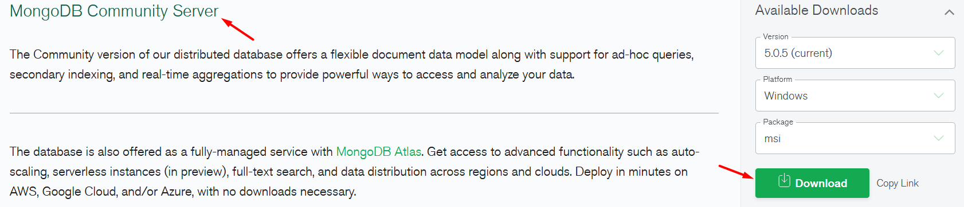
Install MongoDB
Download from: mongodb.com/try/download/community
The package includes MongoDB Compass

Slide 46
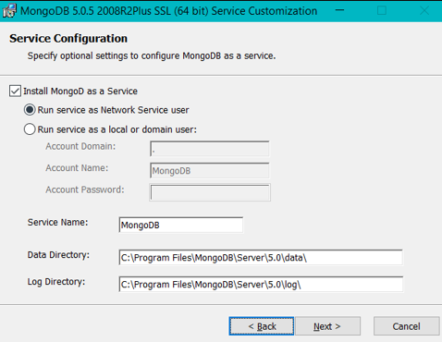
MongoD Windows Service
During installation, configure the MongoDB service:

Slide 47
Working with MongoDB GUI
Choose one of the many
MongoDB Compass is included in the installer
For example
Compass – https://www.mongodb.com/products/compass
Robo 3T – https://robomongo.org/download
NoSQLBooster – https://nosqlbooster.com

Slide 48
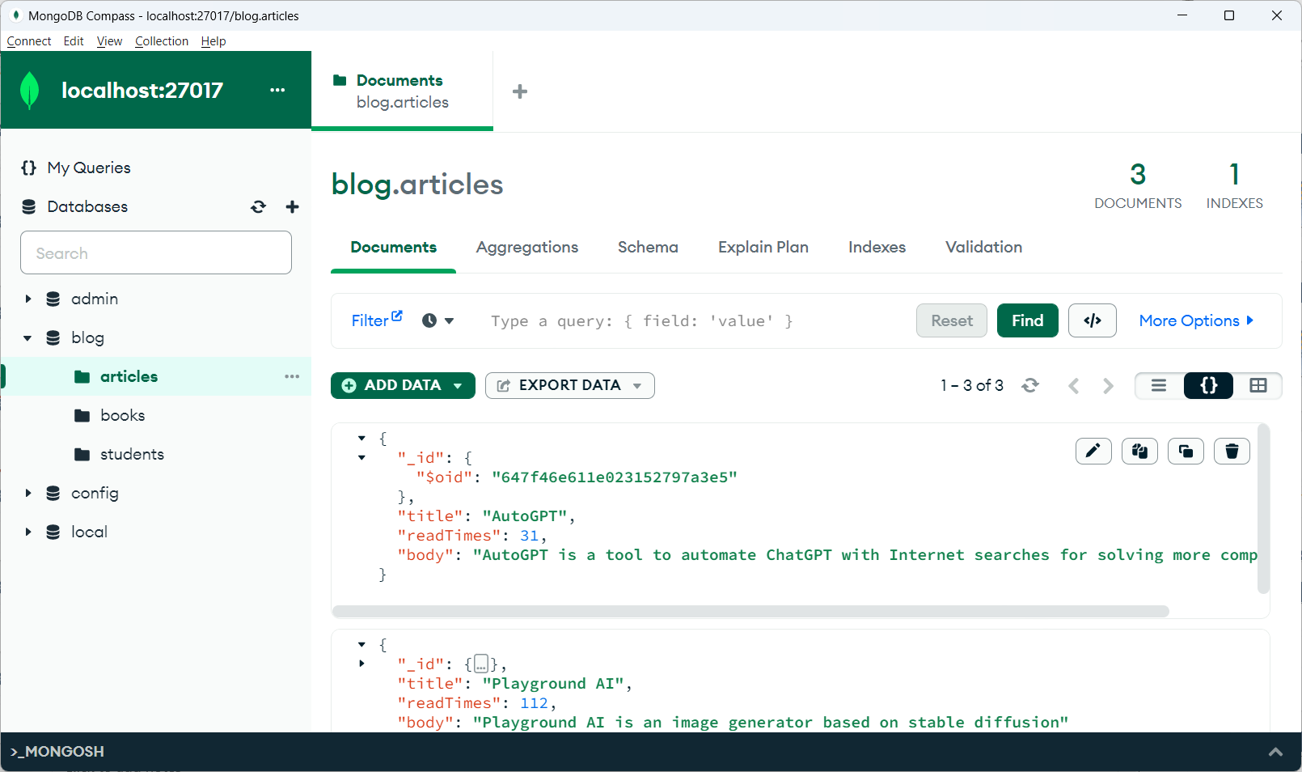
MongoDB Compass

Slide 49
MongoDB Queries Example
Mongoose supports many queries
For equality/non-equality
Selection of some properties
Student.findOne({'lastName':'Petrov'})
Student.find({}).where('age').gt(7).lt(14)
Student.find({}).where('facultyNumber').equals('12399')
Student.findOne({'lastName':'Kirilov'}).select('name age')

Slide 50
Mongoose Queries Example 2
Sorting
Limit & skip
Different methods could be stacked one upon the other
Student.find({}).sort({age:-1})
Student.find({}).sort({age:-1}).skip(30).limit(10)
Student.find({})
.where('firstName').equals('gosho')
.where('age').gt(18).lt(65)
.sort({age:-1})
.skip(10)
.limit(10)

Slide 51
Working with MongoDB Shell Client
Install "MongoDb Shell" and run it from the command line:
Type the command "mongo"
Additional information at: https://www.mongodb.com/try/download/shell
show dbs
use mytestdb
db.mycollection.insertOne({"name":"George"})
db.mycollection.find({"name":" George"})
db.mycollection.find({})

Slide 52

Summary
Databases: store data tables and collections
Relational databases: tables and relationships
Non-Relational: document collections
DBMS (database servers), e.g. MySQL, MongoDB
SQL commands: SELECT, INSERT, UPDATE, DELETE, …
JSON document: {"name":"Joe", "age":25}
Working with MySQL + Workbench
Working with Mongo DB + Compass
Notes:
52

Slide 53









Questions?

Slide 54












SoftUni Diamond Partners

Slide 55

Educational Partners

Slide 56

License
This course (slides, examples, demos, exercises, homework, documents, videos and other assets) is copyrighted content
Unauthorized copy, reproduction or use is illegal
© SoftUni – https://about.softuni.bg/
© Software University – https://softuni.bg
Notes:
56

Slide 57
Trainings @ Software University (SoftUni)
Software University – High-Quality Education, Profession and Job for Software Developers
softuni.bg, about.softuni.bg
Software University Foundation
softuni.foundation
Software University @ Facebook
facebook.com/SoftwareUniversity
Software University Forums
forum.softuni.bg
Notes:
57

