Slide 1
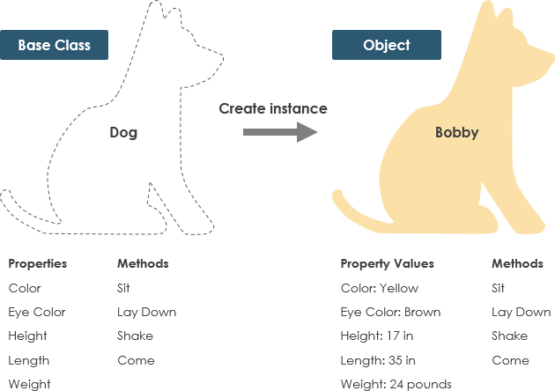
Classes and Objects
Objects, Classes and Class Members
SoftUni Team
Technical Trainers
Software University
https://about.softuni.bg/

Slide 2
Table of Contents
Objects and Classes
Defining Simple Classes
Fields and Properties
Methods
Constructors
2

Slide 3

What is an Object? What is a Class?

Slide 4
Objects
An object holds a set of named values
E.g. birthday object holds day, month and year
Creating a birthday object:
Create a new object of type DateTime
Birthday
Day = 22 Month = 6 Year = 1990
Object name
var day = new DateTime( 2019, 2, 25); Console.WriteLine(day);
Object properties
The new operator creates a new object
var birthday = new { Day = 22, Month = 6, Year = 1990 };
4

Slide 5
Classes
In programming, classes provide the structure for objects
Act as template for objects of the same type
Classes define:
Data (properties), e.g. Day, Month, Year
Actions (behavior), e.g. AddDays(count), Subtract(date)
5

Slide 6
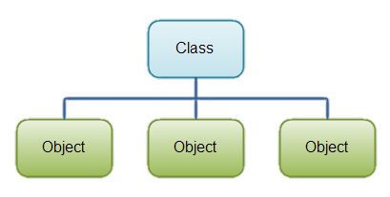
Classes
One class may have many instances (objects)
Sample class: DateTime
Sample objects: peterBirthday, mariaBirthday
6

Slide 7
Objects (Instances of Classes)
Creating the object of a defined class is called instantiation
The instance is the object itself, which is created runtime
All instances have common behaviour
DateTime date1 = new DateTime(2018, 5, 5);
DateTime date2 = new DateTime(2016, 3, 5);
DateTime date3 = new DateTime(2013, 12, 31);
7

Slide 8
Objects and Classes – Example
DateTime peterBirthday = new DateTime(1996, 11, 27);
DateTime mariaBirthday = new DateTime(1995, 6, 14);
Console.WriteLine("Peter's birth date: {0:d-MMM-yyyy}",peterBirthday);
// 27-Nov-1996
Console.WriteLine("Maria's birth date: {0:d-MMM-yyyy}",mariaBirthday);
// 14-Jun-1995
var mariaAfter18Months = mariaBirthday.AddMonths(18);
Console.WriteLine("Maria after 18 months: {0:d-MMM-yyyy}", mariaAfter18Months);
// 14-Dec-1996
TimeSpan ageDiff = peterBirthday.Subtract(mariaBirthday);
Console.WriteLine("Maria older than Peter by: {0} days", ageDiff.Days);
// 532 days

Slide 9
Defining Simple Classes

Slide 10
Defining Simple Classes
Class is a concrete implementation of an ADT (abstract data type)
Classes provide structure for describing and creating objects
Keyword
Class name
class Rectangle
{
…
}
Class body
10

Slide 11
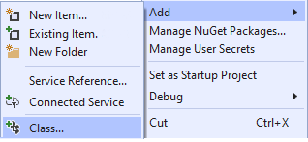
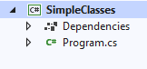

Defining Simple Classes Rectangle
Create a file for this class: [Project] → [Add Class] or: right click on the project [Add]→ [New Item] → [Class]
Class stays in a separate file
11

Slide 12


Naming Classes
Name classes with nouns using PascalCasing
Use descriptive nouns
Avoid abbreviations (except widely known, e.g. URL, HTTP, etc.)
class Dice { … }
class BankAccount { … }
class TPMF { … }
class bankaccount { … }
class intcalc { … }
12

Slide 13
Class Members
Members are declared inside the class
Members can be:
Fields (data)
Properties (data + logic)
Methods (actions)
Constructors
Others
class Rectangle
{
int width;
int Width { get; set; }
void CalcArea() { … }
}
Field
Property
Method

Slide 14
Class Rectangle – Example
Class Rectangle holds properties Width and Height
Rectangle.cs
class Rectangle
{
public int Width { get; set; }
public int Height { get; set; }
public string Color { get; set; }
}

Slide 15

Creating an Object
A class can have many instances (objects)
class Program
{
public static void Main()
{
Rectangle firstRect = new Rectangle();
Rectangle secondRect = new Rectangle();
}
}
Use the new keyword to create an object
A variable stores an object reference
15

Slide 16
Object Reference
Declaring a variable creates a reference in the stack
The new keyword allocates memory on the heap
Rectangle firstRect = new Rectangle();
Stack
Heap
object
firstRect
(1540e19d)
Width = 0
Height = 0
16

Slide 17
Defining a Simple Method in a Class
class Rectangle
{
public int Width { get; set; }
public int Height { get; set; }
public string Color { get; set; }
public int CalcArea()
{
return Width * Height;
}
}
Methods define actions in the classes

Slide 18
Class –> Object
Classes provide structure for describing and creating objects
An object is a single instance of a class
Rectangle
is…
Rectangle ADT
Rectangle (Class)
firstRect
(Object)

Slide 19
Classes vs. Objects
Classes provide structure for creating objects
An object is a single instance of a class
Object name
class
Rectangle
object firstRect
Class name
Width: int
Height: int
Color: string
Width = 6
Height = 3
Color = "blue"
Class data
Object data
CalcArea(…)
Class actions
19

Slide 20
Object-Oriented Programming (OOP)
Object-Oriented Programming (OOP) is the concept of using classes and objects (class instances) to model the real world
Class definition
class Rectangle {
public int Width { get; set; }
public int Height { get; set; }
public int CalcArea() { return width * height;
}
}
width = 5
height = 6
width = 6
height = 4
Properties (data)
width = 7
height = 3
Methods (actions)
Objects
Notes:
Object-oriented programming (OOP) is the concept of using classes and objects to model the real world.
Classes are sets of data fields, together with methods (which are functionality to interact with the data fields and other objects).
Classes define the structure of information objects: the data they holds and the operation they can perform.
Objects are instances of the classes, holding certain values in their data fields.
At the example we have a definition of the class "Rectangle".
It holds two data fields: width and height. – integer values.
It defines a method, holding the code to calculate the area of the rectangle.
This is the class definition … and the programming language here doesn’t matter.
These are the definitions of the data fields, which the class holds in each object.
These are the methods of the class: the operations or actions that objects of this class can do.
And now we have several objects of this class "Rectangle".
The first object is a rectangle of width 5 and height 6.
Another object has width 6 and height 4.
Some other object has width 7 and height 3.
We have one class "Rectangle" and 3 objects (or instances) of this class.
The class holds the definition (the specification, the model, the template) for the objects.
It defines the data fields and methods and more details (in some cases).
Classes don't hold data. They hold data definitions and operation definitions.
Objects hold values for the data fields in the class.
Objects of class "Rectangle" hold data about certain rectangle.
Objects are information structures, holding data.
Typically one class has multiple objects (or instances).
Classes and objects are the building blocks of the object-oriented programming (OOP) and they come together with some other OOP concepts like abstraction, interfaces, data encapsulation, inheritance, polymorphism and exception handling.

Slide 21

Storing Data Inside a Class

Slide 22
Fields and Modifiers
Class fields have type and name
Modifiers define accessibility
public class Rectangle
{
private string color;
private int width;
private int height;
private int[] sections;
private Shape type;
public int CalcArea() { … }
}
Class modifier
Fields should always be private
Fields can be of any type
22

Slide 23
Properties
Used to create accessors and mutators (getters and setters)
public class Rectangle
{
private int width;
public int Width
{
public get { return this.width; }
public set { this.width = value; }
}
}
The field is hidden
The getter provides access to the field
The setter provides field change
23

Slide 24

Problem: Car
Create a class Car
private string make;
private string model;
private int year;
public string Make
{
get { return this.make; }
set { this.make = value; }
}
// TODO: Balance and Year Getter & Setter
Car
-make:string
-model:string
-year:int
(no actions)
Check your solution here: https://judge.softuni.bg/Contests/Practice/Index/3161#0
24

Slide 25
Short Properties in C#
public string Brand { get; private set; }
public string Make { get; set; }
public string BrandAndMake
{
get => Brand + " " + Make;
}

Slide 26

Defining a Class Behaviour

Slide 27
Methods
Store executable code (an algorithm)
public class Rectangle
{
public int Width { get; set; }
public int Height { get; set; }
public int CalcArea()
{
int area = this.Width * this.Height;
return area;
}
}
this points to the current instance
27

Slide 28

Problem: Car Extension
Create a class Car
Car
-make:string
-model:string
-year:int
-fuelQuantity:double
-fuelConsumption:double
+Drive(double distance):void
+WhoAmI():string
28

Slide 29
Solution: Car Extension (1)
// TODO: Get the other fields from previous problem
private double fuelQuantity;
private double fuelConsumption;
// TODO: Get the other properties from previous problem
public double FuelQuantity {
get { return this.fuelQuantity; }
set { this.fuelQuantity = value; }}
public double FuelConsumption {
get { return this.fuelConsumption; }
set { this.fuelConsumption = value; }}
29

Slide 30
Solution: Car Extension (2)
public void Drive(double distance)
{
bool canContinue = this.FuelQuantity –
(distance * this.FuelConsumption) >= 0;
if (canContinue)
{
this.FuelQuantity -= distance * this.FuelConsumption;
}
else
{
Console.WriteLine("Not enough fuel to perform this trip!");
}
}
30

Slide 31
Solution: Car Extension (3)
public string WhoAmI()
{
StringBuilder sb = new StringBuilder();
sb.AppendLine($"Make: {this.Make}");
sb.AppendLine($"Model: {this.Model}");
sb.AppendLine($"Year: {this.Year}");
sb.Append($"Fuel: {this.FuelQuantity:F2}L");
return sb.ToString();
}
Check your solution here: https://judge.softuni.bg/Contests/Practice/Index/3161#1
31

Slide 32


Object Initialization

Slide 33
Constructors
When a constructor is invoked, it creates an instance of its class and usually initializes its members
Classes in C# are instantiated with the keyword new
public class StartUp
{
static void Main()
{
var figure = new Rectangle();
}
}
public class Rectangle
{
public Rectangle() { }
}
33

Slide 34
Object Initial State (1)
Constructors set object's initial state
public class Rectangle {
int width;
int height;
string color;
public Rectangle(int width, int height, string color)
{
this.width = width;
this.height = height;
this.color= color;
}
}
34

Slide 35
Object Initial State (2)
public class Rectangle {
int width;
int height;
private int[] sections;
public Rectangle(int width, int height, string color)
{
this.width = width;
this.height = height;
this.sections= new int[(width * height)/2];
}
}
Always ensure
correct state
35

Slide 36
Multiple Constructors
You can have multiple constructors in the same class
public class Rectangle {
private string color;
public Rectangle()
{
this.color = "white";
}
public Rectangle(string color)
{
this.color = color;
}
}
Constructor without parameters
Constructor with parameters

Slide 37
Constructor Chaining
Constructors can call each other
public class Person {
private string name;
private int age;
public Person()
{
this.age = 18;
}
public Person(string name) : this() {
this.name = name;
}
}
Calls default constructor

Slide 38
Summary
Classes define structure for objects
Objects are instances of a class
NET Core provides thousands of ready-to-use classes
Classes provide structure for describing and creating objects
Classes define fields, methods, properties, constructors and other members
Constructors:
Invoked when creating new instances
Initialize the object's state
…
…
…

Slide 39
Questions?
Notes:
39

Slide 40

License
This course (slides, examples, demos, exercises, homework, documents, videos and other assets) is copyrighted content
Unauthorized copy, reproduction or use is illegal
© SoftUni – https://softuni.org
© Software University – https://softuni.bg
Notes:
40

