Slide 1
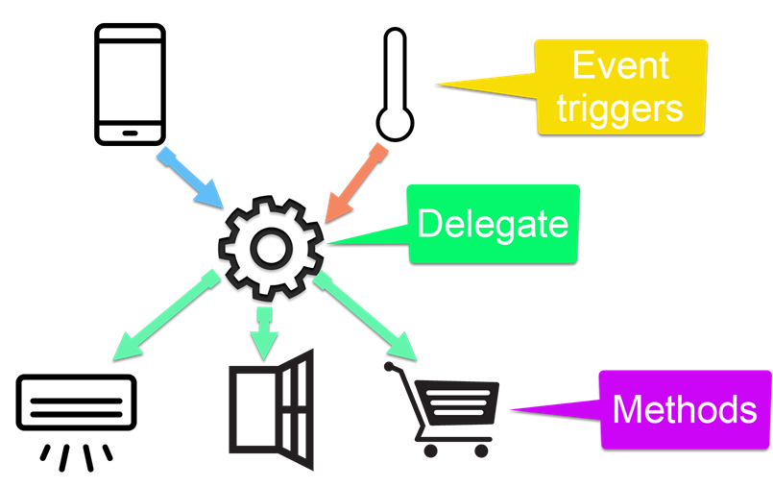
Delegates and Events
Callbacks
SoftUni Team
Technical Trainers
Software University
https://about.softuni.bg/

Slide 2
Table of Contents
Delegates
Predicates
Events
2

Slide 3
Func<T, V>, Action<T>
=>

Slide 4
Delegates
A delegate is a type that represents references to methods with a particular parameter list and return type
Used to pass methods as arguments to other methods
Can be used to define callback methods
public delegate int Multiplier(int x, int y);
Multiplier calc = (x, y) => x * y;

Slide 5
Generic Delegates – Func<T, V>
Initialization of a function
Input and output type can be different types
Input and output type must be from the declared type
Func generic delegate uses type parameters to define the number and types of input parameters and returns the type of the delegate
Lambda Expressions
Input type
Output type
Func<int, string> func = n => n.ToString();
Name
Input parameter
Return expression

Slide 6
Generic Delegates – Action<T>
In .NET Action<T> is a void method:
Instead of writing the method we can do:
Then we use it like that:
private void Print(string message)
{ Console.WriteLine(message); }
Action<string> print = message => Console.WriteLine(message);
print("pesho"); // pesho
print(5.ToString()); // 5

Slide 7
Problem: Sum Numbers
Read numbers from the console
Use your own function to parse each element
Print the count of numbers
Print the sum
10
41
4, 2, 1, 3, 5, 7, 1, 4, 2, 12
8
496
85, 47, 91, 32, 83, 75, 81, 2

Slide 8
Solution: Sum Numbers
string input = Console.ReadLine();
Func<string, int> parser = n => int.Parse(n);
int[] numbers = input.Split(new string[] {", "},
StringSplitOptions.RemoveEmptyEntries)
.Select(parser).ToArray();
Console.WriteLine(numbers.Length);
Console.WriteLine(numbers.Sum());
Check your solution here: https://judge.softuni.bg/Contests/Practice/Index/3168#1

Slide 9

Problem: Extract Uppercase Words
Read a text from the console
Filter only words, that start with a capital letter
Use Func<string, bool> (predicate)
Print each of the words on a new line
The following example shows how to use Predicate
The
Predicate
Print count of words
Print

Slide 10
Solution: Extract Uppercase Words
Func<string, bool> checker =
n => n[0] == n.ToUpper()[0];
var words = Console.ReadLine()
.Split(new string[] {" "},
StringSplitOptions.RemoveEmptyEntries)
.Where(checker)
.ToArray();
foreach (string word in words)
{
Console.WriteLine(word);
}
Check your solution here: https://judge.softuni.bg/Contests/Practice/Index/3168#2

Slide 11
Problem: Add VAT
Read from the console prices of items
Add VAT of 20% to all of them
Use Func<double, double> (unary operator)
1, 3, 5, 7
1.20
3.60
6.00
8.40
10, 24, 12, 71
12.00
28.80
14.40
85.20

Slide 12
Solution: Add VAT
Func<double, double> addVat = p => p * 1.2;
double[] prices = Console.ReadLine()
.Split(new string[] { ", " },
StringSplitOptions.RemoveEmptyEntries)
.Select(double.Parse)
.Select(addVat)
.ToArray();
foreach (var price in prices)
Console.WriteLine($"{price:f2}");
Check your solution here: https://judge.softuni.bg/Contests/Practice/Index/3168#3

Slide 13
Passing Functions to Method
We can pass Func<T> to methods:
We can use the method like that:
private int Operation(int number, Func<int, int> operation)
{
return operation(number);
}
int a = 5;
int b = Operation(a, number => number * 5); // 25
int c = Operation(a, number => number – 3); // 2
int d = Operation(b, number => number % 2); // 1

Slide 14
Problem: Filter by Age
Read from the console n people with their age
Read a condition ("older" or "younger") and an age filter
Read a format type for output and filter the people
4
Lucas, 20
Mia, 29
Noah, 31
Simo, 16
older
20
name age
4
Lucas, 20
Noah, 18
Mia, 29
Simo, 16
younger
20
name
Lucas - 20
Mia - 29
Noah - 31
Noah
Simo

Slide 15
Solution: Filter by Age (1)
// TODO: Read data from the console
Func<int, bool> tester = CreateTester(condition, age);
Action<KeyValuePair<string, int>> printer =
CreatePrinter(format);
PrintFilteredStudent(people, tester, printer);
public static Func<int, bool> CreateTester
(string condition, int age)
{
switch (condition) {
case "younger": return x => x < age;
case "older": return x => x >= age;
default: return null;
}
}

Slide 16
Solution: Filter by Age (2)
public static Action<KeyValuePair<string, int>>
CreatePrinter(string format)
{
switch (format)
case "name":
return person => Console.WriteLine($"{person.Key}");
// TODO: complete the other cases
default: return null;
}
Check your solution here: https://judge.softuni.bg/Contests/Practice/Index/3168#4

Slide 17
Higher Order Functions – Examples
Higher-order functions take other functions as arguments
int Аggregate(int start, int end, Func<int, int, int> func) {
int result = start;
for (int i = start + 1; i <= end; i++)
result = func(result, i);
return result;
}
Аggregate(1, 10, (a, b) => a + b) // 55
Аggregate(1, 10, (a, b) => a * b) // 3628800
Аggregate(1, 10, (a, b) => '' + a + b) // "12345678910"

Slide 18
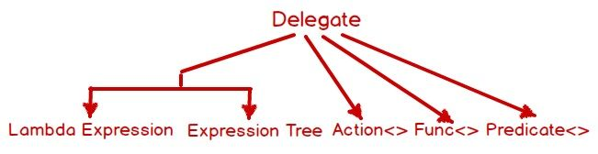
Predefined Boolean Delegates

Slide 19
Predicates
Predicates are predefined Boolean delegates with the following signature
Define a way to check if an object meets some Boolean criteria
Used by many methods in Array and List<T> to search for an element
For example, IList<T>.FindAll(Predicate<T>) retrieves all elements meeting the criteria defined by the predicate
public delegate bool Predicate<T>(T obj)

Slide 20
Predicates – Example
List<string> towns = new List<string>()
{
"Sofia", "Burgas", "Plovdiv", "Varna",
"Ruse", "Sopot", "Silistra"
};
List<string> townsWithS =
towns.FindAll(delegate(string town)
{
return town.StartsWith("S");
});
foreach (string town in townsWithS)
{
Console.WriteLine(town);
}

Slide 21
Events and EventHandler

Slide 22
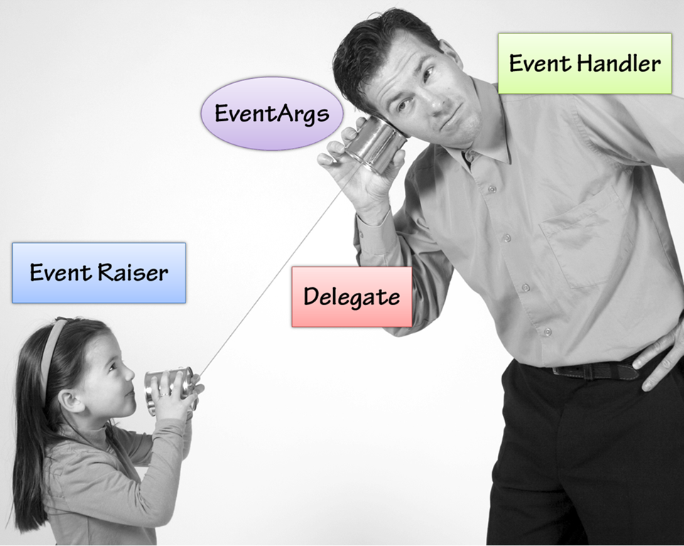
Events
Events are user actions such as key press, clicks, mouse movements, etc., or some occurrence such as system generated notifications
Events are declared in a class and associated with the event handlers using delegates
To receive an event, the event receivers should first "subscribe to the event"

Slide 23
Declaring Events (1)
First declare delegate type
public delegate void Notify();
class ProcessBusinessLogic {
public event Notify ProcessCompleted; // event
public void StartProcess() {
Console.WriteLine("Process Started!");
OnProcessCompleted();
}
protected virtual void OnProcessCompleted() {
//if ProcessCompleted is not null then call delegate
ProcessCompleted?.Invoke();
}
}
Then, declare the event

Slide 24

Declaring Events (2)
static void Main()
{
ProcessBusinessLogic bl = new ProcessBusinessLogic();
bl.ProcessCompleted += bl_ProcessCompleted;
bl.StartProcess();
}
public static void bl_ProcessCompleted()
{
Console.WriteLine("Process Completed!");
}
register with an event

Slide 25
Subscribes and Unsubscribes
The C# compiler automatically defines the += and -= operators for events
+= subscribes for an event
-= unsubscribes for an event
No other operations are allowed

Slide 26
The System.EventHandler Delegate (1)
System.EventHandler defines a reference to a callback method, which handles events
EventHandler represents a method with the signature of (object sender, EventArgs e) returning void
No additional information is sent about the event, just a notification:
The EventArgs class is the base class with no information for the event
public delegate void EventHandler(object sender, EventArgs e);

Slide 27
The System.EventHandler Delegate (2)
public class Button {
public event EventHandler Click;
public event EventHandler GotFocus; // And other types
}
public class ButtonExample {
private static void OnButtonClick(object sender, EventArgs eArgs)
{
Console.WriteLine("OnButtonClick() event called.");
}
public static void Main() {
Button button = new Button();
button.Click += new EventHandler(OnButtonClick);
}

Slide 28


Events in User Interfaces
Events are widely used in Graphical User Interfaces (GUIs)
Components such as buttons define a set of events (OnClick, OnFocus, OnChange, etc)
External components can subscribe (listen) to a specific event and react to it
var button = GetButtonById("btn");
button.OnClick += (sender, args) =>
{
// Code will be executed when button is clicked
};

Slide 29
UI Mouse Click Event Handler – Example
public partial class MainWindow : Window
{
public MainWindow()
{
this.InitializeComponent();
this.MouseDown += this.MainWindow_MouseClick;
}
private void MainWindow_MouseClick(
object sender, MouseButtonEventArgs e)
{
MessageBox.Show(string.Format("Mouse clicked at ({0}, {1})",
e.MouseDevice.GetPosition(this).X,
e.MouseDevice.GetPosition(this).Y));
}
}
Receives info about the click

Slide 30
Event Loop
UI technologies usually have an event loop running
Waits for events from the underlying operating system and notifies the respective components
while (message != "quit")
{
// Blocking operation – waits for an event from OS
message = GetMessage();
ProcessMessage(message);
}
Wait for events
Handle events

Slide 31
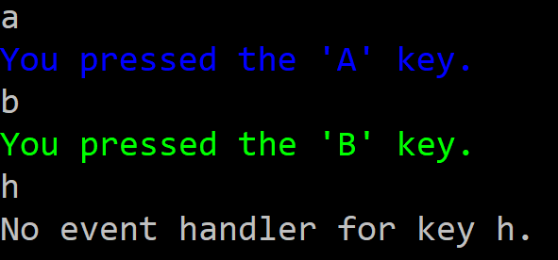
Problem: Console Key Event
Write program that, when you press the [a] or [b] keyboard key, fires an event that writes in color on the console the following message:
You pressed the 'A' key.
You pressed the 'B' key.
No event handler for key {key}

Slide 32
Solution: Console Key Event (1)
public delegate void PressKeyEvent();
public class Keyboard
{
public event PressKeyEvent PressKeyA = null;
public event PressKeyEvent PressKeyB = null;
public void PressKeyAEvent()
{
if (PressKeyA != null) { PressKeyA.Invoke(); }
}
public void PressKeyBEvent()
{
if (PressKeyB != null) { PressKeyB.Invoke();
}
}
Code example continues

Slide 33
Solution: Console Key Event (2)
public void Start() {
while (true) {
string keyPressed = Console.ReadLine();
switch (keyPressed) {
case "a": PressKeyAEvent(); break;
case "b": PressKeyBEvent(); break;
default:
Console.WriteLine("No event handler for key {0}.“
, keyPressed); break;
}
}
}
}

Slide 34
Solution: Console Key Event (3)
static void Main()
{
Keyboard keyboard = new Keyboard();
keyboard.PressKeyA += new PressKeyEvent(PressKeyAWriter);
keyboard.PressKeyB += PressKeyBWriter;
while (true)
{
keyboard.Start();
}
}

Slide 35
Solution: Console Key Event (4)
static private void PressKeyAWriter() {
Console.ForegroundColor = ConsoleColor.Blue;
Console.WriteLine("You pressed the 'A' key.");
Console.ForegroundColor = ConsoleColor.Gray;
}
static private void PressKeyBWriter() {
Console.ForegroundColor = ConsoleColor.Green;
Console.WriteLine("You pressed the 'B' key.");
Console.ForegroundColor = ConsoleColor.Gray;
}

Slide 36
Summary
…
…
…
Delegates are data types that hold methods as their value
Some generic delegates in C#:
Action<T>, Func<T, TResult> and Predicate<T>
Events allow subscribing for notifications about something happening in an object
When an event "happens", all subscribers are notified

Slide 37
Questions?
Notes:
37

Slide 38

License
This course (slides, examples, demos, exercises, homework, documents, videos and other assets) is copyrighted content
Unauthorized copy, reproduction or use is illegal
© SoftUni – https://softuni.org
© Software University – https://softuni.bg
Notes:
38

