Slide 1
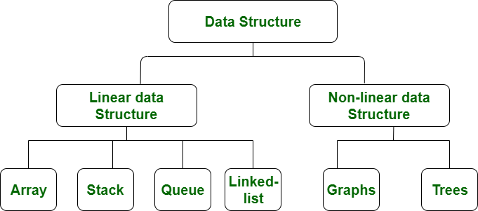
Intro to Data Structures
Data, Data Structures, Hash Tables
SoftUni Team
Technical Trainers
Software University
https://softuni.bg

Slide 2
Table of Contents
Data in Computing
Data Structures
Linear Data Structures: Array, ArrayList, LinkedList, Stack, Queue
Dictionaries and Hash Tables
Complex Data Structures: OrderedBag, MultiDictionary, Heap, etc.
2

Slide 3

How is Data Stored in the Memory?

Slide 4
Data in Computing
Set of symbols gathered and translated for some purpose
Simplified – bits of information stored in memory
If those bits remain unused, they don't do anything
Example:
Binary Data | Translation
100 0001 | 65
100 0001 | A

Slide 5
Data in Computing
The way we read the data retrieves the information of the bits in different ways
However, bits have only 0 or 1 as values
Example:
Type | Binary Data | Translation
Integer | 0000 0100 0001 | 65
Character | 0000 0100 0001 | 'A'
Double | 0000 0100 0001 | 65.0
Instruction Code | 0000 0100 0001 | Store 65
Color | 0000 0100 0001

Slide 6
Overview
A
D
T
A

Slide 7
Data Structures
Data structure – an object which takes responsibility for data organization, storage, management in effective manner
Storing items requires memory consumption:
Data Structure | Size
int | = 4 bytes
float | = 4 bytes
long | = 8 bytes
int[] | ≈ (Array length) * 4 bytes
List<double> | ≈ (List size) * 8 bytes
Dictionary<int, int[]> | ≈ (Dictionary size) * Entry bytes

Slide 8



Basic Data Structures
Linear structures
Lists: fixed size and variable size sequences
Stacks: LIFO (Last In First Out) structures
Queues: FIFO (First In First Out) structures
Trees and tree-like structures
Binary, ordered search trees, balanced trees, etc.
Dictionaries (maps, associative arrays)
Hold pairs (key → value)
Hash tables: use hash functions to search / insert

Slide 9



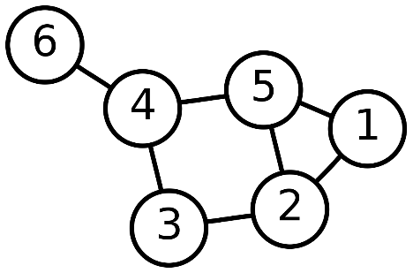
Basic Data Structures (2)
Sets, multi-sets and bags
Set – collection of unique elements
Bag – collection of non-unique elements
Ordered sets and dictionaries
Priority queues / heaps
Special tree structures
Suffix tree, interval tree, index tree, trie, rope, …
Graphs
Directed / undirected, weighted / unweighted, connected / non-connected, cyclic / acyclic, …

Slide 10

Abstract Data Types (ADT)
An Abstract Data Type (ADT) is:
A set of definitions of operations
Defines what we can do with the structure
ADT can have several different implementations
Different implementations can have different efficiency, inner logic and resource needs

Slide 11
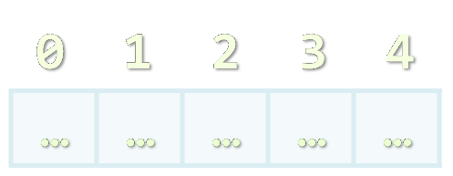
Arrays and Lists

Slide 12
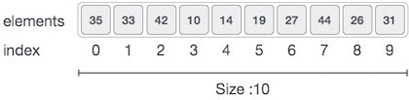
Array Data Structure
Arrays
Very lightweight
Have a fixed size
Usually built into the language
Many collections are implemented by using arrays
List<T> in C#
Queue<T> in C#
Stack<T> in C#

Slide 13
Why Arrays Are Fast?
Arrays use a single block of memory
Uses total of array pointer + (N * element/pointer size)
Array address + (element index * size) = element address
Arrays have a fixed size → to resize the array we make a copy
int size is 4 bytes
int[] array = { 2, 4, 1, 3, 5 };
 |  | 2 | 4 | 1 | 3 | 5
Total: 5 * 4 bytes
Array starts at this address

Slide 14
Dynamic Arrays (Lists): Resize +1
Dynamic (resizable) arrays have a variable size
Implemented using an array
New array with copied elements
List
Add
2 | 4 | 1 | 3 | 5
2 | 4 | 1 | 3 | 5 | 1
Remove
Count = 5
Count = 6
Add
Get
Set
Remove
O(n)
O(1)
O(1)
O(n)

Slide 15
Dynamic Arrays (Lists): Resize *2 – Add O(1)
Resizable arrays: double their capacity when needed
Copying occurs log(n) times → n = 10⁹, only ~30 copies
List
2
2 | 4
2 | 4 | 1
Capacity = 2
Capacity = 2
Capacity = 4
Count = 1
Count = 2
Count = 3
Add
Add
Amortized O(1)
O(1)
O(n)

Slide 16
Linked List
Linked list == dynamic (pointer-based) list implementation
Singly-linked list: each item has value and next
Doubly-linked list: each item has value, next and prev
2
next
7
next
4
next
5
next
null
head
head
tail
2
next
prev
7
next
prev
4
next
prev
5
next
prev
null
null

Slide 17
Example: LinkedList<T>
static void Main()
{
var list = new LinkedList<string>();
list.AddFirst("First");
list.AddLast("Last");
list.AddAfter(list.First, "After First");
list.AddBefore(list.Last, "Before Last");
Console.WriteLine(String.Join(", ", list));
// Result: First, After First, Before Last, Last
}
17

Slide 18
Dictionary<K, V>
key
value
John Smith | +1-555-8976
Sam Doe | +1-555-5030
Sam Smith | +1-555-4542
John Doe | +1-555-3527

Slide 19
The Dictionary (Map) ADT
The abstract data type (ADT) "dictionary" maps key to values
Also known as "map" or "associative array"
Holds a set of {key, value} pairs
Many implementations
Hash table, balanced tree, list, array, ...
key
value
John Smith | +1-555-8976
Sam Doe | +1-555-5030

Slide 20
Example: Dictionary<K, V>
var studentGrades = new Dictionary<string, int>();
studentGrades.Add("Ivan", 4);
studentGrades.Add("Peter", 6);
studentGrades.Add("Maria", 6);
studentGrades.Add("George", 5);
int peterGrade = studentGrades["Peter"];
Console.WriteLine("Peter's grade: {0}", peterGrade); Console.WriteLine("Students and their grades:");
foreach (var pair in studentGrades)
Console.WriteLine("{0} --> {1}", pair.Key, pair.Value);
Source code of Dictionary<TKey, TValue>: https://github.com/microsoft/referencesource
20

Slide 21
SortedDictionary<TKey,TValue>
SortedDictionary<TKey,TValue> implements the ADT "dictionary" as self-balancing search tree
Elements are arranged in the tree ordered by key
Traversing the tree returns the elements in increasing order
Add / Find / Delete perform log N operations
Use SortedDictionary<TKey,TValue> when you need the elements sorted by key – based on balanced search tree
Otherwise use Dictionary<TKey,TValue> – it has better performance – based on hash table

Slide 22
Hash Table
A hash table is an array that holds a set of {key, value} pairs
The process of mapping a key to a position in a table is called hashing
0 | 1 | 2 | 3 | 4 | 5 | … | m-1
T
… | … | … | … | … | … | … | …
Hash table of size m

Slide 23
Hash Functions and Hashing
A hash table has m slots, indexed from 0 to m-1
A hash function converts keys into array indices
0 | 1 | 2 | 3 | 4 | 5 | … | m-1
T
… | … | … | … | … | … | … | …
k.GetHashCode()
Returns 32-bit integer

Slide 24
Adding to Hash Table
 | 0
 | 1
 | 2
 | 3
 | 4
 | 5
 | 6
 | 7
 | 8
 | 9
Hash Function % 10
stamat

Slide 25
Adding to Hash Table (2)
 | 0
 | 1
 | 2
 | 3
 | 4
 | 5
 | 6
 | 7
 | 8
 | 9
stamat
Hash Function % 10
mitko

Slide 26
Adding to Hash Table (3)
stamat
 | 0
 | 1
 | 2
 | 3
 | 4
 | 5
 | 6
 | 7
 | 8
 | 9
Hash Function % 10
ivan
mitko

Slide 27
Adding to Hash Table (4)
 | 0
 | 1
 | 2
 | 3
 | 4
 | 5
 | 6
 | 7
 | 8
 | 9
stamat
Hash Function % 10
ivan
gosho
mitko

Slide 28
Adding to Hash Table (5)
 | 0
 | 1
 | 2
 | 3
 | 4
 | 5
 | 6
 | 7
 | 8
 | 9
stamat
Hash Function % 10
ivan
maria
mitko
gosho

Slide 29

Adding to Hash Table (6)
stamat
 | 0
 | 1
 | 2
 | 3
 | 4
 | 5
 | 6
 | 7
 | 8
 | 9
Collision
Hash Function % 10
maria
ivan
mitko
gosho

Slide 30
Collisions in a Hash Table
Collision == different keys have the same hash value
h(k₁) = h(k₂) for k₁ ≠ k₂
When the number of collisions is sufficiently small, the hash tables work quite well (fast)
Several collisions resolution strategies exist
Chaining collided keys (+ values) in a list
Using other slots in the table (open addressing)
Many others

Slide 31
Collision Resolution: Chaining
Hash Function
maria
0 | 1 | 2 | 3 | 4 | 5 | 6 | 7

Slide 32
Collision Resolution: Chaining
Hash Function
ivan
0 | 1 | 2 | 3 | 4 | 5 | 6 | 7
maria

Slide 33
Collision Resolution: Chaining
Hash Function
stamat
0 | 1 | 2 | 3 | 4 | 5 | 6 | 7
maria
ivan

Slide 34
Collision Resolution: Chaining
Hash Function
pesho
0 | 1 | 2 | 3 | 4 | 5 | 6 | 7
stamat
maria
ivan

Slide 35

Collision Resolution: Chaining
Hash Function
mitko
0 | 1 | 2 | 3 | 4 | 5 | 6 | 7
stamat
maria
ivan
pesho
Items are chained into a linked list

Slide 36
Collision Resolution: Chaining
Hash Function
joro
0 | 1 | 2 | 3 | 4 | 5 | 6 | 7
stamat
maria
ivan
mitko
pesho

Slide 37
Collision Resolution: Chaining
Hash Function
rosi
0 | 1 | 2 | 3 | 4 | 5 | 6 | 7
stamat
maria
ivan
mitko
pesho
joro

Slide 38
Collision Resolution: Chaining
Hash Function
alex
0 | 1 | 2 | 3 | 4 | 5 | 6 | 7
rosi
stamat
maria
ivan
mitko
pesho
joro

Slide 39
Collision Resolution: Chaining
Hash Function
0 | 1 | 2 | 3 | 4 | 5 | 6 | 7
rosi
stamat
maria
ivan
mitko
pesho
joro
alex

Slide 40
Collision Resolution: Linear Probing
Hash Function
maria
0 | 1 | 2 | 3 | 4 | 5 | 6 | 7

Slide 41
Collision Resolution: Linear Probing
Hash Function
ivan
0 | 1 | 2 | 3 | 4 | 5 | 6 | 7
maria

Slide 42
Collision Resolution: Linear Probing
Hash Function
stamat
0 | 1 | 2 | 3 | 4 | 5 | 6 | 7
maria
ivan

Slide 43
Collision Resolution: Linear Probing
Hash Function
pesho
0 | 1 | 2 | 3 | 4 | 5 | 6 | 7
stamat
maria
ivan

Slide 44
Collision Resolution: Linear Probing
Hash Function
pesho
0 | 1 | 2 | 3 | 4 | 5 | 6 | 7
stamat
maria
ivan

Slide 45
Collision Resolution: Linear Probing
Hash Function
pesho
0 | 1 | 2 | 3 | 4 | 5 | 6 | 7
stamat
maria
ivan

Slide 46
Collision Resolution: Linear Probing
Hash Function
mitko
0 | 1 | 2 | 3 | 4 | 5 | 6 | 7
stamat
maria
pesho
ivan

Slide 47
Collision Resolution: Linear Probing
Hash Function
joro
0 | 1 | 2 | 3 | 4 | 5 | 6 | 7
stamat
maria
pesho
ivan
mitko

Slide 48
Collision Resolution: Linear Probing
Hash Function
joro
0 | 1 | 2 | 3 | 4 | 5 | 6 | 7
stamat
maria
pesho
ivan
mitko

Slide 49
Collision Resolution: Linear Probing
Hash Function
joro
0 | 1 | 2 | 3 | 4 | 5 | 6 | 7
stamat
maria
pesho
ivan
mitko

Slide 50
Collision Resolution: Linear Probing
Hash Function
rosi
0 | 1 | 2 | 3 | 4 | 5 | 6 | 7
stamat
maria
pesho
ivan
joro
mitko

Slide 51
Collision Resolution: Linear Probing
Hash Function
alex
0 | 1 | 2 | 3 | 4 | 5 | 6 | 7
rosi
stamat
maria
pesho
ivan
joro
mitko

Slide 52
Collision Resolution: Linear Probing
Hash Function
alex
0 | 1 | 2 | 3 | 4 | 5 | 6 | 7
rosi
stamat
maria
pesho
ivan
joro
mitko

Slide 53
Collision Resolution: Linear Probing
Hash Function
alex
0 | 1 | 2 | 3 | 4 | 5 | 6 | 7
rosi
stamat
maria
pesho
ivan
joro
mitko

Slide 54
Collision Resolution: Linear Probing
Hash Function
alex
0 | 1 | 2 | 3 | 4 | 5 | 6 | 7
rosi
stamat
maria
pesho
ivan
joro
mitko

Slide 55
Collision Resolution: Linear Probing
Hash Function
alex
0 | 1 | 2 | 3 | 4 | 5 | 6 | 7
rosi
stamat
maria
pesho
ivan
joro
mitko

Slide 56
Collision Resolution: Linear Probing
Hash Function
alex
0 | 1 | 2 | 3 | 4 | 5 | 6 | 7
rosi
stamat
maria
pesho
ivan
joro
mitko

Slide 57
Collision Resolution: Linear Probing
Hash Function
0 | 1 | 2 | 3 | 4 | 5 | 6 | 7
rosi
alex
stamat
maria
pesho
ivan
joro
mitko

Slide 58

Examples

Slide 59


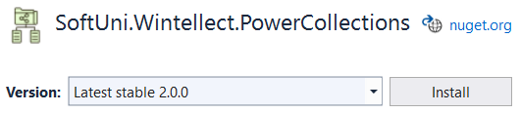
OrderedBag<T>
OrderedBag<T>
A bag (multi-set) based on balanced search tree
Contains <Key, Value> pairs
Any number of elements may have the same key
Add / Find / Remove work in time O(log(N))
T should implement IComparable<T>
To use OrderedBag<T>, install Softuni.Wintellect.PowerCollections from NuGet Packages

Slide 60
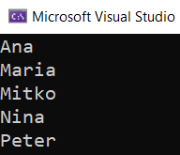
Example: OrderedBag<T>
Use the class OrderedBag<T> to read a list of words and print them in a sorted order
OrderedBag<string> bag = new OrderedBag<string>();
bag.Add("Peter");
bag.Add("Maria");
bag.Add("Ana");
bag.Add("Nina");
bag.Add("Mitko");
foreach (var element in bag)
{
Console.WriteLine(element);
}
60

Slide 61

MultiDictionary<TKey, TValue>
MultiDictionary<TKey, TValue>
A dictionary (map) implemented by hash-table
Allows duplicates (configurable)
Add / Find / Remove work in time O(1)
Like Dictionary<TKey, List<TValue>>
To use MiltiDictionary<TKey, TValue>, install SoftUni.Wintellect.PowerCollections from NuGet Packages

Slide 62

Example: MultiDictionary<K, V>
Use the MultiDictionary<K, V> class to read a phone book, where each person can have multiple phone numbers:
Peter → 088 123 456
Maria → 089 999 888
Peter → 088 999 777
Find the phone numbers for "Peter"
MultiDictionary<string, string> phoneBook =
new MultiDictionary<string, string>(true);
phoneBook.Add("Peter", "088 123 456");
phoneBook.Add("Maria", "089 999 888");
phoneBook.Add("Peter", "088 999 777");
foreach (var phoneNum in phoneBook["Peter"])
{
Console.WriteLine(phoneNum);
}
62

Slide 63
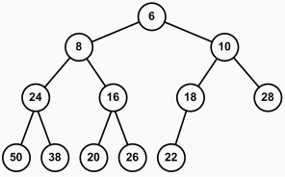
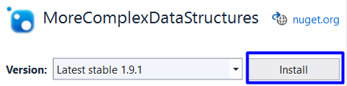
MaxHeap<T> (Binary Pyramid)
Heap<T>
Tree-based data structure, stored in array
Fast retrieve of min and max element
Heaps hold the heap property for each node:
Min heap: parent ≤ children
Max heap: parent ≥ children
To use MaxHeap<T>, install NuGet package MoreComplexDataStructures

Slide 64
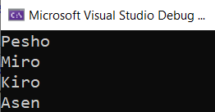
Example: MaxHeap<T>
Use the MaxHeap<T> class to sort names in descending order
Print each name, using the ExtractMax() method
MaxHeap<string> heap = new MaxHeap<string>();
heap.Insert("Pesho");
heap.Insert("Kiro");
heap.Insert("Asen");
heap.Insert("Miro");
while (heap.Count > 0)
{
Console.WriteLine(heap.ExtractMax());
}
64

Slide 65
Summary
…
…
…
Data structures organize data in computer systems for efficient use
Abstract data types (ADT) describe a set of operations
Linear data structures: arrays, lists, stack, queue, linked list
Dictionaries and hash tables
Complex data structures: Bag, Heap, …

Slide 66
Questions?
Notes:
66

Slide 67

License
This course (slides, examples, demos, exercises, homework, documents, videos and other assets) is copyrighted content
Unauthorized copy, reproduction or use is illegal
© SoftUni – https://softuni.org
© Software University – https://softuni.bg
Notes:
67

Slide 68
Trainings @ Software University (SoftUni)
Software University – High-Quality Education, Profession and Job for Software Developers
softuni.bg, softuni.org
Software University Foundation
softuni.foundation
Software University @ Facebook
facebook.com/SoftwareUniversity
Software University Forums
forum.softuni.bg
68
Notes:
68

