Slide 1



ASP.NET MVC Apps with Databases
MVC Apps with Entity Framework and SQL Server. Implementing CRUD Operations with Scaffolding
SoftUni Team
Technical Trainers
Software University
https://softuni.bg

Slide 2
Table of Contents
Implementing CRUD operations in ASP.NET MVC + Entity Framework + SQL Server
Creating ASP.NET Core MVC App
Scaffolding Entity Framework data classes
Scaffolding MVC Controllers and Views by data class
CRUD controllers and views
Inside the generated CRUD controllers
Inside the generated CRUD views
2

Slide 3
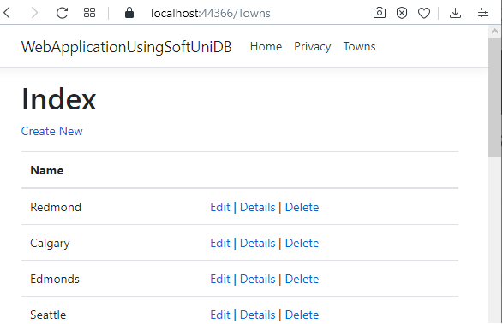
Build ASP.NET MVC Data-Driven App
Create a CRUD Application with "SoftUni" Database

Slide 4

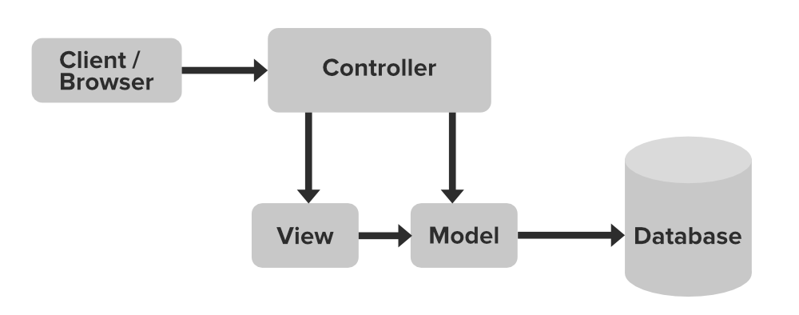
ASP.NET MVC + Entity Framework
ASP.NET MVC controllers
EF Core
Razor views: (.cshtml)

Slide 5
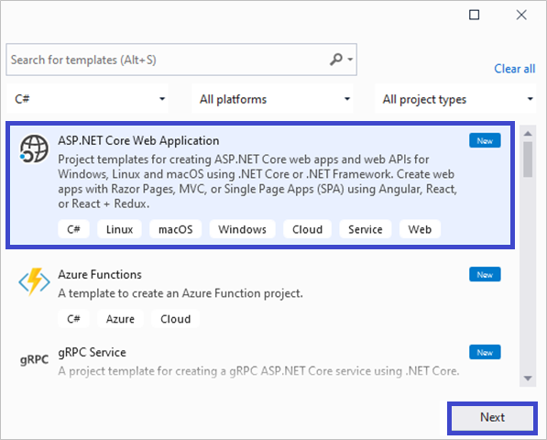
Creating an ASP.NET Core Project
Open Microsoft SQL Management Studio and make sure you have the "SoftUni" DB
In Visual Studio create a new C# Web project
Use the ASP.NET Web Application (.NET Core) template

Slide 6
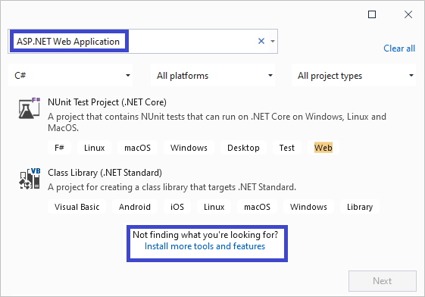

Install ASP.NET Core Web Application
If you do not see the ASP.NET Core Web Application template
Choose the "Install more tools and features" link
Install the feature "ASP.NET and web development"

Slide 7
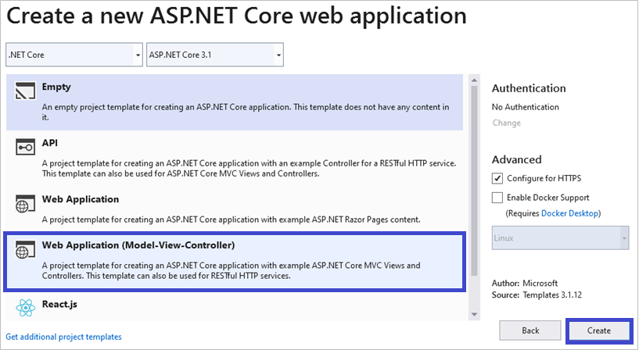
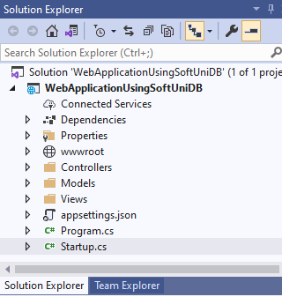
Create ASP.NET Core Web Application
Choose the Model-View-Controller (MVC) project template:

Slide 8
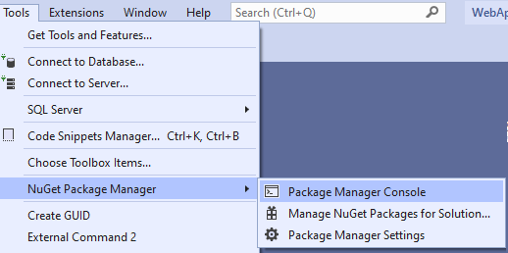
Integrating Entity Framework Core Libs
Install EF Core libraries
Go to [Tools] → [NuGet Package Manager] → [Package Manager Console] and run the following commands individually:
Install-Package Microsoft.EntityFrameworkCore.Tools
Install-Package Microsoft.EntityFrameworkCore.SqlServer.Design
Install-Package Microsoft.EntityFrameworkCore.SqlServer

Slide 9
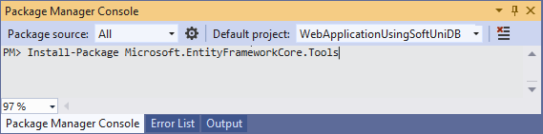
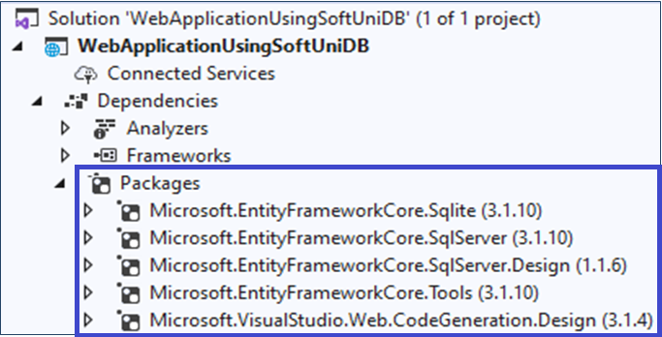
Integrating Entity Framework Core Libs (2)

Slide 10
Generating Entity Models and DBContext
In the Package Manager Console run the following command:
The command above will generate data models and DbContext from the existing database in the "Models" folder:
Town.cs, SoftUniContext.cs, …
Scaffold-DbContext -Connection "Server=(localdb)\MSSQLLocalDB;Database=SoftUni;Integrated Security=True;" -Provider Microsoft.EntityFrameworkCore.SqlServer -OutputDir Models

Slide 11
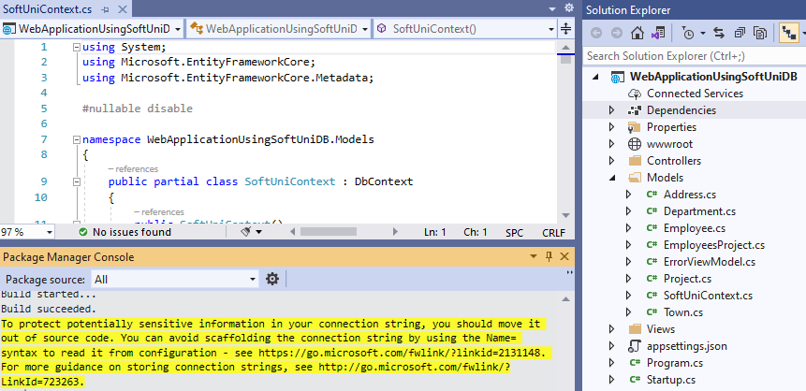
The "Models" Folder
EF models
DbContext
Build succeeded

Slide 12
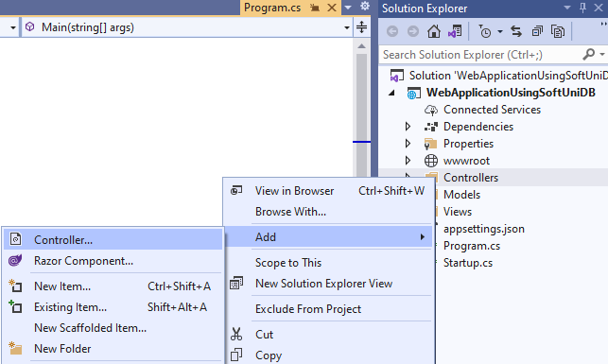
Scaffolding Controller with Views
Create an ASP.NET Core MVC Controller for handling data and performing basic CRUD operations
Right-click on the Controllers folder in Solution Explorer
Select [Add] → [Controller]

Slide 13
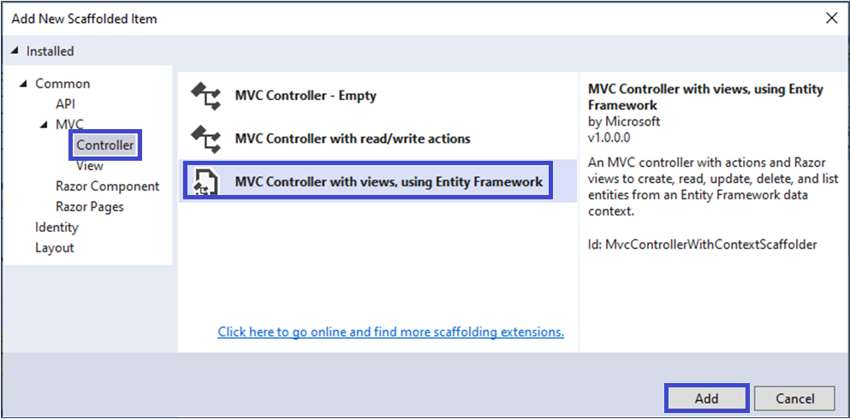
Controller with Views Using Entity Framework
Select MVC Controller with Views using Entity Framework

Slide 14
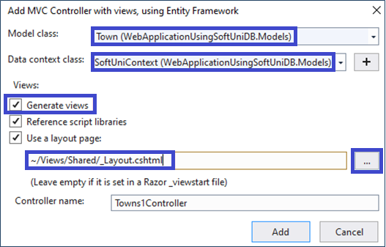
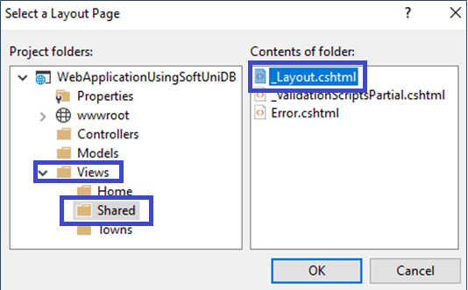
Controller with Views Using Entity Framework
Select "Town" as Model class
SoftUniContext as the Data context class
Tick the Generate views option
In the "Select a Layout Page": [Views] → [Shared] → _Layout.cshtml

Slide 15
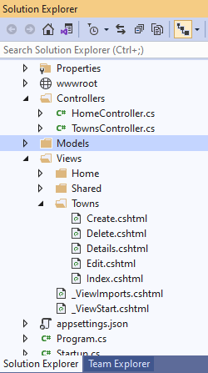
Controller with Views
A view is used to display data
The Views folder contains all the .cshtml view files in your app
Controllers prepare data (model) for the view
Views display the data as HTML
Controllers take the data from the DB using Entity Framework
Controllers
Views

Slide 16
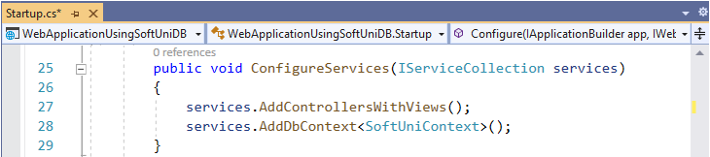
Register the DbContext in the App Startup
Register your configuration class at the ConfigureServices() method in Startup.cs, by adding:
Startup.cs
services.AddDbContext<SoftUniContext>();

Slide 17
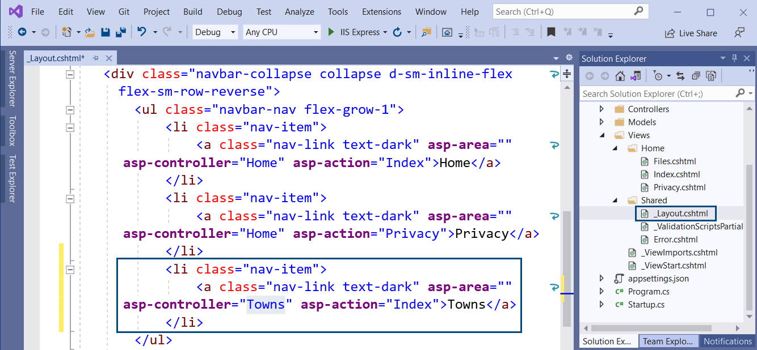
Include the Towns Page in the Menu
Edit _Layout.cshtml to include the "Towns" link in the app menus:
17

Slide 18
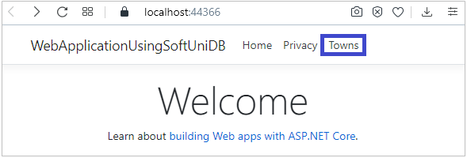
Testing the Application
Now build and run the application using [Ctrl] + [F5]

Slide 19

CRUD in ASP.NET MVC with EF
Manipulating Databases in ASP.NET MVC

Slide 20
Generated CRUD Controllers
We can retrieve an entire collection, using the DbContext:
Generated route: “/Towns/Index”
// GET: /Towns/Index
public IActionResult Index()
{
return View(this._context.Towns.ToList());
}

Slide 21
Generated CRUD Controllers (2)
Asynchronous version of the previous controller:
Asynchronous code is more efficient (load faster)
// GET: /Towns/Index
public async Task<IActionResult> Index()
{
return View(await _context.Towns.ToListAsync());
}

Slide 22
Generated CRUD Controllers (3)
Other operations (see the generated code):
// GET: Towns/Details/5
public async Task<IActionResult> Details(int? id) { … }
// GET: Towns/Create
public IActionResult Create() { … }
// POST: Towns/Create
[HttpPost] [ValidateAntiForgeryToken]
public async Task<IActionResult> Create([Bind("TownId, Name")] Town town) { … }

Slide 23
Generated CRUD Controllers (4)
Other operations (see the generated code):
// GET: Towns/Edit/5
public async Task<IActionResult> Edit(int? id){…}
POST: Towns/Edit/5
[HttpPost][ValidateAntiForgeryToken]
public async Task<IActionResult> Edit(int id, [Bind("TownId,Name")] Town town){…}
GET: Towns/Delete/5
public async Task<IActionResult> Delete(int? id){…}

Slide 24
Generated CRUD Controllers (5)
Other operations (see the generated code):
// POST: Towns/Delete/5
[HttpPost, ActionName("Delete")] [ValidateAntiForgeryToken]
public async Task<IActionResult> DeleteConfirmed(int id){…}

Slide 25
Generated CRUD Views
Index.cshtml
@foreach (var item in Model) {
<tr>
<td>@Html.DisplayFor(modelItem => item.Name)</td>
<td>
<a asp-action="Edit" asp-route-id="@item.TownId">Edit</a> |
<a asp-action="Details" asp-route-id="@item.TownId">Details</a> |
<a asp-action="Delete" asp-route-id="@item.TownId">Delete</a>
</td>
</tr>
}

Slide 26
Generated CRUD Views (2)
Edit.cshtml
<form asp-action="Edit">
<div asp-validation-summary="ModelOnly"></div>
<input type="hidden" asp-for="TownId"/>
<label asp-for="Name"></label>
<input asp-for="Name"/>
<span asp-validation-for="Name"></span>
<div>
<input type="submit" value="Save"/>
</div>
</form>

Slide 27
Generated CRUD Views (3)
Details.cshtml
<dl class="row">
<dt class = "col-sm-2">
@Html.DisplayNameFor(model => model.Name)
</dt>
<dd class = "col-sm-10">
@Html.DisplayFor(model => model.Name)
</dd>
</dl>
<div>
<a asp-action="Edit" asp-route-id="@Model.TownId">Edit</a> |
<a asp-action="Index">Back to List</a>
</div>

Slide 28
Generated CRUD Views (4)
Delete.cshtml
<dl class="row">
<dt class = "col-sm-2">
@Html.DisplayNameFor(model => model.Name)
</dt>
<dd class = "col-sm-10">
@Html.DisplayFor(model => model.Name)
</dd>
</dl>
<form asp-action="Delete">
<input type="hidden" asp-for="TownId" />
<input type="submit" value="Delete" class="btn btn-danger" /> |
<a asp-action="Index">Back to List</a>
</form>

Slide 29
Generated CRUD Views (5)
Create.cshtml
<form asp-action="Create">
<div asp-validation-summary="ModelOnly"></div>
<div>
<label asp-for="Name"></label>
<input asp-for="Name"/>
<span asp-validation-for="Name"></span>
</div>
<div>
<input type="submit" value="Create"/>
</div>
</form>

Slide 30
Summary
ASP.NET MVC is powerful Web development platform
Views render HTML code
Controllers process HTTP GET / POST actions
Great integration with databases and EF Core
VS generates CRUD operations by existing model
…
…
…
@foreach (var item in @Model)
{ <li>@item</li> }
public ActionResult Index()
{ return this.View(GetAllItems()); }

Slide 31
Questions?
Notes:
31

Slide 32

License
This course (slides, examples, demos, exercises, homework, documents, videos and other assets) is copyrighted content
Unauthorized copy, reproduction or use is illegal
© SoftUni – https://softuni.org
© Software University – https://softuni.bg
Notes:
32

Slide 33
Trainings @ Software University (SoftUni)
Software University – High-Quality Education, Profession and Job for Software Developers
softuni.bg, softuni.org
Software University Foundation
softuni.foundation
Software University @ Facebook
facebook.com/SoftwareUniversity
Software University Forums
forum.softuni.bg
33
Notes:
33

