Slide 1

Cascade Operations and E/R Diagrams
Relational Database Operations
SoftUni Team
Technical Trainers
Software University
https://softuni.bg

Slide 2
Table of Contents
Retrieving Related Data
Simple JOIN Statements
Cascade Operations
Cascade Delete
Cascade Update
E/R Diagrams
2

Slide 3
Retrieving Related Data
Towns
Countries
Using Simple JOIN Statements

Slide 4
JOIN Statements
With a JOIN statement, we can get data from two tables simultaneously
JOINs require at least two tables and a "join condition"
SELECT * FROM Towns
JOIN Countries ON
Countries.Id = Towns.CountryId
Join Condition

Slide 5

Problem: Peaks in Rila
Use database "Geography". Report all peaks for "Rila" mountain.
Report includes mountain's name, peak's name and also peak's elevation
Peaks should be sorted by elevation descending

Slide 6
Solution: Peaks in Rila
Cross Table Selection
SELECT m.MountainRange, p.PeakName, p.Elevation
FROM Mountains AS m
JOIN Peaks As p ON p.MountainId = m.Id
WHERE m.MountainRange = 'Rila'
ORDER BY p.Elevation DESC
Join Condition

Slide 7

Cascade Operations
Cascade Delete/Update

Slide 8
Definition
Cascading allows when a change is made to certain entity, this change to apply to all related entities
Primary key
Foreign key
Primary key
Orders
OrderItems
ItemId | OrderId
4 | 1
24 | 22
87 | 1
OrderID | OrderName
1 | …
22 | …
Cascade delete
8

Slide 9
Cascade Delete
Cascade can be either Delete or Update.
Use Cascade Delete when:
The related entities are meaningless without the "main" one
Do not use Cascade Delete when:
You perform a "logical delete"
Entities are marked as deleted (but not actually deleted)
In more complicated relations, cascade delete won't work with circular references

Slide 10
Cascade Update
Use Cascade Update when:
The primary key is not identity (not auto-increment) and therefore it can be changed
Best used with unique constraint
Do not use Cascade Update when:
The primary is identity (auto-increment)
Cascading can be avoided using triggers or procedures.

Slide 11
Cascade Delete: Example
CREATE TABLE Drivers(
DriverID INT PRIMARY KEY,
DriverName VARCHAR(50)
)
CREATE TABLE Cars(
CarID INT PRIMARY KEY,
DriverID INT,
CONSTRAINT FK_Car_Driver FOREIGN KEY(DriverID)
REFERENCES Drivers(DriverID) ON DELETE CASCADE )
Foreign Key
Cascade

Slide 12
Cascade Update: Example
CREATE TABLE Products(
BarcodeId INT PRIMARY KEY,
Name VARCHAR(50)
)
CREATE TABLE Stock(
Id INT PRIMARY KEY,
Barcode INT,
CONSTRAINT FK_Stock_Products FOREIGN KEY(BarcodeId)
REFERENCES Products(BarcodeId) ON UPDATE CASCADE )
Foreign Key
Cascade

Slide 13

E/R Diagrams
Entity / Relationship Diagrams
Notes:
E/R diagrams represent the tables which are called entities and the relationships between them. They are used as a technical illustration of the database design.
To Do: snip how to create e/r diagram.

Slide 14
Relational Schema
Relational schema of a DB is the collection of:
The schemas of all tables
Relationships between the tables
Any other database objects (e.g. constraints)
The relational schema describes the structure of the database
Doesn't contain data, but metadata
Relational schemas are graphically displayed in Entity / Relationship diagrams (E/R Diagrams)
14

Slide 15
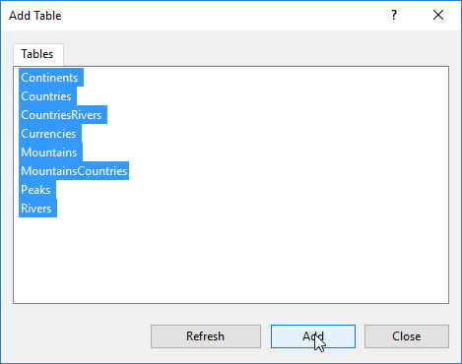
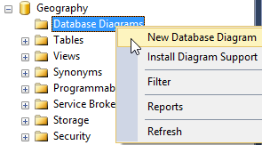
SSMS E/R Diagram: Usage
Expand a database in Object Explorer
Right click "Database Diagrams" then select "New Database Diagram"

Slide 16
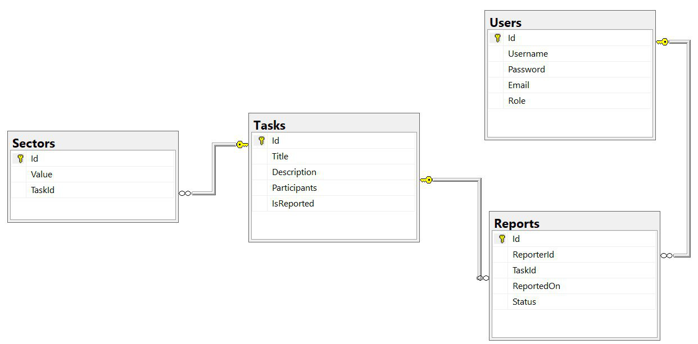
SSMS E/R Diagram
16

Slide 17

Summary
Using JOIN statements to get results from multiple tables
Pros and cons of Cascading
Visualizing relations in a database using E/R Diagrams
…
…
…

Slide 18
Questions?
Notes:
18

Slide 19
Trainings @ Software University (SoftUni)
Software University – High-Quality Education, Profession and Job for Software Developers
softuni.bg, softuni.org
Software University Foundation
softuni.foundation
Software University @ Facebook
facebook.com/SoftwareUniversity
Software University Forums
forum.softuni.bg
19
Notes:
19

Slide 20

License
This course (slides, examples, demos, exercises, homework, documents, videos and other assets) is copyrighted content
Unauthorized copy, reproduction or use is illegal
© SoftUni – https://softuni.org
© Software University – https://softuni.bg
Notes:
20

