Slide 1


Built-in Functions
Math and Text Functions in SQL Server
SoftUni Team
Technical Trainers
Software University
https://softuni.bg

Slide 2
Table of Contents
Function Overview
String Functions
Math Functions
2

Slide 3

Overview

Slide 4
SQL Functions
Aggregate functions
It perform a calculation on a set of values and return a single value
Examples: AVG, COUNT, MIN, MAX, SUM
Analytic functions
It compute an aggregate value based on a group of rows
Unlike aggregate functions, analytic functions can return multiple rows for each group
PERCENTILE_CONT(0.5) WITHIN GROUP (ORDER BY Salary DESC) OVER (PARTITION BY DepartmentId) AS MedianCont
4

Slide 5
SQL Functions
Ranking functions
Returns a ranking value for each row in a partition
RANK, ROW_NUMBER, DENSE_RANK, NTILE (OVER)
Rowset functions
Returns an object that can be used like table references in an statement
OPENDATASOURCE, OPENJSON, OPENXML, OPENROWSET
Scalar functions
Operate on a single value and then return a single value. Scalar functions can be used wherever an expression is valid
5

Slide 6

String Functions

Slide 7
String Functions (1)
Concatenation – combines strings
CONCAT replaces NULL values with empty string
CONCAT_WS combines strings with separator
SELECT FirstName + ' ' + LastName
AS [Full Name]
FROM Employee
SELECT CONCAT(FirstName, ' ', LastName)
AS [Full Name]
FROM Employee

Slide 8
String Functions (2)
SUBSTRING – extracts a part of a string
Example: get short summary of an article
SUBSTRING(String, StartIndex, Length)
SUBSTRING('SoftUni', 5, 3)
Uni
SELECT ArticleId, Author, Content,
SUBSTRING(Content, 1, 200) + '...' AS Summary
FROM Articles

Slide 9
String Functions (3)
REPLACE – replaces a specific string with another
Example: censor the word blood from album names
REPLACE(String, Pattern, Replacement)
REPLACE('SoftUni', 'Soft', 'Hard')
HardUni
SELECT REPLACE(Title, 'blood', '*****’)
AS Title
FROM Album

Slide 10
String Functions (4)
LTRIM & RTRIM – remove spaces from either side of string
LEN – counts the number of characters
DATALENGTH – gets the number of used bytes
LTRIM(String)
RTRIM(String)
LEN(String)
DATALENGTH(String)

Slide 11
String Functions (5)
LEFT & RIGHT – get characters from the beginning or the end of a string
Example: name shortened (first 3 letters)
LEFT(String, Count)
RIGHT(String, Count)
SELECT Id, Start,
LEFT(Name, 3) AS Shortened
FROM Games

Slide 12
String Functions (6)
LOWER & UPPER – change letter casing
REVERSE – reverses order of all characters in a string
REPLICATE – repeats a string
FORMAT – format a value with a valid .NET format string
LOWER(String)
UPPER(String)
REVERSE(String)
REPLICATE(String, Count)
FORMAT(SomeDate, 'yyyy-MMMM-dd', 'bg-BG')

Slide 13
Problem: Obfuscate CC Numbers
Our database contains credit card details for customers
Provide a summary without revealing the serial numbers
ID | FirstName | LastName | PaymentNumber
1 | Guy | Gilbert | 5645322227179083
2 | Kevin | Brown | 4417937746396076
… | … |  | …
ID | FirstName | LastName | PaymentNumber
1 | Guy | Gilbert | 564532**********
2 | Kevin | Brown | 441793**********
… | … |  | …

Slide 14
Solution : Obfuscate CC Numbers
We reveal the first 6 digits and obfuscate the rest
Bonus – create a View for the use of clients
SELECT CustomerID,
FirstName,
LastName,
LEFT(PaymentNumber, 6) + '**********'
FROM Customers
CREATE VIEW v_PublicPaymentInfo AS
…

Slide 15
String Functions (7)
CHARINDEX – locates a specific pattern (substring) in a string
STUFF – inserts a substring at a specific position
Optional, begins at 1
CHARINDEX(Pattern, String, [StartIndex])
STUFF(String, StartIndex, Length, Substring)
Number of chars
to delete

Slide 16

Arithmetic, PI, ABS, ROUND, Etc.

Slide 17
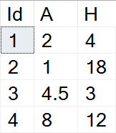
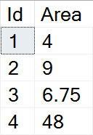

Math Functions (1)
SQL Server supports basic arithmetic operations
Example: find the area of triangles by the given side and height
SELECT Id,
(A*H)/2 AS Area
FROM Triangles

Slide 18
Math Functions (2)
PI – gets the value of Pi as a float (15 –digit precision)
ABS – absolute value
SQRT – square root (the result will be float)
SQUARE – raise to power of two
SELECT PI() --3.14159265358979
ABS(Value)
SQRT(Value)
SQUARE(Value)

Slide 19
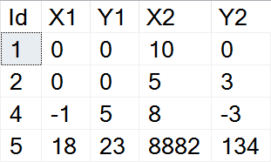
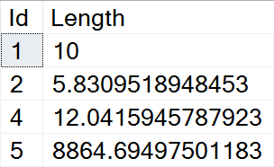
Example: Line Length
Find the length of a line by given coordinates of the end points
SELECT Id,
SQRT(SQUARE(X1-X2) + SQUARE(Y1-Y2))
AS Length
FROM Lines

Slide 20
Math Functions (3)
POWER – raises value to the desired exponent
ROUND – obtains the desired precision
Negative precision rounds characters before the decimal point
FLOOR & CEILING – return the nearest integer
POWER(Value, Exponent)
ROUND(Value, Precision)
FLOOR(Value)
CEILING(Value)

Slide 21
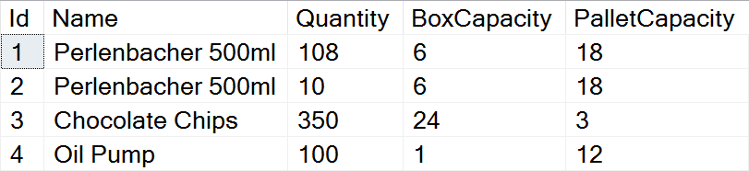
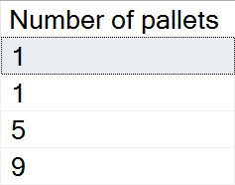
Problem: Pallets
Calculate the required number of pallets to ship each item
BoxCapacity specifies how many items can fit in one box
PalletCapacity specifies how many boxes can fit in a pallet

Slide 22
Solution: Pallets
Since we can't use half a box or half a pallet, we need to round up to the nearest integer value
SELECT
CEILING(
CEILING(
CAST(Quantity AS float) /
BoxCapacity) / PalletCapacity)
AS [Number of pallets]
FROM Products

Slide 23
Math Functions (4)
SIGN – returns 1, -1 or 0, depending on the value of the sign
RAND – gets a random float value in the range [0, 1]
If Seed is not specified, it will be assigned randomly
SIGN(Value)
RAND()
RAND(Seed)

Slide 24

Summary
…
…
…
Various built-in functions
String functions - CONCAT, LEFT/RIGHT, REPLACE, etc.
Math functions - PI, ABS, POWER, ROUND, etc.

Slide 25
Questions?
Notes:
25

Slide 26

License
This course (slides, examples, demos, exercises, homework, documents, videos and other assets) is copyrighted content
Unauthorized copy, reproduction or use is illegal
© SoftUni – https://softuni.org
© Software University – https://softuni.bg
Notes:
26

Slide 27
Trainings @ Software University (SoftUni)
Software University – High-Quality Education, Profession and Job for Software Developers
softuni.bg, softuni.org
Software University Foundation
softuni.foundation
Software University @ Facebook
facebook.com/SoftwareUniversity
Software University Forums
forum.softuni.bg
27
Notes:
27

