Slide 1

Entity Framework Core – Introduction
The ORM Concept
SoftUni Team
Technical Trainers
Software University
https://about.softuni.bg/

Slide 2
Table of Contents
ORM - Introduction
Entity Framework Core (EF)
Database First Model in EF
Reading Data
CRUD Operations
EF Core Components

Slide 3
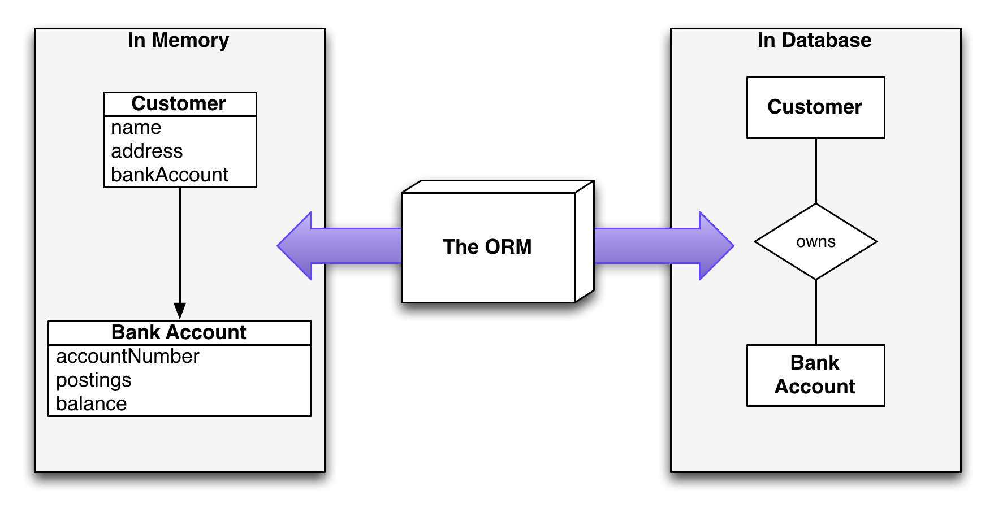
Introduction to ORM
Object-Relational Mapping

Slide 4
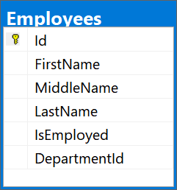
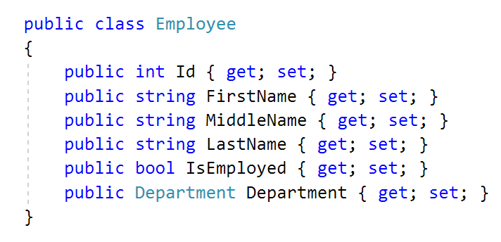
What is ORM?
Object-Relational Mapping (ORM) allows manipulating databases using common classes and objects
Database Tables ➔ C#/Java/etc. classes

Slide 5
ORM Frameworks: Features
ORM frameworks typically provide the following functionality:
Automatically generate SQL to perform data operations
Create database schema from object model (Code First model)
Create object model from database schema (DB First model)
Query data by object-oriented API (e.g. LINQ queries)
database.Employees.Add(new Employee
{
FirstName = "Gosho",
LastName = "Ivanov",
IsEmployed = true
});
INSERT INTO Employees
(FirstName, LastName, IsEmployed)
VALUES ('Gosho', 'Ivanov', 1)
SaveChanges()

Slide 6
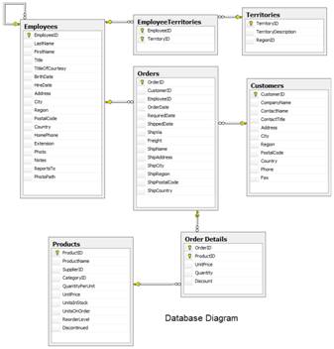
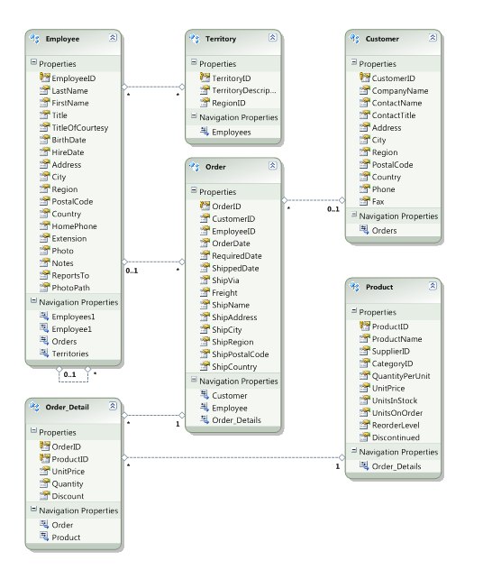




ORM Mapping – Example
ORM
Framework
Relational database schema
ORM Entities
(C# classes)

Slide 7

Entity Framework Core
Overview and Features

Slide 8
Entity Framework Core: Overview
The standard ORM framework for .NET and .NET Core
Provides LINQ-based data queries and CRUD operations
Automatic change tracking of in-memory objects
Works with many relational databases (with different providers), like MS SQL Server, MySQL, SQLite, …
Open source with independent release cycle from .NET

Slide 9
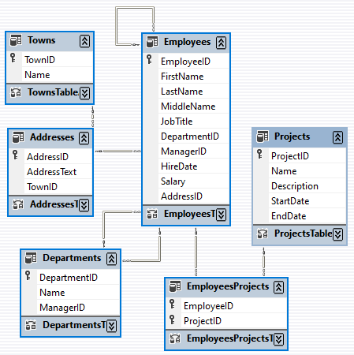
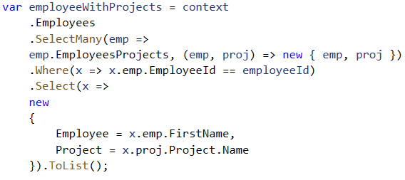
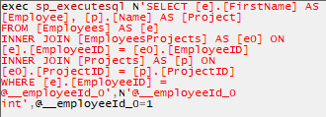
EF Core: Basic Workflow (1)
Define the data model (Code First or Scaffold from DB)
Write & execute query over IQueryable
EF generates & executes an SQL query in the DB

Slide 10
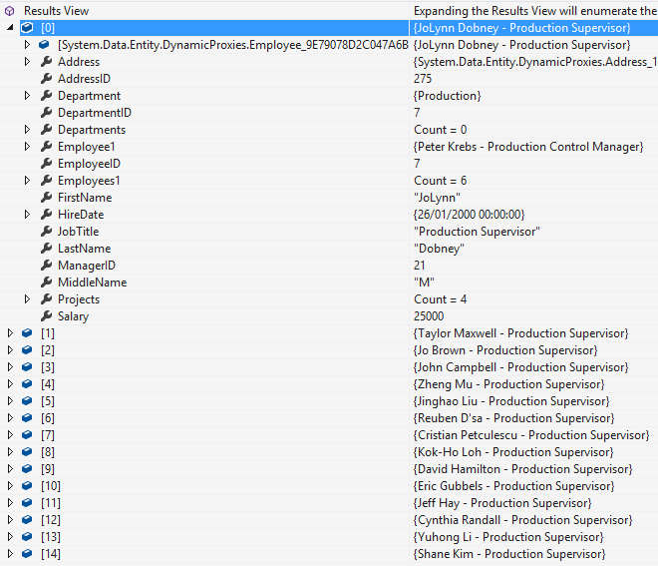
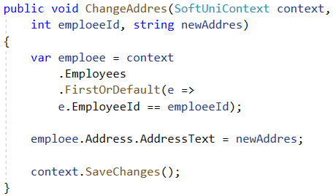
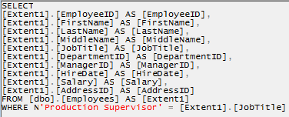
EF Core: Basic Workflow (2)
EF transforms the query results into .NET objects
Modify data with C# code and call "SaveChanges()"
Entity Framework generates & executes SQL command to modify the DB

Slide 11

Database First with EF Core
Generating DBContext and Entity Classes from DB

Slide 12
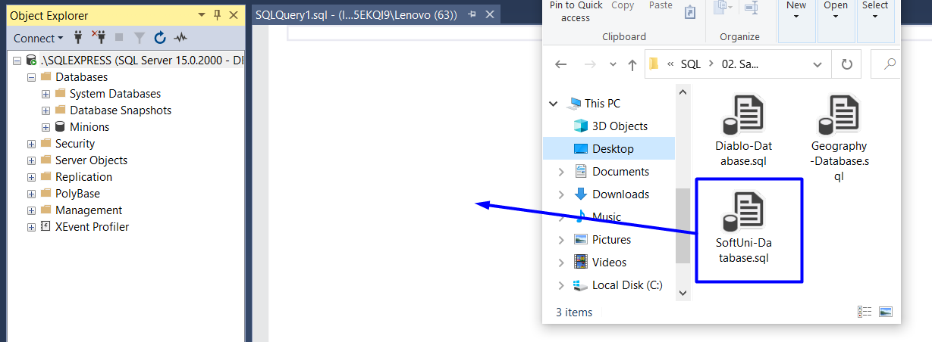
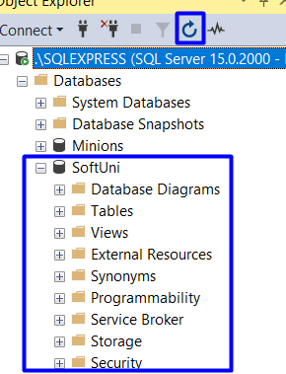
Importing the "SoftUni" Database in SQL Server

Slide 13
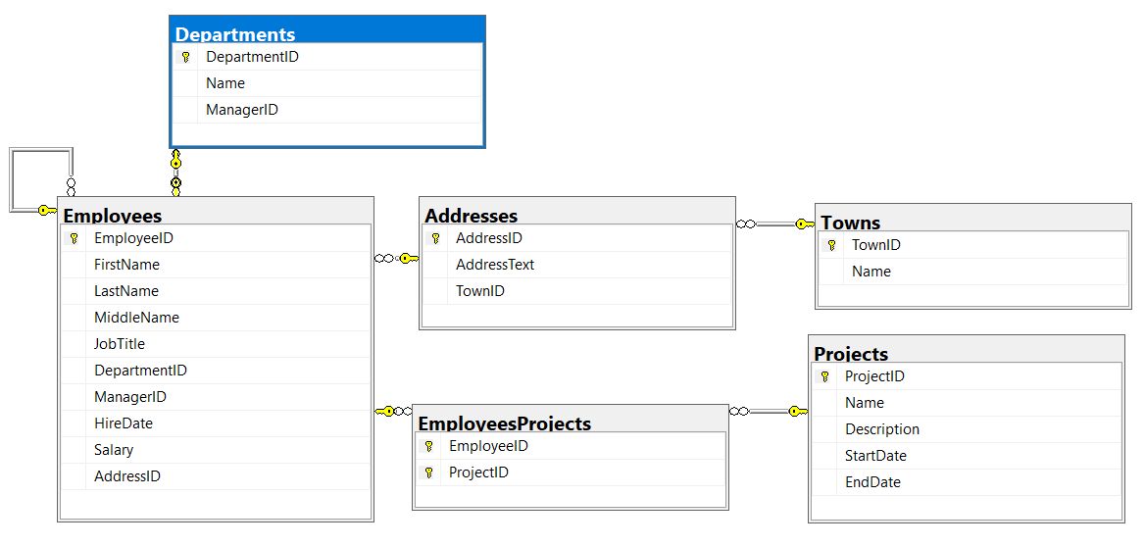
The SoftUni Database

Slide 14
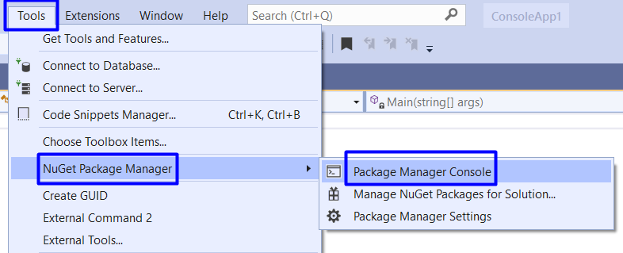
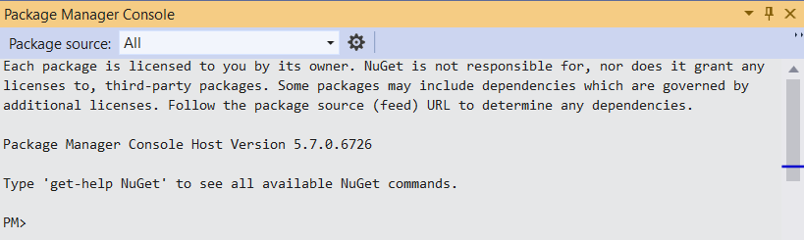
Package Manager Console

Slide 15
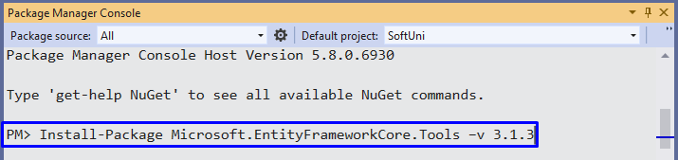
Install EF Packages
Install the following commands one by one:
If the installed versions are newer than these, your solution may be marked as incorrect when tested in the SoftUni judge
Install-Package Microsoft.EntityFrameworkCore.Tools –v 3.1.3
Install-Package Microsoft.EntityFrameworkCore.SqlServer –v 3.1.3
Install-Package Microsoft.EntityFrameworkCore.SqlServer.Design

Slide 16
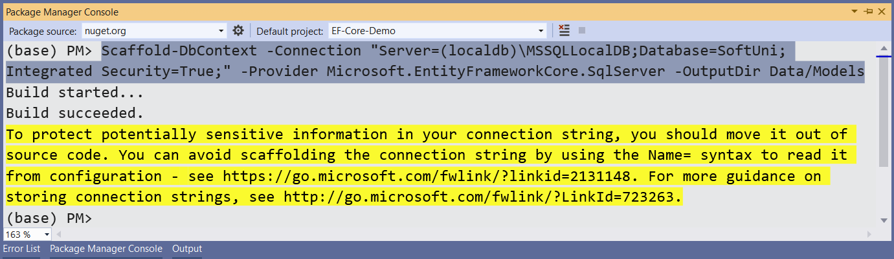
Scaffold the Context Class
Execute the following command to scaffold the context class
Scaffold-DbContext -Connection "Server=(localdb)\MSSQLLocalDB;Database=SoftUni;Integrated Security=True;" -Provider Microsoft.EntityFrameworkCore.SqlServer -OutputDir Data/Models

Slide 17
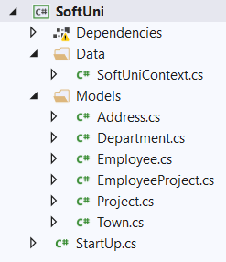
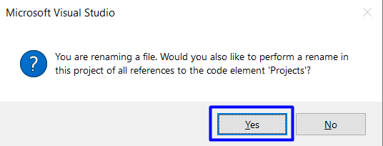
Change Class Structure
Change file names and structure to look like this:
Make sure that your namespaces are exactly the same as these:
SoftUni
SoftUni.Data
SoftUni.Models

Slide 18
Reading Data
Querying the DB Using Entity Framework

Slide 19
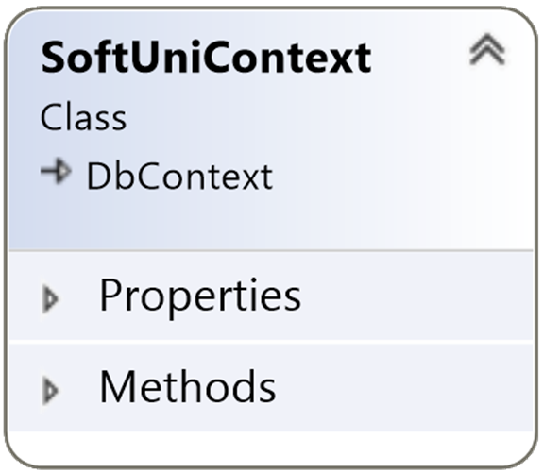
The DbContext Class
DbContext provides:
CRUD operations
A way to access entities
Methods for creating new entities (the Add() method)
Ability to manipulate database data by modifying objects
Easily navigate through table relations
Executing LINQ queries as native SQL queries
Managing database creation/deletion/migration

Slide 20
Using DbContext Class
First create instance of the DbContext:
In the constructor you can pass a database connection string
DbContext properties:
Database – EnsureCreated/Deleted methods, DB Connection
ChangeTracker – holds info about the automatic change tracker
All entity classes (tables) are listed as properties
e.g. DbSet<Employee> Employees { get; set; }
var context = new SoftUniContext();

Slide 21
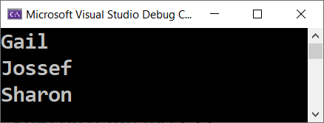
Reading Data with LINQ Query
Executing LINQ-to-Entities query over EF entity:
Employees property in the DbContext:
public static string FindEmployeesWithJobTitle(SoftUniContext context)
{
var employees = context.Employees
.Where(e => e.JobTitle == "Design Engineer")
.Select(x => x.FirstName)
.ToList();
return string.Join(Environment.NewLine, employees);
}
EF translates this to an SQL query
public partial class SoftUniContext : DbContext {
public DbSet<Employee> Employees { get; set; }
…
}

Slide 22

Reading Data with LINQ Query
Find element by ID
public static string FindProjectWithId(SoftUniContext context)
{
var project = context.Projects.Find(2);
return project.Name;
}

Slide 23
CRUD Operations
CRUD
With Entity Framework

Slide 24
Creating New Data
To create a new database row use DbSet.Add(…):
public static void CreateNewProject(SoftUniContext context)
{
var project = new Project()
{
Name = "Our Newest Project",
StartDate = new DateTime(2021, 1, 1),
};
context.Projects.Add(project);
context.SaveChanges();
}
Create a new Project object
Add the object to the DbSet
Execute SQL statements

Slide 25
Updating Existing Data
DbContext allows modifying entities and persisting them in the DB
Just load an entity, modify it and call SaveChanges()
The DbContext automatically tracks all changes on entity objects
public static string UpdateFirstEmployee(SoftUniContext context){
Employee employee = context.Employees.FirstOrDefault();
if (employee != null)
{ employee.FirstName = "Alex";
context.SaveChanges();
return employee.FirstName;
} return "";
}
SELECT the first in order
Execute an SQL UPDATE

Slide 26
Deleting Existing Data
Delete is done by Remove() on the specified entity collection
SaveChanges() method performs the delete action in the DB
public static string DeleteFirstProject(SoftUniContext context)
{
Project project = context.Projects.FirstOrDefault();
var entitiesWithProject = context.EmployeesProjects
.Where(x => x.ProjectId == project.ProjectId).ToList();
context.EmployeesProjects.RemoveRange(entitiesWithProject);
context.Projects.Remove(project);
context.SaveChanges(); return project.Name;
}
Delete entities from EmployeesProjects with this ProjectId
Mark the entity for deleting at the next save
Execute the SQL DELETE command

Slide 27
EF Core Components
DbContext
Post
User
Overview of System Objects

Slide 28
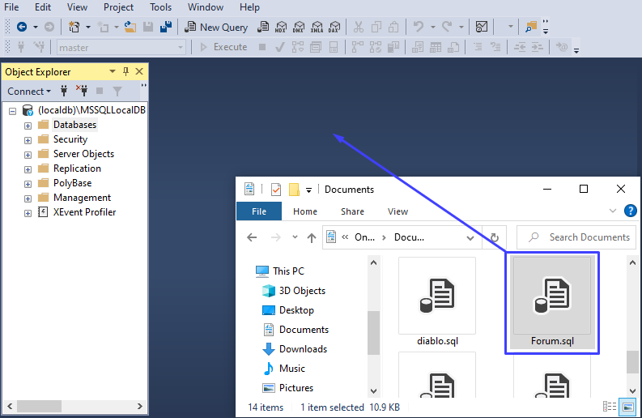
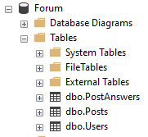
Importing the "Forum" Database in SQL Server

Slide 29
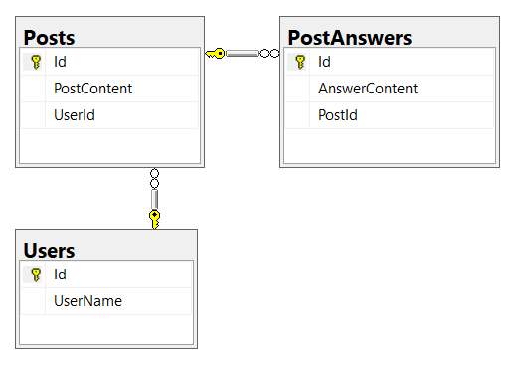
The "Forum" Database

Slide 30
Domain Classes (Entity Models) (1)
Bunch of normal C# classes (POCO)
May contain navigation properties for table relationships
Recommended to be in a separate class library
public class PostAnswer
{
public int Id { get; set; }
public string AnswerContent { get; set; }
public int PostId { get; set; }
public Post Post { get; set; }
}
Primary key
Foreign key
Navigation property

Slide 31
Domain Classes (Entity Models) (2)
Another example of a domain class (model)
public class Post
{
public int Id { get; set; }
public string Content { get; set; }
public int UserId { get; set; }
public User User { get; set; }
public IList<PostAnswer> PostAnswers { get; set; }
}
Navigation property
One-to-Many relationship

Slide 32
Domain Classes (Entity Models) (3)
Another example of a domain class (model)
public class User
{
public int Id { get; set; }
public string UserName { get; set; }
public IList<Post> Posts { get; set; }
}

Slide 33
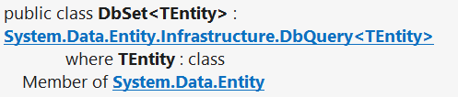
DbSet Type
Maps a collection of entities from a table
Set operations: Add, Attach, Remove, Find
DbContext contains multiple DbSet<T> properties
public DbSet<Post> Posts { get; set; }

Slide 34
The DbContext Class
Usually named after the database e.g. BlogDbContext, ForumDbContext
Inherits from DbContext
Manages model classes using DbSet<T> type
Implements identity tracking, change tracking
Provides API for CRUD operations and LINQ-based data access
Recommended to be in a separate class library
Don't forget to reference the EF Core library + any providers
Use several DbContext if you have too much models

Slide 35
Defining DbContext Class – Example
EF Reference
using Microsoft.EntityFrameworkCore;
using MyProject.Data.Models;
public class ForumDbContext : DbContext
{
public DbSet<Post> Posts { get; set; }
public DbSet<PostAnswer> PostAnswers { get; set; }
public DbSet<User> Users { get; set; }
}
Models Namespace

Slide 36
Summary
ORM frameworks maps database schema to objects in a programming language
Entity Framework Core is the standard .NET ORM
The "Database First" approach generates classes from existing DB
We can use Database Migrations to update our database without losing our data
…
…
…

Slide 37
Questions?

Slide 38

License
This course (slides, examples, code, demos, exercises, tutorials, homework, projects, documents, videos and other assets) is copyrighted content, created by SoftUni
Unauthorized copy, reproduction or use is illegal
© SoftUni – https://softuni.org
© Software University – https://softuni.bg

