Slide 1

Entity Framework Core – Introduction
The ORM Concept
SoftUni Team
Technical Trainers
Software University
https://about.softuni.bg/

Slide 2
Table of Contents
ORM - Introduction
Entity Framework Core
Reading Data
Code First Model
CRUD Operations
EF Core Components
Database First model vs Code-first model
Database Migrations
2

Slide 3
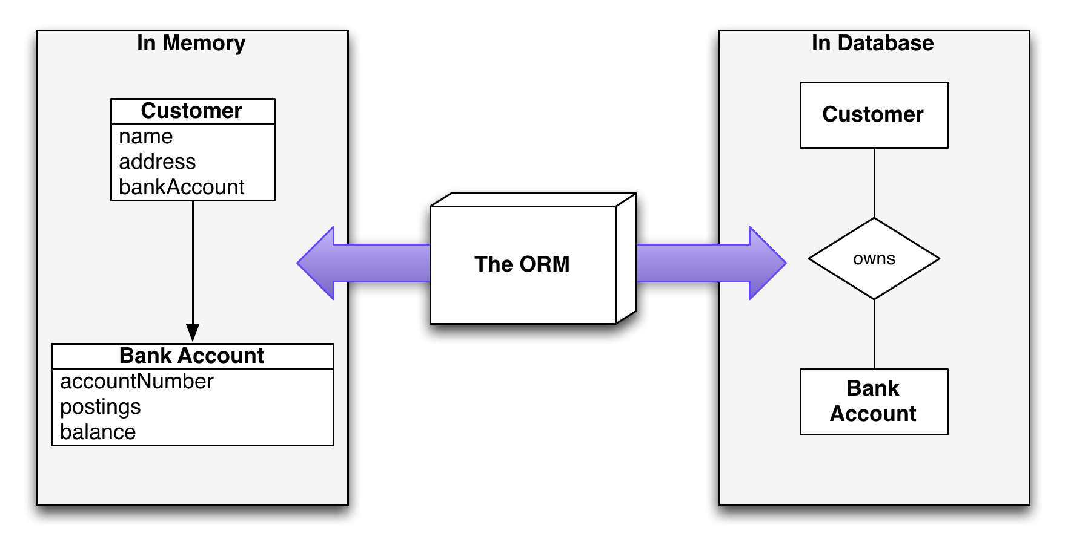
Introduction to ORM
Object-Relational Mapping

Slide 4
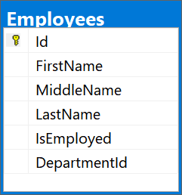
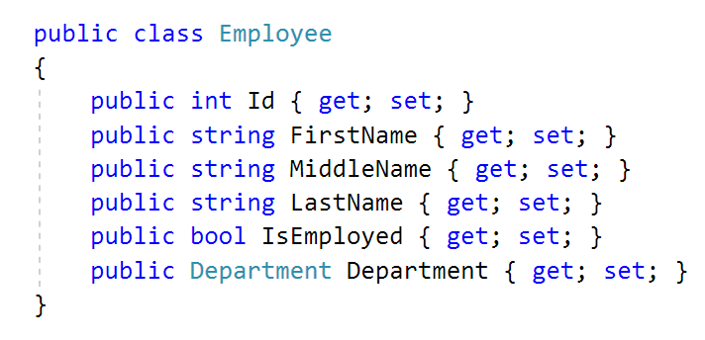
What is ORM?
Object-Relational Mapping (ORM) allows manipulating databases using common classes and objects
Database Tables ➔ C#/Java/etc. classes
4

Slide 5
ORM Frameworks: Features
ORM frameworks typically provide the following functionality:
Automatically generate SQL to perform data operations
Create database schema from object model (Code First model)
Create object model from database schema (DB First model)
Query data by object-oriented API (e.g. LINQ queries)
database.Employees.Add(new Employee
{
FirstName = "Gosho",
LastName = "Ivanov",
IsEmployed = true
});
INSERT INTO Employees
(FirstName, LastName, IsEmployed)
VALUES ('Gosho', 'Ivanov', 1)

Slide 6
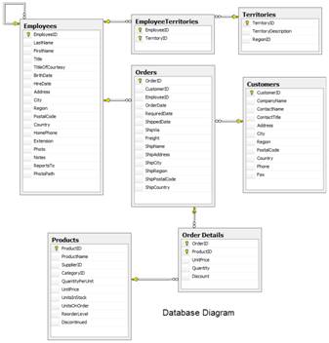
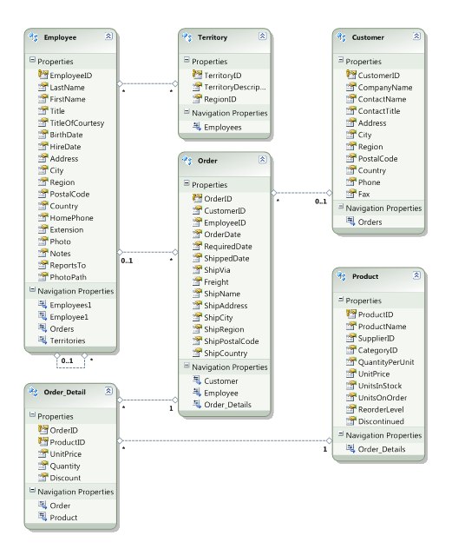




ORM Mapping – Example
ORM
Framework
Relational database schema
ORM Entities
(C# classes)

Slide 7

Entity Framework Core
Overview and Features

Slide 8
Entity Framework Core: Overview
The standard ORM framework for .NET and .NET Core
Provides LINQ-based data queries and CRUD operations
Automatic change tracking of in-memory objects
Works with many relational databases (with different providers)
Open source with independent release cycle
8

Slide 9
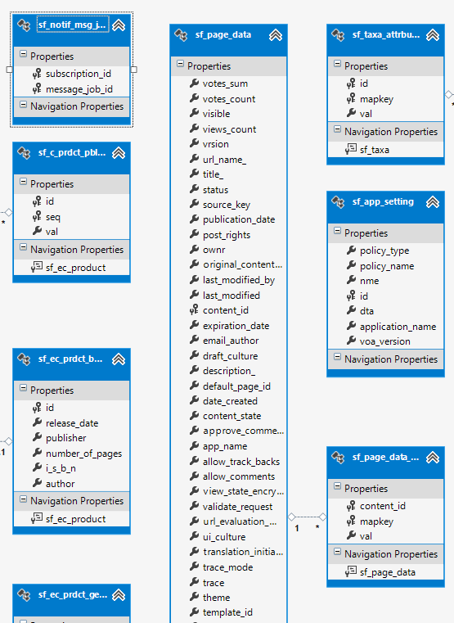
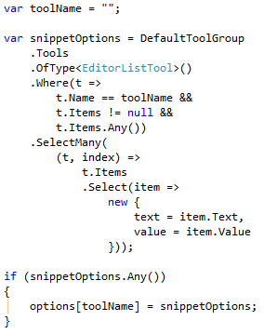
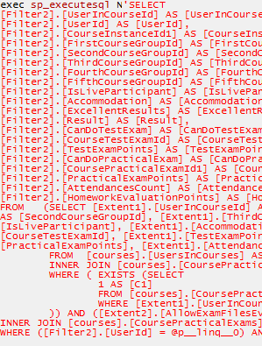
EF Core: Basic Workflow (1)
Define the data model (Code First or Scaffold from DB)
Write & execute query over IQueryable
EF generates & executes an SQL query in the DB

Slide 10
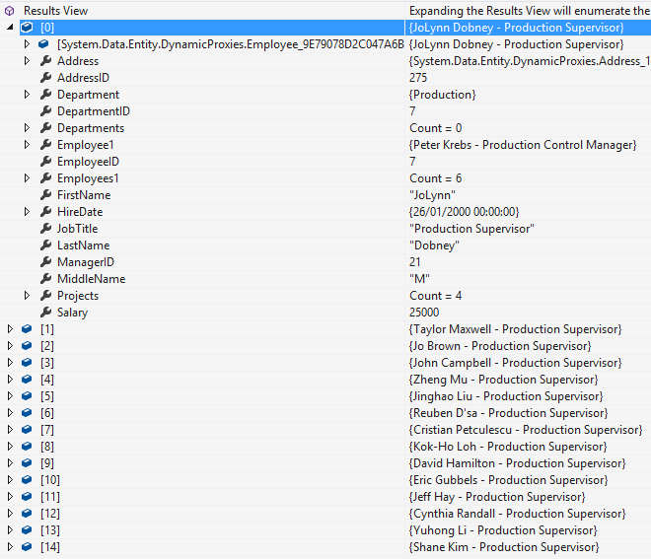
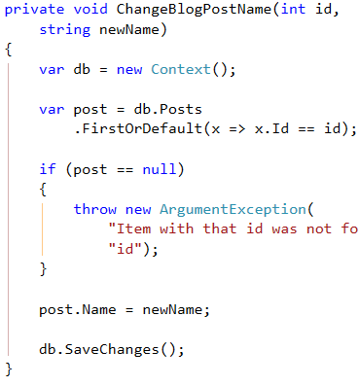
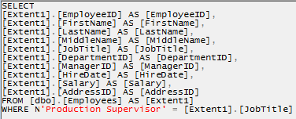
EF Core: Basic Workflow (2)
EF transforms the query results into .NET objects
Modify data with C# code and call "Save Changes()"
Entity Framework generates & executes SQL command to modify the DB

Slide 11

Database First with EF Core
Generating DBContext and Entity Classes from DB

Slide 12
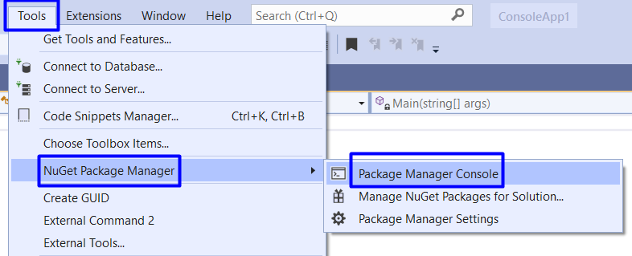
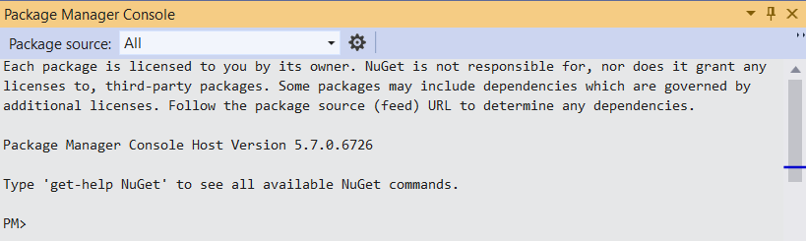
Package Manager Console

Slide 13
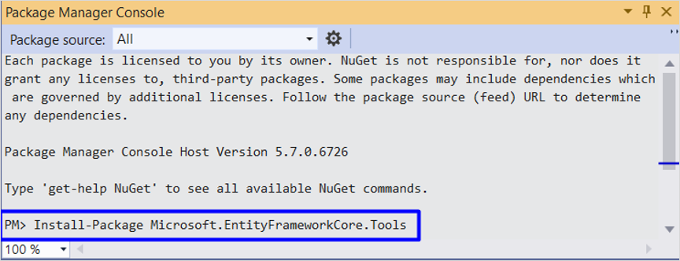
Install EF Packages
Install the following commands one by one:
Install-Package Microsoft.EntityFrameworkCore.Tools
Install-Package Microsoft.EntityFrameworkCore.SqlServer
Install-Package Microsoft.EntityFrameworkCore.SqlServer.Design

Slide 14
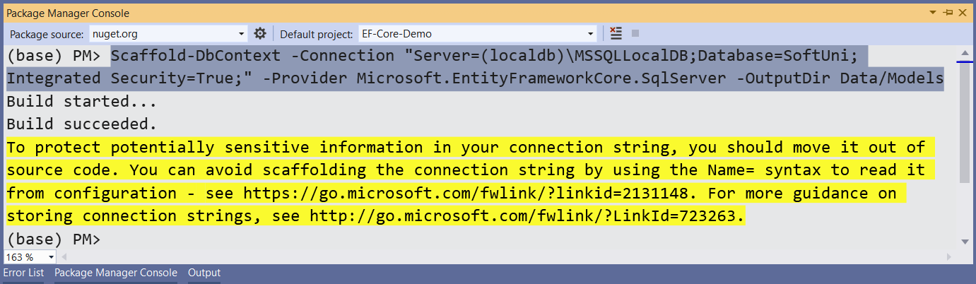
Scaffold the Context Class
Execute the following command to scaffold the context class
Scaffold-DbContext -Connection "Server=(localdb)\MSSQLLocalDB;Database=SoftUni;Integrated Security=True;" -Provider Microsoft.EntityFrameworkCore.SqlServer -OutputDir Data/Models

Slide 15
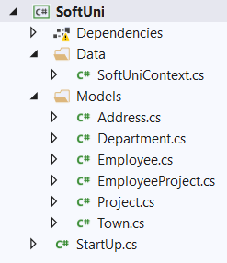
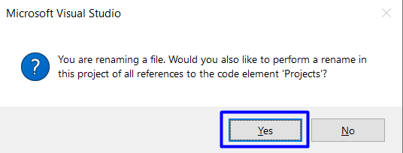
Change Class Structure
Change file names and structure to look like this:
Make sure that your namespaces are exactly the same as these:
SoftUni
SoftUni.Data
SoftUni.Models

Slide 16
Reading Data
Querying the DB Using Entity Framework

Slide 17
The DbContext Class
DbContext provides:
CRUD operations
A way to access entities
Methods for creating new entities (Add() method)
Ability to manipulate database data by modifying objects
Easily navigate through table relations
Executing LINQ queries as native SQL queries
Managing database creation/deletion/migration

Slide 18
Using DbContext Class
First create instance of the DbContext:
In the constructor you can pass a database connection string
DbContext properties:
Database - EnsureCreated/Deleted methods, DB Connection
ChangeTracker - Holds info about the automatic change tracker
All entity classes (tables) are listed as properties
e.g. DbSet<Employee> Employees { get; set; }
var context = new SoftUniContext();

Slide 19
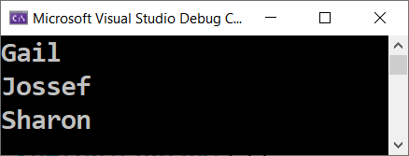
Reading Data with LINQ Query
Executing LINQ-to-Entities query over EF entity:
Employees property in the DbContext:
public static string FindEmployeesWithJobTitle(SoftUniContext context)
{
var employees = context.Employees
.Where(e => e.JobTitle == "Design Engineer")
.Select(x => x.FirstName)
.ToList();
return string.Join(Environment.NewLine, employees);
}
EF translates this to an SQL query
public partial class SoftUniContext : DbContext {
public DbSet<Employee> Employees { get; set; }
…
}

Slide 20

Reading Data with LINQ Query
Find element by ID
public static string FindProjectWithId(SoftUniContext context)
{
var project = context.Projects.Find(2);
return project.Name;
}

Slide 21
CRUD Operations
CRUD
With Entity Framework

Slide 22
Creating New Data
To create a new database row use DbSet.Add(…):
public static void CreateNewProject(SoftUniContext context)
{
var project = new Project()
{
Name = "Our Newest Project",
StartDate = new DateTime(2021, 1, 1),
};
context.Projects.Add(project);
context.SaveChanges();
}
Create a new Project object
Add the object to the DbSet
Execute SQL statements

Slide 23
Updating Existing Data
DbContext allows modifying entities and persisting them in the DB
Just load an entity, modify it and call SaveChanges()
The DbContext automatically tracks all changes on entity objects
public static string UpdateFirstEmployee(SoftUniContext context){
Employee employee = context.Employees.FirstOrDefault();
if (employee != null)
{ employee.FirstName = "Alex";
context.SaveChanges();
return employee.FirstName;
} return "";
}
SELECT the first in order
Execute an SQL UPDATE

Slide 24
Deleting Existing Data
Delete is done by Remove() on the specified entity collection
SaveChanges() method performs the delete action in the DB
public static string DeleteFirstProject(SoftUniContext context)
{
Project project = context.Projects.FirstOrDefault();
var entitiesWithProject = context.EmployeesProjects
.Where(x => x.ProjectId == project.ProjectId).ToList();
context.EmployeesProjects.RemoveRange(entitiesWithProject);
context.Projects.Remove(project);
context.SaveChanges(); return project.Name;
}
Delete entities from EmployeesProjects with this ProjectId
Mark the entity for deleting at the next save
Execute the SQL DELETE command

Slide 25
EF Core Components
DbContext
Post
User
Overview of System Objects

Slide 26
Domain Classes (Models) (1)
Bunch of normal C# classes (POCO)
May contain navigation properties for table relationships
Recommended to be in a separate class library
public class PostAnswer
{
public int Id { get; set; }
public string Content { get; set; }
public int PostId { get; set; }
public Post Post { get; set; }
}
Primary key
Foreign key
Navigation property

Slide 27
Domain Classes (Models) (2)
Another example of a domain class (model)
public class Post
{
public int Id { get; set; }
public string Content { get; set; }
public int AuthorId { get; set; }
public User Author { get; set; }
public IList<PostAnswer> Answers { get; set; }
}
Navigation property
One-to-Many relationship

Slide 28
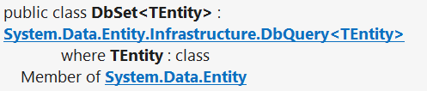
DbSet Type
Maps a collection of entities from a table
Set operations: Add, Attach, Remove, Find
DbContext contains multiple DbSet<T> properties
public DbSet<Post> Posts { get; set; }

Slide 29
The DbContext Class
Usually named after the database e.g. BlogDbContext, ForumDbContext
Inherits from DbContext
Manages model classes using DbSet<T> type
Implements identity tracking, change tracking
Provides API for CRUD operations and LINQ-based data access
Recommended to be in a separate class library
Don't forget to reference the EF Core library + any providers
Use several DbContext if you have too much models

Slide 30
Defining DbContext Class – Example
EF Reference
using Microsoft.EntityFrameworkCore;
using MyProject.Data.Models;
public class ForumDbContext : DbContext
{
public DbSet<Category> Categories { get; set; }
public DbSet<Post> Posts { get; set; }
public DbSet<PostAnswer> PostAnswers { get; set; }
public DbSet<User> Users { get; set; }
}
Models Namespace

Slide 31
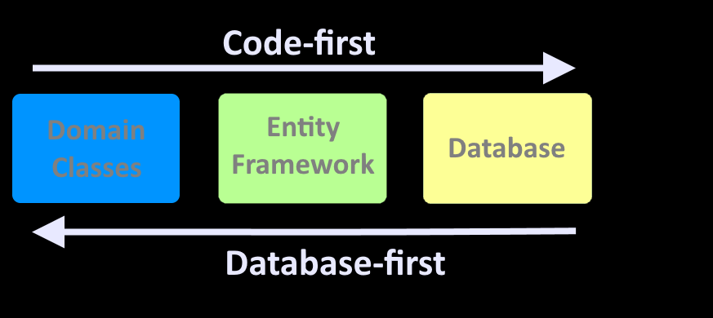
Database First vs Code-first
Approaches to Model the Data Structure

Slide 32
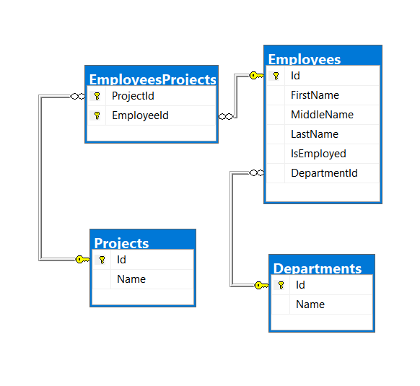
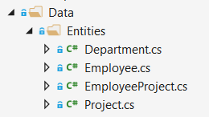
Database First Model
Database First model - models the entity classes after the database

Slide 33
Code-First Model
Code-first model - begins with classes that describe the model and then the ORM generate a database

Slide 34
Code-first
Creates a Database Based on Classes

Slide 35
Why Use Code First?
Write code without having to define mappings in XML or create database tables
Define objects in C# format
Enables database persistence with no configuration
Changes to code can be reflected (migrated) in the schema
Data Annotations or Fluent API describe properties
Key, Required, MinLength, etc.

Slide 36
Code First with EF Core: Setup
To add EF Core support to a project in Visual Studio:
Install it from Package Manager Console
Or using .NET Core CLI
EF Core is modular – any data providers must be installed too
Install-Package Microsoft.EntityFrameworkCore
dotnet add package Microsoft.EntityFrameworkCore
Microsoft.EntityFrameworkCore.SqlServer

Slide 37
How to Connect to SQL Server?
One way to connect is to create a Configuration class with your connection string:
Then add the connection string in the OnConfiguring method in the DbContext class
public static class Configuration
{
public const string ConnectionString = "Server=.;Database=…;";
}
protected override void OnConfiguring(DbContextOptionsBuilder builder)
{
if (!builder.IsConfigured)
builder.UseSqlServer(Configuration.ConnectionString);
}

Slide 38
Fluent API
The OnModelCreating Method let us use the Fluent API to describe our table relations to EF Core
protected override void OnModelCreating(ModelBuilder builder)
{
builder.Entity<Category>()
.HasMany(c => c.Posts)
.WithOne(p => p.Category);
builder.Entity<Post>()
.HasMany(p => p.Replies)
.WithOne(r => r.Post);
builder.Entity<User>()
.HasMany(u => u.Posts)
.WithOne(p => p.Author);
}

Slide 39
Database Connection Workflow
Database Exists?
Yes
Use Database
No
Create Database

Slide 40
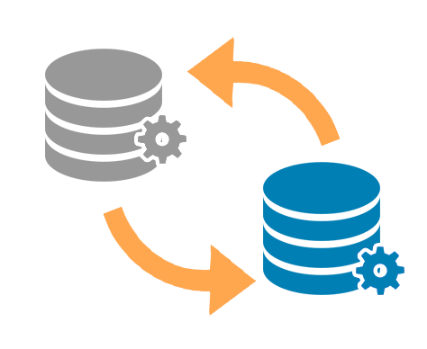
Database Migrations
A Way to Keep the Database Schema in Sync

Slide 41
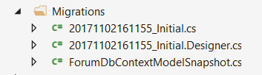
What Are Database Migrations?
Updating database schema without losing data
Adding/dropping tables, columns, etc.
Migrations in EF Core keep their history
Entity Classes, DB Context versions are all preserved
Automatically generated migrations:
41

Slide 42
Migrations in EF Core
To use migrations in EF Core, we use the dotnet ef migrations add command from the EF CLI Tools
To undo a migration, we use migrations remove
Commit changes to the database
dotnet ef migrations add {MigrationName}
dotnet ef migrations remove {MigrationName}
dotnet ef database update
db.Database.Migrate()

Slide 43
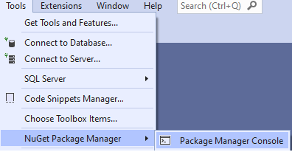
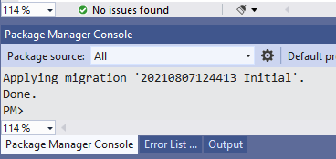
Package Manager Console Migrations
Migration commands in Entity Framework Core can be executed using the Package Manager Console
Add command
Remove command
Commit changes to the database
Add-Migration {MigrationName}
Remove-Migration
Update-Database

Slide 44
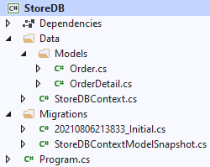
Code First and Migrations

Slide 45
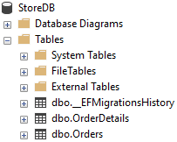
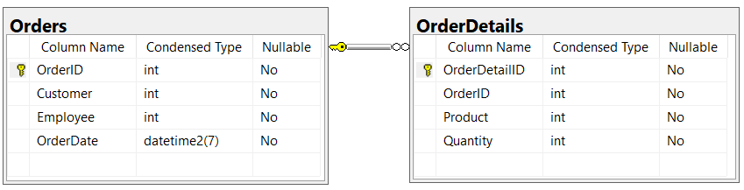
Problem: Store Database
Use the Code-First model to create a Store database with two tables: Orders and OrderDetails
Use Migrations to create that database in Microsoft SQL Server

Slide 46
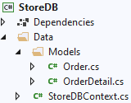
Solution: Store Database
public class Order
{
public int OrderID { get; set; }
public int Customer { get; set; }
public int Employee { get; set; }
public DateTime OrderDate { get; set; }
public List<OrderDetail> OrderDetails { get; set; }
}

Slide 47
Solution: Store Database (2)
public class OrderDetail
{
public int OrderDetailID { get; set; }
public int OrderID { get; set; }
public Order Order { get; set; }
public int Product { get; set; }
public int Quantity { get; set; }
}

Slide 48
Solution: Store Database (3)
Install the following Packages:
Microsoft.EntityFrameworkCore.SqlServer
Microsoft.EntityFrameworkCore
public class StoreDBContext : DbContext {
public DbSet<OrderDetail> OrderDetails { get; set; }
public DbSet<OrderDetailet<Order> Orders { get; set; }
protected override void OnConfiguring(DbContextOptionsBuilder optionsBuilder)
{
optionsBuilder.UseSqlServer(
@"Server=(localdb)\mssqllocaldb;Database=StoreDB");
}
}

Slide 49
Solution: Store Database (4)
To create a database using migrations from your model, install the following packages:
Once these packages are installed, run the following command in Package Manager Console
then run the following command
Microsoft.EntityFrameworkCore.Tools
Microsoft.EntityFrameworkCore.Design
Create the set of tables for your model
Add-Migration Initial
Apply the new migration to the database
Update-Database

Slide 50
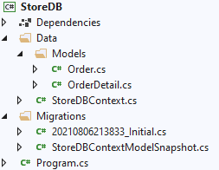
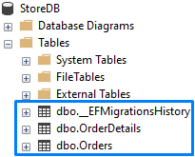
Solution: Store Database (5)
Migrations folder
Migration file

Slide 51
Summary
ORM frameworks maps database schema to objects in a programming language
Entity Framework Core is the standard .NET ORM
We can use Database Migrations to update our database without losing our data
…
…
…

Slide 52
Questions?
Notes:
52

Slide 53
Trainings @ Software University (SoftUni)
Software University – High-Quality Education, Profession and Job for Software Developers
softuni.bg, softuni.org
Software University Foundation
softuni.foundation
Software University @ Facebook
facebook.com/SoftwareUniversity
Software University Forums
forum.softuni.bg
53
Notes:
53

Slide 54

License
This course (slides, examples, demos, exercises, homework, documents, videos and other assets) is copyrighted content
Unauthorized copy, reproduction or use is illegal
© SoftUni – https://softuni.org
© Software University – https://softuni.bg
Notes:
54

