Slide 1


LINQ
Language Integrated Query in Entity Framework Core
SoftUni Team
Technical Trainers
Software University
https://softuni.bg

Slide 2
Table of Contents
LINQ
Filtering
Select() / Projection
Aggregation
Joining
SelectMany()
IEnumerable vs IQueryable
Result Models
2

Slide 3
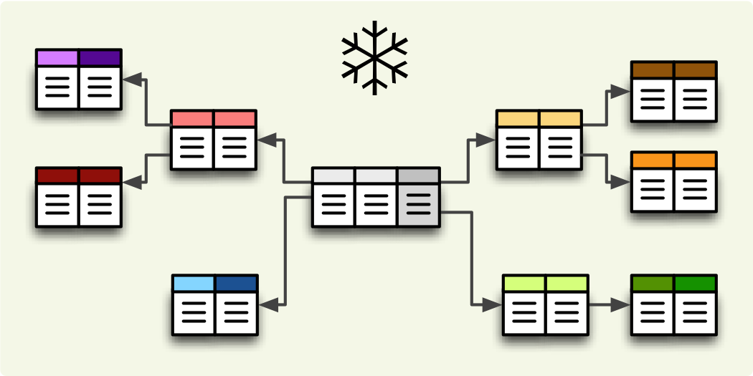
Filtering and Aggregating Tables
Select, Join and Group Data Using LINQ

Slide 4
Filtering
Where()
Selects values that are based on a predicate function
Syntax:
string[] words = { "the", "quick", "brown", "fox", "jumps" };
IEnumerable<string> query =
words.Where(word => word.Length == 3);
IEnumerable<string> query = from word in words
where word.Length == 3
select word;

Slide 5
Good Reasons to Use Select
Select() – Limits the network traffic by reducing the queried columns
Syntax:
var employeesWithTown = context
.Employees
.Select(employee => new
{
EmployeeName = employee.FirstName,
TownName = employee.Address.Town.Name
});

Slide 6
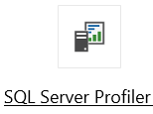

Good Reasons to Use Select (2)
SQL Server Profiler – graphical tool used to monitor an instance of Microsoft SQL Server
SELECT [employee].[FirstName] AS [EmployeeName], [employee.Address.Town].[Name] AS [TownName]
FROM [Employees] AS [employee]
LEFT JOIN [Addresses] AS [employee.Address] ON [employee].[AddressID] = [employee.Address].[AddressID]
LEFT JOIN [Towns] AS [employee.Address.Town] ON [employee.Address].[TownID] = [employee.Address.Town].[TownID]

Slide 7
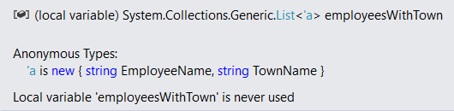
Good Reasons Not to Use Select
Data that is selected is not of the initial entity type
Anonymous type, generated at runtime
Data cannot be modified (updated, deleted)
Entity is of a different type
Not associated with the context anymore

Slide 8
Aggregation
Aggregate functions perform calculations on a set of input values and return a value
Average - Calculates the average value of a collection of values
Count - Counts the elements in a collection, optionally only those elements that satisfy a predicate function
Max and Min - Determine the maximum and the minimum value in a collection
Sum - Calculates the sum of the values in a collection

Slide 9
Joining Tables in EF: Using Join()
Join tables in EF with LINQ / extension methods on IEnumerable<T> (like when joining collections)
var employees = softUniEntities.Employees
.Join(softUniEntities.Departments,
(e => e.DepartmentID),
(d => d.DepartmentID),
(e, d) => new {
Employee = e.FirstName,
JobTitle = e.JobTitle,
Department = d.Name
}
);

Slide 10
Grouping Tables in EF
Grouping also can be done by LINQ
The same way as with collections in LINQ
Grouping with LINQ:
Grouping with extension methods:
var groupedEmployees =
from employee in softUniEntities.Employees
group employee by employee.JobTitle;
var groupedCustomers = softUniEntities.Employees
.GroupBy(employee => employee.JobTitle);

Slide 11
SelectMany – Example (1)
public class PhoneNumber
{
public string Number {get;set;}
}
public class Person
{
public IEnumerable<PhoneNumber> PhoneNumbers {get;set;}
public string Name {get;set;}
}

Slide 12
SelectMany – Example (2)
IEnumerable<Person> people = new List<Person>();
// "Select" gets a list of lists of phone numbers
IEnumerable<IEnumerable<PhoneNumber>> phoneLists =
people.Select(p => p.PhoneNumbers);
// SelectMany flattens it to just a list of phone numbers
IEnumerable<PhoneNumber> phoneNumbers =
people.SelectMany(p => p.PhoneNumbers);

Slide 13
SelectMany – Example (3)
// To include data from the parent in the result pass an expression
// to the second parameter (resultSelector) in the overload:
var directory = people.SelectMany(p => p.PhoneNumbers,
(parent, child) => new { parent.Name, child.Number });

Slide 14

IEnumerable vs IQueryable

Slide 15
Differences Between IEnumerable and IQueryable
IEnumerable<T>
System.Collections.Generic namespace
Base type for almost all .NET collections
LINQ methods works with Func<>
Good for in-memory collections like List, Array…
IQueryable<T>
System.Linq namespace
Derives the base interface from IEnumerable<T>
LINQ methods works with Expression<Func<>>
Good for queries over data stores such as databases
15

Slide 16

IEnumerable vs IQueryable Example
Accessing the data from the Employee table and then taking only 3 rows from that data
var context = new SoftUniContext();
IQueryable<Employee> employees = context
.Employees.Where(e => e.Department.Name == "Sales");
employees = employees.Take(3);
SELECT TOP 3

Slide 17

IEnumerable vs IQueryable Example (2)
IEnumerable executes SELECT query on the server-side, loads data in-memory on the client-side and then filters the data
var context = new SoftUniContext();
IEnumerable<Employee> employees = context
.Employees.Where(e => e.Department.Name == "Sales");
employees = employees.Take(3);

Slide 18
Result Models
Simplifying Models

Slide 19
Result Models
Select(), GroupBy() can work with custom classes
Allow you to pass them to methods and use them as a return type
Require some extra code (class definition)
Sample Result Model:
public class UserResultModel
{
public string FullName { get; set; }
public string Age { get; set; }
}
19

Slide 20
Result Models (2)
Assign the fields as you would with an anonymous object:
The new type can be used in a method signature:
var currentUser = context.Users
.Where(u => u.Id == 8)
.Select(u => new UserResultModel
{
FullName = u.FirstName + " " + u.LastName,
Age = u.Age
})
.SingleOrDefault();
public UserResultModel GetUserInfo(int Id) { … }

Slide 21

Summary
…
…
…
LINQ
Filtering – Where(), Select()
Aggregation – Average(), Count(), Sum()
SelectMany() – flattens to just a list
Join() – like when joining collections
IEnumerable – Good for in-memory collections
Loads all the data in-memory
IQueryable – Good for queries over data stores
Takes only the needed data
Select(), GroupBy() can work with custom classes

Slide 22
Questions?
Notes:
22

Slide 23

License
This course (slides, examples, demos, exercises, homework, documents, videos and other assets) is copyrighted content
Unauthorized copy, reproduction or use is illegal
© SoftUni – https://softuni.org
© Software University – https://softuni.bg
Notes:
23

