Slide 1
Lists
Processing Variable-Length Sequences of Elements
0
1
2
3
4
…
…
…
…
…
SoftUni Team
Technical Trainers
Software University
https://softuni.bg

Slide 2
Table of Contents
Lists Overview
List Manipulating
Reading Lists from the Console
Sorting Lists and Arrays
2

Slide 3
Lists
0
1
2
3
4
…
…
…
…
…

Slide 4
List<T> – Overview
List<T> holds a list of elements of the same type
List<string> names = new List<string>(); // Create a list of strings
names.Add("Peter");
names.Add("Maria");
names.Add("George");
// Add elements
foreach (var name in names)
Console.WriteLine(name);
Console.WriteLine(string.Join(", ", names));
// Print elements
4

Slide 5
List<T> – Basic Methods
Provides operations to add / insert / remove / find elements:
Add(element) – adds an element to the List<T>
Count – number of elements in the List<T>
Remove(element) – removes an element (returns true / false)
RemoveAt(index) – removes an element at a certain index
Insert(index, element) – inserts an element to a given index
Contains(element) – determines whether an element is in the list
Sort() – sorts the array/list in ascending order

Slide 6
Add() – Appends an Element
We create an empty List and we add several elements
The Count increases each time we add an element
10
20
30
0
Count:
2
1
List<int>
3

Slide 7
Remove() – Deletes an Element
We remove an element from the List
The Count decreases each time we remove an element
2
List<int>
Count:
3
10
20
30

Slide 8
Insert() – Inserts an Element at Position
We insert an element at index 1
Other elements indices are changed upon insertion
-10
3
List<int>
Count:
2
10
30

Slide 9
List<T> – Basic Methods Example
List<int> nums = new List<int> { 10, 20, 30, 40, 50, 60 };
nums.Remove(30);
nums.Add(100);
nums.Insert(0, -100);
Console.WriteLine(string.Join(", ", nums));
Console.WriteLine($"Count: {nums.Count}");
-100, 10, 20, 40, 50, 60, 100
Count: 7

Slide 10

Using for Loop or String.Split()

Slide 11
Reading Lists from the Console
First, read from the console the list length:
Next, create a list of a given size n and read its elements:
int n = int.Parse(Console.ReadLine());
List<int> list = new List<int>();
for (int i = 0; i < n; i++)
{
int number = int.Parse(Console.ReadLine());
list.Add(number));
}
// The list now holds: {10, 20, 30, 40, 50}
5
10
20
30
40
50

Slide 12
Reading List Values from a Single Line
Lists can be read from a single line of space separated values:
2 8 30 25 40 72 -2 44 56
string values = Console.ReadLine();
List<string> items = values.Split(' ').ToList();
List<int> nums = new List<int>();
for (int i = 0; i < items.Count; i++)
nums.Add(int.Parse(items[i]));
Convert a collection into List
List<int> items = Console.ReadLine() .Split(' ').Select(int.Parse).ToList();
Read a List of integers

Slide 13
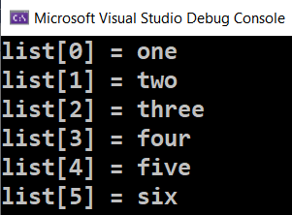
Printing Lists On the Console
Printing a list using a for-loop:
Printing a list using a string.Join(…):
List<string> list = new List<string>() {
"one", "two", "three", "four", "five", "six"};
for (int i = 0; i < list.Count; i++)
Console.WriteLine("list[{0}] = {1}", i, list[i]);
List<string> list = new List<string>() {
"one", "two", "three", "four", "five", "six"};
Console.WriteLine(string.Join("; ", list));
// Output: one; two; three; four; five; six

Slide 14
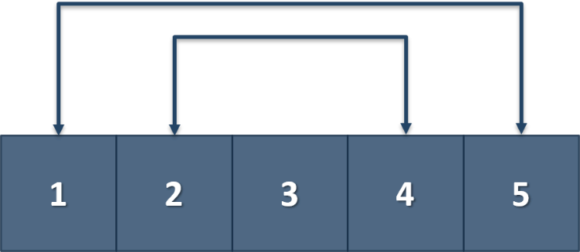
Problem: Gauss' Trick
Write a program that sums all numbers in a list in the following order:
first + last, first + 1 + last - 1, first + 2 + last - 2, … first + n, last - n
Examples:
1 2 3 4 5
6 6 3
1 2 3 4
5 5

Slide 15
Solution: Gauss' Trick
List<int> numbers = Console.ReadLine() .Split()
.Select(int.Parse)
.ToList();
int originalLength = numbers.Count;
for (int i = 0; i < originalLength / 2; i++)
{
numbers[i] += numbers[numbers.Count - 1];
numbers.RemoveAt(numbers.Count - 1);
}
Console.WriteLine(string.Join(" ", numbers));
Check your solution here: https://judge.softuni.org/Contests/Practice/Index/3171#11

Slide 16

Problem: Merging Lists
You receive two lists with numbers. Print a result list, which contains the numbers from both of the lists.
If the lengths of the two lists are not equal, just add the remaining elements at the end of the list:
list1[0], list2[0], list1[1], list2[1], …
1 2 3 4 5
6 7 8
1 6 2 7 3 8 4 5

Slide 17
Solution: Merging Lists (1)
// TODO: Read the input
List<int> resultNums = new List<int>();
for (int i = 0; i < Math.Min(nums1.Count, nums2.Count); i++)
// TODO: Add numbers in resultNums
if (nums1.Count > nums2.Count)
resultNums.AddRange(GetRemainingElements(nums1, nums2));
else if (nums2.Count > nums1.Count)
resultNums.AddRange(GetRemainingElements(nums2, nums1));
Console.WriteLine(string.Join(" ", resultNums));

Slide 18
Solution: Merging Lists (2)
static List<int> GetRemainingElements(
List<int> longerList, List<int> shorterList)
{
List<int> nums = new List<int>();
for (int i = shorterList.Count; i < longerList.Count; i++)
nums.Add(longerList[i]);
return nums;
}
Check your solution here: https://judge.softuni.org/Contests/Practice/Index/3171#12

Slide 19

Sorting Lists and Arrays

Slide 20
Sorting Lists
Sorting a list == reorder its elements incrementally: Sort()
List items should be comparable, e. g. numbers, strings, dates, …
List<string> names = new List<string>() {"Peter", "Michael", "George", "Victor", "John" };
names.Sort();
Console.WriteLine(string.Join(", ", names));
// George, John, Michael, Peter, Victor
names.Sort();
names.Reverse();
Console.WriteLine(string.Join(", ", names));
// Victor, Peter, Michael, John, George
Sort in natural (ascending) order
Reverse the sorted result

Slide 21
Problem: List of Products
Read a number n and n lines of products
Print a numbered list of all the products ordered by name
Examples:
4
Potatoes
Tomatoes
Onions
Apples
AZ
1.Apples
2.Onions
3.Potatoes
4.Tomatoes

Slide 22
Solution: List of Products
int n = int.Parse(Console.ReadLine());
List<string> products = new List<string>();
for (int i = 0; i < n; i++)
{
string currentProduct = Console.ReadLine();
products.Add(currentProduct);
}
products.Sort();
for (int i = 0; i < products.Count; i++)
Console.WriteLine($"{i + 1}.{products[i]}");
Check your solution here: https://judge.softuni.org/Contests/Practice/Index/3171#13

Slide 23
Problem: Remove Negatives and Reverse
Read a list of integers, remove all negative numbers from it
Print the remaining elements in reversed order
In case of no elements left in the list, print "empty"
10 -5 7 9 -33 50
50 9 7 10
7 -2 -10 1
1 7
-1 -2 -3
empty

Slide 24
Solution: Remove Negatives and Reverse
List<int> nums = // TODO: Read the List from the console
for (int i = 0; i < nums.Count; i++)
if (nums[i] < 0) { nums.RemoveAt(i--); }
nums.Reverse();
if (nums.Count == 0)
Console.WriteLine("empty");
else
Console.WriteLine(string.Join(" ", nums));
Check your solution here: https://judge.softuni.org/Contests/Practice/Index/3171#14

Slide 25
Summary
Lists hold an editable sequence of elements (variable-length)
Can add / remove / insert / modify elements at any time
Creating (allocating) a list: new List<T>()
Accessing list elements by index: list[i]
Printing list elements: string.Join(…)
…
…
…

Slide 26
Questions?
Notes:
26

Slide 27

License
This course (slides, examples, demos, exercises, homework, documents, videos and other assets) is copyrighted content
Unauthorized copy, reproduction or use is illegal
© SoftUni – https://softuni.org
© Software University – https://softuni.bg
Notes:
27

