Slide 1


Regular Expressions (RegEx)
Regular Expressions Language Syntax
SoftUni Team
Technical Trainers
Software University
https://softuni.bg

Slide 2
Table of Contents
Regular Expressions Syntax
Definition and Pattern
Predefined Character Classes
Quantifiers and Grouping
Backreferences
Regular Expressions in C#
2

Slide 3
Regular Expressions
[A-Z]

Slide 4
What Are Regular Expressions?
Regular expressions (regex)
Match text by pattern
Patterns are defined by special syntax, e.g.
[0-9]+ matches non-empty sequence of digits
[A-Z][a-z]* matches a capital + small letters
Play with regex live at: regexr.com, regex101.com
4

Slide 5
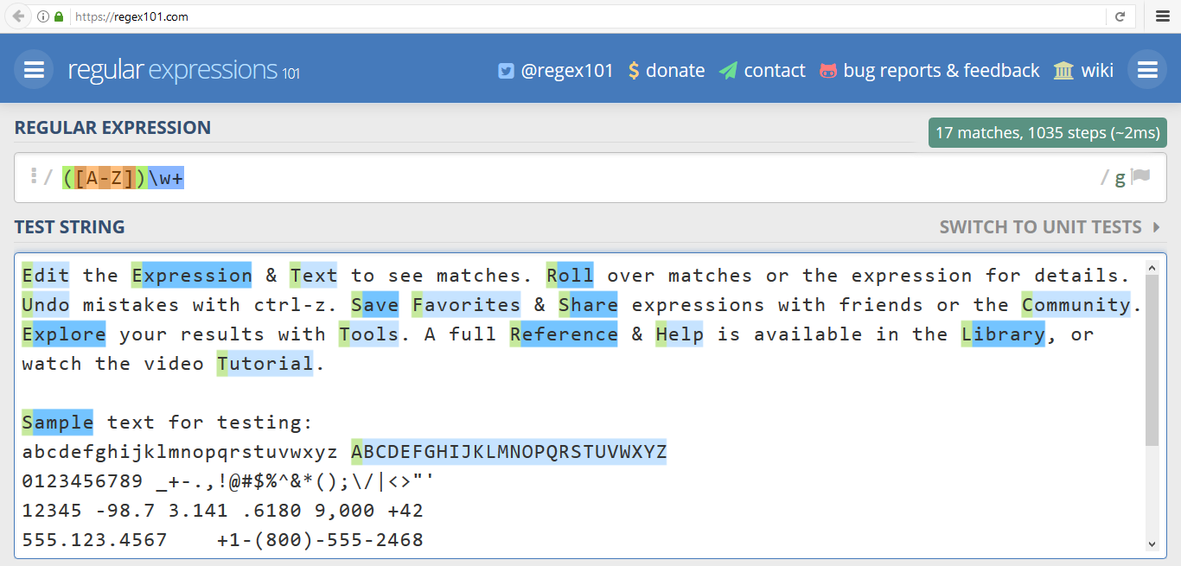
Live Demo

Slide 6
Regular Expression Pattern – Example
Regular expressions (regex) describe a search pattern
Used to find / extract / replace / split data from text by pattern
[A-Z][a-z]+ [A-Z][a-z]+
John Smith
Linda Davis
Contact: Alex Scott

Slide 7
Character Classes: Ranges
[nvj] matches any character that is either n, v or j
[^abc] – matches any character that is not a, b or c
[0-9] – character range: matches any digit from 0 to 9
node.js v0.12.2
Abraham
John is 8 years old.

Slide 8
Predefined Classes
\w – matches any word character (a-z, A-Z, 0-9, _)
\W – matches any non-word character (the opposite of \w)
\s – matches any white-space character
\S – matches any non-white-space character (opposite of \s)
\b – matches the border between space and non-space
\d – matches any decimal digit (0-9)
\D – matches any non-decimal character (the opposite of \d)

Slide 9
Quantifiers
(\w+)

Slide 10
Quantifiers
* - matches the previous element zero or more times
+ - matches the previous element one or more times
? - matches the previous element zero or one time
{3} - matches the previous element exactly 3 times
\+\d*
+359885976002 a+b
\+\d+
+359885976002 a+b
\+\d?
+359885976002 a+b
\+\d{3}
+359885976002 a+b

Slide 11
Grouping Constructs
(subexpression) - captures the matched subexpression as numbered group
(?:subexpression) - defines a non-capturing group
(?<name>subexpression) - defines a named capturing group
\d{2}-(\w{3})-\d{4}
22-Jan-2015
^(?:Hi|hello),\s*(\w+)$
Hi, Peter
(?<day>\d{2})-(?<month>\w{3})-(?<year>\d{4})
22-Jan-2015

Slide 12
Problem: Match All Words
Write a regular expression in www.regex101.com that extracts all word char sequences from given text
_ (Underscores) are also word characters!
_|Underscores|are|also|word|characters

Slide 13
Solution: Match All Words
string pattern = @"\w+";
\w+ matches word characters one or more times

Slide 14
Problem: Match Dates
Write a regular expression that extracts dates from text
Valid date format: dd-MMM-yyyy
Examples: 12-Jun-1999, 3-Nov-1999
I was born on 30-Dec-1994. My father was born on the 9-Jul-1955. 01-July-2000 is not a valid date.

Slide 15
Solution: Match Dates
\d? matches a digit zero or one time
\d{4} matches exactly 4 digits
\d matches a digit
string pattern = @"\d?\d-[A-Z][a-z]{2}-\d{4}";
[a-z]{2} matches exactly 2 lower case letters
[A-Z] matches a capital letter
I was born on 30-Dec-1994 in Sofia.

Slide 16
Problem: Email Validation
Write a regular expression that performs simple email validation
An email consists of: username @ domain name
Usernames are alphanumeric
Domain names consist of two strings, separated by a period
Domain names may contain only English letters
Valid:
valid123@email.bg
Valid:
hi@mail.abv.bg
Invalid:
invalid*name@emai1.bg
Invalid:
pesho@abv.

Slide 17
Solution: Email Validation
\w+ matches a sequence of word chars
$ asserts position at end of a line
^ asserts position at start of a line
string pattern = @"^\w+@(\w+\.)+\w+$";
@ matches the character "@"
(\w+\.)+ matches several words + "."
\. matches exactly "."
hi@mail.abv.bg

Slide 18
Backreferences
\1

Slide 19
Backreferences Match Previous Groups
\number - matches the value of a numbered capture group
<(\w+)[^>]*>.*?<\/\1>
<b>Regular Expressions</b> are cool!
<p>I am a paragraph</p> … some text after
Hello, <div>I am a<code>DIV</code></div>!
<span>Hello, I am Span</span>
<a href="https://softuni.bg/">SoftUni</a>

Slide 20
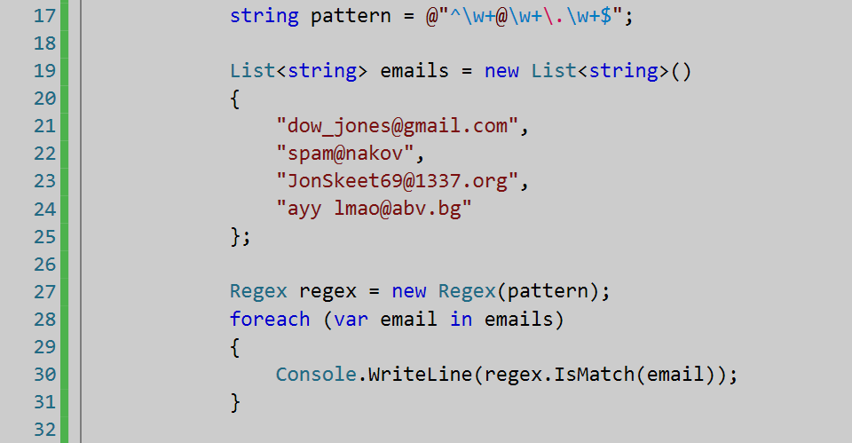
Using .NET Built-In Regex Classes

Slide 21
Regex in C#
C# supports a built-in regular expression class: Regex
Located in System.Text.RegularExpressions namespace
using System.Text.RegularExpressions;
static void Main()
{
string pattern = @"A\w+";
Regex regex = new Regex(pattern);
}

Slide 22
Validating String by Pattern
IsMatch(string text)
Determines whether the text matches given pattern
string text = "Today is 2015-05-11";
string pattern = @"\d{4}-\d{2}-\d{2}";
Regex regex = new Regex(pattern);
bool containsValidDate = regex.IsMatch(text);
Console.WriteLine(containsValidDate); // True

Slide 23
Checking for a Single Match
Match(string text)
Returns the first match of given pattern
string text = "Nakov: 123";
string pattern = @"([A-Z][a-z]+): (\d+)";
Regex regex = new Regex(pattern);
Match match = regex.Match(text);
Console.WriteLine(match.Groups.Count); // 3
Console.WriteLine("Matched text: \"{0}\"", match.Groups[0]);
Console.WriteLine("Name: {0}", match.Groups[1]); // Nakov
Console.WriteLine("Number: {0}", match.Groups[2]); // 123

Slide 24
Checking for Matches
Matches(string text) - returns a collection of matches
string text = "Nakov: 123, Branson: 456";
string pattern = @"([A-Z][a-z]+): (\d+)";
Regex regex = new Regex(pattern);
MatchCollection matches = regex.Matches(text);
Console.WriteLine("Found {0} matches", matches.Count);
foreach (Match match in matches)
Console.WriteLine("Name: {0}", match.Groups[1]);
// Found 2 matches
// Name: Nakov
// Name: Branson

Slide 25
Replacing with Regex
Replace(string text, string replacement) - replaces all strings that match the pattern with the provided replacement
string text = "Nakov: 123, Branson: 456";
string pattern = @"\d{3}";
string replacement = "999";
Regex regex = new Regex(pattern);
string result = regex.Replace(text, replacement);
Console.WriteLine(result);
// Nakov: 999, Branson: 999

Slide 26
Splitting with Regex
Split(string text) - splits the text by the pattern
Returns string[]
string text = "1 2 3 4";
string pattern = @"\s+";
string[] results = Regex.Split(text, pattern);
Console.WriteLine(string.Join(", ", results));
// 1, 2, 3, 4

Slide 27
Problem: Match Full Name
You are given a list of names
Match all full names (two words, starting with capital letter)
Ivan Ivanov, Ivan ivanov, ivan Ivanov, IVan Ivanov, Test Testov, Ivan Ivanov
Ivan Ivanov
Test Testov

Slide 28
Solution: Match Full Names
string listOfNames = Console.ReadLine();
string pattern @"\b[A-Z][a-z]+ [A-Z][a-z]+";
Regex regex = new Regex(pattern);
MatchCollection validNames = regex.Matches(input);
foreach (Match name in validNames)
{
Console.Write($"{name.Value}" + "\n");
}
Check your solution here: https://judge.softuni.org/Contests/Practice/Index/3178#21
Notes:
You can try also: @"<a.*href=((?:.|\n)*?(?=>))>((?:.|\n)*?(?=<))<\/a>"

Slide 29
Problem: Match Dates
You are given a string
Match all dates in the format "dd{separator}MMM{separator}yyyy" and print them space-separated
13/Jul/1928, 01/Jan-1951
Day: 13, Month: Jul, Year: 1928

Slide 30
Solution: Match Dates
string input = Console.ReadLine();
string pattern = @"\b(?<day>\d{2})(\.|-|\/) (?<month>[A-Z][a-z]{2})\1(?<year>\d{4})\b";
MatchCollection matches = Regex.Matches(input, pattern);
foreach (Match date in matches)
Console.WriteLine($"Day: {date.Groups["day"].Value}, Month: {date.Groups["month"].Value}, Year: {date.Groups["year"].Value}");
Check your solution here: https://judge.softuni.org/Contests/Practice/Index/3178#23
Notes:
You can try also: @"<a.*href=((?:.|\n)*?(?=>))>((?:.|\n)*?(?=<))<\/a>"

Slide 31
Summary
…
…
…
Regular expressions describe patterns for searching through text
Define special characters, operators and constructs for building complex pattern
Can utilize character classes, groups, quantifiers, etc.
In C# use the Regex class

Slide 32
Questions?
Notes:
32

Slide 33

License
This course (slides, examples, demos, exercises, homework, documents, videos and other assets) is copyrighted content
Unauthorized copy, reproduction or use is illegal
© SoftUni – https://softuni.org
© Software University – https://softuni.bg
Notes:
33

