Slide 1

Combinatorial Algorithms
Permutations, Variations, Combinations
SoftUni Team
Training Team
Software University
http://softuni.bg

Slide 2
Table of Contents
Permutations
Permutation with Recursion
Variations
Combinations
Pascal's Triangle

Slide 3
Permutations
Arrange Members of a Set Into a Linear Order

Slide 4
Permutations
Permutation of a set is an arrangement of its members into a sequence or linear order
If the set is already ordered, it is a rearrangement of the elements in the set
There are two types of permutations:
Without repetition
With repetition

Slide 5
Permutations – Example
Order A, B and C in all possible ways
A
B
C
A | B
A | C
B | A
B | C
C | A
C | B
A | B | C
A | C | B
B | A | C
B | C | A
C | A | B
C | B | A
Permutations

Slide 6
Permutations – Real-Life Example
Imagine you're ordering your books on your bookshelf and you wonder in how many ways can you fit your 3 favourite books
3! = 6 ways in total

Slide 7
Permutations Repetition – Real-Life Example
Imagine you're ordering your books on your bookshelf and you wonder in how many ways can you fit your 2 favourite books
One of the books is a duplicate
3 ways in total

Slide 8
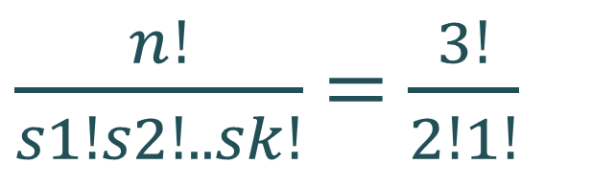
Permutations Count
Order A, B and C in all possible ways (without repetition)
Count how many ways are there
Order A, B and B (with repetition)
A | B | B
$\frac{n!}{s1!s2!..sk!}$ = $\frac{3!}{2!1!}$
A | B | C
3
2
1
6 possible ways
3 possible ways
n! = 3!

Slide 9
Problem: Permutations
Generates all possible permutations of a given set of elements
Without using extra memory
ABC
ACB
BAC
BCA
CAB
CBA
A B C

Slide 10
Algorithm: Permutations
Create method Permute(index) to generate variations P(n)
Put unused elements 0 … n-1 at position index
Mark/unmark elements as being used
Call permute(index + 1) to generate the rest of the array
permute(0)
permute(1)
permute(n)
print(); stop();
0… n - 1 | x | x | x | x
y
0… n - 1 | x | x | x | x
unused
unused
permute(1)
permute(2)

Slide 11

Generating Permutations
static void Permute(int index)
{
if (index >= elements.Length)
Print();
else {
Permute(index + 1);
for (int i = index + 1; i < elements.Length; i++) {
Swap(index, i);
Permute(index + 1);
Swap(index, i);
}
}
}

Slide 12
Problem: Permutations with Repetition
Use the given array = new [] { A, B, B }
By definition: { A, B', B'' } == { A, B'', B' }
Generate all permutations from a multi-set
ABB
BAB
BBA
A B B

Slide 13

Solution: Permutations with Repetition (2)
if (!swapped.Contains(elements[i]))
{
Swap(index, i);
Permute(index + 1);
Swap(index, i);
swapped.Add(elements[i]);
}
static void Permute(int index)
{
if (index >= elements.Length)
{
Print();
return;
}
Permute(index + 1);
var swapped = new HashSet<string> { elements[index] };
for (int i = index + 1; i < elements.Length; i++)
{
…
}
}

Slide 14
Variations
Arrange Members of a Set Into a K Amount of Slots

Slide 15
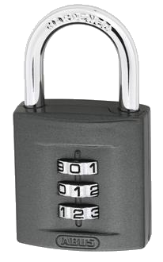
Variations
Variation is the arrangement of N elements into a K amount of open slots into a linear order
In variations order matters
A B is not the same as B A
There are two types of variations:
Without repetition
With repetition
N = 10 possible numbers, K = 3 slots

Slide 16
Variations
Order A, B and C in all possible ways in k slots
Pick each item only once
A
B
C
A | B
A | C
B | A
B | C
C | A
C | B
Variations

Slide 17
Variations – Real-Life Example
Imagine you're ordering your cups on your cup shelf and you wonder how many ways can you fit your 3 favourite cups
When there are only 2 spaces available
3 * 2 = 6 variations

Slide 18
Variations Repetition – Real-Life Example
Imagine you're ordering your cups on your cup shelf and you wonder how many ways can you fit your 3 favourite cups
When there are only 2 spaces available
3 ^ 2 = 9 variations

Slide 19

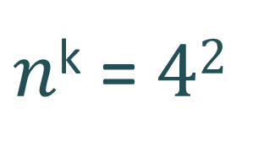
Variations Count
Order two from A, B, C and D in all possible ways
How many ways are there?
AA
AB
AC
AD
BB
BA
BC
BD
CC
CA
CB
CD
DD
DA
DB
DC
AB
AC
AD
BA
BC
BD
CA
CB
CD
DA
DB
DC
A | B | C | D
A | B | C | D
Multiply
4
3
Multiply
4
4
12 different ways without repetition
$\frac{n!}{(n−k)!}$ = $\frac{4!}{2!}$
16 different ways with repetition
$n$^{k} = $42$

Slide 20

Problem: Generate Variations
Generates all possible variations of k from a set of elements
You can pick an item once
static void GenerateVariations(int index)
{
if (index >= variations.Length) Print();
else {
for (int i = 0; i < elements.Length; i++) {
if (!used[i]) {
used[i] = true;
variations[index] = elements[i];
GenerateVariations(index + 1);
used[i] = false;
}
}
}
}
AB
AC
BA
BC
CA
CB
A B C
2

Slide 21

Problem: Generate Variations with Reps
Generates all possible variations of a given elements
You can pick an item multiple times
AA
AB
AC
BA
BB
BC
CA
CB
CC
static void GenerateVariations(int index)
{
if (index >= variations.Length)
Print();
else {
foreach (int n in elements) {
variations[index] = n;
GenerateVariations(index + 1); }
}
}
A B C
2

Slide 22

Combinations
$$\frac{n!}{k!\left(n−k\right)! }$$
Variations Without Order

Slide 23
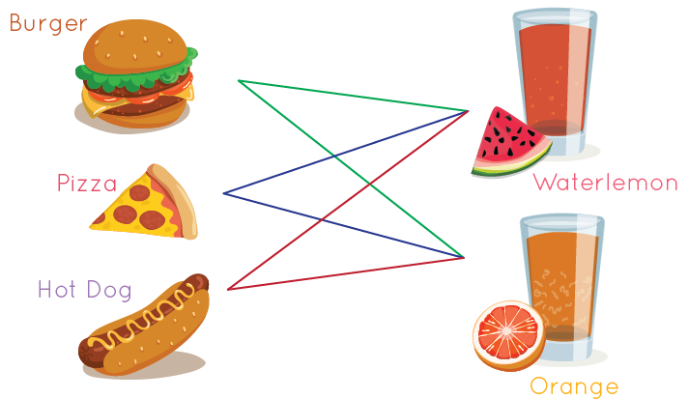


Combinations
Combination is the arrangement of N elements into a K amount of open slots into a linear order
In combinations order does not matter
A B is the same as B A
There are two types of combinations:
Without repetition
With repetition
same

Slide 24
Combinations
Pick two from A, B and C
Order does not matter
A
B
C
A | B
A | C
B | C
Combinations

Slide 25
Combinations – Real-Life Example
Imagine you're ordering your SoftUni certificates on your certificates shelf and you wonder how many ways can you fit your 3 favourite certificates
When order does not matter and there are only 2 spaces available
6 / 2 = 3 combinations

Slide 26
Combinations Repetition – Real-Life Example
Imagine you're ordering your SoftUni certificates on your shelf and you wonder how many ways can you fit your 3 favourite certificates
When order does not matter and there are only 2 spaces available
24 / 4 = 6 combinations

Slide 27
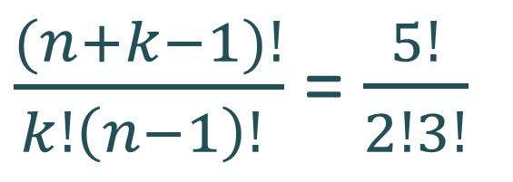
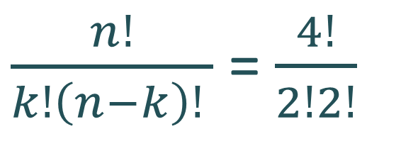
Combinations Count
Pick two from {A, B, C, D} in all possible ways
Order does not matter
How many ways are there?
AB
AC
AD
BC
BD
CD
AA, AB, AC, AD, BB, BC, BD, CC, CD, DD
4
3
Variations n = 4, k = 2
4
3
Variations n = 4, k = 2
2
1
Permutations of n = 2
2
1
Permutations of n = 2
6 different ways without repetition
10 different ways with repetition
$\frac{n!}{k!\left(n−k\right)! }$ = $\frac{4!}{2!2!}$
$\frac{(n+k−1)!}{k!\left(n−1\right)! }$ = $\frac{5!}{2!3!}$

Slide 28

Problem: Generate Combinations
Generate all possible combinations from given elements
You can pick each item only once
static void GenerateCombs(int index, int start)
{
if (index >= slots.Length) {
Print();
return;
}
for (int i = start; i <
elements.Length; i++) {
slots[index] = elements[i];
GenerateCombs(index + 1, i + 1);
}
}
AB
AC
BC
A B C
2

Slide 29

Problem: Combinations with Repetition
Generating the combinations for n = 3 and k = 2
static void GenerateCombs(int index, int start)
{
if (index >= slots.Length)
Print();
else {
for (int i = start; i < elements.Length; i++) {
slots[index] = elements[i];
GenerateCombs(index + 1, i);
}
}
}
A | A
B | B
C | C
A | B
B | C
A | C

Slide 30


N Choose K Count
Binomial Coefficients

Slide 31
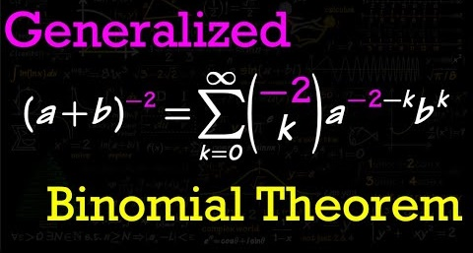
What is Binomial Coefficients
Binomial Coefficient == combination
A binomial coefficient is a number that occurs in the binomial theorem
Used to denote the number of possible ways to choose a subset of objects from a larger set – also known as a combination
We can use Pascal's triangle to find binomial coefficients
This allows us to more efficiently find combinations

Slide 32
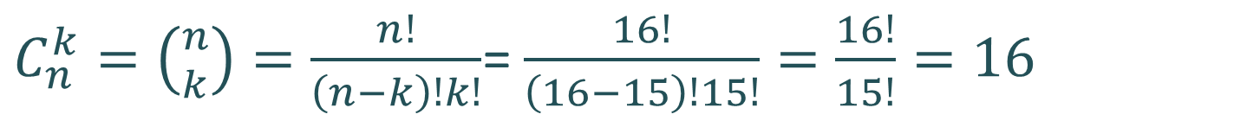
Problem: Combinations Count
How many combinations we have when n = 16, k = 15?
Solution:
Find how many ways are there to pick 16 items (n!)
Find how many ways are there to pick 16 items (n₁!)
Divide n! by n₁!
Possible combinations → 16
$C_{n}^{k}=\left({n \atop k}\right)=\frac{n!}{\left(n−k\right)!k!}$= $\frac{16!}{\left(16−15\right)!15!}=\frac{16!}{15!}=16$

Slide 33
Pascal's Triangle
Triangular array of the binomial coefficients
Combination of n k
In how many ways each node can be reached?
Quickly find N choose K count
Go down to row n (the top row is 0)
Move along k places to the right
n = 4
k = 1

Slide 34
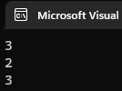
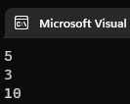
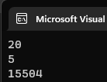
Binomial Coefficients: Calculation
static long Binom(int n, int k)
{
if (n <= 1)
return 1;
if (k == 0 || k == n)
return 1;
return Binom(n - 1, k) + Binom(n - 1, k - 1);
}

Slide 35
Summary
…
…
…
Permutations
Ways to order n elements in a linear order
Variations
Ways to order k of n elements in a linear order
Combinations
Ways to choose k of n elements in a linear order
Pascal's Triangle
Binomial coefficients – N choose K Count

Slide 36
Questions?

Slide 37

License
This course (slides, examples, code, demos, exercises, tutorials, homework, projects, documents, videos and other assets) is copyrighted content, created by SoftUni
Unauthorized copy, reproduction or use is illegal
© SoftUni – https://softuni.org
© Software University – https://softuni.bg

Slide 38
Trainings @ Software University (SoftUni)
Software University – High-Quality Education, Profession and Job for Software Developers
softuni.bg, about.softuni.bg
Software University Foundation
softuni.foundation
Software University @ Facebook
facebook.com/SoftwareUniversity
Software University Forums
forum.softuni.bg
38
Notes:
38

