Slide 1

Recursion and Backtracking
Recursive Algorithms and Backtracking
SoftUni Team
Technical Trainers
Software University
https://about.softuni.bg

Slide 2
Table of Contents
Generating 0/1 Vectors
Backtracking: Concepts
Backtracking Example
The 8 Queens Problem

Slide 3
Recursive Algorithms
0 | 0 | 0
0 | 0 | 1
0 | 1 | 1
1 | 1 | 1
Simple Combinatorial Generators

Slide 4
Generating 0/1 Vectors
How to generate all 8-bit vectors recursively?
0 0 0 0 0 0 0 0
0 0 0 0 0 0 0 1
...
0 1 1 1 1 1 1 1
1 0 0 0 0 0 0 0
...
1 1 1 1 1 1 1 0
1 1 1 1 1 1 1 1

Slide 5
Generating 0/1 Vectors
Start with a blank vector
Choose the first position and loop through all possibilities
For each possibility, generate all (n – 1)-bit vectors
0 | … | … | … | … | … | … | …
0 | … | … | … | … | … | … | …
1 | … | … | … | … | … | … | …
n - 1
n - 1
Check your solution here: https://judge.softuni.bg/Contests/2726/Recursive-Algorithms

Slide 6
Solution: Generate N-bit Vectors
static void Gen01(int index, int[] vector)
{
if (index >= vector.Length)
Console.WriteLine(string.Join(" ", vector));
else
{
for (int i = 0; i <= 1; i++)
vector[index] = i;
Gen01(index + 1, vector);
}
}

Slide 7
Generating 3-bit Vectors Recursion Tree
length = 3
0
vector:
… | … | …
0
1
1
1
0
1
0
1
2
2
2
2
0
1
0
1
0
1
0
1
3
3
3
3
3
3
3
3
Print

Slide 8
Backtracking
Track
Recurre
Backtrack
Generating All Candidates

Slide 9
Backtracking
What is backtracking?
Class of algorithms for finding all solutions
E. g. find all possible paths from Source to Destination
V
V
V
V
D
S

Slide 10
Backtracking
How does backtracking work?
At each step tries all perspective possibilities recursively
Drop all non-perspective possibilities as early as possible
Backtracking has exponential running time!

Slide 11
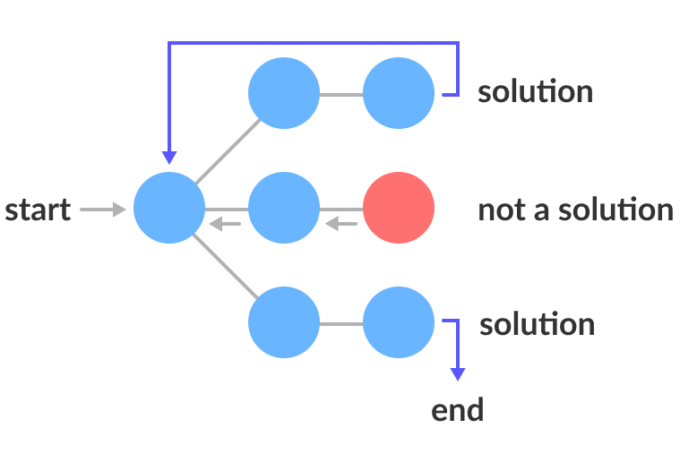
The "Backtracking" Algorithm (Pseudocode)
static void backtracking(Node node)
{
if (node is solution)
printSolution(node);
else
for each child c of node
if (c is perspective candidate)
{
markPositionVisited(c);
backtracking(c);
unmarkPositionVisited(c);
}
}

Slide 12
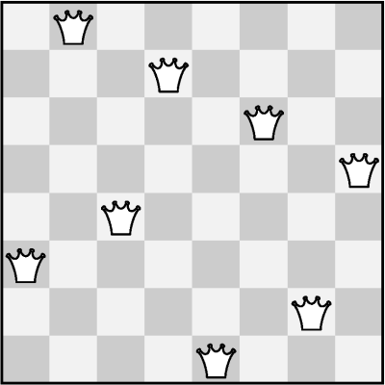
The "8 Queens" Puzzle
Write a program to find all possible placements of
8 queens on a chessboard
So that no two queens can attack each other
http://en.wikipedia.org/wiki/ Eight_queens_puzzle
Check your solution here: https://judge.softuni.bg/Contests/2726/Recursive-Algorithms

Slide 13
Solving the "8 Queens" Puzzle
Find all solutions to "8 Queens Puzzle“
At each step:
Check for solution
Put a queen at free position
Recursive call
Remove the queen
static void PlaceQueens(row)
{
if (row == 8)
PrintSolution();
else
for (col = 0 … 7)
if (CanPlaceQueen(row, col))
{
SetQueen(row, col);
PlaceQueens(row + 1);
RemoveQueen(row, col);
}
}

Slide 14
Summary
…
…
…
Recursive algorithms
Use recursion to generate simple combinatorial objects
Combinations, variations, permutations, others
Backtracking
Use backtracking to check recursively all possibilities at each step
E. g. generate all possible configurations that match certain criteria

Slide 15
Questions?

Slide 16
Resources
"Fundamentals of Computer Programming with C#“ ➔ "Recursion“ ➔ pages 365-398
https://introprogramming.info/wp-content/uploads/2018/07/CSharp-Principles-Book-Nakov-v2018.pdf

Slide 17

License
This course (slides, examples, code, demos, exercises, tutorials, homework, projects, documents, videos and other assets) is copyrighted content, created by SoftUni
Unauthorized copy, reproduction or use is illegal
© SoftUni – https://softuni.org
© Software University – https://softuni.bg

