Slide 1
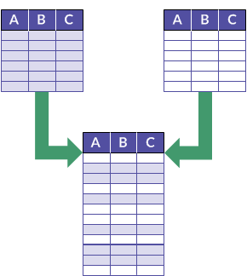
Combining Data Structures
Choosing a Data Structure
SoftUni Team
Technical Trainers
Software University
https://softuni.bg

Slide 2
Table of Contents
Collection Data Structures
Linear Data Structures
Hash Tables
Binary Search Trees
2. Choosing a Data Structure
3. Combining Data Structures

Slide 3
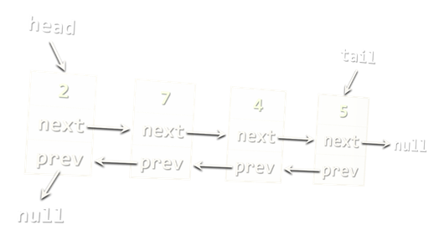
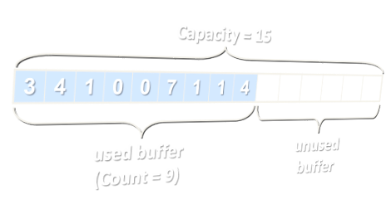
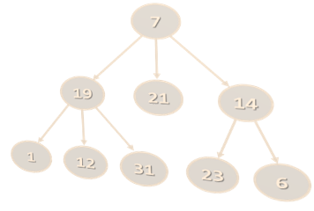
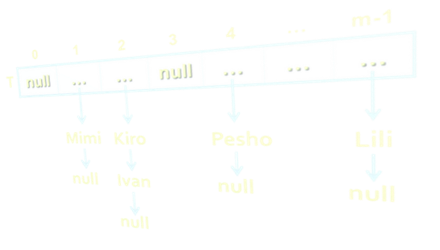
Choosing the Right Data Structure
Lists vs. Hash Tables vs. Balanced Trees

Slide 4
Choosing a Collection – Array
Array (T[])
Use when fixed number of elements need processing by index
No resize → for fixed number of elements only
Add / delete needs creating a new array + move O(n) elements
Compact and lightweight
Data Structure | Complexity
 | Add | Find | Delete | Get-by-index
Static Array: T[] | O(n) | O(n) | O(n) | O(1)

Slide 5
Choosing a Collection – Array Based List
Resizable array-based list (List<T>)
Use when elements should be added fast and processed by index
Add (append to the end) has O(1) amortized complexity
The most-commonly used collection in programming
Data Structure | Complexity
 | Add | Find | Delete | Get-by-index
Auto-Resizable Array-Based List: List<T> | O(1) | O(n) | O(n) | O(1)

Slide 6
Choosing a Collection – Linked List
Doubly-linked list (LinkedList<T>)
Use when elements should be added at both sides of the list
Use when you need to remove by a node reference
Otherwise use resizable array-based list (List<T>)
Data Structure | Complexity
 | Add | Find | Delete | Get-by-index
Double-Linked List: LinkedList<T> | O(1) | O(n) | O(n) | O(n)

Slide 7
Choosing a Collection – Stack
Stack (Stack<T>)
Use to implement LIFO (Last-In-First-Out) behavior
List<T> could also work well
Data Structure | Complexity
 | Add | Find | Delete | Get-by-index
Stack: Stack<T> | O(1) | - | O(1) | -

Slide 8
Choosing a Collection – Queue
Queue (Queue<T>)
Use to implement FIFO (First-In-First-Out) behavior
LinkedList<T> could also work well
Data Structure | Complexity
 | Add | Find | Delete | Get-by-index
Queue: Queue<T> | O(1) | - | O(1) | -

Slide 9
Choosing a Collection – Map
Hash-table-based map (Dictionary<K,V>)
Fast add key-value pairs + fast search by key – O(1)
Keys have no particular order
Keys should implement GetHashCode(…) and Equals(…)
Data Structure | Complexity
 | Add | Find | Delete | Get-by-index
Hash-Table: Dictionary<K,V> | O(1) | O(1) | O(1) | -

Slide 10
Choosing a Collection – Tree Map
Balanced tree-based map (OrderedDictionary<K,V>)
Elements are ordered by key
Fast add key-value pairs + fast search by key + fast sub-range
Keys should be IComparable<T>
Balanced trees → slower than hash-tables: O(log n) vs. O(1)
Data Structure | Complexity
 | Add | Find | Delete | Get-by-index
Balanced Tree-Based Dictionary: SortedDictionary<K,V> | O(log(n)) | O(log(n)) | O(log(n)) | -

Slide 11
Choosing a Collection – Multi Map
Hash-table-based multi-dictionary (MultiDictionary<K,V>)
Fast add key-value + fast search by key + multiple values by key
Add by existing key appends a new value for the same key
Keys have no particular order
Data Structure | Complexity
 | Add | Find | Delete | Get-by-index
Hash-Table-Based Multi-Dictionary: MultiDictionary<K,V> | O(1) | O(1) | O(1) | -

Slide 12
Choosing a Collection – Tree Multi Map
Tree-based multi-dictionary (OrderedMultiDictionary<K,V>)
Keys are ordered by key
Fast add key-value + fast search by key + fast sub-range
Add by existing key appends a new value for the same key
Data Structure | Complexity
 | Add | Find | Delete | Get-by-index
Tree-Based Multi-Dictionary: OrderedMultiDictionary<K,V> | O(log(n)) | O(log(n)) | O(log(n)) | -

Slide 13
Choosing a Collection – Hash Set
Hash-table-based set (HashSet<T>)
Unique values + fast add + fast contains
Elements have no particular order
Elements should implement GetHashCode(…) and Equals(…)
Data Structure | Complexity
 | Add | Find | Delete | Get-by-index
Hash-Table-Based Set: HashSet<T> | O(1) | O(1) | O(1) | -

Slide 14
Choosing a Collection – Tree Set
Balanced tree-based set (SortedSet<T>)
Unique values + sorted order
Fast add + fast contains + fast sub-range
Elements should be IComparable<T>
Data Structure | Complexity
 | Add | Find | Delete | Get-by-index
Balanced Tree-Based Set: SortedSet<T> | O(log(n)) | O(log(n)) | O(log(n)) | -

Slide 15
Choosing a Collection – Hash Bag
Hash-table-based bag (Bag<T>)
Bags allow duplicates
Fast add + fast find + fast contains
Elements have no particular order
Data Structure | Complexity
 | Add | Find | Delete | Get-by-index
Hash-Table-Based Bag: Bag<T> | O(1) | O(1) | O(1) | -

Slide 16
Choosing a Collection – Tree Bag
Balanced tree-based bag (SortedBag<T>)
Allow duplicates, sorted order
Fast add + fast find + fast contains
Access by sorted index + extract sub-range
Data Structure | Complexity
 | Add | Find | Delete | Get-by-index
Balanced Tree-Based Bag: SortedBag<T> | O(log(n)) | O(log(n)) | O(log(n)) | -

Slide 17
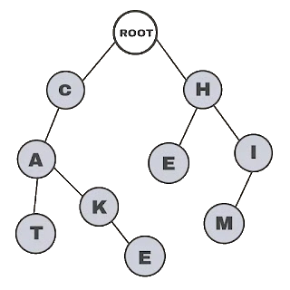
Choosing a Collection – Special DS
Priority Queue (Heap) – fast max/min element
Rope – fast add/remove by index
Prefix tree (Trie) – fast prefix search
17
11
6
4
structure
6
_data_
I_am_
Hello_
pe
a_ro
5
4
1
3
2

Slide 18
Data Structure Efficiency – Comparison
Data Structure | Complexity
 | Add | Find | Delete | Get-by-index
Static Array: T[] | O(n) | O(n) | O(n) | O(1)
Auto-Resizable Array-Based List: List<T> | O(1) | O(n) | O(n) | O(1)
Double-linked list: LinkedList<T> | O(1) | O(n) | O(n) | O(n)
Stack: Stack<T> | O(1) | - | O(1) | -

Slide 19
Data Structure Efficiency – Comparison (2)
Data Structure | Complexity
 | Add | Find | Delete | Get-by-index
Queue: Queue<T> | O(1) | - | O(1) | -
Hash-Table: Dictionary<K,V> | O(1) | O(1) | O(1) | -
Balanced Tree-Based Dictionary: SortedDictionary<K,V> | O(log(n)) | O(log(n)) | O(log(n)) | -
Hash-Table-Based Set: HashSet<T> | O(1) | O(1) | O(1) | -

Slide 20
Data Structure Efficiency – Comparison (3)
Data Structure | Complexity
 | Add | Find | Delete | Get-by-index
Balanced Tree--Based Set: SortedSet<T> | O(log(n)) | O(log(n)) | O(log(n)) | -
Hash-Table-Based Multi-Dictionary: MultiDictionary<K,V> | O(1) | O(1) | O(1) | -
Tree-Based Multi-Dictionary: OrderedMultiDictionary<K,V> | O(log(n)) | O(log(n)) | O(log(n)) | -
Hash-Table-Based Bag: Bag<T> | O(1) | O(1) | O(1) | -
Balanced Tree-Based Bag: OrderedBag<T> | O(log(n)) | O(log(n)) | O(log(n))

Slide 21

Combining Data Structures
Use a Combination of Data Structures for Best Results

Slide 22
Combining Data Structures
Many scenarios → combine several data structures
No ideal DS → choose between space or time
For example, it is recommended to use:
A hash-table for fast search by key₁ (e.g. name)
A hash-table for fast search by {key₂ + key₃} (e.g. name + town)
A balanced search tree for fast extract-range(start_key … end_key)
A rope for fast access by index
A balanced search tree for fast access by sorted index

Slide 23
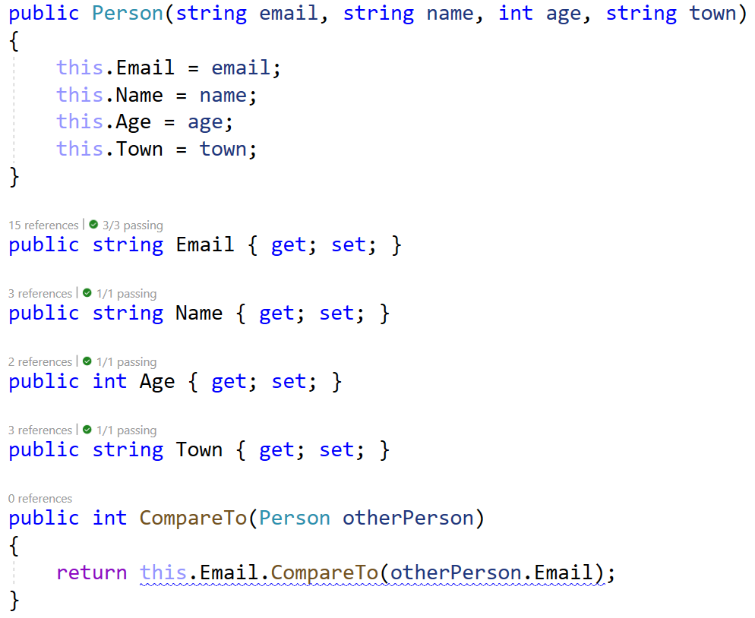
Problem: Collection of Persons
You have a Person class
Design a data structure that implements:
Operation
bool AddPerson(email, name, age, town)
Person FindPerson(email)
bool Delete(email)
List<Person> FindPeople(emailDomain)
List<Person> FindPeople(name, town)

Slide 24
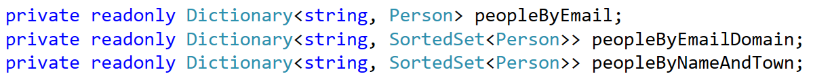
Dictionary-Based Solution
Dictionary-based solution is the best way to achieve best performance
Dictionaries have the best time complexity for lookup – O(1)
You will have multiple dictionaries for all operations
However, it is a bit difficult to implement

Slide 25
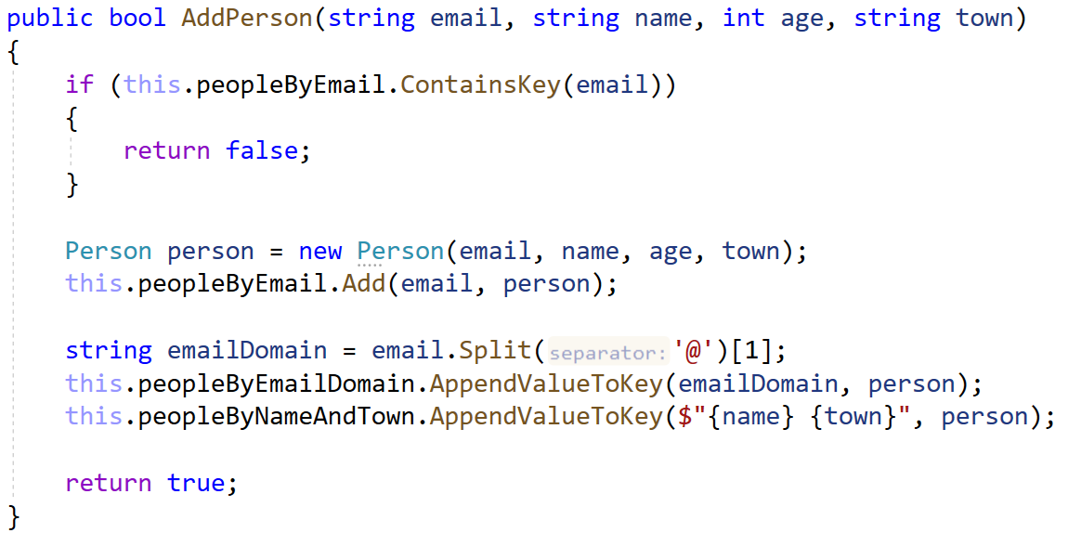
Solution: Add Person
Create a Person object to hold { email + name + age + town }
Add the new person to all 3 collections
Add the new person to all 3 collections
Add the new person to all 3 collections

Slide 26
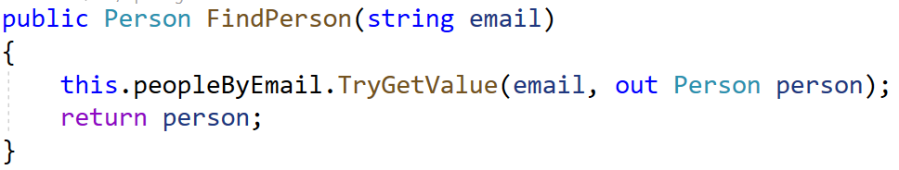
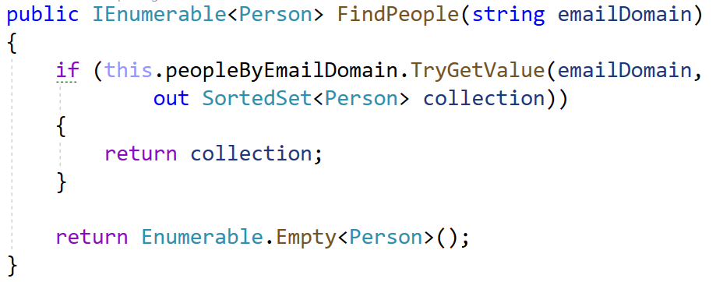
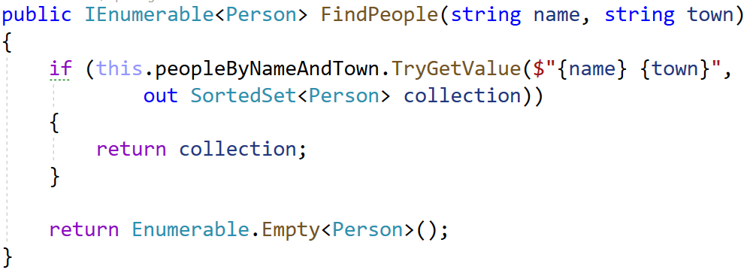
Solution: Find Person / People by Email
Use TryGetValue() for O(1) complexity
Use TryGetValue() for O(1) complexity
Use TryGetValue() for O(1) complexity

Slide 27
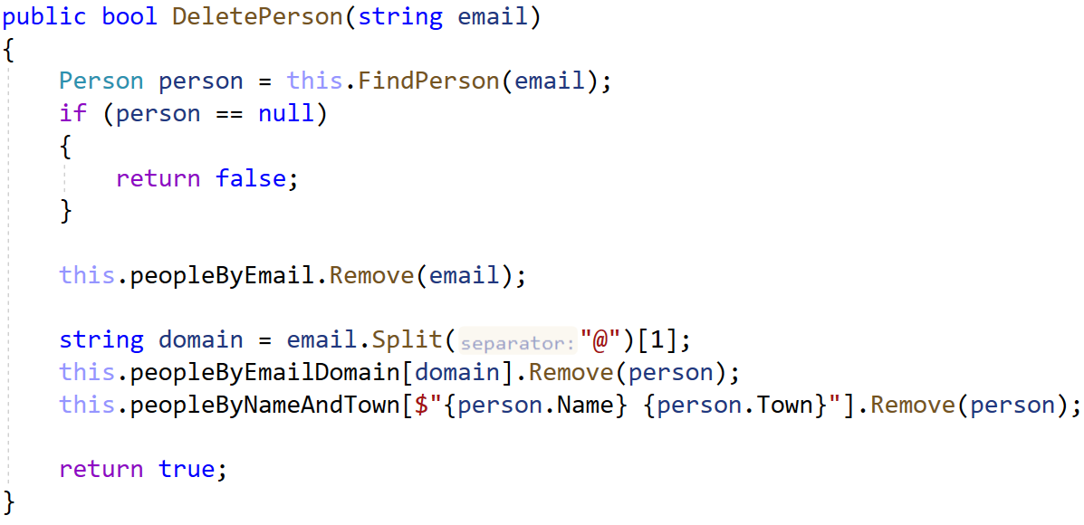
Solution: Delete
We get our person using the previous method
Delete the person from all 3 collections
Delete the person from all 3 collections
Delete the person from all 3 collections

Slide 28
Summary
…
…
…
Choosing a Data Structure
Different structures have a different performance
Hash-tables for fast search by key
Balanced search tree for fast range extract
Rope for fast indexing
Combining Data Structures
How combining different structures gives us better results?
No ideal data structure exists, one must choose between less space or better time

Slide 29
Questions?

Slide 30

License
This course (slides, examples, code, demos, exercises, tutorials, homework, projects, documents, videos and other assets) is copyrighted content, created by SoftUni
Unauthorized copy, reproduction or use is illegal
© SoftUni – https://softuni.org
© Software University – https://softuni.bg

Slide 31
Trainings @ Software University (SoftUni)
Software University – High-Quality Education, Profession and Job for Software Developers
softuni.bg, about.softuni.bg
Software University Foundation
softuni.foundation
Software University @ Facebook
facebook.com/SoftwareUniversity
Software University Forums
forum.softuni.bg
31
Notes:
31

