Slide 1



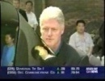
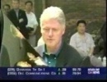
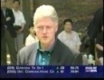
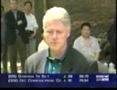
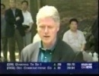





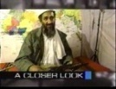
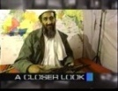
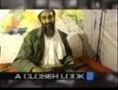












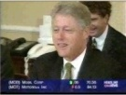
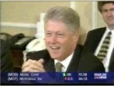

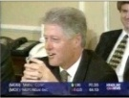

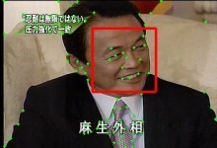
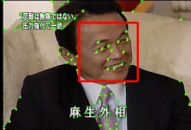



















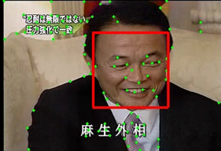
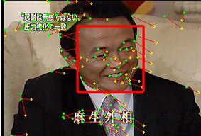






Tên công trình
Tác giả ^{1,3}
Tác giả ²
Tác giả 3 ^{3,1} Tác giả 4^{3,1}
¹ Đơn vị 1
² Đơn vị 2
³ Đơn vị 3
What ?
Why ?
We introduce a framework to process and retrieve faces in video, in which we have:
The human face is one of the most important objects in video since it provides rich information for spotting people of interest and is the basis for interpreting facts. Therefore, detecting and recognizing faces appearing in video are essential tasks of video indexing and retrieval applications.
Proposed a robust method to extract face-tracks in news video.
Built the largest face database compare to current popular worldwide face databases.
Evaluated several face-track matching methods.
Most studies have focused on static images rather than large-scale and real video dataset.
Overview
Face Detection
Face-Track Extraction
Face-Track Matching
Face-Track X
Face-Track X and Z belong to one person
Face-Track Y
Face-Track Z
Description
1. Face Detection
2. Face-Track Extraction
Frame 3014
Frame 3015
Frame 3016
The face detector implemented in OpenCV based on Viola method was used for detecting frontal views of faces in every frame of our video sequences.
We used Kanade–Lucas–Tomasi (KLT) method to create and track key/interest points between frames.
A high threshold was used to reduce the number of false positives.
The number of key points that pass through pairs of faces in consecutive frames was computed to make decision on grouping faces into face-tracks.
Input:
- Pair of consecutive frames.
- Face detection.
- List of key points.
UPDATE
Several treatments are proposed to handle tracking traps in news video.
Remove
flash-frames
Track
points
Group faces
into face-tracks
Re-generate
lost points
Flash-frame detector.
Adaptively generating key points.
Face-Track X
Face
Track
Face-Track Z
Face-Track Y
Figure 2. Process-flow of face tracker.
Min-Min
distance
Figure 1. Detection results with a high threshold.
3. Face-Track Matching
Face-track matching is done by applying similarity estimation methods (e.g. Min-Min distance) on the feature space.
Figure 3. Key/Interest points (plotted as green dots) in the left frame are tracked in the right frame. Small lines from green dots are motion of these points. Two faces in these frames share 22/23 points.
Figure 4. Apply Min-Min method for face-track matching.

