Slide 1
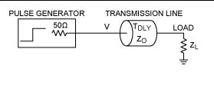
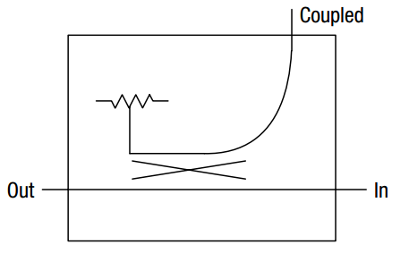
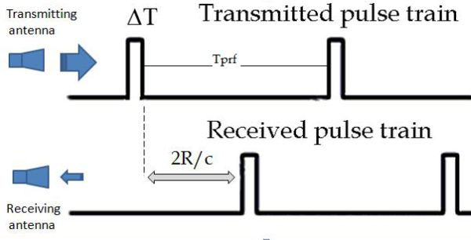
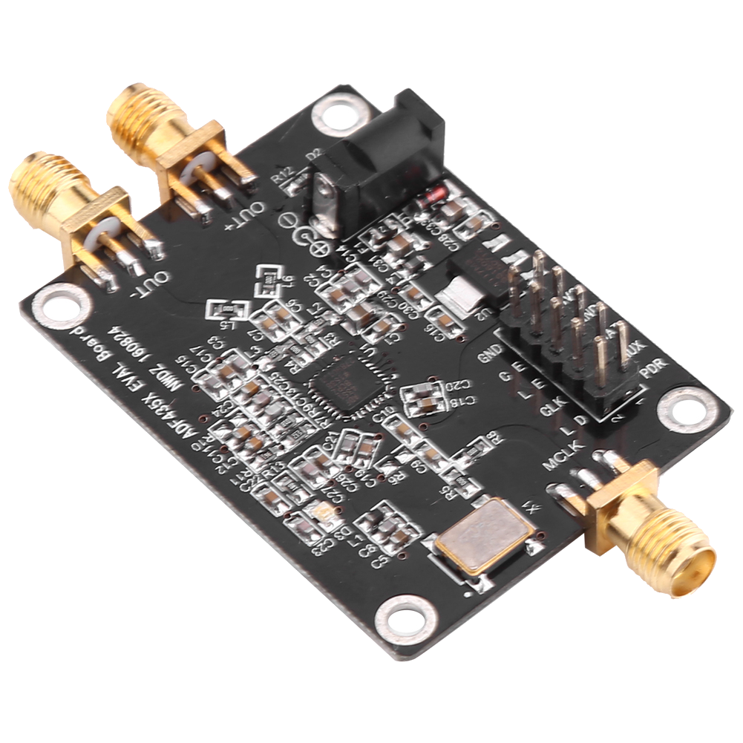
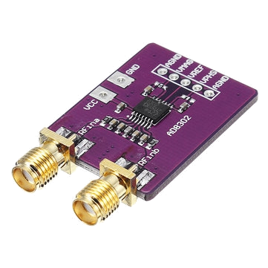
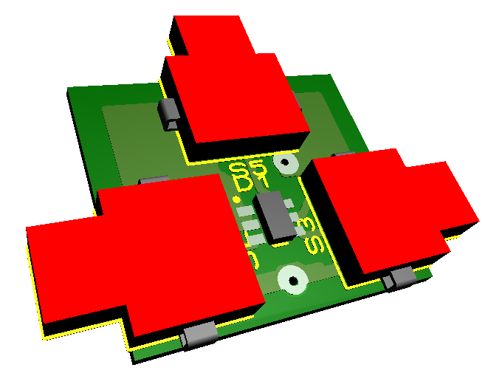
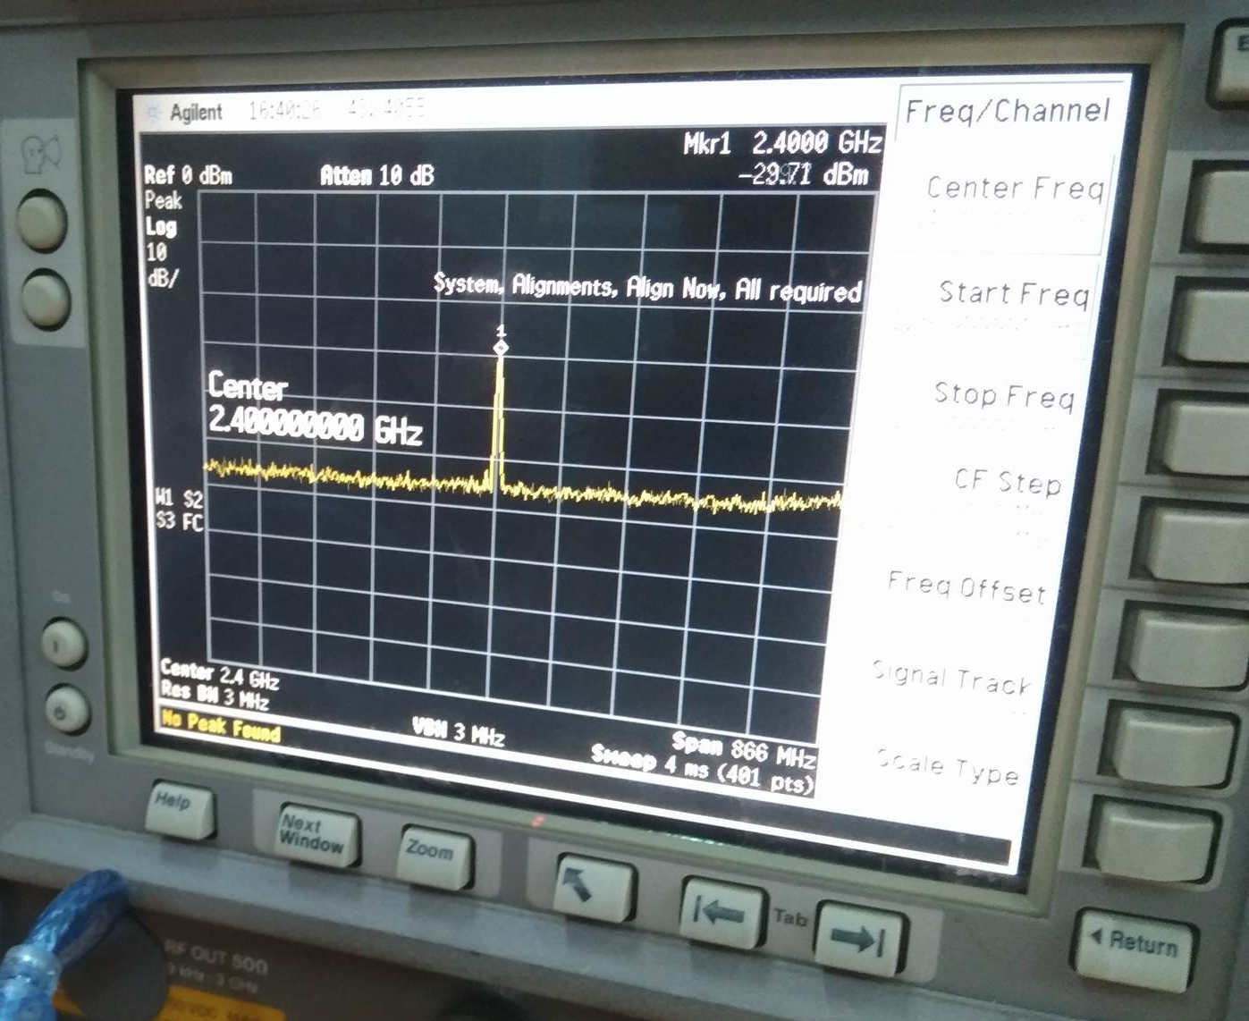
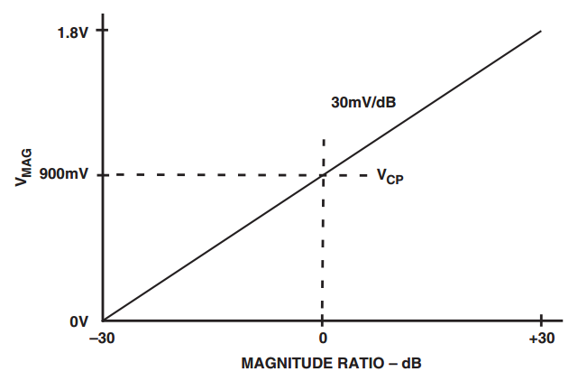



Low-cost vector network analyzer – VNA for measuring the antenna of IoT devices
Nguyen Manh Thao
Ph.D Trinh Le Huy
Phan Tri Dung
Computer Engineering
Instructor
Computer Engineering
What ?
Why ?
We introduce a device to analyzes qualities of the antenna in IoT devices, in which we have:
Nowadays, the IoT field is developing significantly, so the quality requirements of IoT devices is not only about the stable operation of itself but also a good ability in communicating with other IoT devices. Therefore, the demand of analyzing qualitiy of the antenna is more necessary.
Low cost (Under 100$)
Small size & easy to use
Work in most popular frequencies, such as 433MHz, 868MHz, 2.4GHz,…
However, the solutions, as well as devices that analyze the quality of the antenna, are still not popular and very expensive.
Overview
Generating a wave
Coupling a reverse wave
Coupling a reverse wave
Description
1. Generating a wave
2. Coupling a reverse wave
3. Compare to get the result
The generating module (ADF435x) will receive a command from microcontroller and generate the wave depended on the working frequency of antenna under test.
When the antenna transmits the message, the antenna always has the reverse wave. It is the reason making the quality of the antenna becomes worse
The quality of the antenna depends on result after comparing the reverse wave with the transmit wave. The less number of reverse wave, the better quality of the antenna
Picture 1: ADF4350 module
Picture 4: AD8302 module
Picture 3: 3D model or Coupler module
We used DC08-73LF to coupling the reverse wave from transmit wave. Therefore, we can analyse the quality of the antenna
Picture 2: ADF4350 output spectrum at 2.4GHz
Picture 4: Idealized Transfer Characteristics for the Gain Measurement Mode

