Slide 1
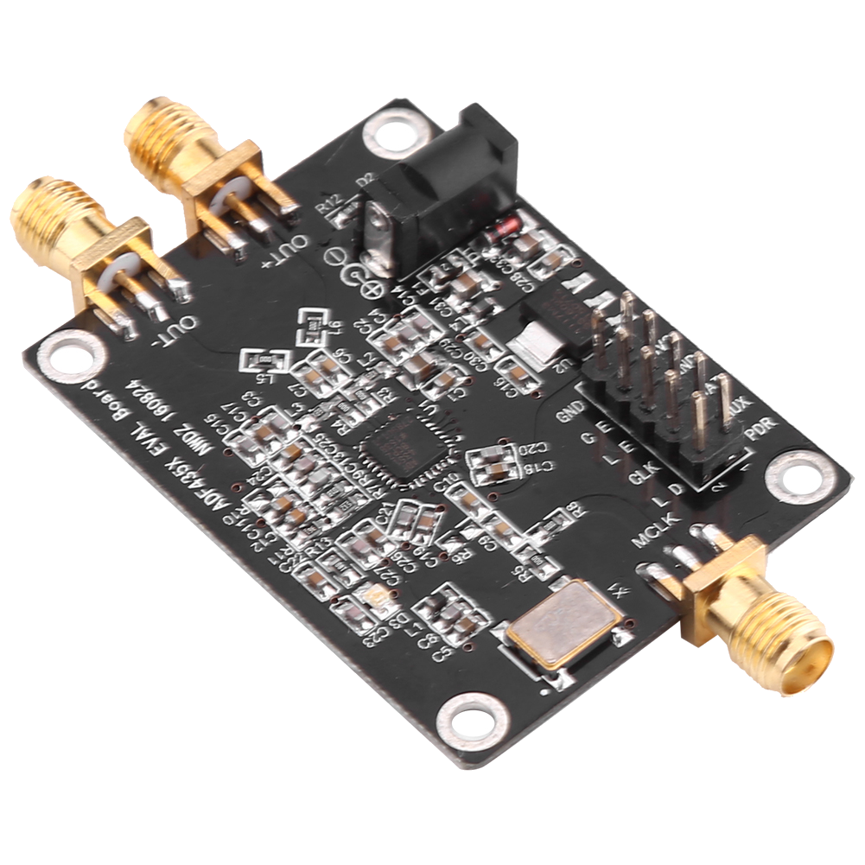
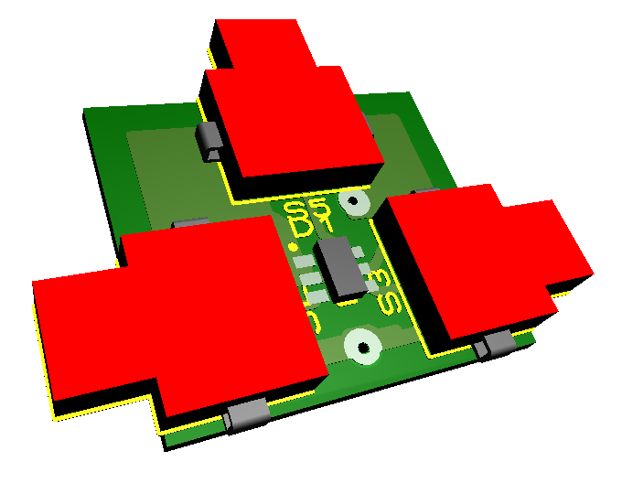
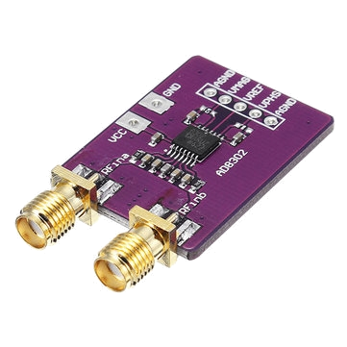
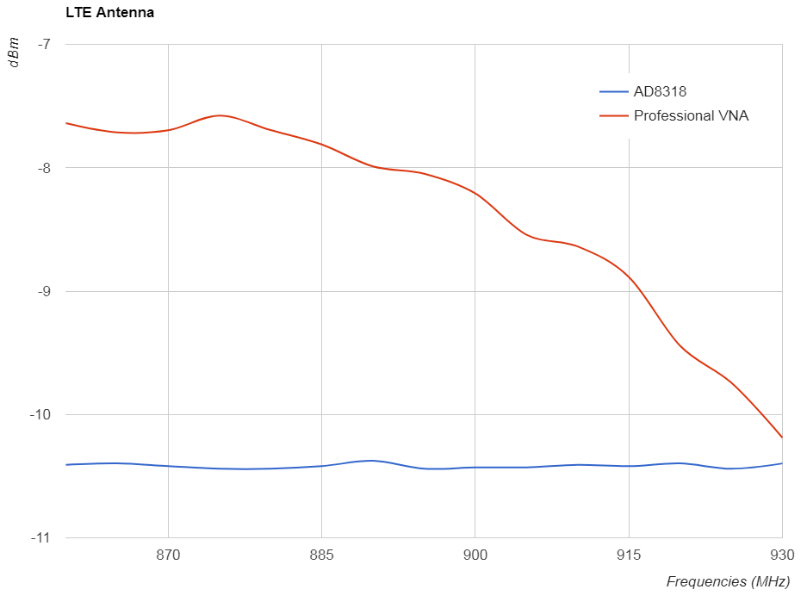
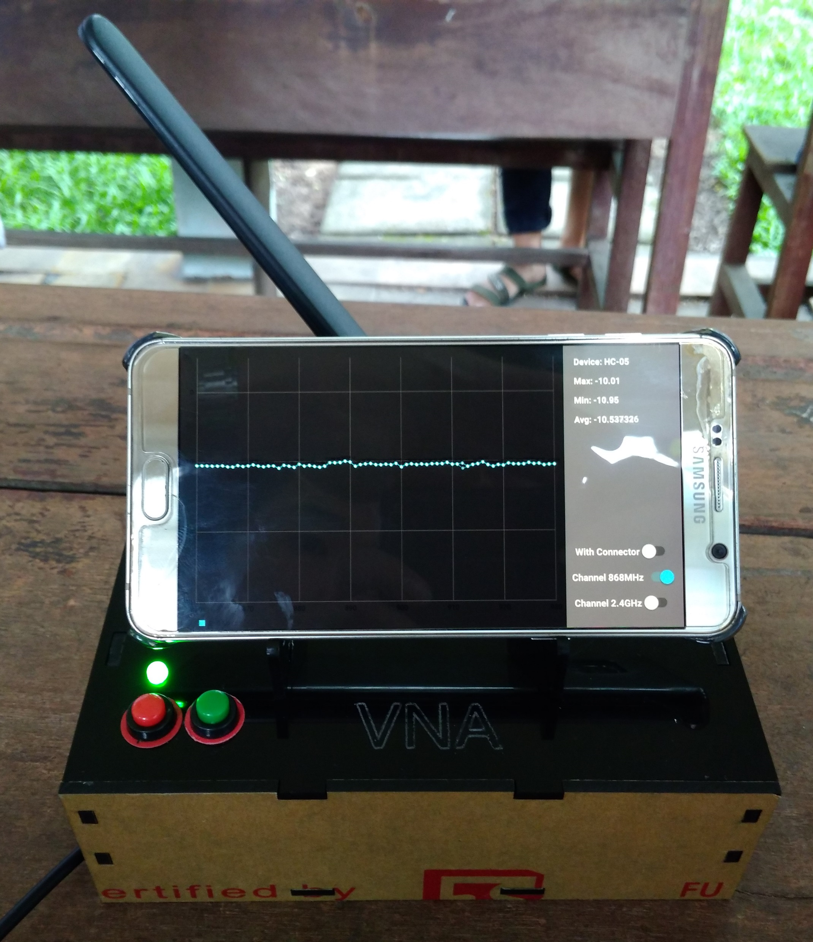
Low-cost vector network analyzer – VNA for measuring the antenna of IoT devices
Nguyen Manh Thao
Ph.D Trinh Le Huy
Phan Tri Dung
Computer Engineering
Computer Engineering
Lecturer
What ?
Why ?
We introduce a device to analyzes qualities of the antenna in IoT devices, in which we have:
Nowadays, the IoT field is developing significantly, so the quality requirements of IoT devices is not only about the stable operation of itself but also a good ability in communicating with other IoT devices. Therefore, the demand of analyzing qualitiy of the antenna is more necessary.
Low cost (Under 100$)
Small size & easy to use
Work in most popular frequencies, such as 433MHz, 868MHz, 2.4GHz,…
However, the solutions, as well as devices that analyze the quality of the antenna, are still not popular and very expensive.
Description
Generating a wave
Coupling a reverse wave
Compare to get the result
ADF4350 module
3D model or Coupler module
AD8302 module
Result
Conclusion
Although the device does not meet the accuracy specified, it still meets the following set of criteria:
Evaluate whether the antenna operates at frequencies between 860 MHz and 930 MHz (LoRa frequency)
Low cost (< 100 USD)
University of Information Technology

