Slide 1
Mini VNA
Mini vector network analyzer

Slide 2
Member
Nguyen Manh Thao Leader
Phan Tri Dung Member
Nguyen Tran Kha Member
Trinh Le Huy Instructor

Slide 3
Content
1. STATUS QUO
2. SOLUTION
3. DESIGN
4. RESULT
5. PLAN

Slide 4
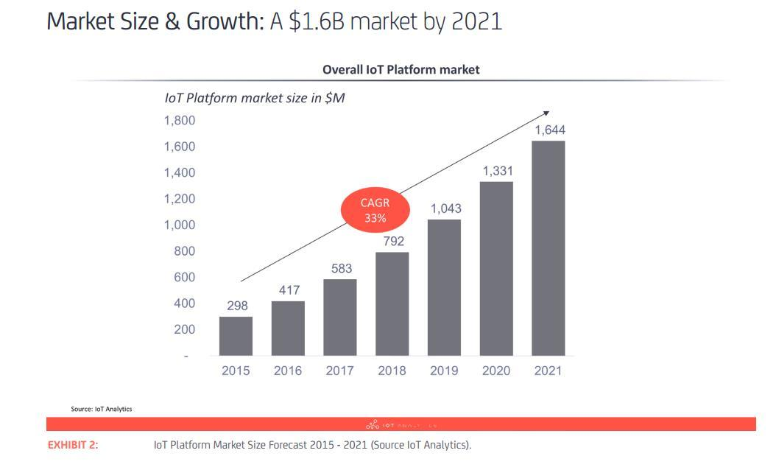
1. STATUS QUO
IoT market is now growth up and up

Slide 5
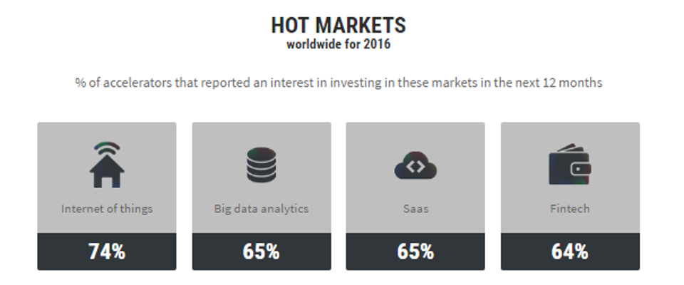
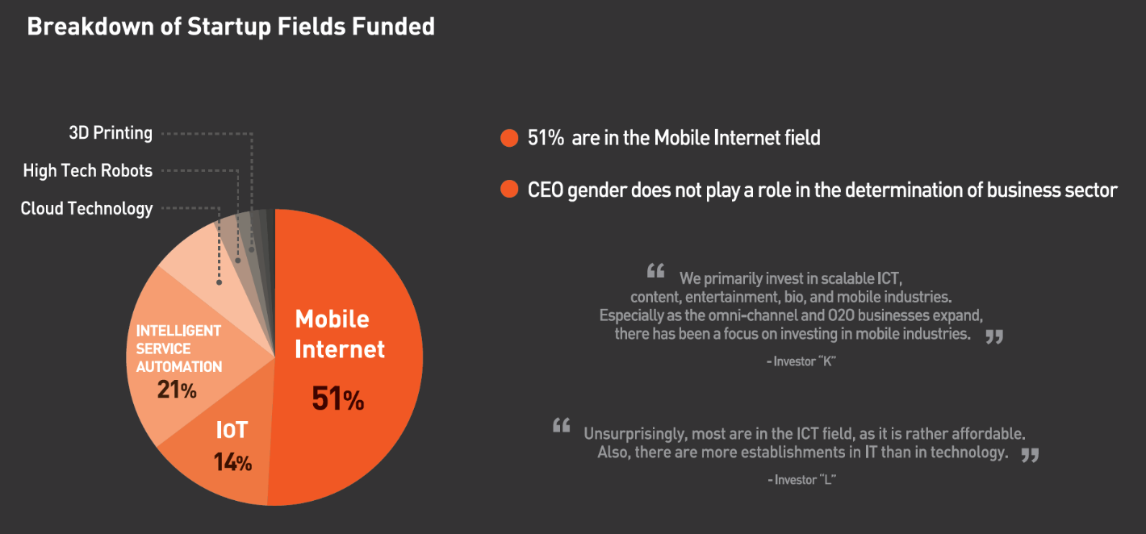
1. STATUS QUO
IoT market is now growth up and up
More and more Startup are in IoT field

Slide 6

1. STATUS QUO
But for the Startuper
how to know their product doing well – especially the antenna with
Have not much knowledge about atenna
Little money
Professional devices are very expensive

Slide 7

2. Solution
The project presents a device that analyzes qualities of the antenna in IoT devices.
Cheap
Small
Easy to use
Have two optional wave

Slide 8
2. Solution
RF reflection
MAGNITUDE

Slide 9
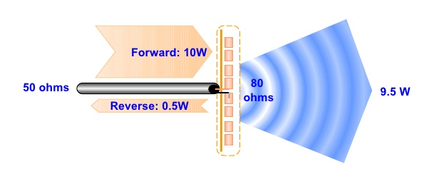
2. Solution
RF reflection
In real, when an atenna operates. Antenna always has a forward and reverse signal.
The good atenna the less reverse signal

Slide 10
2. Solution
MAGNITUDE
PM = log10 ( Prev/Pfor )
Pm: the output corresponding to the magnitude of the signal level difference (dB)
Prev: power of reverse signal
Pfor: power of forward signal

Slide 11
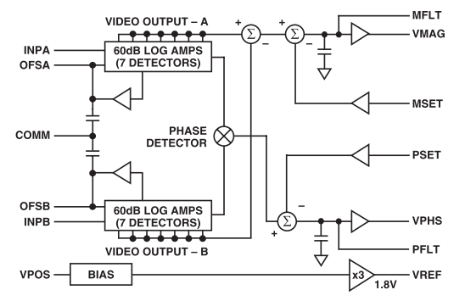

2. Solution
MAGNITUDE
Vmag: VMAG is the output corresponding to the magnitude of the signal level difference (V)
Vslp: called the slope (voltage) = 3.3/20
VinA: voltage of reverse signal.
VinB: voltage of forward signal.

Slide 12
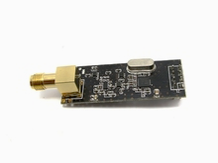
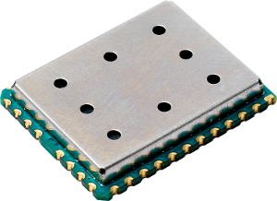
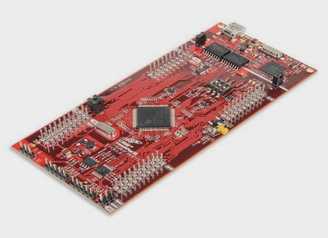
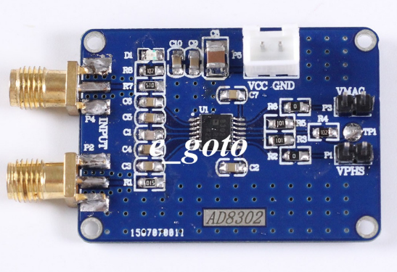
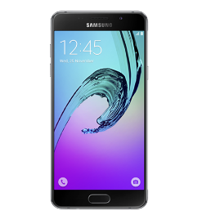
3. Design
DUT
1.5$
16,67$
1$
Generator
IM881a+NRF24L01
Coupler
36$
Forward signal
Reverse signal
UART+SPI
AD8302
Gain and Phase Detector
MCU
MAGNITUDE
20$
Total
75,17$
Bluetooth

Slide 13
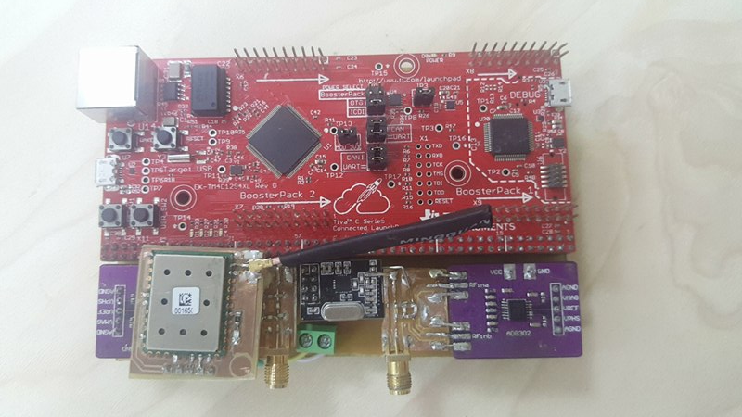
3. Design

Slide 14
3. Design
How it work
Create a sample wave
868Mhz and 2.4Ghz

Slide 15
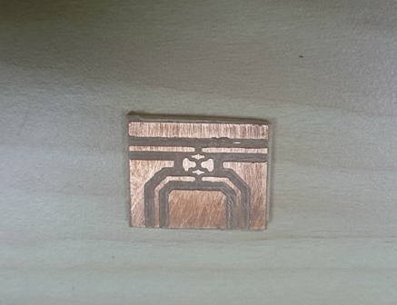
3. Design
How it work
Forward wave
Reverse
wave

Slide 16
3. Design
How it work
AD8302
Forward and reverse wave
Analog signals

Slide 17
3. Design
How it work
Analog signals
Calculate and sent results to smartphone

Slide 18
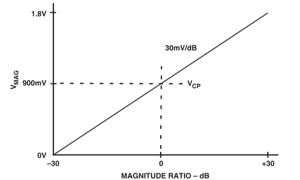
3. Design
How it work
Value = (100/3)*Vmag - 30
With this formula and the chart, we figure out the MAGNITUDE of the RF wave

Slide 19
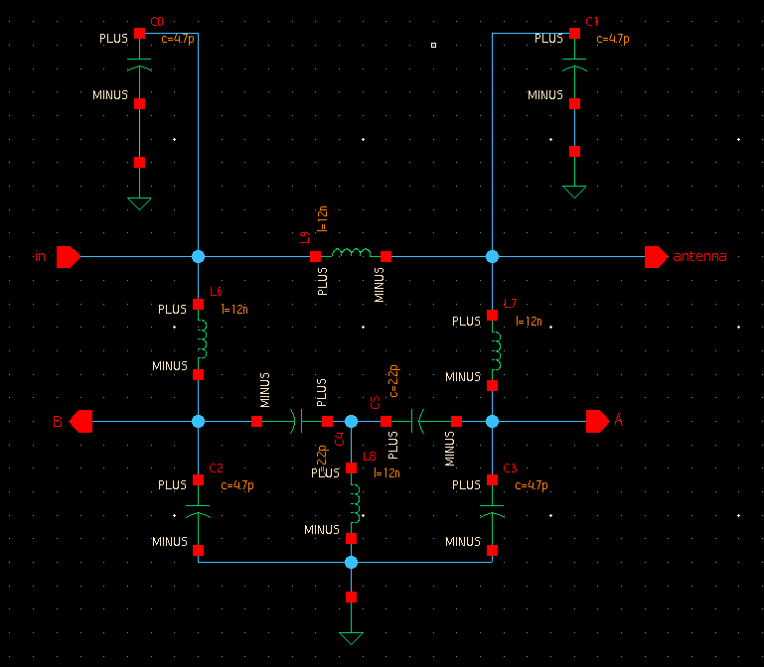
5. Plan
Make a chip

Slide 20
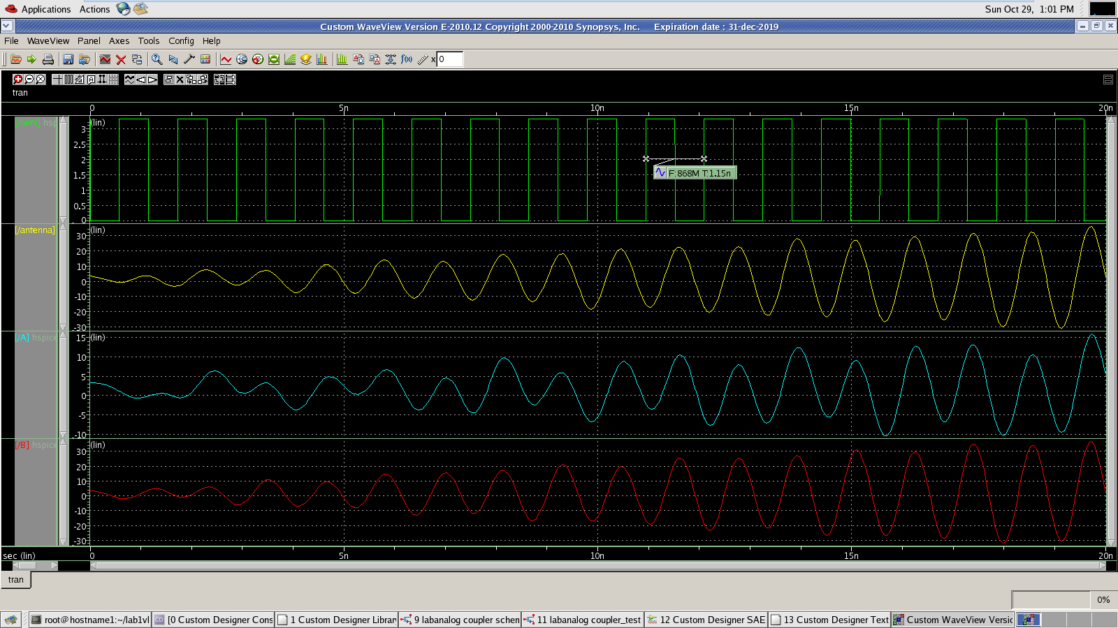
5. Plan

Slide 21
Our problem
Old Circuits worked unstable
Need new circuit
Weather maked the delivery to be late

Slide 22
Q&A

Slide 23
Thank you

