Slide 1
Proposed AX.25 Packet Network System
Josef Matondang

Slide 2
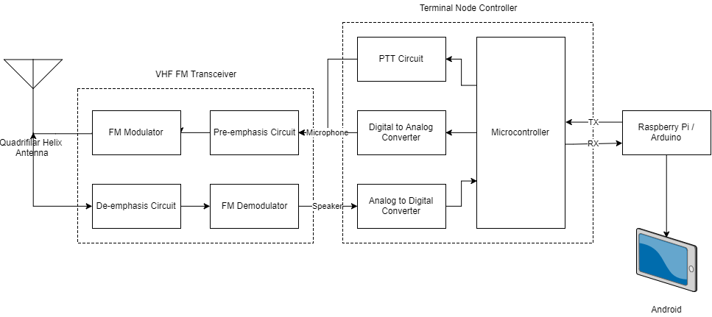
AX.25 Packet Network Hardware Block Diagram

Slide 3
AX.25 Packet Network Hardware Selection
Half-Duplex FM Radio AX.25 Network
Wide-Band FM VHF Transceiver
KISS TNC
Antenna (Omnidirectional)
Raspberry Pi Rev. 3
Power Supply for Radio
Full-Duplex FM Radio AX.25 Network
Analog Repeater
Wide-Band FM VHF Transceiver
KISS TNC
Antenna (Omnidirectional)
Raspberry Pi Rev. 3
Power Supply for Radio
Half-Duplex LoRa AX.25 Network
LoRa Module (SX1278)
KISS TNC, Arduino based
Antenna (Omnidirectional)
Raspberry Pi Rev.3
Power Supply for LoRa

Slide 4
Half Duplex - FM VHF Transceiver Based

Slide 5
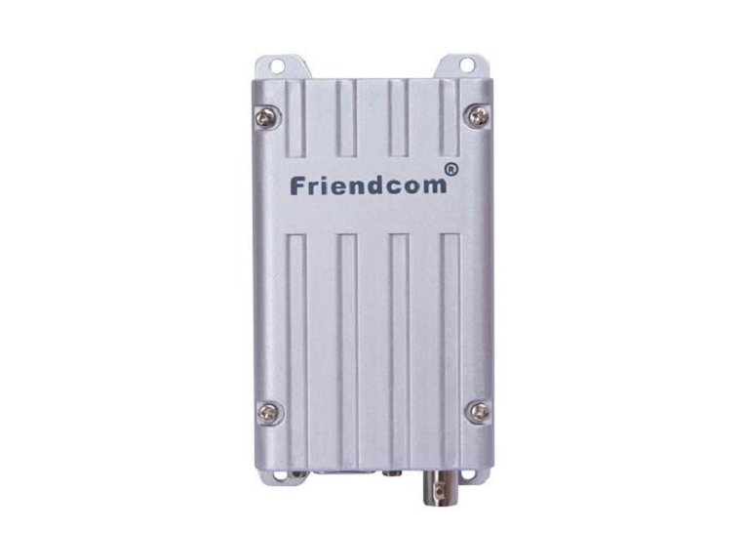
FM Transceiver Based AX.25 Network: Radio
Radio: FC-302/D
Specification:
FM Wideband 5W Power
CTCSS/DTCS
Max frequency deviation = 5 kHz
Duplex
Connectors:
Input: DB-15 Connector to Modem
Output: Antenna via RG-58 BNC

Slide 6
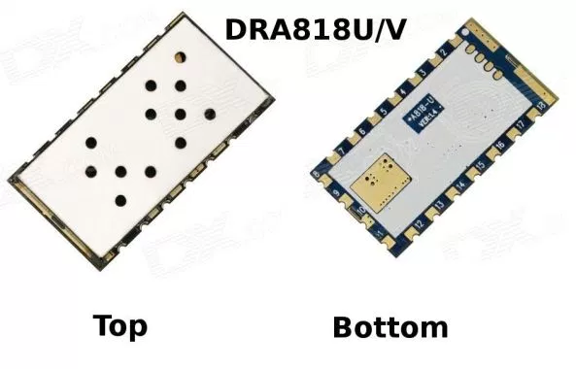
FM Transceiver Based AX.25 Network: Radio
Radio Alternative: Dorji DRA818V
Specification:
FM Narrow-band 1W Power on 3.3V Power
CTCSS/DTCS
Max frequency deviation = 2.5 kHz
Board:
Components:
Level Translator (TTL5V – CMOS3V3)
Power Amplifier (1W – 5W)
Connectors:
Input: Molex Conector for TTL and Power
Output: SMA Connector Male for Antenna

Slide 7
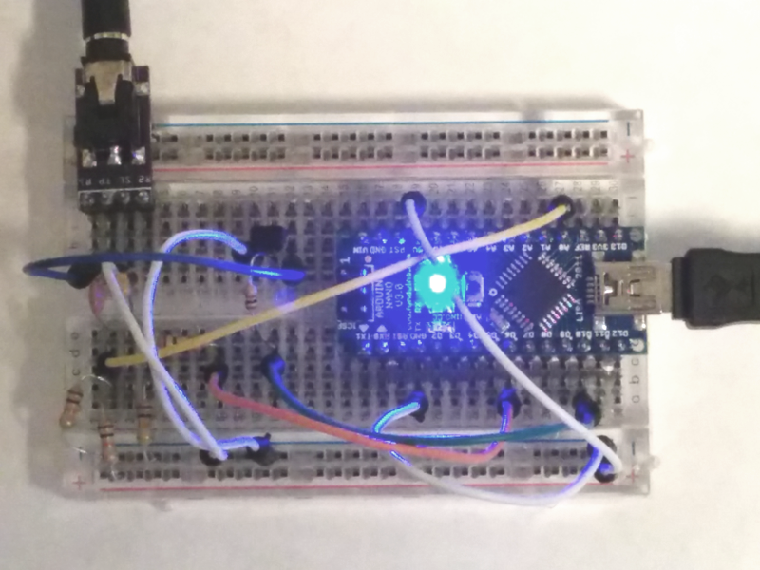
FM Transceiver Based AX.25 Network: KISS TNC
TNC: Mobilinkd
Specification:
Serial KISS Mode with CSMA
AFSK 1200 baud with HDLC
Board:
Components:
AF Impedance Matching (opt.) and AF Filters, ATmega328p + Arduino System Minimum.
Connectors:
Input: Serial Connector (USB) / Direct Serial Port to Raspberry Pi with Level Translator
Output: Molex connector for Audio Out, Audio In; Molex Connector for Power

Slide 8
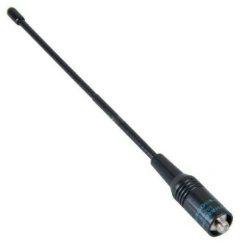
FM Transceiver Based AX.25 Network: Antenna
Omnidirectional Antenna (2dBi) To avoid Hidden Transmitter Syndrome
Quarter Wavelength Whip Antenna (Nagoya NA-701)
Length: 21 cm
Connectors:
BNC Connector

Slide 9
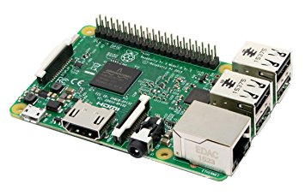
FM Transceiver Based AX.25 Network: Raspberry Pi
Software:
Client Socket Software
Digipeater Socket Software
Server Socket Software
Specification:
Bluetooth + WiFi + USB Interface
Connections:
Power via Micro USB

Slide 10
Full Duplex – FM VHF Transceiver Based

Slide 11
FM Transceiver Based AX.25 Network: Radio
Radio: FC-302/D
Specification:
FM Wideband 5W Power
CTCSS/DTCS
Max frequency deviation = 5 kHz
Duplex
Connectors:
Input: DB-15 Connector to Modem
Output: Antenna via RG-58 BNC

Slide 12
FM Transceiver Based AX.25 Network: KISS TNC
TNC: Mobilinkd
Specification:
Serial KISS Mode with CSMA
AFSK 1200 baud with HDLC
Board:
Components:
AF Impedance Matching (opt.) and AF Filters, ATmega328p + Arduino System Minimum.
Connectors:
Input: Serial Connector (USB) / Direct Serial Port to Raspberry Pi with Level Translator
Output: Molex connector for Audio Out, Audio In; Molex Connector for Power

Slide 13
FM Transceiver Based AX.25 Network: Raspberry Pi
Software:
Client Socket Software
Digipeater Socket Software
Server Socket Software
Specification:
Bluetooth + WiFi + USB Interface
Connections:
Power via Micro USB

Slide 14
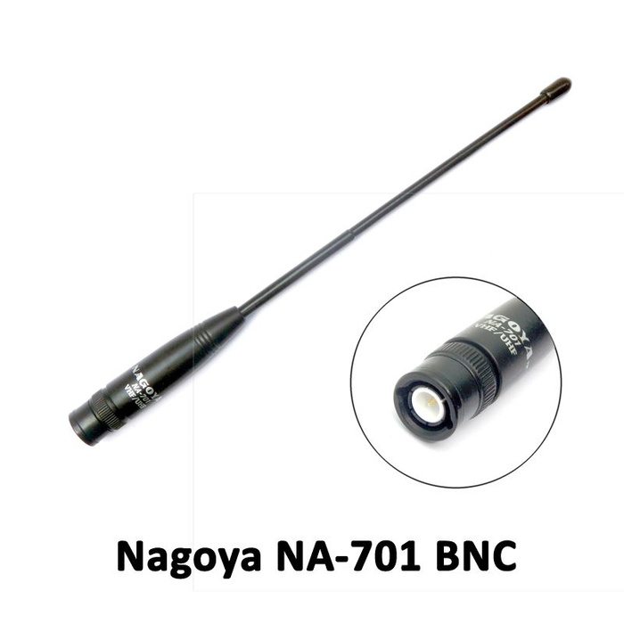
FM Transceiver Based AX.25 Network: Antenna
Omnidirectional Antenna (2dBi) To avoid Hidden Transmitter Syndrome
Quarter Wavelength Whip Antenna (Nagoya NA-701)
Length: 21 cm
Connectors:
BNC Connector

Slide 15
Half Duplex – LoRa Based

Slide 16
LoRa Based AX.25 Network: Radio
Radio: SX-1278
Specification:
Half-duplex SPI comm. to Microcontroller
LoRa Modulation
Power = 10mW
CAD mode, RF detect, CRC 256 bytes

Slide 17
FM Transceiver Based AX.25 Network: KISS TNC
TNC: Develop Own TNC
Specification:
KISS Mode with CSMA
Uses LoRa modulation, with CAD, LoRa packet framing
Board:
SX1278
Antenna Connector (SMA Male)
SPI Level Translator

Slide 18
FM Transceiver Based AX.25 Network: Raspberry Pi
Software:
Client Socket Software
Digipeater Socket Software
Server Socket Software
Specification:
Bluetooth + WiFi + USB Interface
Connections:
Power via Micro USB

Slide 19
FM Transceiver Based AX.25 Network: Antenna
Omnidirectional Antenna (2dBi) To avoid Hidden Transmitter Syndrome
Quarter Wavelength Whip Antenna (Nagoya NA-701)
Length: 21 cm
Connectors:
SMA Connector Female

