Slide 1
Aligning whole genomes with cactus – part 2
Chiara Bortoluzzi, PhD
ETH Zürich, Switzerland

Slide 2
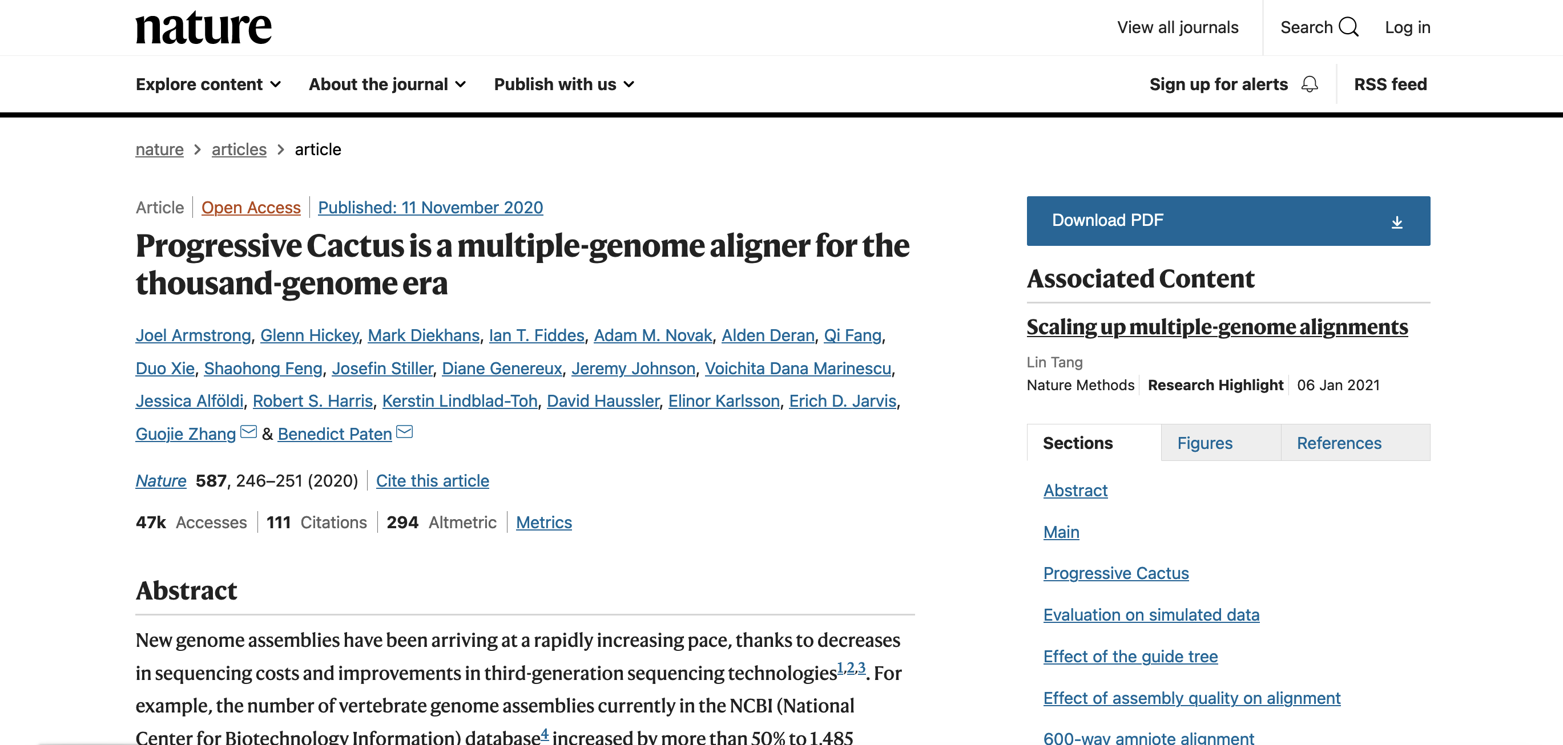
Progressive cactus
Paper of reference: https://www.nature.com/articles/s41586-020-2871-y

Slide 3
Progressive cactus - Input files
NEWICK tree
Name1 path1
Name2 path2
...
NameN pathN
Phylogenetic tree in NEWICK format
The phylogenetic tree should represent – as much as the possible – the “true” evolutionary relationships between species
Genome assemblies in FASTA format
The genome assemblies should be soft-masked (i.e., repeats in smallcase letters)

Slide 4
Progressive cactus
Phylogenetic tree to be used as guide tree
((simHuman:0.144018,(simMouse:0.084509,simRat:0.091589):0.271974):0.020593,(simCow:0.18908,simDog:0.16303):0.032898);
simHuman /path/to/genome/simHuman.chr6.fasta
simMouse /path/to/genome/simMouse.chr6.fasta
simRat /path/to/genome/simRat.chr6.fasta
simCow /path/to/genome/simCow.chr6.fasta
simDog /path/to/genome/ simDog.chr6.fasta
RUN : cactus jobStore evolverMammals.txt evolverMammals.hal
Genome assemblies in FASTA format
ATTENTION: make sure that the species name in the guide tree is the same as the genome assembly

Slide 5
Dataset
Download cactus alignment in HAL format from Ensembl Rapid Release (this is going to take )
https://ftp.ensembl.org/pub/rapid-release/data_files/multi/hal_files/Coleoptera_36-way_20230217.hal
Install cactus
https://github.com/ComparativeGenomicsToolkit/cactus
!! When running cactus and its utilities, remember to activate the virtual environment by simply typing
source cactus_env/bin/activate
If you want to deactivate the virtual environment, simpy type deactivate

Slide 6
Install cactus – part 1
# We are going to create another directory where we will install cactus
mkdir –p programme && cd programme
# Export PATH
export PATH="/workspace/conda/bin:$PATH”
# Let’s install a few more dependencies (this step is normally not necessary when installing cactus on a server! )
conda install gxx_linux-64
conda install –c anaconda hdf5
sudo apt-get install python3-pip

Slide 7
Install cactus – part 2
# Download cactus from the GitHub repository
git clone https://github.com/ComparativeGenomicsToolkit/cactus.git --recursive
# Install virtual environment
python3 -m pip install virtualenv
cd cactus
virtualenv -p python3 cactus_env
echo "export PATH=$(pwd)/bin:\$PATH" >> cactus_env/bin/activate
echo "export PYTHONPATH=$(pwd)/lib:\$PYTHONPATH" >> cactus_env/bin/activate
source cactus_env/bin/activate
python3 -m pip install -U setuptools pip
python3 -m pip install -U .
python3 -m pip install -U -r ./toil-requirement.txt
make –j 8

Slide 8
Work with the cactus alignment 1/n
The output file in HAL format represents the multiple sequence alignment. It includes all input and inferred ancestral sequences.
We can access the HAL file using the set of HAL tools that are included in cactus either as static binaries for the binary release or within the Docker image for the Docker release.
The first thing we need to do is to check that the HAL database is valid
halValidate $HAL

Slide 9
Working with cactus alignment 2/n
Print a list of genomes in alignment (including ancestral genomes)
halStats --genomes $HAL > genomes.txt
Print phylogenetic tree (including ancestral genomes)
halStats –tree $HAL> tree.nh
Print root genome name
halStats –root $HAL
Print sequences of a given genome in BED format (→ make sure that you use the name of the species as it appears in the HAL alignment. If you don’t remember it, then run the command above to print the list of genomes in alignment)
halStats --bedSequences $genome $HAL > $genome.bed

Slide 10
Working with cactus alignment 3/n
Export sequences of genome or subtree of genomes from HAL database FASTA file
hal2fasta $HAL $genome –sequence 1 –length 1000000 > $genome.1.1000000.fa
Count alignment depth. By default, this is a count of the number of other unique genomes each base aligns to, including ancestral genomes.
halAlignmentDepth --refSequence 1 --start 0 --length 1000000 --noAncestors --step 1 --outWiggle chr1.0.1000000.wig $HAL $genome
Transform WIG to BED:
cat chr1.0.1000000.wig | while read line;do awk ‘OFS=“\t”{print 1, NR-1, NR, $line}';done > chr1.0.1000000.bed

Slide 11
Working with cactus alignment 4/n
Extract single copy regions (in BED format)
halSingleCopyRegionsExtract --refSequence 1 --start 0 --length 1000000 $HAL $genome > $genome.singleCopyRegions.bed
Calculate coverage by sampling bases (by default: 1000000 bases)
halCoverage $HAL $genome --numSamples 100000 > $genome.100000.coverage

Slide 12
Working with cactus alignment 5/n
Map BED or PSL genome interval coordinates between two genomes
halLiftover --outPSL $HAL $source_genome $source.bed $target_genome $target.bed
→ The PSL output can be used in axtChain to generate a pairwise alignment
Most comparative genomics programmes require a multiple sequence alignment in MAF format.
hal2maf --refSequence 1 –refGenome $genome –start 0 --length 1000000 --noAncestors --onlyOrthologs $HAL $genome.1.1000000.maf

Slide 13
Useful resources to work with an alignment in MAF format
Phylogenetic Analysis with Space/Time models (PHAST): http://compgen.cshl.edu/phast/
MAFTools: https://github.com/ComparativeGenomicsToolkit/mafTools
Maf_stream: https://github.com/ComparativeGenomicsToolkit/maf_stream

