Slide 1


Running cactus
Thiago A. L. GENEZ, PhD
Embl-ebi, Hinxton, Cambridgeshire

Slide 2
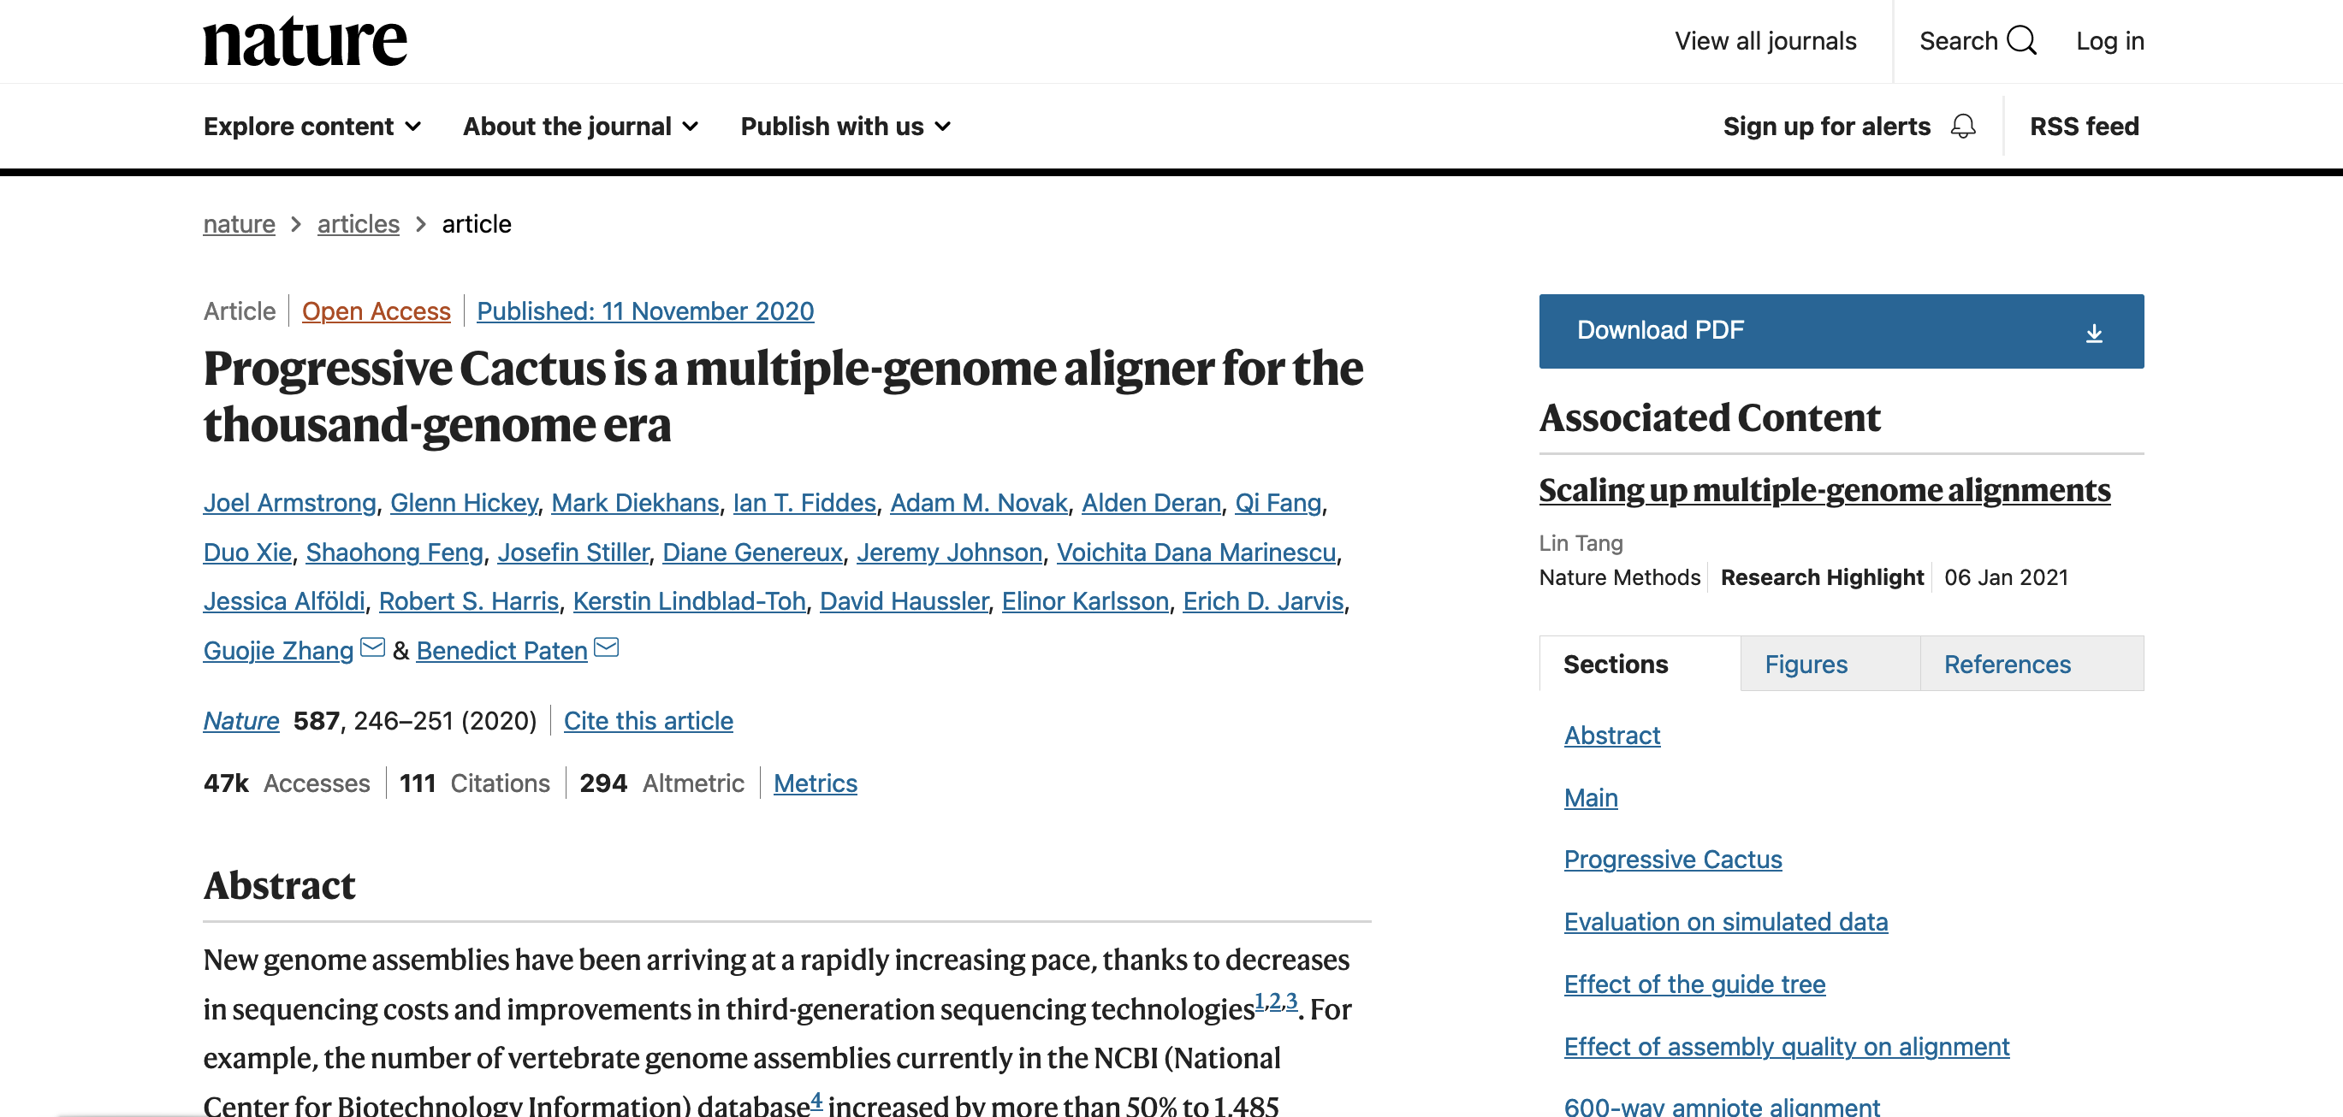
Progressive cactus
Paper of reference: https://www.nature.com/articles/s41586-020-2871-y

Slide 3
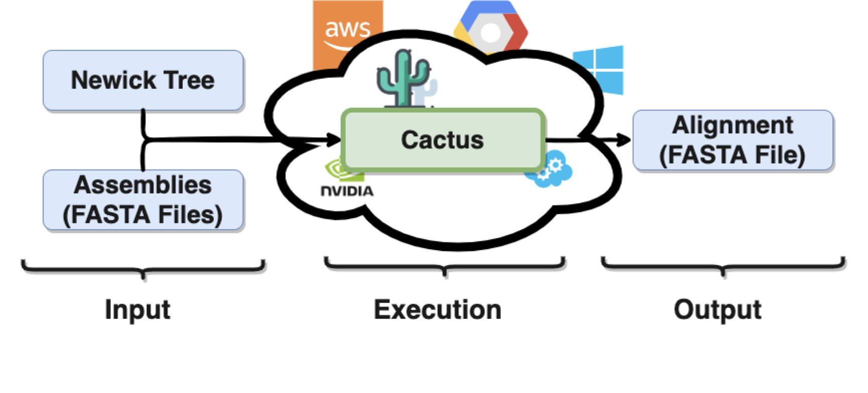
Running Cactus
Computationally demanding task
Alignments in timely manner requires a large amount of resources
Input: Phylogenetic tree and assemblies in FASTA format
Output: Alignment for the given tree in the HAL format
Processing capabilities
Cluster
HPC
Cloud-based

Slide 4
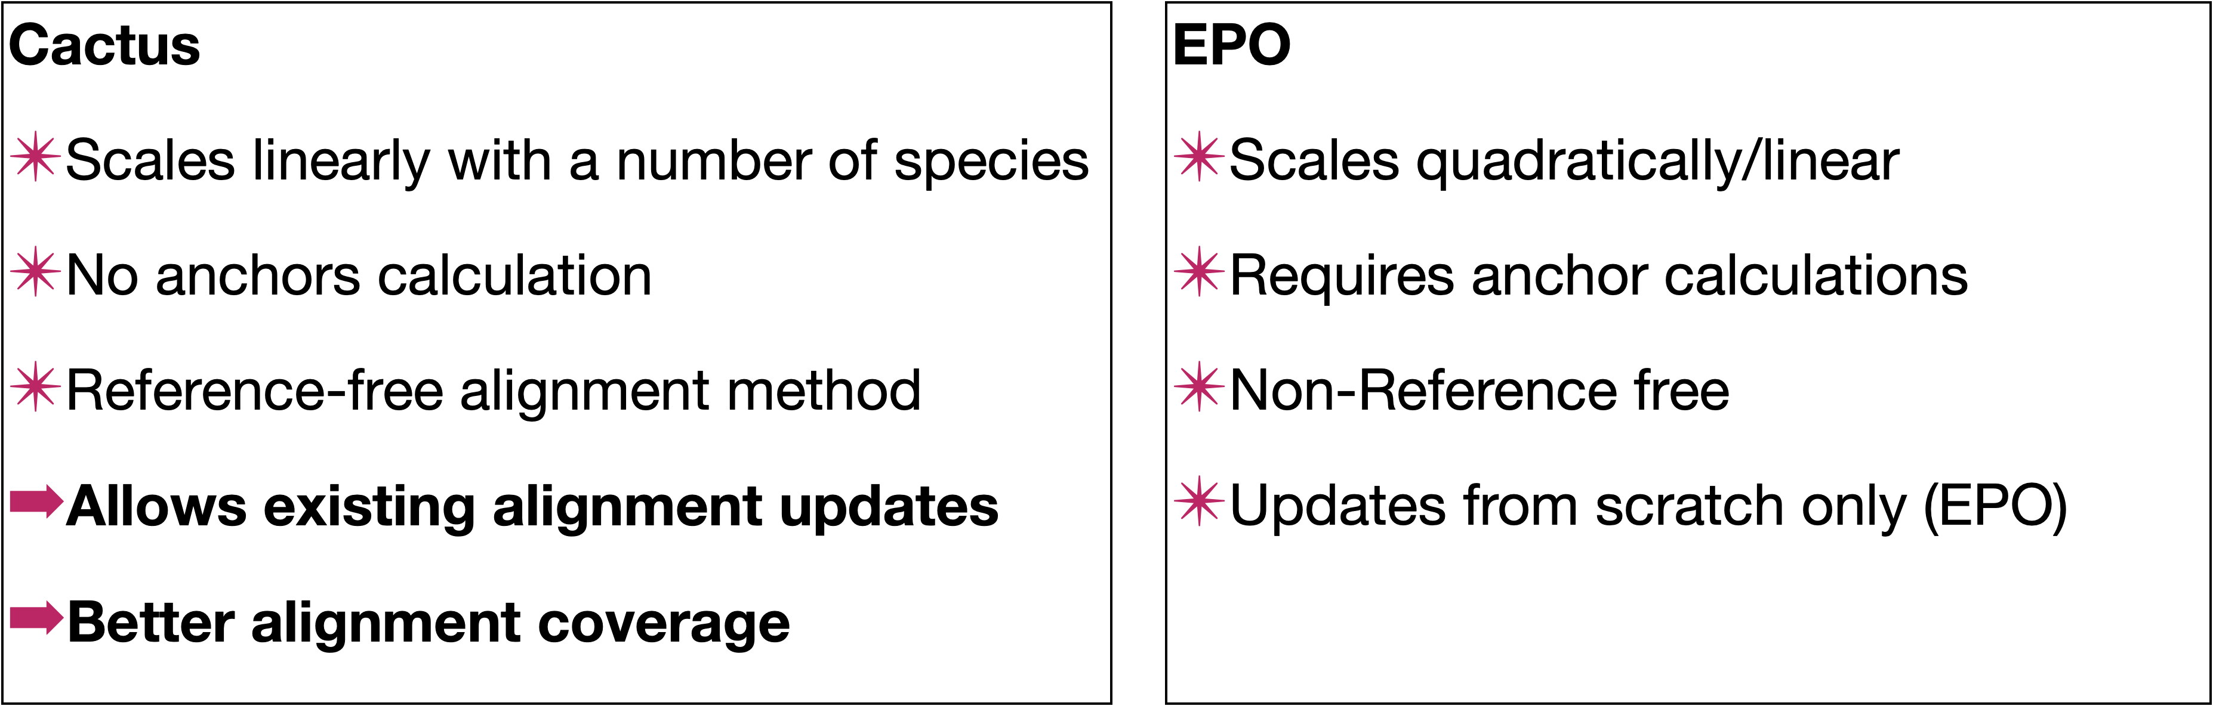
Running cactus

Slide 5
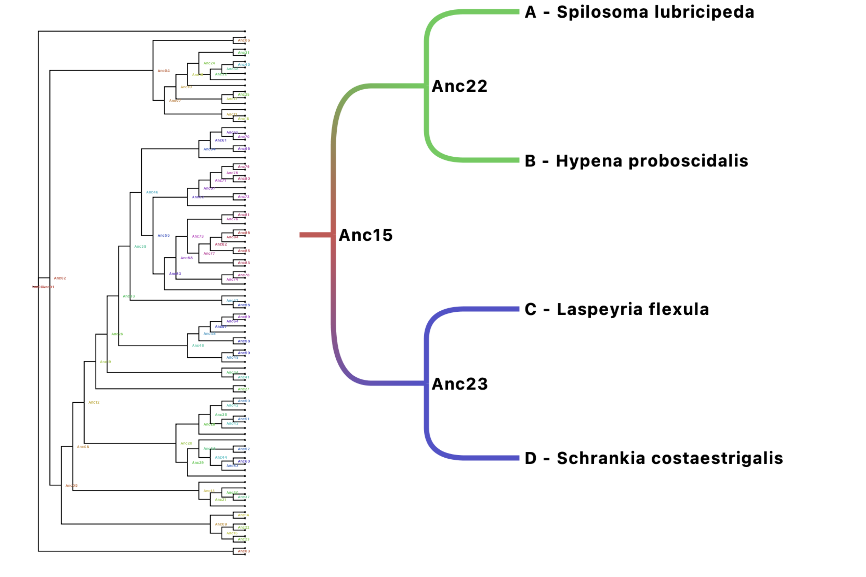

Running Cactus
Lepidoptera Example
88 genomes
Rootward fashion

Slide 6
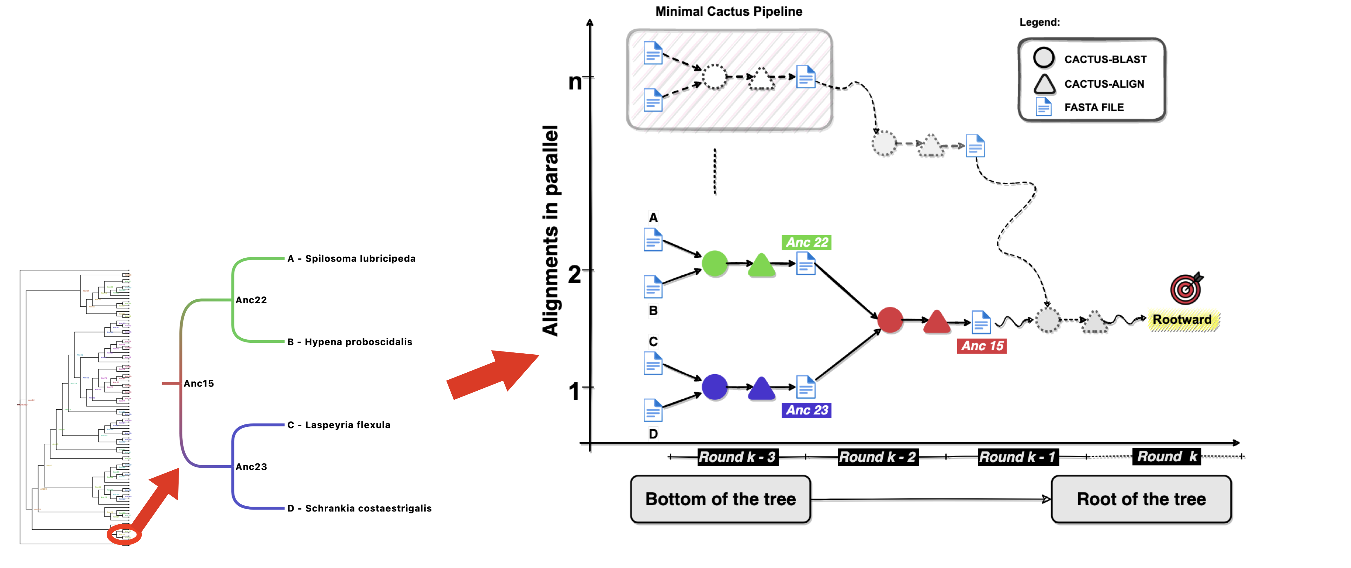
Running Cactus
Minimal Pipeline
Cactus-Blast (input: FASTA file)
Cactus-Align
Hal2fasta (output: FASTA file)

Slide 7
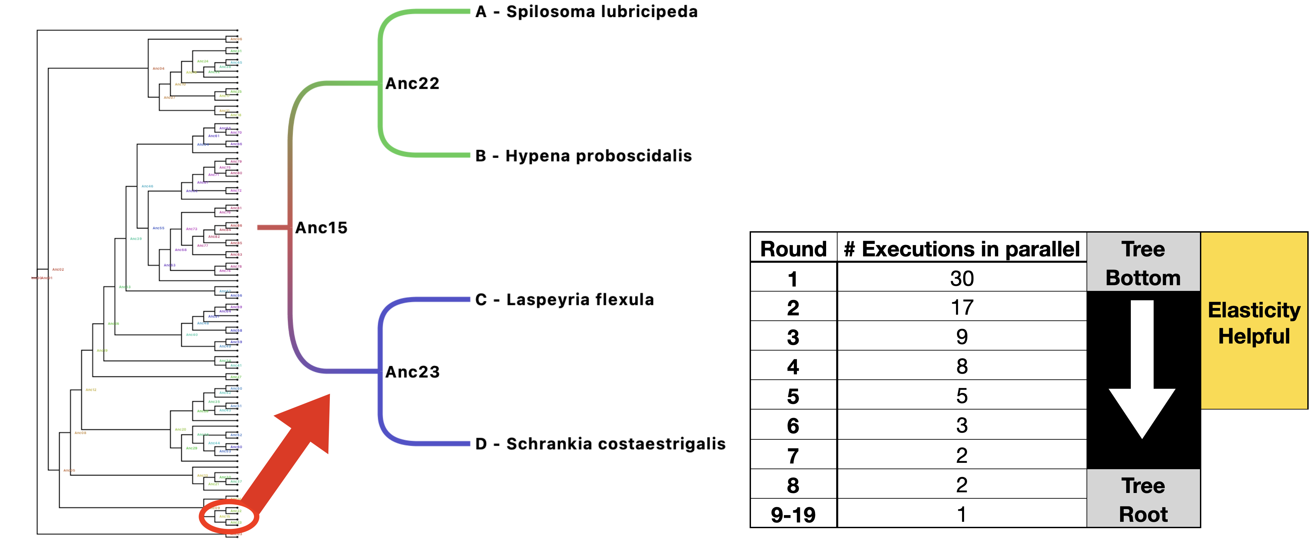
Running Cactus
Lepidoptera Example
88 genomes
19 levels (rounds)
87 minimal cactus pipeline
47

Slide 8
Running Cactus
Cactus-Blast
Run in one machine
GPU enable
Inter-core and -GPU Parallelisation
Cactus-Align
Run in one machine
CPU-only
Inter-core Parallelisation
Memory hungry
Hal2fasta
Mono-core executable
O(n) memory, where n is the size of the HAL file
Minimal Cactus Pipeline
Cactus-blast
Cactus-align
hal2fasta

Slide 9
Exercise 01
Let’s have some Fun!
/workspace/cactus/exercises/01/exercise-01.md

Slide 10
Progressive cactus - Input files
NEWICK tree
Name1 path1
Name2 path2
...
NameN pathN
Phylogenetic tree in NEWICK format
The phylogenetic tree should represent – as much as the possible – the “true” evolutionary relationships between species
Genome assemblies in FASTA format
The genome assemblies should be soft-masked (i.e., repeats in smallcase letters)

Slide 11
Progressive cactus
Phylogenetic tree to be used as guide tree
((simHuman:0.144018,(simMouse:0.084509,simRat:0.091589):0.271974):0.020593,(simCow:0.18908,simDog:0.16303):0.032898);
simHuman /path/to/genome/simHuman.chr6.fasta
simMouse /path/to/genome/simMouse.chr6.fasta
simRat /path/to/genome/simRat.chr6.fasta
simCow /path/to/genome/simCow.chr6.fasta
simDog /path/to/genome/ simDog.chr6.fasta
RUN : cactus jobStore evolverMammals.txt evolverMammals.hal
Genome assemblies in FASTA format
ATTENTION: make sure that the species name in the guide tree is the same as the genome assembly

Slide 12
Running Cactus
cactus-prepare \
/workspace/cactus_install/cactus/examples/evolverMammals.txt \
--jobStore jobstore \
--outDir working_dir \
--outSeqFile working_dir/steps.txt \
--outHal working_dir/final_alignment.hal \
--preprocessBatchSize 1 \
--cactusOptions '--logInfo --retryCount 0' \
--blastCores 8 \
--alignCores 8 > commands.txt
((simHuman:0.144018,(simMouse:0.084509,simRat:0.091589):0.271974):0.020593,(simCow:0.18908,simDog:0.16303):0.032898);
simHuman /path/to/genome/simHuman.chr6.fasta
simMouse /path/to/genome/simMouse.chr6.fasta
simRat /path/to/genome/simRat.chr6.fasta
simCow /path/to/genome/simCow.chr6.fasta
simDog /path/to/genome/ simDog.chr6.fasta

Slide 13
Running Cactus
## Preprocessor
cactus-preprocess jobstore/0 tree.nwk steps/steps.txt --inputNames bactrocera_neohumeralis_gca024586455v2rs --logInfo --retryCount 0 --gpu all --logFile steps/logs/preprocess-bactrocera_neohumeralis_gca024586455v2rs.log
cactus-preprocess jobstore/1 tree.nwk steps/steps.txt --inputNames machimus_atricapillus_gca933228815v1 --logInfo --retryCount 0 --gpu all --logFile steps/logs/preprocess-machimus_atricapillus_gca933228815v1.log
[...]
## Alignment
### Round 0
cactus-blast jobstore/40 steps/steps.txt steps/Anc06.paf --root Anc06 --logInfo --retryCount 0 --maxCores 48 --gpu all --logFile steps/logs/blast-Anc06.log
cactus-align jobstore/41 steps/steps.txt steps/Anc06.paf steps/Anc06.hal --root Anc06 --logInfo --retryCount 0 --maxCores 48 --logFile steps/logs/align-Anc06.log
hal2fasta steps/Anc06.hal Anc06 --hdf5InMemory > steps/Anc06.fa
cactus-blast jobstore/42 steps/steps.txt steps/Anc09.paf --root Anc09 --logInfo --retryCount 0 --maxCores 48 --gpu all --logFile steps/logs/blast-Anc09.log
cactus-align jobstore/43 steps/steps.txt steps/Anc09.paf steps/Anc09.hal --root Anc09 --logInfo --retryCount 0 --maxCores 48 --logFile steps/logs/align-Anc09.log
hal2fasta steps/Anc09.hal Anc09 --hdf5InMemory > steps/Anc09.fa
### Round 1
[…]
### Round 2
[…]
### Round k
cactus-blast jobstore/116 steps/steps.txt steps/Anc00.paf --root Anc00 --logInfo --retryCount 0 --maxCores 48 --gpu all --logFile steps/logs/blast-Anc00.log
cactus-align jobstore/117 steps/steps.txt steps/Anc00.paf steps/40-way-drosophila.hal --root Anc00 --logInfo --retryCount 0 --maxCores 48 --logFile steps/logs/align-Anc00.log
hal2fasta steps/40-way-drosophila.hal Anc00 --hdf5InMemory > steps/Anc00.fa
## HAL merging
halAppendSubtree steps/40-way-drosophila.hal steps/Anc02.hal Anc02 Anc02 --merge --hdf5InMemory
halAppendSubtree steps/40-way-drosophila.hal steps/Anc05.hal Anc05 Anc05 --merge --hdf5InMemory
[...]

Slide 14
Exercise 02
Let’s have MORE Fun!
/workspace/cactus/exercises/02/exercise-02.md

Slide 15
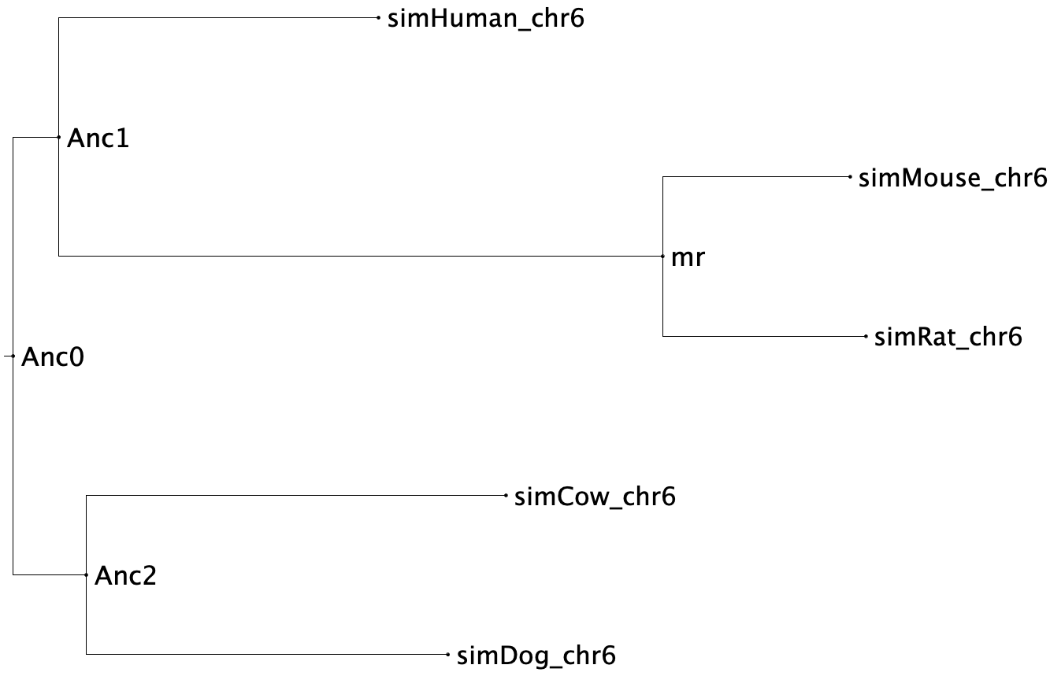

Slide 16
Running Cactus
Output file of Cactus-prepare
List of Cactus command-lines
Parsed to a specialised Workflow Management System
SLURM-based cluster (Compara)
LSF based cluster
Nextflow (work in proress)

Slide 17
Take away
#!/bin/bash
### - preprocessor step
source run/batch/1-preprocessors/scripts/all/all-preprocessor.sh
### - alignments step
source run/batch/2-alignments/0/scripts/all/Anc06.sh
source run/batch/2-alignments/0/scripts/all/Anc09.sh
[...]
### - alignments step round 1
[...]
### - alignments step round 2
[...]
[...]
### - alignments step round k
source run/batch/2-alignments/13/scripts/all/Anc00.sh
### - merging step
source run/batch/3-merging/scripts/all/all-merging.sh
SLURM based cluster at Ensembl/Compara
Algorithm
Get the tree and fasta files
Call cactus-prepare and save the output
Call ”slumify” script to parse the output of cactus-prepare
Call script to dispatch the jobs to the SLURM cluster

Slide 18
Aligning whole genomes with cactus – part 2
Chiara Bortoluzzi, PhD
ETH Zürich, Switzerland

Slide 19
Dataset
Download cactus alignment in HAL format from Ensembl Rapid Release (this is going to take )
https://ftp.ensembl.org/pub/rapid-release/data_files/multi/hal_files/Coleoptera_36-way_20230217.hal
Install cactus
https://github.com/ComparativeGenomicsToolkit/cactus
!! When running cactus and its utilities, remember to activate the virtual environment by simply typing
source cactus_env/bin/activate
If you want to deactivate the virtual environment, simpy type deactivate

Slide 20
Install cactus – part 1
# We are going to create another directory where we will install cactus
mkdir –p programme && cd programme
# Export PATH
export PATH="/workspace/conda/bin:$PATH”
# Let’s install a few more dependencies (this step is normally not necessary when installing cactus on a server! )
conda install gxx_linux-64
conda install –c anaconda hdf5
sudo apt-get install python3-pip

Slide 21
Install cactus – part 2
# Download cactus from the GitHub repository
git clone https://github.com/ComparativeGenomicsToolkit/cactus.git --recursive
# Install virtual environment
python3 -m pip install virtualenv
cd cactus
virtualenv -p python3 cactus_env
echo "export PATH=$(pwd)/bin:\$PATH" >> cactus_env/bin/activate
echo "export PYTHONPATH=$(pwd)/lib:\$PYTHONPATH" >> cactus_env/bin/activate
source cactus_env/bin/activate
python3 -m pip install -U setuptools pip
python3 -m pip install -U .
python3 -m pip install -U -r ./toil-requirement.txt
make –j 8
PS – For SPACK users – it will be available soon via Ensembl

Slide 22
Work with the cactus alignment 1/n
The output file in HAL format represents the multiple sequence alignment. It includes all input and inferred ancestral sequences.
We can access the HAL file using the set of HAL tools that are included in cactus either as static binaries for the binary release or within the Docker image for the Docker release.
The first thing we need to do is to check that the HAL database is valid
halValidate $HAL

Slide 23
Working with cactus alignment 2/n
Print a list of genomes in alignment (including ancestral genomes)
halStats --genomes $HAL > genomes.txt
Print phylogenetic tree (including ancestral genomes)
halStats –tree $HAL> tree.nh
Print root genome name
halStats –root $HAL
Print sequences of a given genome in BED format (→ make sure that you use the name of the species as it appears in the HAL alignment. If you don’t remember it, then run the command above to print the list of genomes in alignment)
halStats --bedSequences $genome $HAL > $genome.bed

Slide 24
Working with cactus alignment 3/n
Export sequences of genome or subtree of genomes from HAL database FASTA file
hal2fasta $HAL $genome –sequence 1 –length 1000000 > $genome.1.1000000.fa
Count alignment depth. By default, this is a count of the number of other unique genomes each base aligns to, including ancestral genomes.
halAlignmentDepth --refSequence 1 --start 0 --length 1000000 --noAncestors --step 1 --outWiggle chr1.0.1000000.wig $HAL $genome
Transform WIG to BED:
cat chr1.0.1000000.wig | while read line;do awk ‘OFS=“\t”{print 1, NR-1, NR, $line}';done > chr1.0.1000000.bed

Slide 25
Working with cactus alignment 4/n
Extract single copy regions (in BED format)
halSingleCopyRegionsExtract --refSequence 1 --start 0 --length 1000000 $HAL $genome > $genome.singleCopyRegions.bed
Calculate coverage by sampling bases (by default: 1000000 bases)
halCoverage $HAL $genome --numSamples 100000 > $genome.100000.coverage

Slide 26
Working with cactus alignment 5/n
Map BED or PSL genome interval coordinates between two genomes
halLiftover --outPSL $HAL $source_genome $source.bed $target_genome $target.bed
→ The PSL output can be used in axtChain to generate a pairwise alignment
Most comparative genomics programmes require a multiple sequence alignment in MAF format.
hal2maf --refSequence 1 –refGenome $genome –start 0 --length 1000000 --noAncestors --onlyOrthologs $HAL $genome.1.1000000.maf

Slide 27
Useful resources to work with an alignment in MAF format
Phylogenetic Analysis with Space/Time models (PHAST): http://compgen.cshl.edu/phast/
MAFTools: https://github.com/ComparativeGenomicsToolkit/mafTools
Maf_stream: https://github.com/ComparativeGenomicsToolkit/maf_stream

Slide 28
Thank you!
Questions?

Slide 29
Thank you to
Ensembl EMBL-EBI Group
Ensembl EMBL-EBI Compara Team

