Slide 1
Implementation of Frame Mode MPLS
Introducing MPLS Networks

Slide 2

The MPLS Conceptual Model

Slide 3
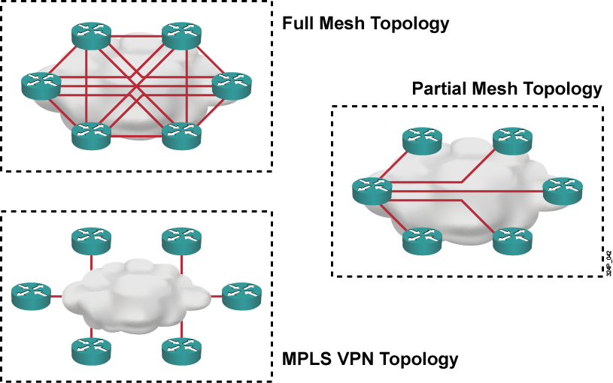
VPN Topologies

Slide 4
Basic MPLS Features
  MPLS is a switching mechanism in which packets are forwarded based on labels.
  Labels usually correspond to IP destination networks (equal to traditional IP forwarding).
  Labels can also correspond to other parameters:
    Layer 3 VPN destination
    Layer 2 circuit
    Outgoing interface on the egress router
    QoS
    Source address
  MPLS was designed to support forwarding of non-IP protocols as well.

Slide 5
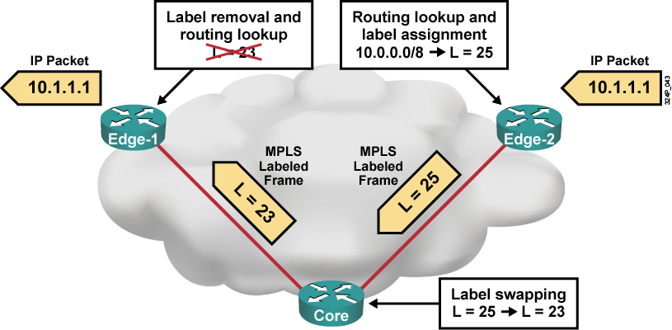
Basic MPLS Concepts Example
  Only edge routers must perform a routing lookup.
  Core routers switch packets based on simple label lookups and swap labels.

Slide 6
Router Switching Mechanisms

Slide 7
Cisco IOS Platform Switching Mechanisms
The Cisco IOS platform supports three IP switching mechanisms:
  Routing table-driven switching—process switching:
    Full lookup is performed at every packet
  Cache-driven switching—fast switching:
    Most recent destinations are entered in the cache
    First packet is always process-switched
  Topology-driven switching:
    CEF (prebuilt FIB table)

Slide 8
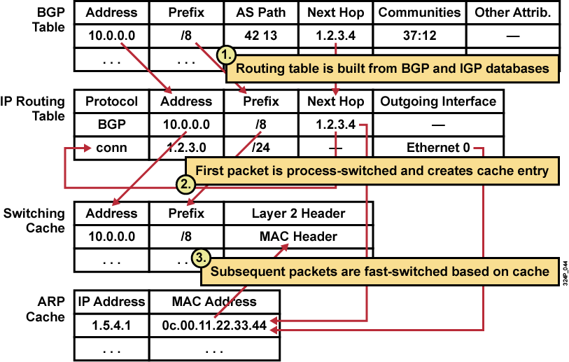
Standard IP Switching Review

Slide 9
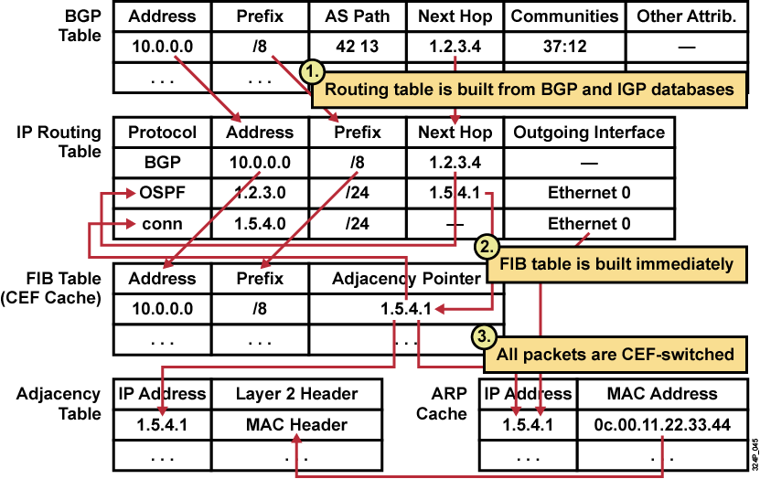
CEF Switching Review

Slide 10
MPLS Architecture

Slide 11
Major Components of MPLS Architecture
  Control plane:
    Exchanges routing information and labels
    Contains complex mechanisms to exchange routing information, such as OSPF, EIGRP, IS-IS, and BGP
    Exchanges labels, such as LDP, BGP, and RSVP
  Data plane:
    Forwards packets based on labels
    Has a simple forwarding engine

Slide 12
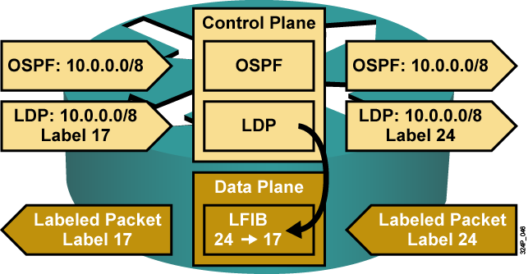
Control Plane Components Example
  Information from control plane is sent to data plane.

Slide 13
MPLS Labels

Slide 14
MPLS Labels
  MPLS technology is intended to be used anywhere, regardless of Layer 1 media and Layer 2 protocol.
  MPLS uses a 32-bit label field that is inserted between Layer 2 and Layer 3 headers (frame mode MPLS).
  MPLS over ATM uses the ATM header as the label (cell mode MPLS).

Slide 15

Label Format
MPLS uses a 32-bit label field that contains this information:
  20-bit label
  3-bit experimental field
  1-bit bottom-of-stack indicator
  8-bit TTL field

Slide 16
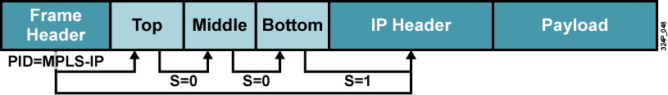
Label Stack
  Protocol ID (PID) in a Layer 2 header specifies that the payload starts with a label (or labels) and is followed by an IP header.
  Bottom-of-stack bit indicates whether the next header is another label or a Layer 3 header.
  Receiving router uses the top label only.

Slide 17
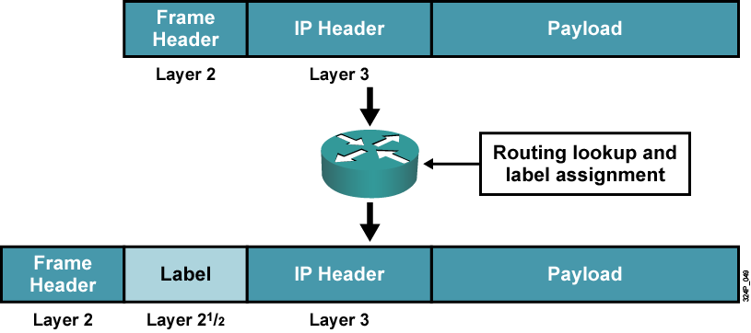
Frame Mode MPLS

Slide 18
Label Switch Routers

Slide 19
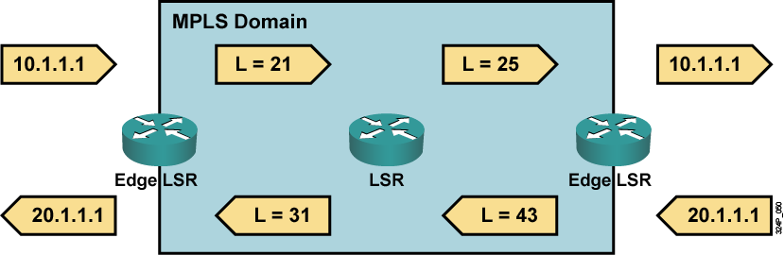
Label Switch Routers
  LSR primarily forwards labeled packets (swap label).
  Edge LSR:
    Labels IP packets (impose label) and forwards them into the MPLS domain
    Removes labels (pop label) and forwards IP packets out of the MPLS domain

Slide 20
LSR Component Architecture

Slide 21
Functions of LSRs
Component | Functions
Control plane | Exchanges routing information Exchanges labels
Data plane | Forwards packets (LSRs and edge LSRs)

Slide 22
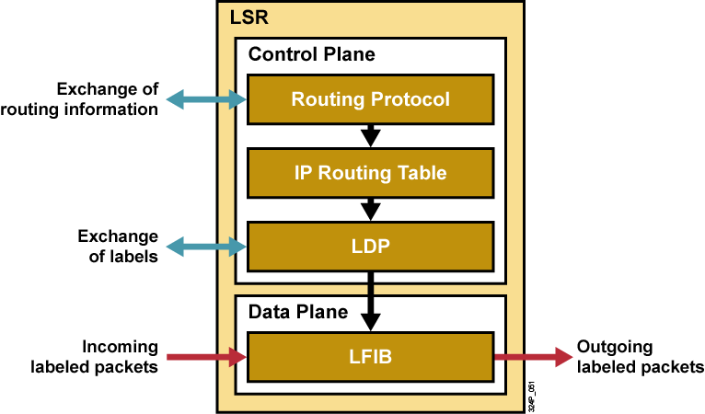
Component Architecture of LSR

Slide 23
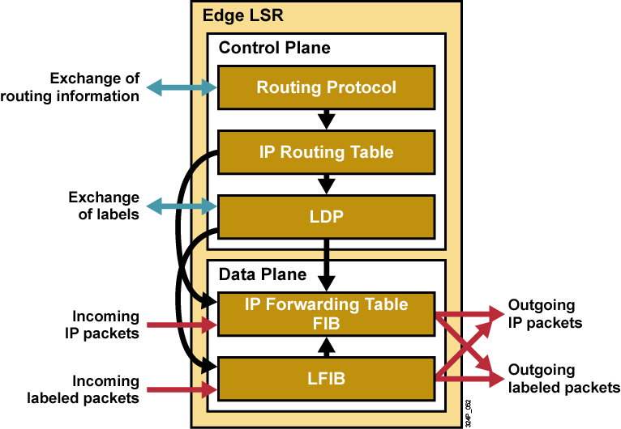
Component Architecture of Edge LSR

Slide 24
Summary
  MPLS is a switching mechanism that uses labels to forward packets. The result of using labels is that only edge routers perform a routing lookup; all the core routers simply forward packets based on labels assigned at the edge.
  MPLS consists of two major components: control plane and data plane.
  MPLS uses a 32-bit label field that contains label, experimental field, bottom-of-stack indicator, and TTL field.
  LSR is a device that forwards packets primarily based on labels.
  Edge LSR is a device that labels packets or removes labels from packets.
  Exchange routing information and exchange labels are part of the control plane, while forward packets is part of the data plane.

Slide 25
