Slide 1
Implementation of Frame Mode MPLS
Assigning MPLS Labels to Packets

Slide 2

Label Allocation in a Frame Mode MPLS Environment

Slide 3
Label Allocation in a Frame Mode
MPLS Environment
  Label allocation and distribution in a frame mode MPLS network follows these steps:
    IP routing protocols build the IP routing table.
    Each LSR assigns a label to every destination in the IP routing table independently.
    LSRs announce their assigned labels to all other LSRs.
    Every LSR builds its LIB, LFIB, and FIB data structures based on the received labels.
  Note: Label allocation, label imposing, label swapping, and label popping usually happen in the service provider network, not the customer (enterprise) network. Customer routers will never see a label.

Slide 4
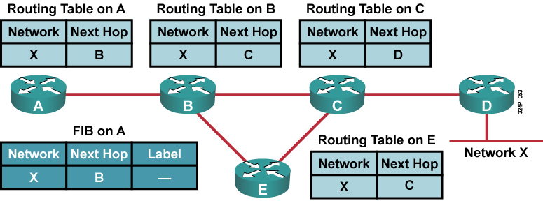
Building the IP Routing Table
  IP routing protocols are used to build IP routing tables on all LSRs.
  FIBs are built based on IP routing tables, initially with no labeling information.

Slide 5
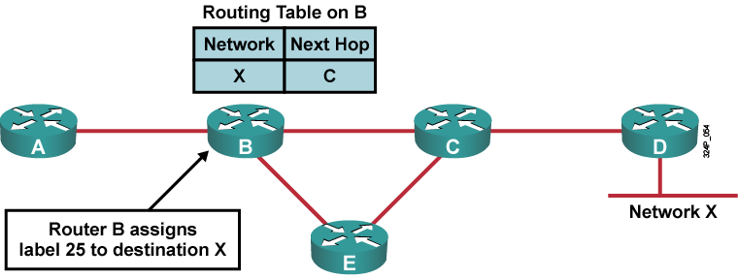
Allocating Labels
  Every LSR allocates a label for every destination in the IP routing table.
  Labels have local significance.
  Label allocations are asynchronous.

Slide 6
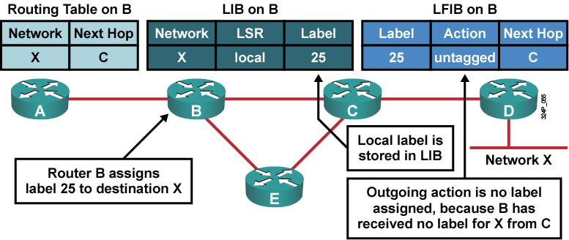
LIB and LFIB Setup
  LIB and LFIB structures have to be initialized on the LSR allocating the label.
  Untagged action will remove the label from the frame and the router will send a pure IP packet.

Slide 7
Label Distribution and Advertisement

Slide 8
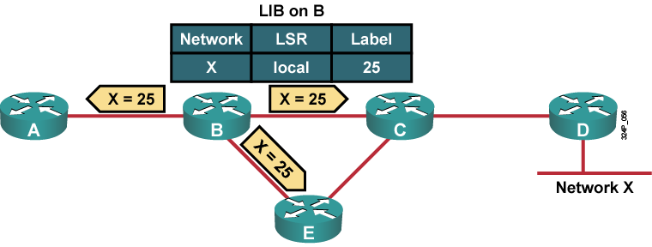
Label Distribution and Advertisement
  The allocated label is advertised to all neighbor LSRs, regardless of whether the neighbors are upstream or downstream LSRs for the destination.

Slide 9
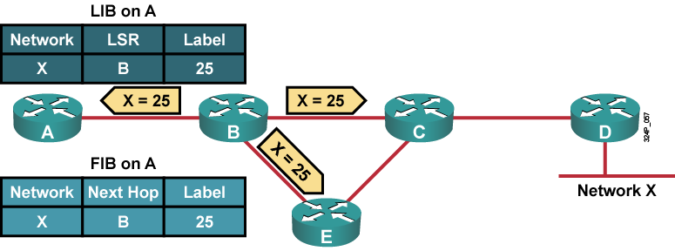
Receiving Label Advertisement
  Every LSR stores the received label in its LIB.
  Edge LSRs that receive the label from their next hop also store the label information in the FIB.

Slide 10
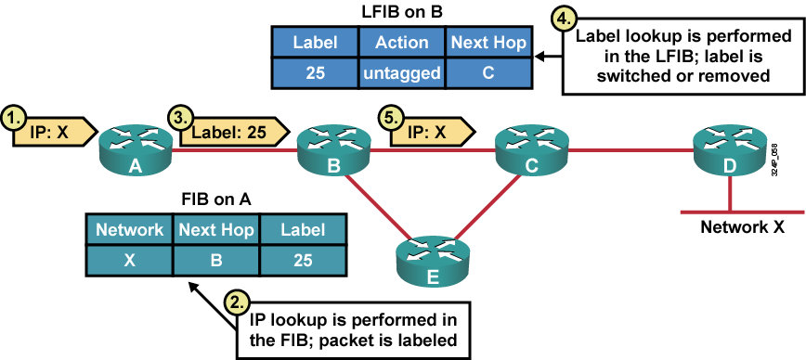
Interim Packet Propagation
  Forwarded IP packets are labeled only on the path segments where the labels have already been assigned.

Slide 11
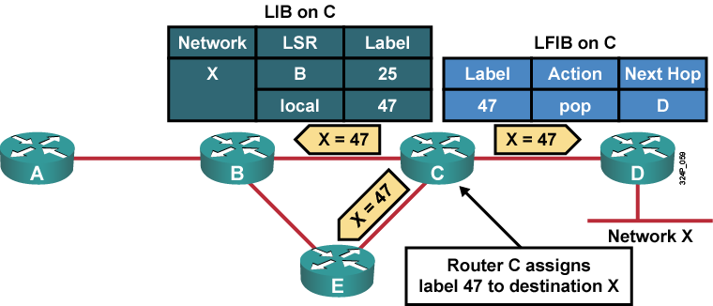
Further Label Allocation
  Every LSR will eventually assign a label for every destination.

Slide 12
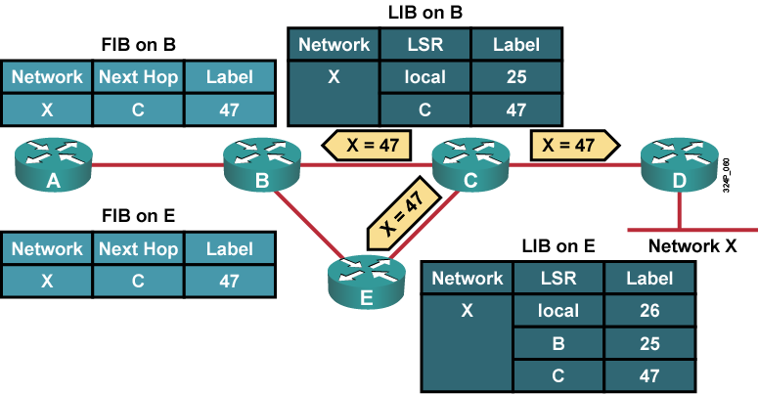
Receiving Label Advertisement
  Every LSR stores received information in its LIB.
  LSRs that receive their label from their next-hop LSR will also populate the IP forwarding table.

Slide 13
Populating the LFIB Table

Slide 14
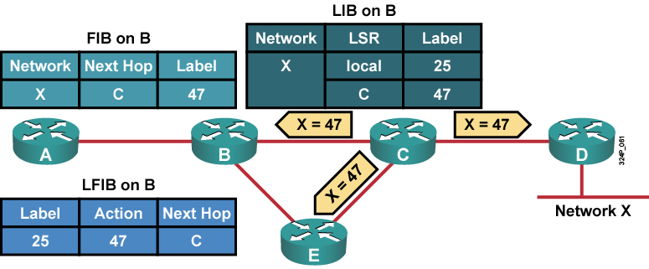
Populating the LFIB Table
  Router B has already assigned a label to network X and created an entry in the LFIB.
  The outgoing label is inserted in the LFIB after the label is received from the next-hop LSR.

Slide 15
Packet Propagation Across an MPLS Network

Slide 16
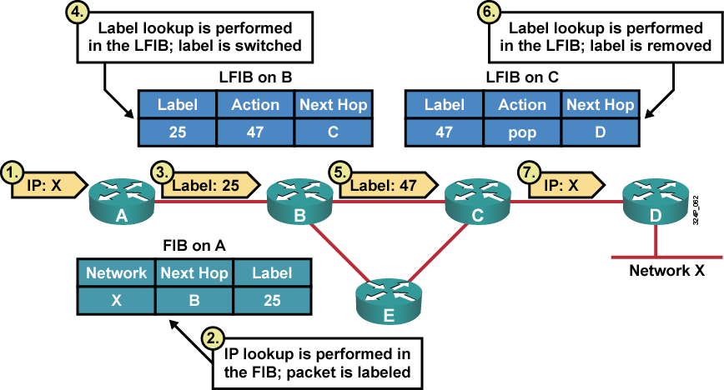
Packet Propagation Across an MPLS Network

Slide 17
Penultimate Hop Popping

Slide 18
Penultimate Hop Popping
  PHP optimizes MPLS performance (one less LFIB lookup).
  The pop or implicit null label uses a reserved value when being advertised to a neighbor.

Slide 19
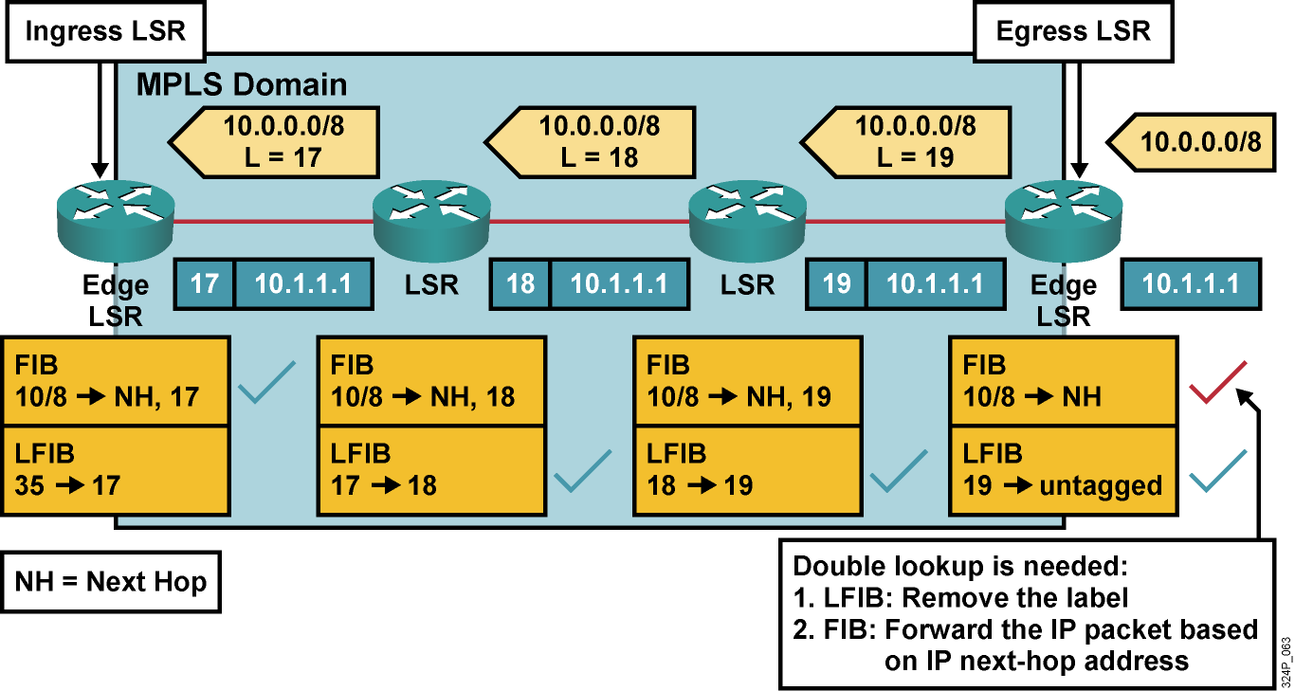
Before the Introduction of the PHP
  Double lookup is not an optimal way of forwarding labeled packets.
  A label can be removed one hop earlier.

Slide 20
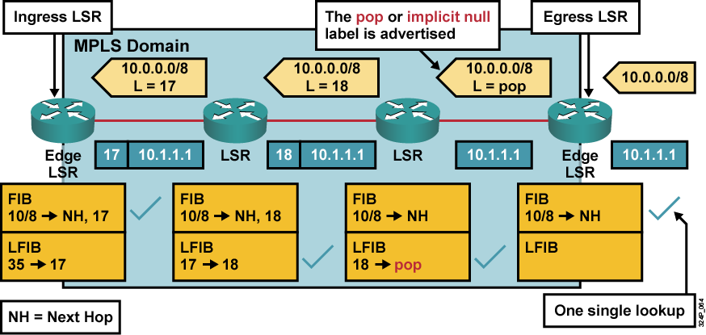
After the Introduction of the PHP
  A label is removed on the router before the last hop within an MPLS domain.

Slide 21
Summary
  Every LSR assigns a label for every destination in the IP routing table.
  Although labels are locally significant, they have to be advertised to directly reachable peers.
  Outgoing labels are inserted in the LFIB after the label is received from the next-hop LSR.
  Packets are forwarded using labels from the LFIB table rather than the IP routing table.
  PHP optimizes MPLS performance (one less LFIB lookup).

Slide 22


