Slide 1
Implementation of Frame Mode MPLS
Implementing Frame Mode MPLS

Slide 2

The Procedure to Configure MPLS

Slide 3
The Procedure to Configure MPLS
  Configure CEF
  Configure MPLS on a frame mode interface
  (Optional) Configure the MTU size in label switching

Slide 4
Configuring IP CEF

Slide 5
Step 1: Configure CEF
  Configure CEF:
    Start CEF switching to create the FIB table
    Enable CEF switching on all core interfaces
  Configure MPLS on a frame mode interface
  (Optional) Configure the MTU size in label switching

Slide 6
Step 1: Configure CEF (Cont.)
Router(config)#
ip cef [distributed]
  Starts CEF switching and creates the FIB table
  The distributed keyword configures distributed CEF (running on VIP or line cards)
  All CEF-capable interfaces run CEF switching
Router(config-if)#
ip route-cache cef
  Enables CEF switching on an interface
  Usually not needed

Slide 7
Monitoring IP CEF
Router#
show ip cef detail
  Displays a summary of the FIB
Router#show ip cef detail
IP CEF with switching (Table Version 6), flags=0x0
6 routes, 0 reresolve, 0 unresolved (0 old, 0 new)
9 leaves, 11 nodes, 12556 bytes, 9 inserts, 0 invalidations
0 load sharing elements, 0 bytes, 0 references
2 CEF resets, 0 revisions of existing leaves
refcounts: 543 leaf, 544 node
Adjacency Table has 4 adjacencies
0.0.0.0/32, version 0, receive
192.168.3.1/32, version 3, cached adjacency to Serial0/0.10
0 packets, 0 bytes
tag information set
local tag: 28
fast tag rewrite with Se0/0.10, point2point, tags imposed: {28}
via 192.168.3.10, Serial0/0.10, 0 dependencies
next hop 192.168.3.10, Serial0/0.10
valid cached adjacency
tag rewrite with Se0/0.10, point2point, tags imposed: {28}

Slide 8
Configuring MPLS on a Frame Mode Interface

Slide 9
Step 2: Configure MPLS on a Frame Mode Interface
  Configure CEF
  Configure MPLS on a frame mode interface:
    Enable label switching on a frame mode interface
    Start LDP or TDP label distribution protocol
  (Optional) Configure the MTU size in label switching

Slide 10
Step 2: Configure MPLS on a Frame Mode Interface (Cont.)
Router(config-if)#
mpls ip
  Enables label switching on a frame mode interface
  Starts LDP on the interface
Router(config-if)#
mpls label protocol [tdp | ldp | both]
  Starts selected label distribution protocol on the specified interface

Slide 11
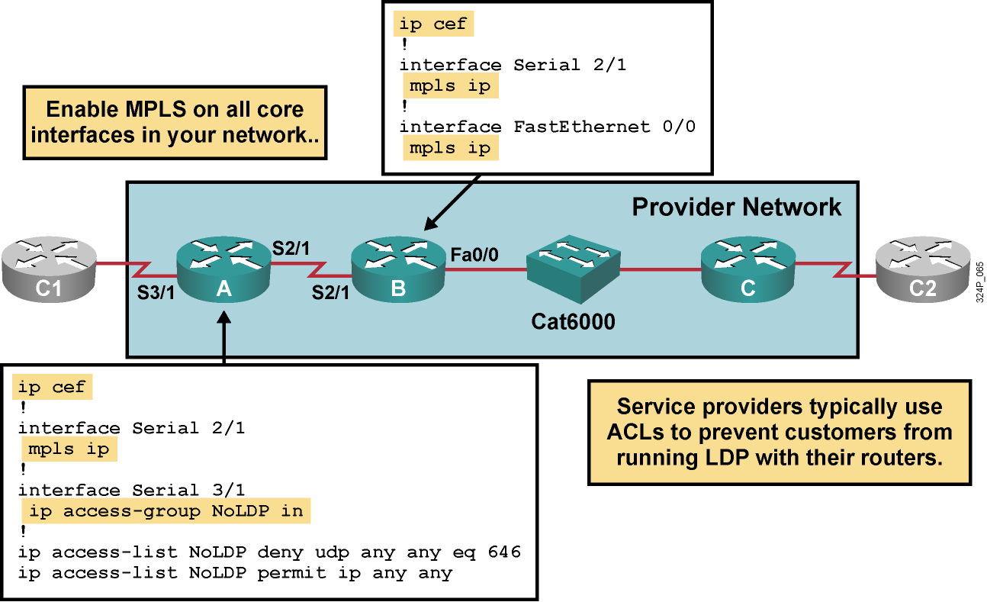
Configuring MPLS on a Frame Mode Interface: Example 1

Slide 12
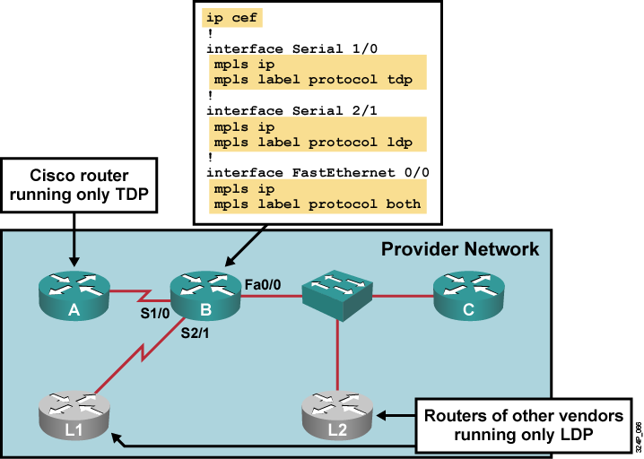
Configuring MPLS on a Frame Mode Interface: Example 2

Slide 13
Configuring the MTU Size in Label Switching

Slide 14
Step 3: Configure the MTU Size in Label Switching
  Configure CEF
  Configure MPLS on a frame mode interface
  (Optional) Configure the MTU size in label switching:
    Increase MTU on LAN interfaces

Slide 15
Step 3: Configure the MTU Size in Label Switching (Cont.)
Router(config-if)#
mpls mtu bytes
  Label switching increases the maximum MTU requirements on an interface, because of additional label header
  Interface MTU is automatically increased on WAN interfaces; IP MTU is automatically decreased on LAN interfaces
  Label-switching MTU can be increased on LAN interfaces (resulting in jumbo frames) to prevent IP fragmentation

Slide 16
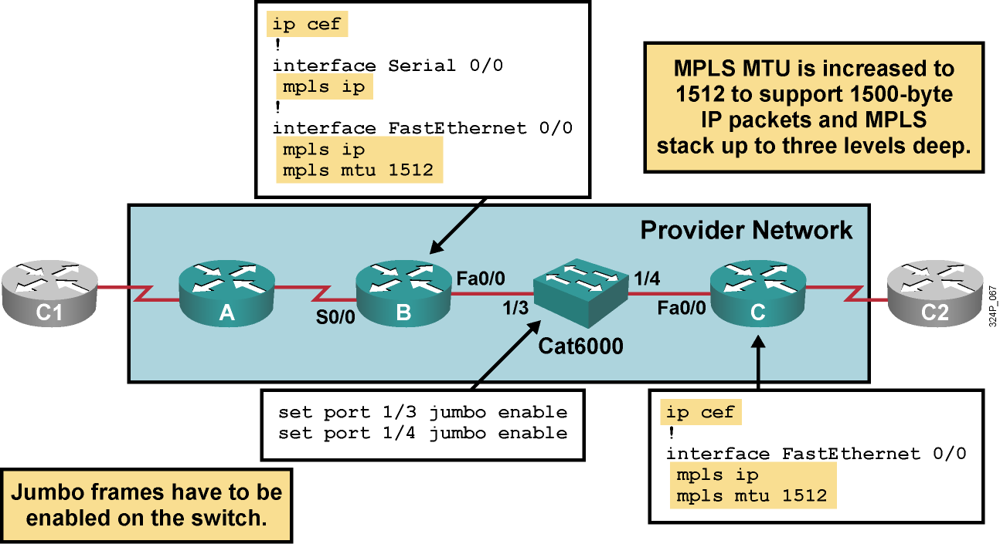
Configuring Label Switching MTU: Example

Slide 17
Summary
  MPLS configuration tasks include configuring IP CEF, tag switching, and setting MTU size.
  CEF is configured globally.
  Use the mpls ip command to enable MPLS on an interface level.
  To set MTU for labeled packets, use the mpls mtu interface configuration command.

Slide 18
