Slide 1
Implementation of Frame Mode MPLS
MPLS VPN Technology

Slide 2

Defining MPLS VPN

Slide 3
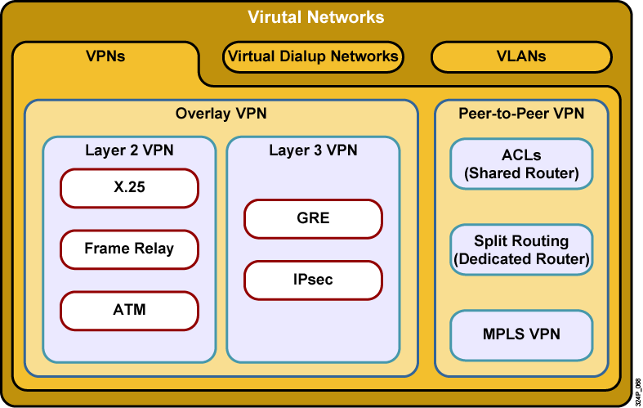
VPN Taxonomy

Slide 4
VPN Models
VPN services can be offered based on two major models:
  Overlay VPNs, in which the service provider provides virtual point-to-point links between customer sites
  Peer-to-peer VPNs, in which the service provider participates in the customer routing

Slide 5
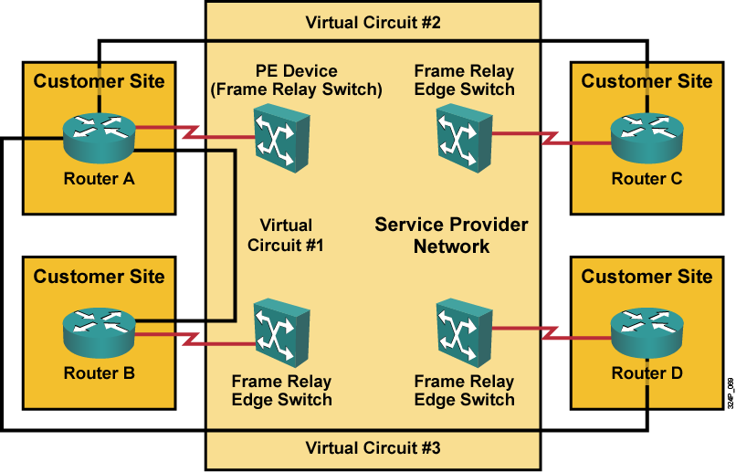
Overlay VPNs: Frame Relay Example

Slide 6
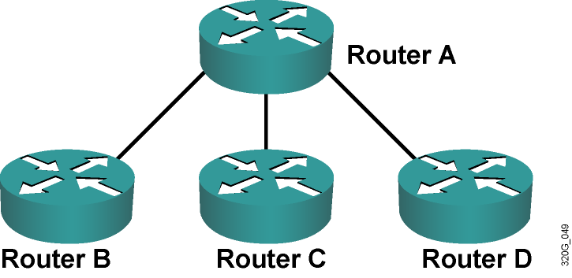
Overlay VPNs: Layer 3 Routing
  The service provider infrastructure appears as point-to-point links to customer routes.
  Routing protocols run directly between customer routers.
  The service provider does not see customer routes and is responsible only for providing point-to-point transport of customer data.

Slide 7
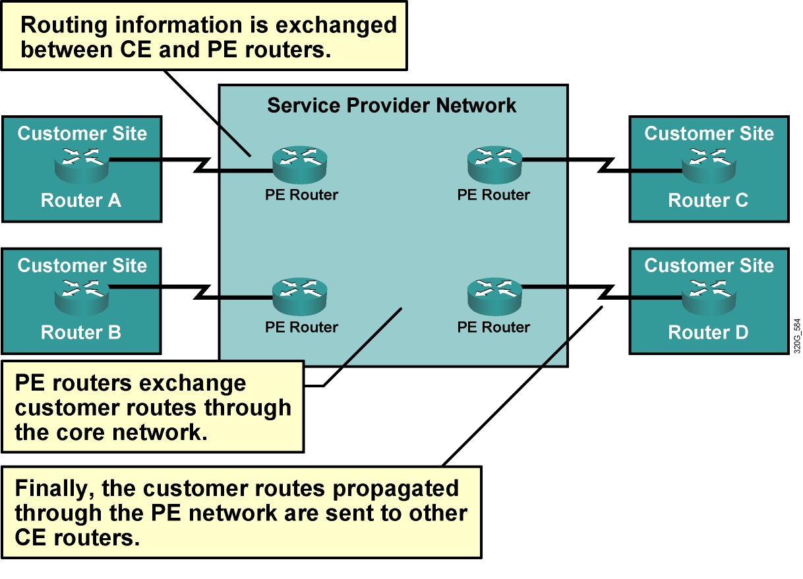
Peer-to-Peer VPNs

Slide 8
Benefits of VPN Implementations
  Overlay VPN:
    Well-known and easy to implement
    Service provider does not participate in customer routing
    Customer network and service provider network are well-isolated
  Peer-to-peer VPN:
    Guarantees optimum routing between customer sites
    Easier to provision an additional VPN
    Only sites are provisioned, not links between them

Slide 9
Drawbacks of VPN Implementations
  Overlay VPN:
    Implementing optimum routing requires a full mesh of VCs.
    VCs have to be provisioned manually.
    Bandwidth must be provisioned on a site-to-site basis.
    Overlay VPNs always incur encapsulation overhead (IPsec or GRE).
  Peer-to-peer VPN:
    The service provider participates in customer routing.
    The service provider becomes responsible for customer convergence.
    PE routers carry all routes from all customers.
    The service provider needs detailed IP routing knowledge.

Slide 10
Drawbacks of Peer-to-Peer VPNs
  Shared PE router:
    All customers share the same (provider-assigned or public) address space.
    High maintenance costs are associated with packet filters.
    Performance is lower—each packet has to pass a packet filter.
  Dedicated PE router:
    All customers share the same address space.
    Each customer requires a dedicated router at each POP.

Slide 11
MPLS VPN Architecture

Slide 12
MPLS VPN Architecture
An MPLS VPN combines the best features of an overlay VPN and a peer-to-peer VPN:
  PE routers participate in customer routing, guaranteeing optimum routing between sites and easy provisioning.
  PE routers carry a separate set of routes for each customer (similar to the dedicated PE router approach).
  Customers can use overlapping addresses.

Slide 13
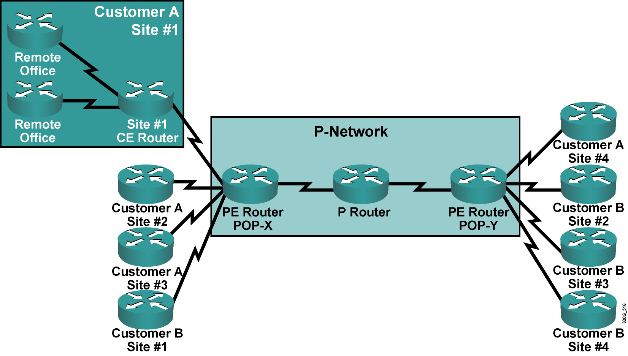
MPLS VPN Architecture: Terminology

Slide 14
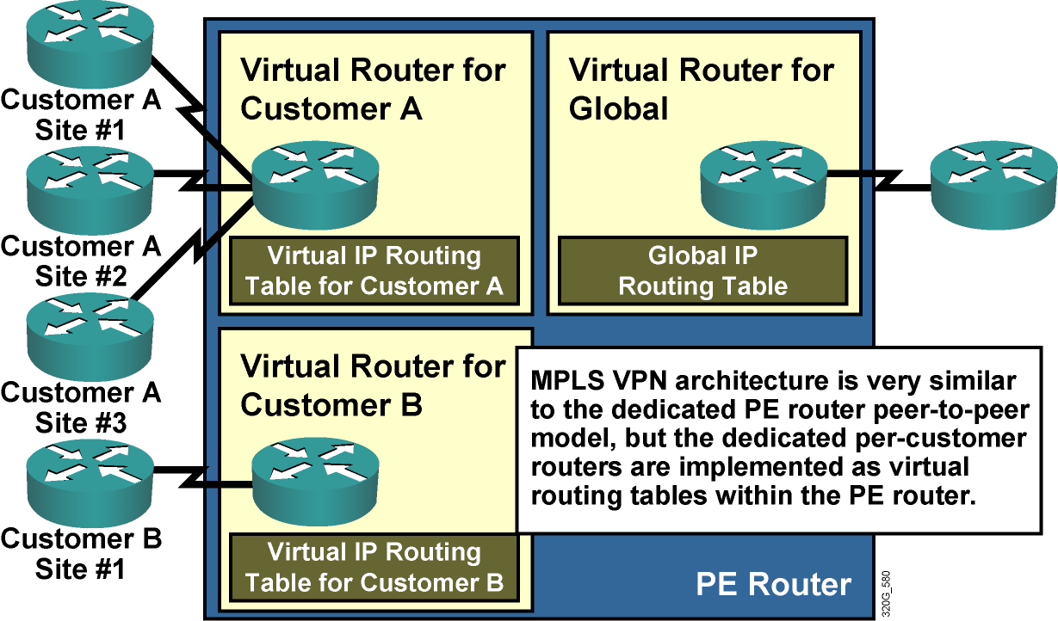
PE Router Architecture

Slide 15
Propagation of Routing Information Across the P-Network

Slide 16
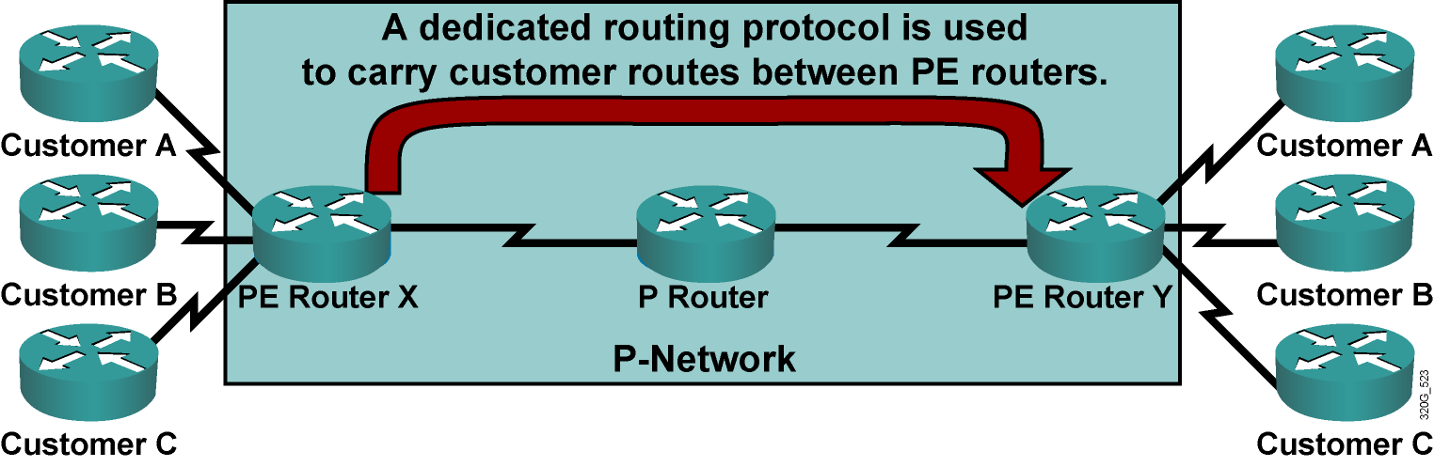
Propagation of Routing Information
Across the P-Network
  The number of customer routes can be very large; BGP is the only routing protocol that can scale to such a number.
  BGP is used to exchange customer routes directly between PE routers.

Slide 17
Route Distinguishers
  Question: How will information about the overlapping subnetworks of two customers be propagated via a single routing protocol?
  Answer: Extend the customer addresses to make them unique.
  The 64-bit RD is prepended to an IPv4 address to make it globally unique.
  The resulting address is a VPNv4 address.
  VPNv4 addresses are exchanged between PE routers via BGP.
  BGP that supports address families other than IPv4 addresses is called multiprotocol BGP (MPBGP).

Slide 18
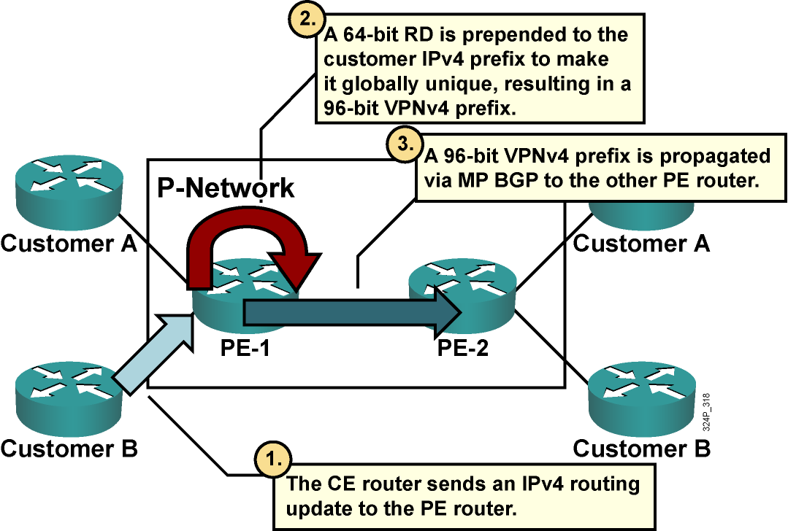
Route Distinguishers (Cont.)

Slide 19
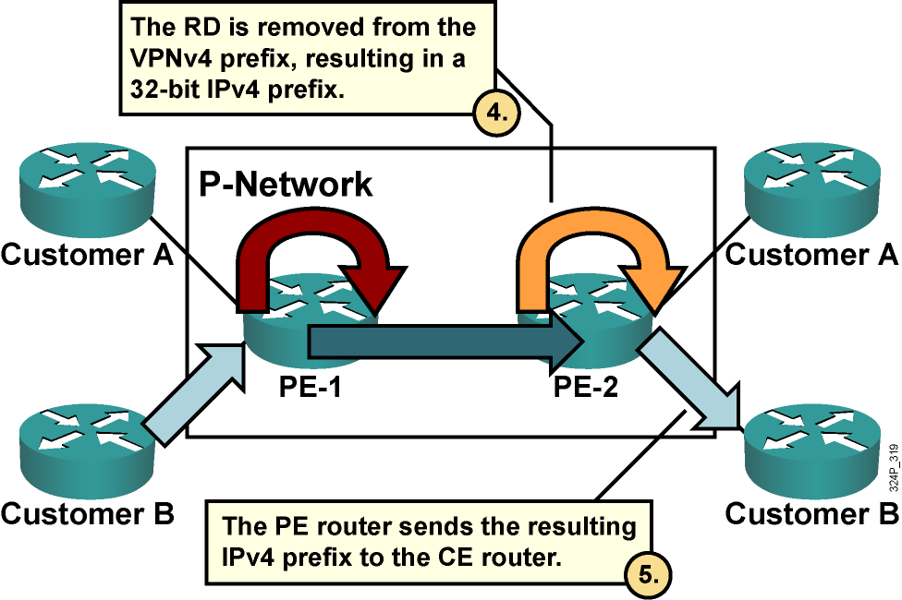
Route Distinguishers (Cont.)

Slide 20
Usage of RDs in an MPLS VPN
  The RD has no special meaning.
  The RD is used only to make potentially overlapping IPv4 addresses globally unique.
  This design cannot support all topologies required by the customer.

Slide 21
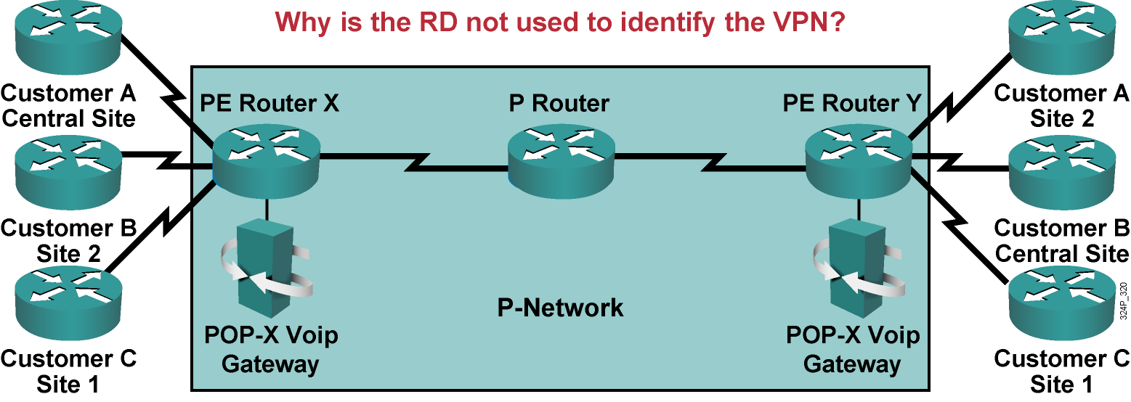
VoIP Service Example
Requirements:
  All sites of one customer need to communicate.
  Central sites of both customers need to communicate with VoIP gateways and other central sites.
  Other sites from different customers do not communicate with each other.

Slide 22
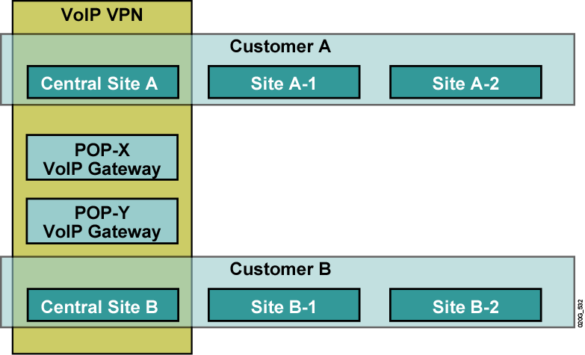
VoIP Service Example:
Connectivity Requirements

Slide 23
Route Targets
  Some sites have to participate in more than one VPN.
  The RD cannot identify participation in more than one VPN.
  RTs were introduced in the MPLS VPN architecture to support complex VPN topologies.
  RTs are additional attributes attached to VPNv4 BGP routes to indicate VPN membership.

Slide 24
How Do RTs Work?
  Export RTs:
    Identify VPN membership
    Append to the customer route when it is converted into a VPNv4 route
  Import RTs:
    Associate with each virtual routing table
    Select routes inserted into the virtual routing table

Slide 25
End-to-End Routing Information Flow

Slide 26
MPLS VPN Routing Requirements
  CE routers have to run standard IP routing software.
  PE routers have to support MPLS VPN services and Internet routing.
  P routers have no VPN routes.

Slide 27
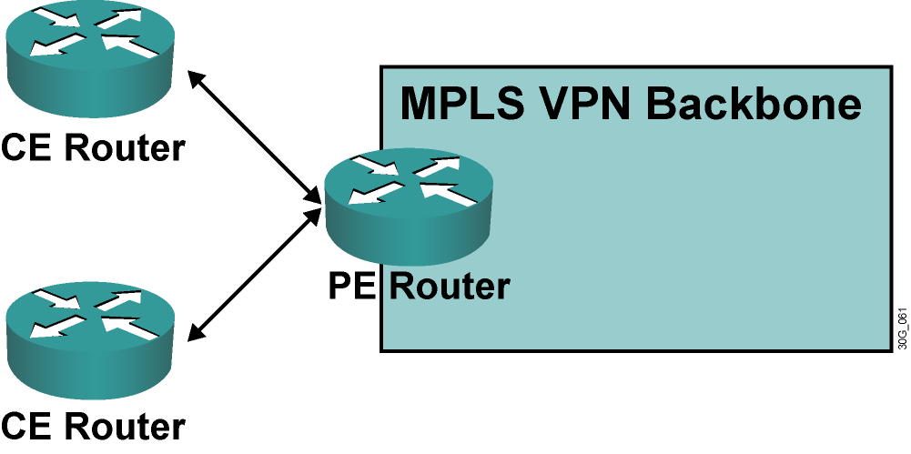
MPLS VPN Routing: CE Router Perspective
  The CE routers run standard IP routing software and exchange routing updates with the PE router.
  The PE router appears as another router in the C-network.

Slide 28
PE-CE Routing Protocols
  PE-CE routing protocols are configured for individual VRFs.
  Supported protocols include BGP, OSPF, static, RIP, and EIGRP.
  Routing configuration on the CE router has no VRF information.

Slide 29
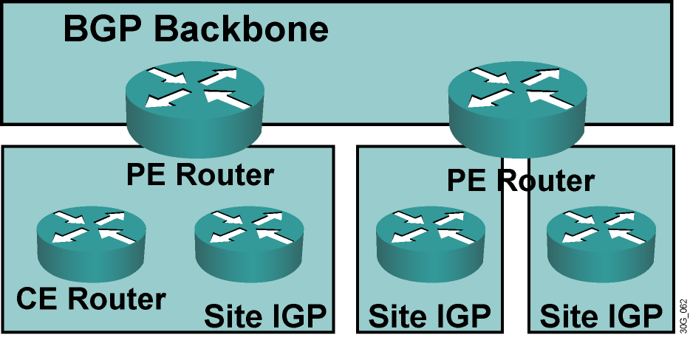
MPLS VPN Routing: Overall
Customer Perspective
  To the customer, the PE routers appear as core routers connected via a BGP backbone.
  The usual BGP and IGP design rules apply.
  The P routers are hidden from the customer.

Slide 30
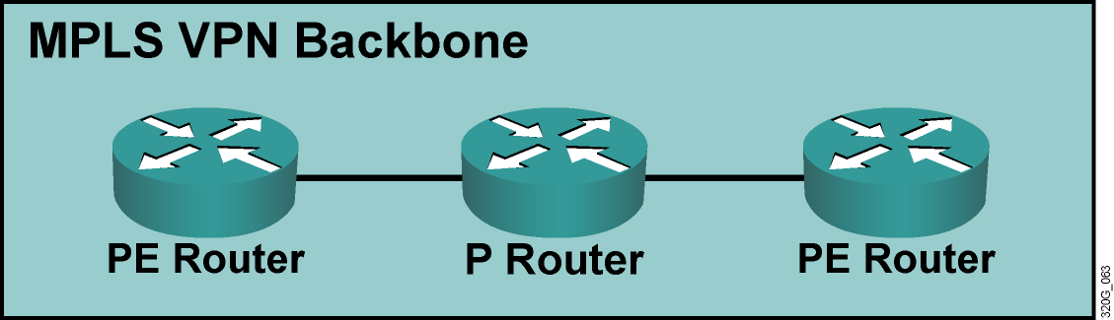
MPLS VPN Routing: P Router Perspective
P routers perform as follows:
  Do not participate in MPLS VPN routing and do not carry VPN routes.
  Run backbone IGP with the PE routers and exchange information about global subnetworks (core links and loopbacks).

Slide 31
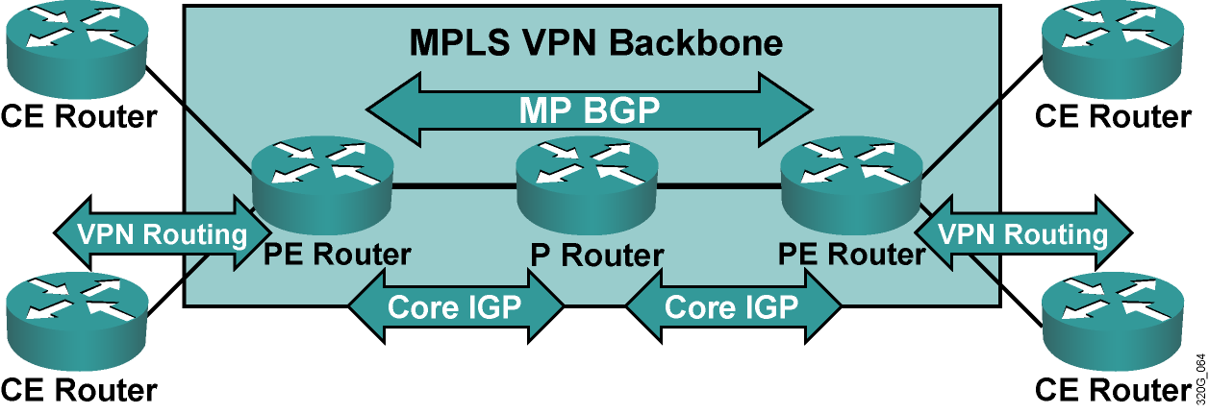
MPLS VPN Routing: PE Router Perspective
PE routers exchange the following:
  VPN routes with CE routers via per-VPN routing protocols
  Core routes with P routers and PE routers via core IGP
  VPNv4 routes with other PE routers via MPBGP sessions

Slide 32
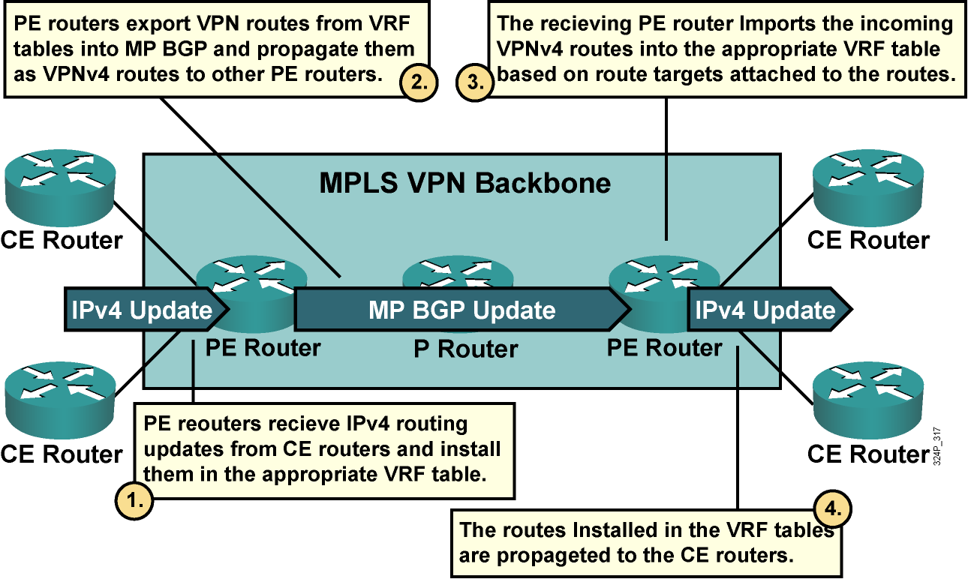
End-to-End Routing Information Flow

Slide 33
MPLS VPNs and Packet Forwarding

Slide 34
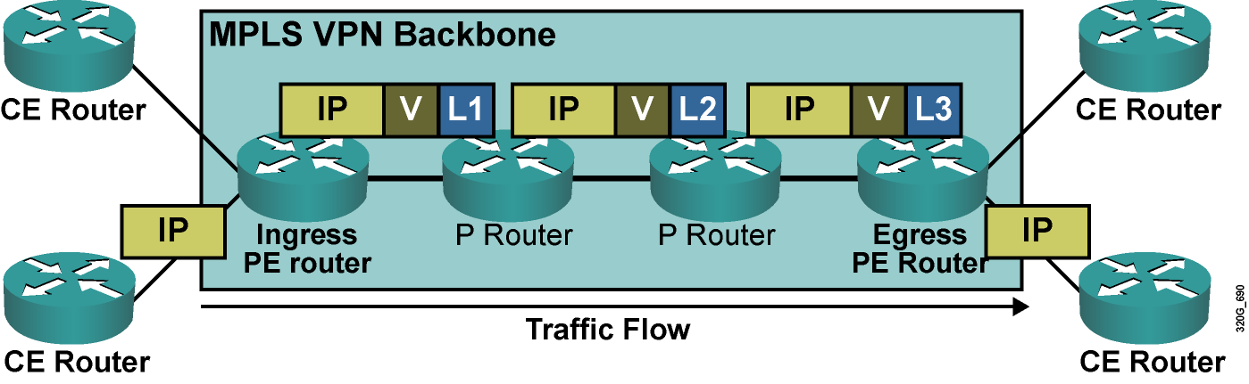
MPLS VPNs and Packet Forwarding
The PE routers will label the VPN packets with a label stack, as follows:
  Using the LDP label for the egress PE router as the top label
  Using the VPN label assigned by the egress PE router as the second label in the stack

Slide 35
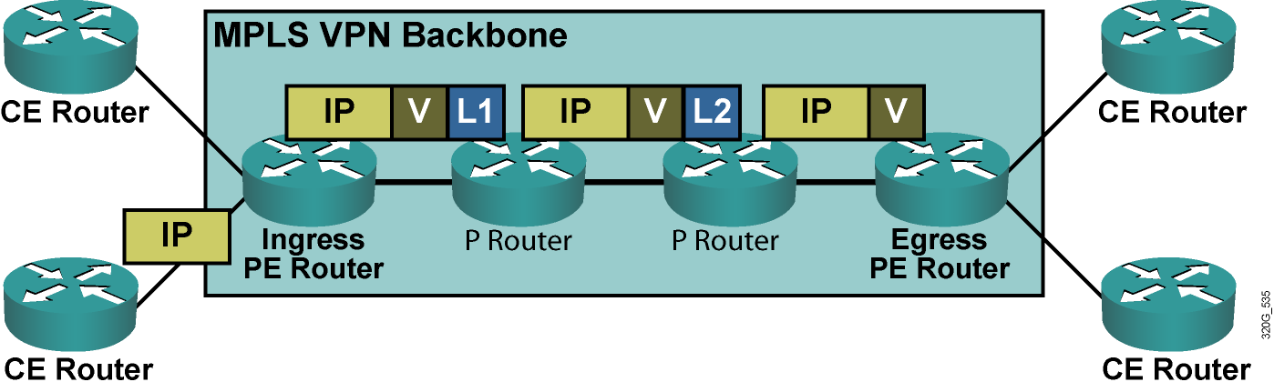
VPN PHP
  PHP on the LDP label can be performed on the last P router.
  The egress PE router performs label lookup only on the VPN label, resulting in faster and simpler label lookup.
  IP lookup is performed only once—in the ingress PE router.

Slide 36
Summary
  There are two major VPN paradigms: overlay VPN and peer-to-peer VPN.
  MPLS VPN architecture combines the best features of the overlay and peer-to-peer VPN models.
  BGP is used to exchange customer routes between PE routers.
  Routes are transported using IGP (internal core routes), BGP IPv4 (core Internet routes), and BGP VPNv4 (PE-to-PE VPN routes).
  PE routers forward packets across the MPLS VPN backbone using label stacking.

Slide 37
