Slide 1
IPsec VPNs
IPsec Components and IPsec VPN Features

Slide 2

IPsec Overview

Slide 3
What Is IPsec?
  IPsec is an IETF standard that employs cryptographic mechanisms on the network layer:
    Authentication of every IP packet
    Verification of data integrity for each packet
    Confidentiality of packet payload
  Consists of open standards for securing private communications
  Scales from small to very large networks
  Is available in Cisco IOS software version 11.3(T) and later
  Is included in PIX Firewall version 5.0 and later

Slide 4
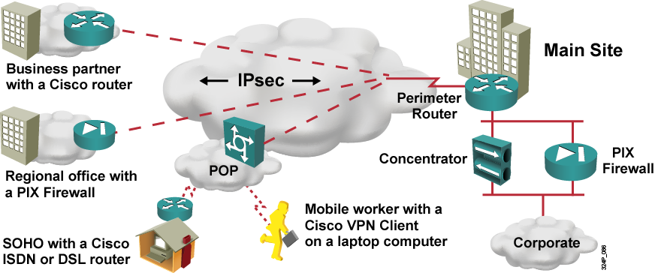
IPsec Security Features
IPsec is the only standard Layer 3 technology that provides:
  Confidentiality
  Data integrity
  Authentication
  Replay detection

Slide 5
IPsec Protocols
IPsec uses three main protocols to create a security framework:
  Internet Key Exchange (IKE):
    Provides framework for negotiation of security parameters
    Establishment of authenticated keys
  Encapsulating Security Payload (ESP):
    Provides framework for encrypting, authenticating, and securing of data
  Authentication Header (AH):
    Provides framework for authenticating and securing of data

Slide 6
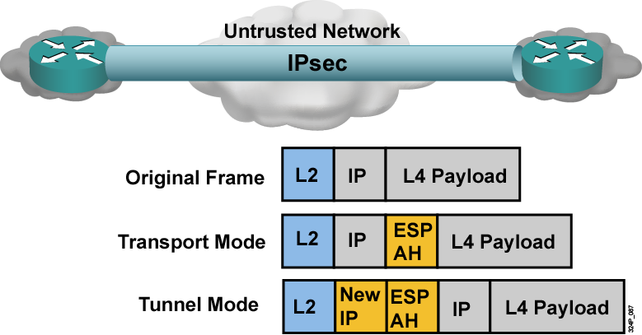
IPsec Headers
IPsec ESP provides the following:
  Authentication and data integrity (MD5 or SHA-1 HMAC) with AH and ESP
  Confidentiality (DES, 3DES, or AES) only with ESP

Slide 7
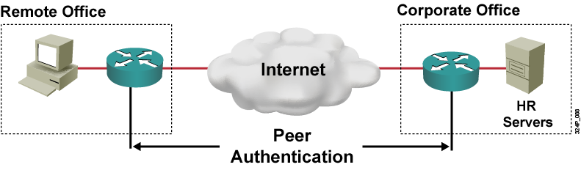
Peer Authentication
Peer authentication methods:
  Username and password
  OTP (Pin/Tan)
  Biometric
  Preshared keys
  Digital certificates

Slide 8
Internet Key Exchange

Slide 9
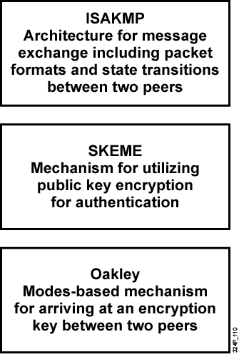
Internet Key Exchange
IKE solves the problems of manual and unscalable implementation of IPsec by automating the entire key exchange process:
  Negotiation of SA characteristics
  Automatic key generation
  Automatic key refresh
  Manageable manual configuration

Slide 10
IKE Phases
  Phase 1:
    Authenticate the peers
    Negotiate a bidirectional SA
    Main mode or aggressive mode
  Phase 1.5:
    Xauth
    Mode config
  Phase 2:
    IPsec SAs/SPIs
    Quick mode

Slide 11
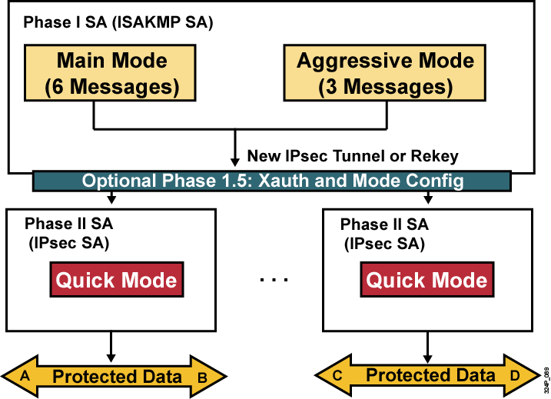
IKE Modes

Slide 12
IKE: Other Functions

Slide 13
IKE: Other Functions
  Dead peer detection (DPD):
    Bidirectional
    Sent on periodic intervals
    Sender must receive a reply or disconnect
  IKE keepalives are unidirectional and are sent every 10 seconds.
  NAT traversal:
    Defined in RFC 3947
    Encapsulates IPsec packet in UDP packet
  Mode config (Push Config) and Xauth (User Authentication)

Slide 14
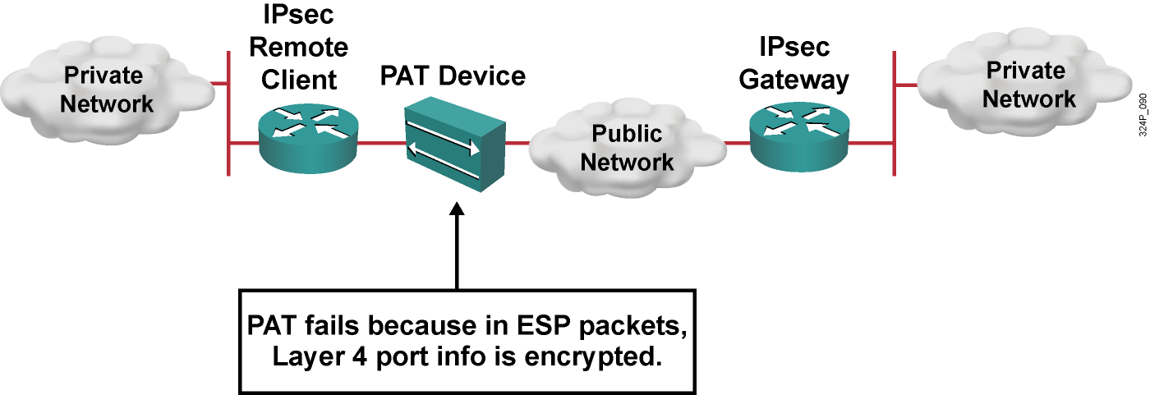
IPsec and NAT: The Problem

Slide 15
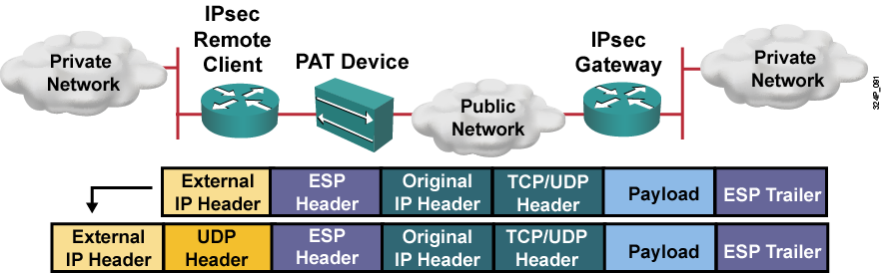
IPsec NAT Traversal
Need NAT traversal with IPsec over TCP/UDP:
  NAT traversal detection
  NAT traversal decision
  UDP encapsulation of IPsec packets
  UDP encapsulated process for software engines

Slide 16
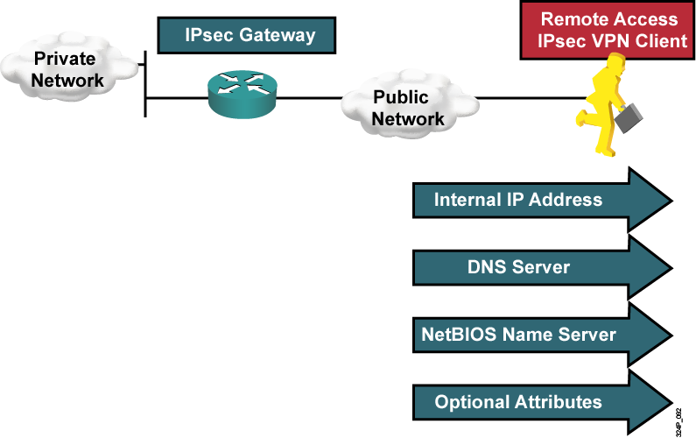
Mode Configuration
  Mechanism used to push attributes to IPsec VPN clients

Slide 17
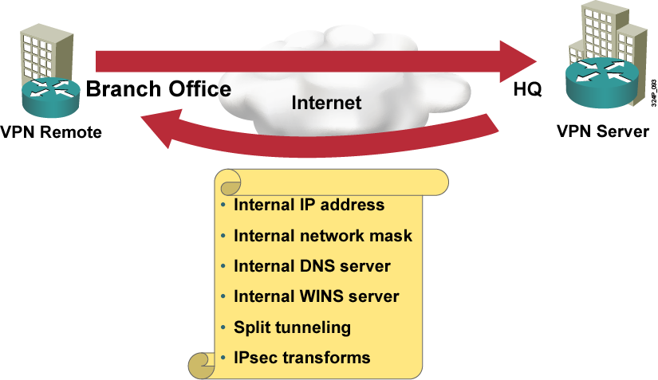
Easy VPN
  Dynamically updated:
    Central services and security policy
    Offload VPN function from local devices
    Client and network extension mode
  Centralized control:
    Configuration and security policy pushed at the time of the VPN tunnel establishment

Slide 18
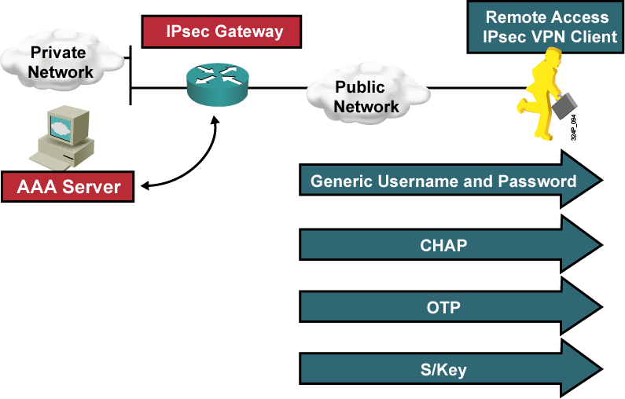
Xauth
  Mechanism used for user authentication for VPN clients

Slide 19
ESP and AH

Slide 20
ESP and AH
  IPsec protocols:
    ESP or AH
    ESP uses IP protocol number 50
    AH uses IP protocol number 51
  IPsec modes:
    Tunnel or transport mode
    Tunnel mode creates a new additional IP header
    The Message is concatenated with a symmetric key

Slide 21
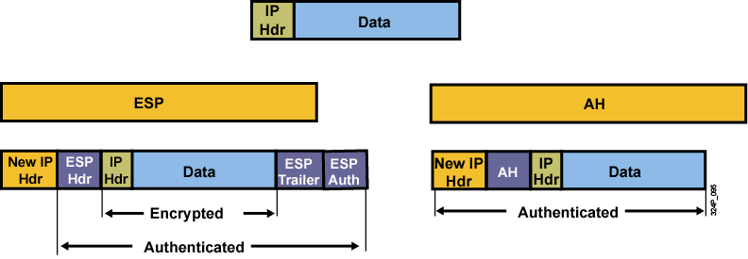
ESP and AH Header
  ESP allows encryption and authenticates the original packet.
  AH authenticates the whole packet (including the header) and does not allow encryption.

Slide 22
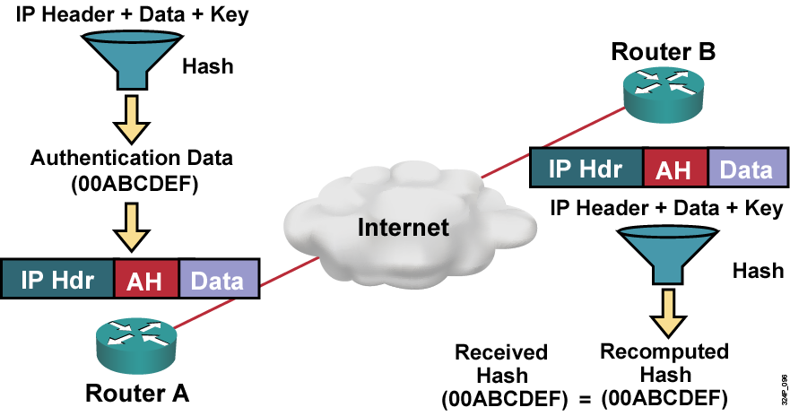
AH Authentication and Integrity

Slide 23
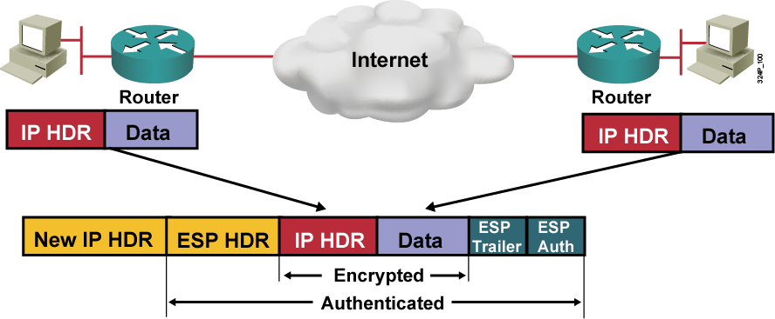
ESP Protocol
  Provides confidentiality with encryption
  Provides integrity with authentication

Slide 24
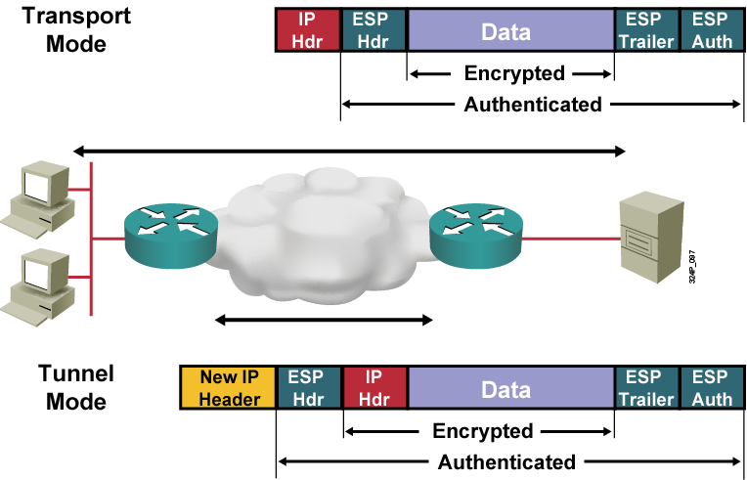
Tunnel and Transport Mode

Slide 25
Message Authentication and Integrity Check

Slide 26
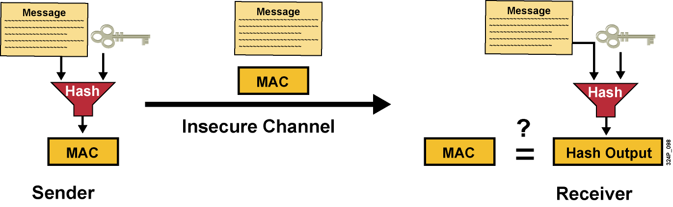
Message Authentication and
Integrity Check Using Hash
  A MAC is used for message authentication and integrity check.
  Hashes are widely used for this purpose (HMAC).

Slide 27
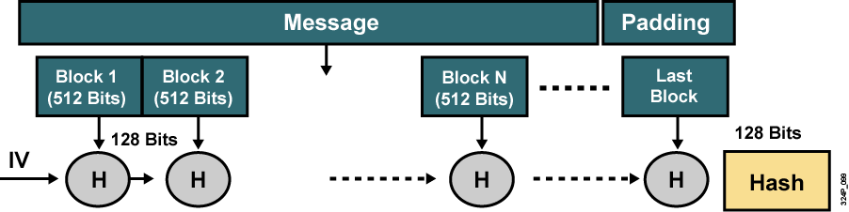
Commonly Used Hash Functions
  MD5 provides 128-bit output.
  SHA-1 provides 160-bit output (only first 96 bits used in IPsec).
  SHA-1 is computationally slower than MD5, but more secure.

Slide 28
Symmetric vs. Asymmetric Encryption Algorithms

Slide 29
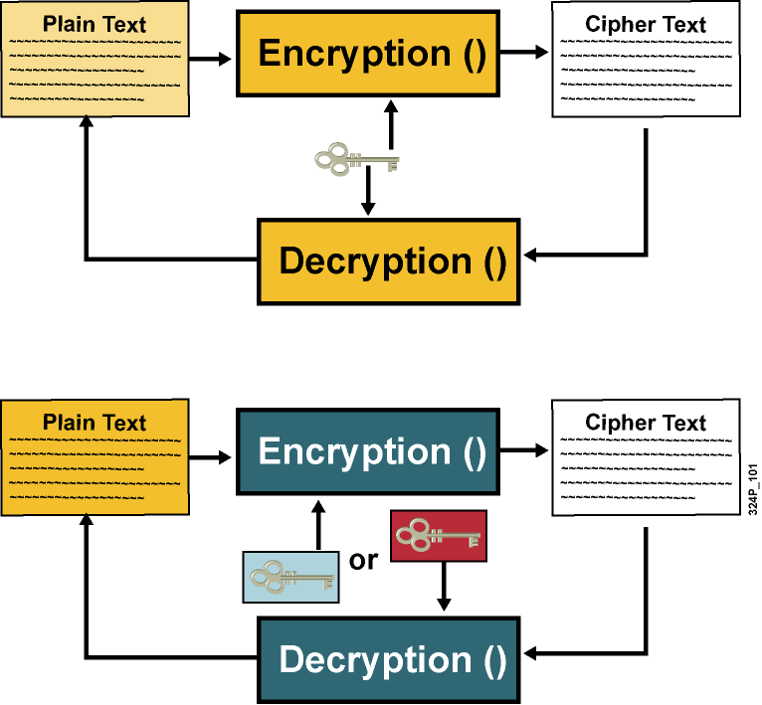
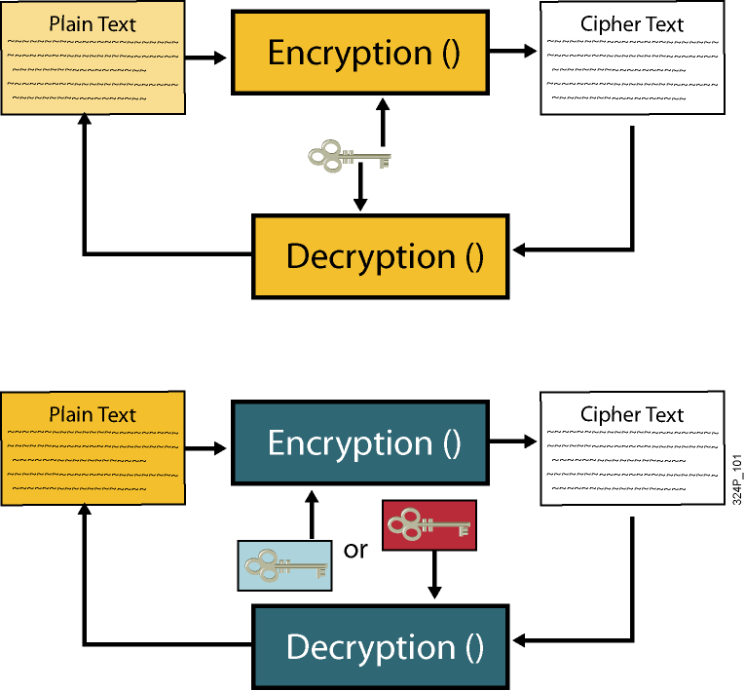
Symmetric vs. Asymmetric
Encryption Algorithms
  Symmetric algorithm:
    Secret key cryptography
    Encryption and decryption use
    the same key
    Typically used to encrypt the content of a message
    Examples: DES, 3DES, AES
  Asymmetric algorithm:
    Public key cryptography
    Encryption and decryption
    use different keys
    Typically used in digital
    certification and key management
    Example: RSA

Slide 30
Key Lengths of Symmetric vs.
Asymmetric Encryption Algorithms
  Comparable key lengths required for asymmetric keys compared to symmetric keys
Symmetric Key Length | Asymmetric Key Length
80 | 1024
112 | 2048
128 | 3072
192 | 7680
256 | 15,360

Slide 31
Security Level of Cryptographic Algorithms
Security Level | Work Factor | Algorithms
Weak | O(2⁴⁰) | DES, MD5
Legacy | O(2⁶⁴) | RC4, SHA-1
Baseline | O(2⁸⁰) | 3DES
Standard | O(2¹²⁸) | AES-128, SHA-256
High | O(2¹⁹²) | AES-192, SHA-384
Ultra | O(2²⁵⁶) | AES-256, SHA-512

Slide 32
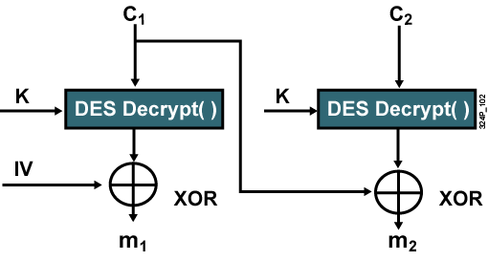
Symmetric Encryption: DES
  Symmetric key encryption algorithm
  Block cipher: Works on 64-bit data block, uses 56-bit key (last bit of each byte used for parity)
  Mode of operation: Apply DES to encrypt blocks of data

Slide 33
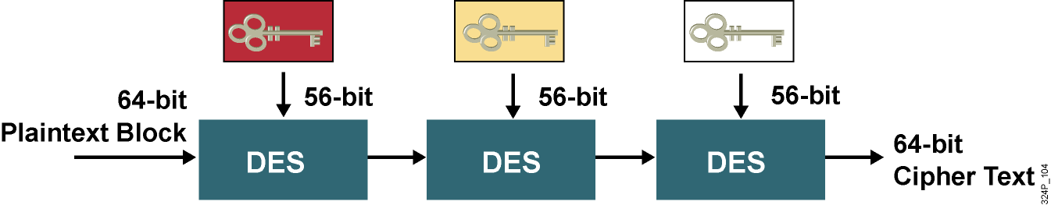
Symmetric Encryption: 3DES
  168-bit total key length
  Mode of operation decides how to process DES three times
  Normally: encrypt, decrypt, encrypt
  3DES requires more processing than DES

Slide 34
Symmetric Encryption: AES
  Formerly known as ‘Rijndael’
  Successor to DES and 3DES
  Symmetric key block cipher
  Strong encryption with long expected life
  AES can support 128-, 192-, and 256-bit keys; 128-bit key is considered safe

Slide 35
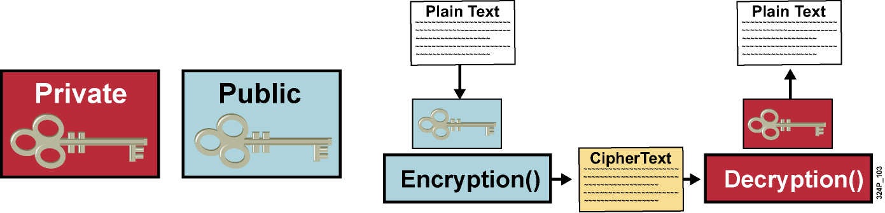
Asymmetric Encryption: RSA
  Based on Diffie-Hellman key exchange (IKE) principles
  Public key to encrypt data, and to verify digital signatures
  Private key to decrypt data, and to sign with a digital signature
  Perfect for insecure communication channels

Slide 36
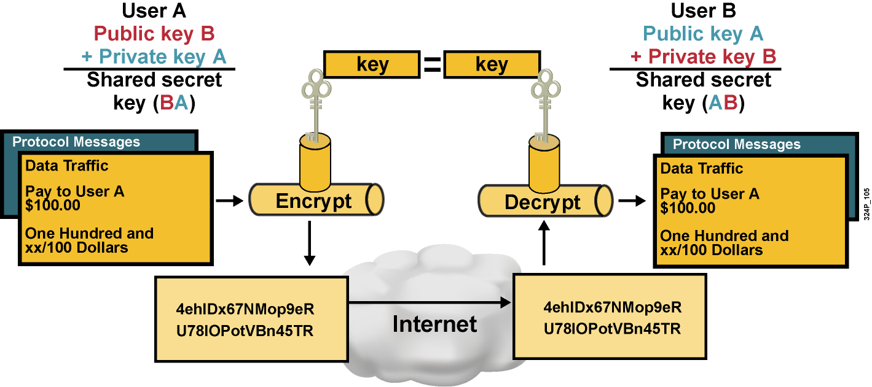
Diffie-Hellman Key Exchange

Slide 37
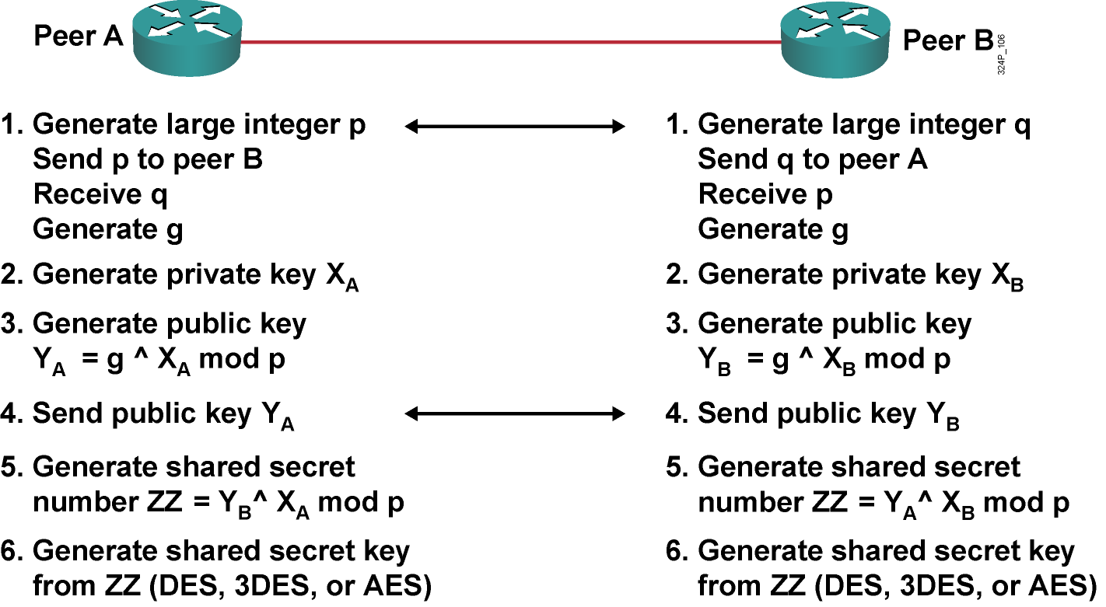
Diffie-Hellman Key Exchange (Cont.)

Slide 38
PKI Environment

Slide 39
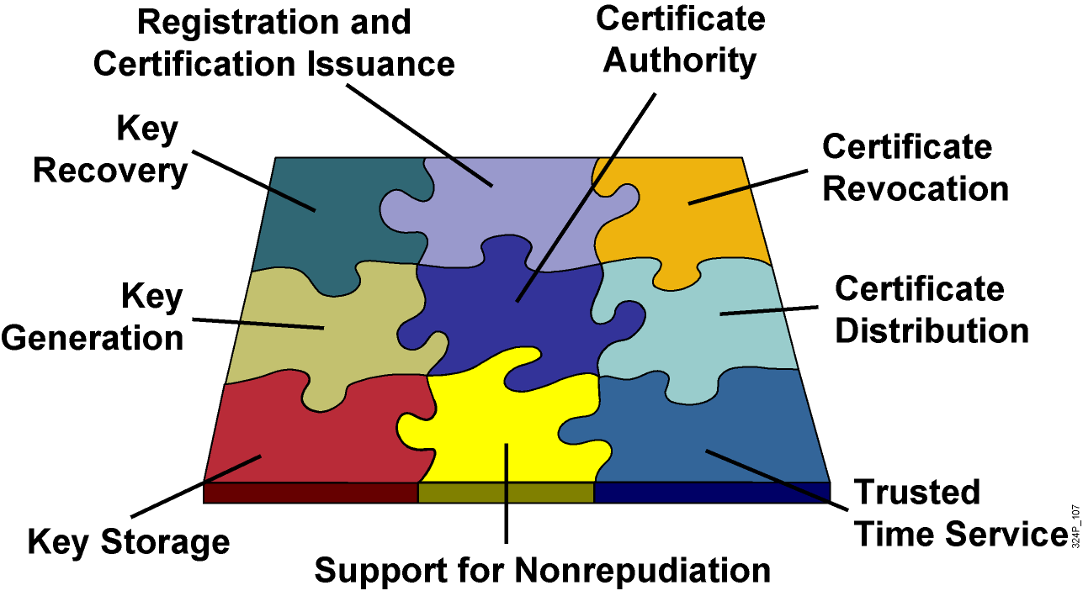
PKI Environment

Slide 40
Certificate Authority
  The trust basis of a PKI system
  Verifies user identity, issues certificates by binding identity of a user to a public key with a digital certificate
  Revokes certificates and publishes CRL
  In-house implementation or outsourcing

Slide 41
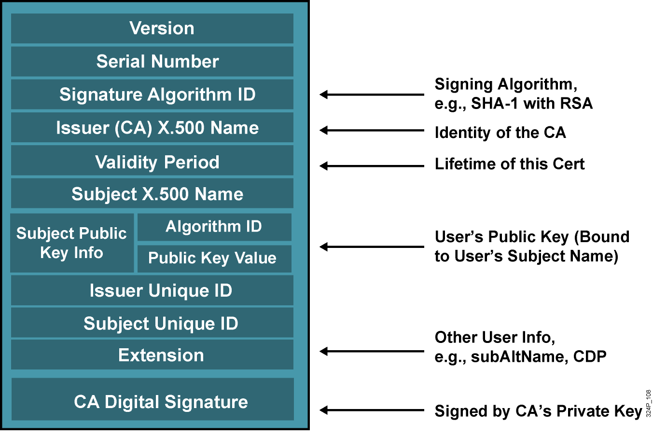
X.509 v3 Certificate

Slide 42
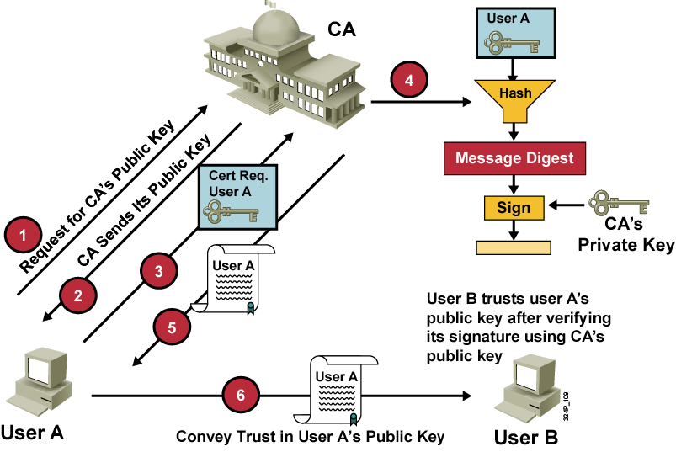
PKI Message Exchange

Slide 43
PKI Credentials
How to store PKI credentials:
  RSA keys and certificates
  NVRAM
  eToken:
    Cisco 871, 1800, 2800, 3800 Series router
    Cisco IOS Release 12.3(14)T image
    Cisco USB eToken
    A k9 image

Slide 44
Summary
  IPsec provides a mechanism for secure data transmission over IP networks.
  The IKE protocol is a key management protocol standard used in conjunction with the IPsec standard.
  IKE has some additional functions: DPD, NAT traversal, encapsulation in UDP packet, config mode, and Xauth.
  The two IP protocols used in the IPsec standard are ESP and AH.
  For message authentication and integrity check, an HMAC is used.
  The two types of encryption are symmetric encryption and asymmetric encryption.
  PKI provides customers with a scalable, secure mechanism for distributing, managing, and revoking encryption and identity information in a secured data network.

Slide 45


