Slide 1
IPsec VPNs
Site-to-Site IPsec VPN Operation

Slide 2

Site-to-Site IPsec VPN Operations

Slide 3
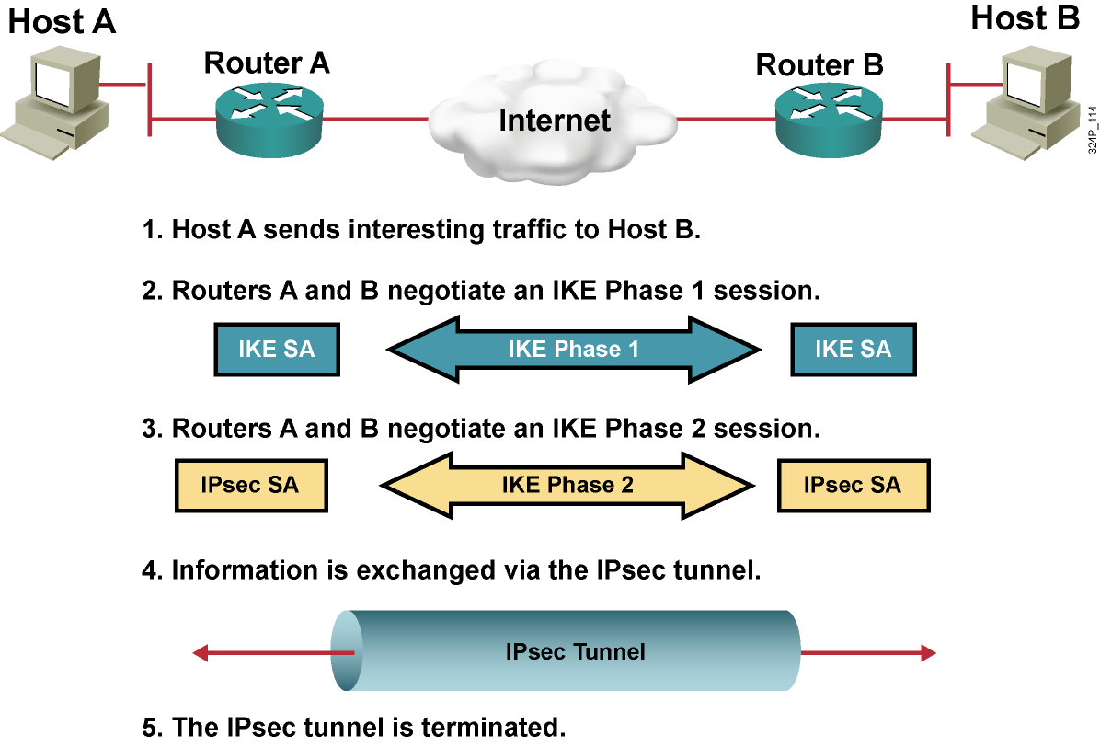
Five Steps of IPsec

Slide 4
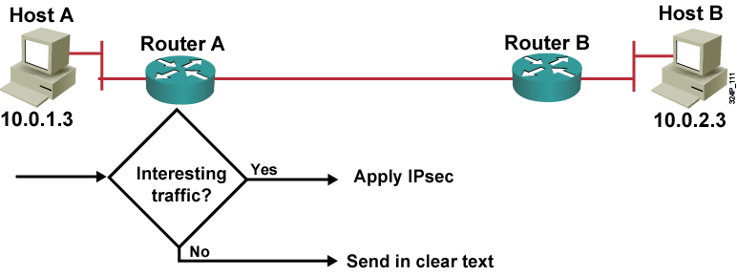
Step 1: Interesting Traffic

Slide 5
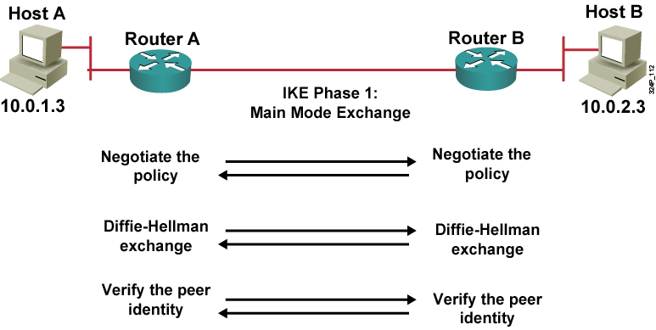
Step 2: IKE Phase 1

Slide 6
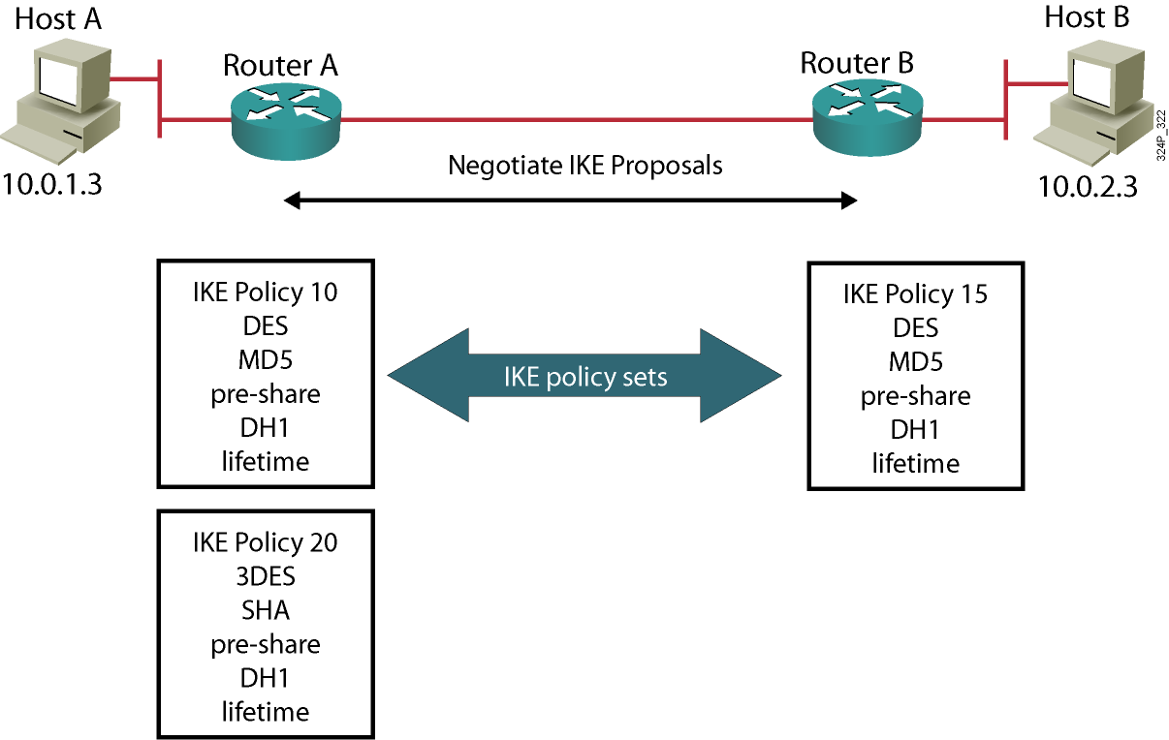
IKE Policy
  Negotiates matching IKE transform sets to protect IKE exchange

Slide 7
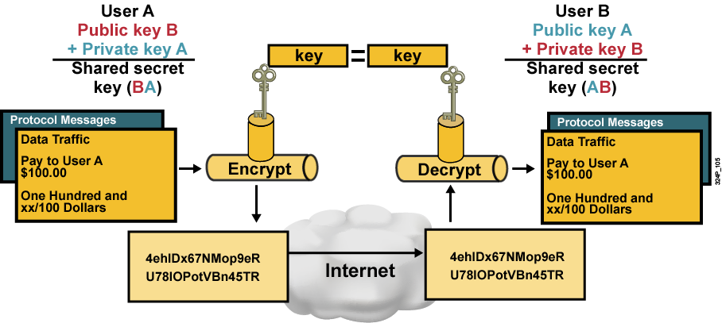
Diffie-Hellman Key Exchange

Slide 8
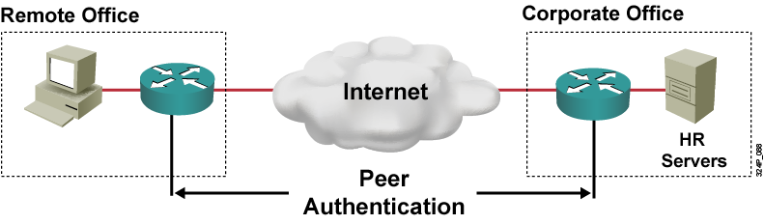
Authenticate Peer Identity
Peer authentication methods:
  Preshared keys
  RSA signatures
  RSA encrypted nonces

Slide 9
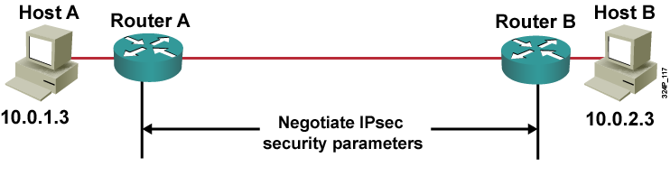
Step 3: IKE Phase 2
  Negotiates IPsec security parameters, IPsec transform sets
  Establishes IPsec SAs
  Periodically renegotiates IPsec SAs to ensure security
  Optionally, performs an additional Diffie-Hellman exchange

Slide 10
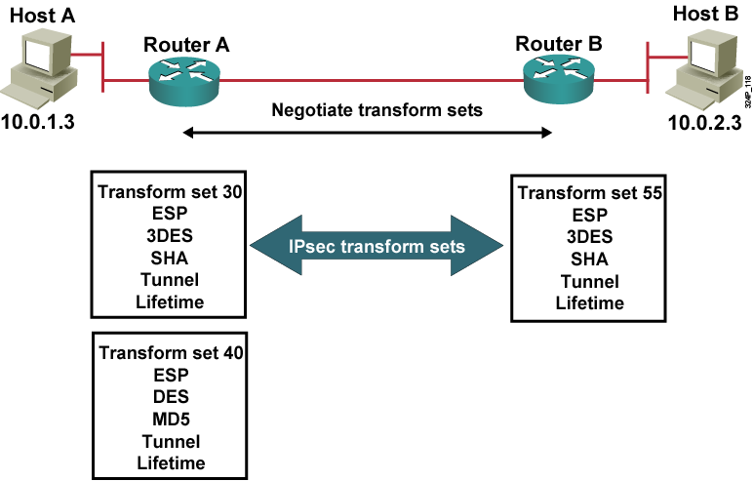
IPsec Transform Sets
  A transform set is a combination of algorithms and protocols that enact a security policy for traffic.

Slide 11
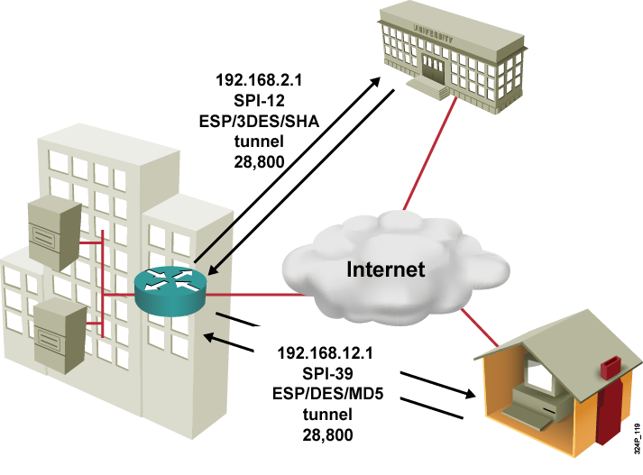
Security Associations
  SA database:
    Destination IP address
    SPI
    Protocol (ESP or AH)
  Security policy database:
    Encryption algorithm
    Authentication algorithm
    Mode
    Key lifetime

Slide 12
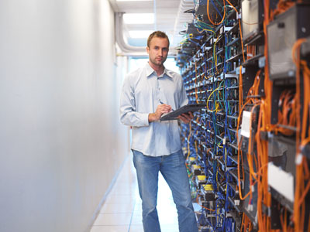

SA Lifetime
Data transmitted-based
Time-based

Slide 13
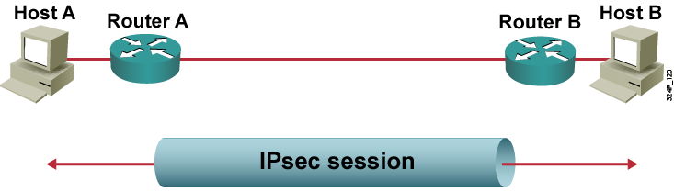
Step 4: IPsec Session
  SAs are exchanged between peers.
  The negotiated security services are applied to the traffic.

Slide 14
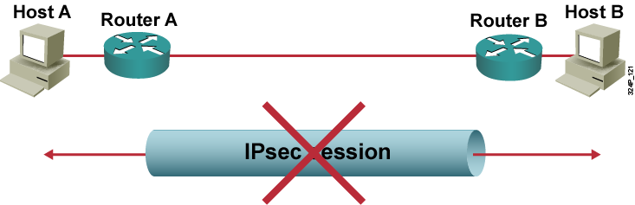
Step 5: Tunnel Termination
  A tunnel is terminated by one of the following:
    By an SA lifetime timeout
    If the packet counter is exceeded
  IPsec SA is removed

Slide 15
Configuring IPsec

Slide 16
Configuration Steps for
Site-to-Site IPsec VPN
  Establish ISAKMP policy
  Configure IPsec transform set
  Configure crypto ACL
  Configure crypto map
  Apply crypto map to the interface
  Configure interface ACL

Slide 17
Site-to-Site IPsec Configuration: Phase 1

Slide 18
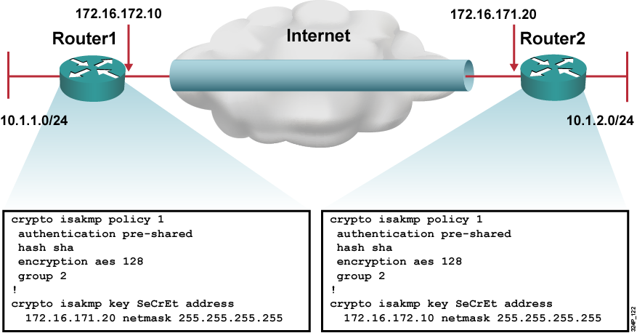
Site-to-Site IPsec Configuration: Phase 1

Slide 19
Site-to-Site IPsec Configuration: Phase 2

Slide 20
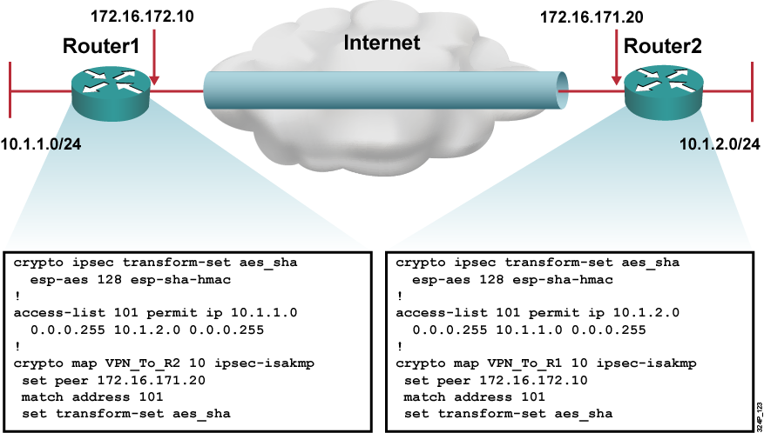
Site-to-Site IPsec Configuration: Phase 2

Slide 21
Site-to-Site IPsec Configuration: Apply VPN Configuration

Slide 22
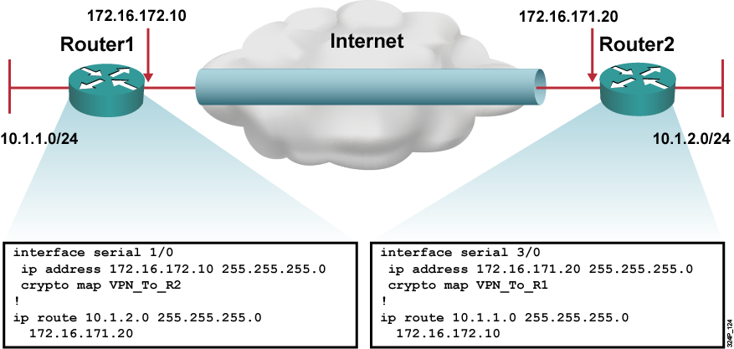
Site-to-Site IPsec Configuration:
Apply VPN Configuration

Slide 23
Site-to-Site IPsec Configuration: Interface ACL

Slide 24
Site-to-Site IPsec Configuration:
Interface ACL
When filtering at the edge, there is not much to see:
  IKE: UDP port 500
  ESP and AH: IP protocol numbers 50 and 51, respectively
  NAT transparency enabled:
    UDP port 4500
    TCP (port number has to be configured)

Slide 25
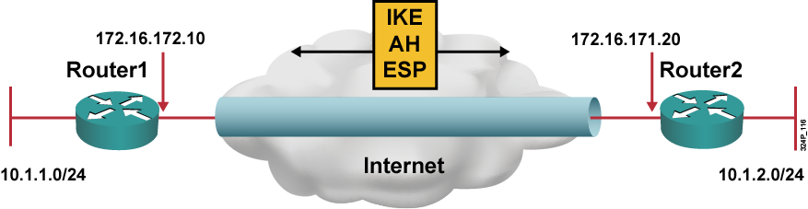
Site-to-Site IPsec Configuration:
Interface ACL (Cont.)
Router1#show access-lists
access-list 102 permit ahp host 172.16.172.10 host 172.16.171.20
access-list 102 permit esp host 172.16.172.10 host 172.16.171.20
access-list 102 permit udp host 172.16.172.10 host 172.16.171.20 eq isakmp
  Ensure that protocols 50 and 51 and UDP port 500 traffic is not blocked on interfaces used by IPsec.

Slide 26
Summary
  IPsec operation includes these steps: Initiation by interesting traffic of the IPsec process, IKE Phase 1, IKE Phase 2, data transfer, and IPsec tunnel termination.
  To configure a site-to-site IPsec VPN: Configure the ISAKMP policy, define the IPsec transform set, create a crypto ACL, create a crypto map, apply crypto map, and configure ACL.
  To define an IKE policy, use the crypto isakmp policy global configuration command.
  To define an acceptable combination of security protocols and algorithms used for IPsec, use the crypto ipsec transform-set global configuration command.
  To apply a previously defined crypto map set to an interface, use the crypto map interface configuration command.
  Configure an ACL to enable the IPsec protocols (protocol 50 for ESP or 51 for AH) and IKE protocol (UDP/500).

Slide 27


