Slide 1
IPsec VPNs
Configuring IPsec Site-to-Site VPN Using SDM

Slide 2

Introducing the SDM VPN Wizard Interface

Slide 3
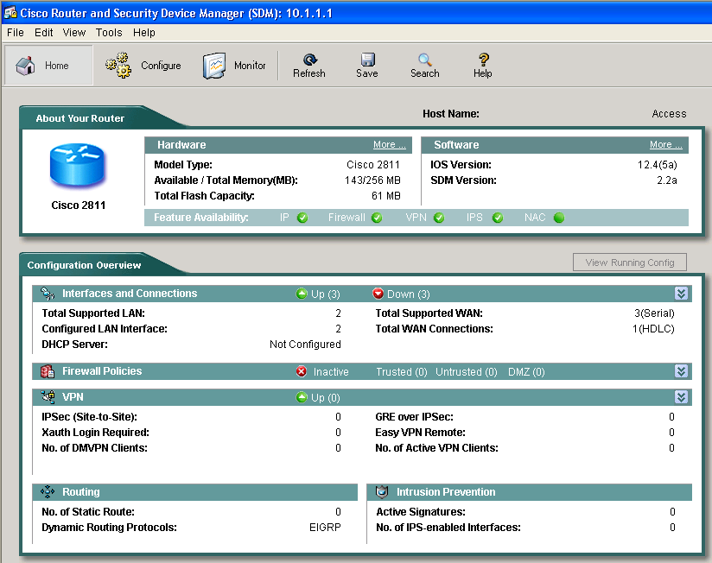
Cisco Router and SDM

Slide 4
What Is Cisco SDM?
  SDM is an embedded web-based management tool.
  Provides intelligent wizards to enable quicker and easier deployments, and does not require knowledge of Cisco IOS CLI or security expertise.
  Contains tools for more advanced users:
    ACL editor
    VPN crypto map editor
    Cisco IOS CLI preview

Slide 5
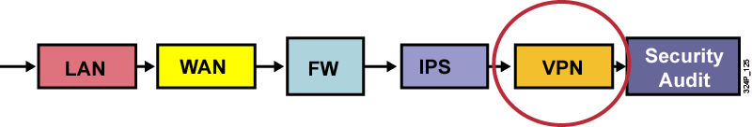
Cisco SDM Features
  Smart wizards for these frequent router and security configuration issues:
    Avoid misconfigurations with integrated routing and security
    Secure the existing network infrastructure easily and cost-effectively
    Uses Cisco TAC- and ICSA-recommended security configurations
  Startup wizard, one-step router lockdown, policy-based firewall and ACL management (firewall policy), one-step VPN (site-to-site), and inline IPS
  Guides untrained users through workflow

Slide 6
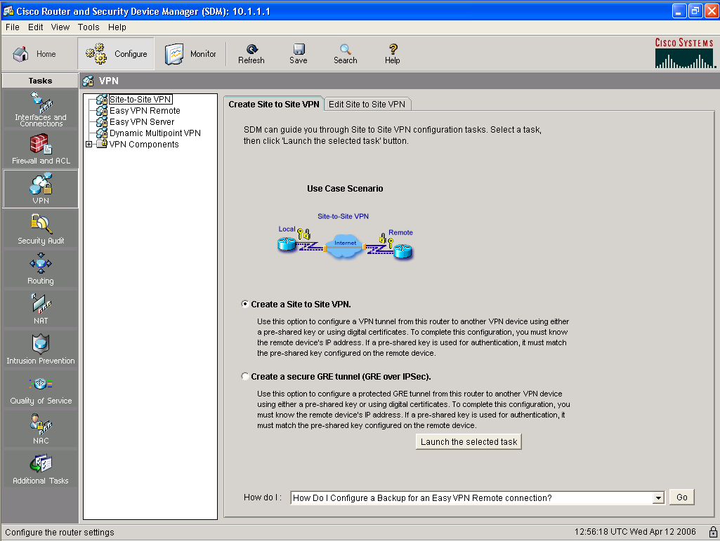
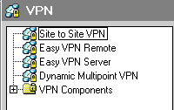
Introducing the SDM VPN Wizard Interface
1.
3.
Wizards for IPsec
solutions
Individual IPsec
components
2.

Slide 7
Site-to-Site VPN Components

Slide 8
Site-to-Site VPN Components
  VPN wizards use two sources to create a VPN connection:
    User input during the step-by-step wizard process
    Preconfigured VPN components
  SDM provides some default VPN components:
    Two IKE policies
    IPsec transform set for Quick Setup wizard
  Other components are created by the VPN wizards.
  Some components (e.g., PKI) must be configured before the wizards can be used.

Slide 9
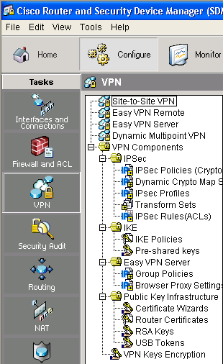
Site-to-Site VPN Components (Cont.)
  Two main components:
    IPsec
    IKE
  Two optional components:
    Group Policies for Easy VPN server functionality
    Public Key Infrastructure for IKE authentication using digital certificates
Individual IPsec
components used
to build VPNs

Slide 10
Launching the
Site-to-Site VPN Wizard

Slide 11
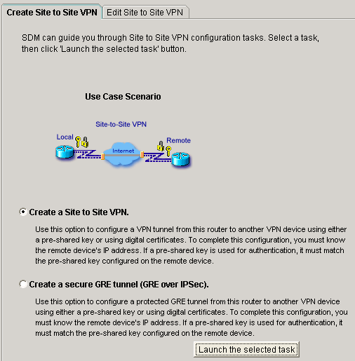
Launching the Site-to-Site VPN Wizard
1.

Slide 12
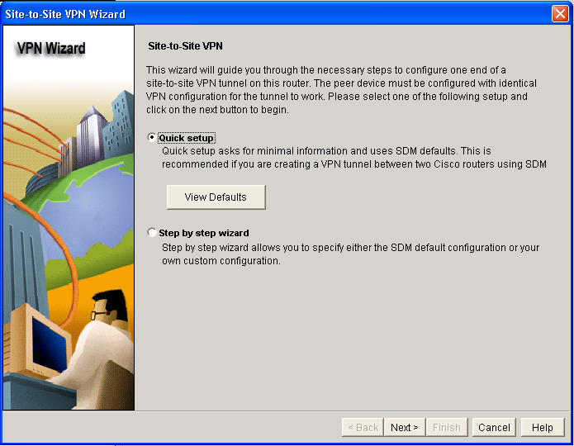
Launching the Site-to-Site
VPN Wizard (Cont.)
2a.
2b.
3.

Slide 13
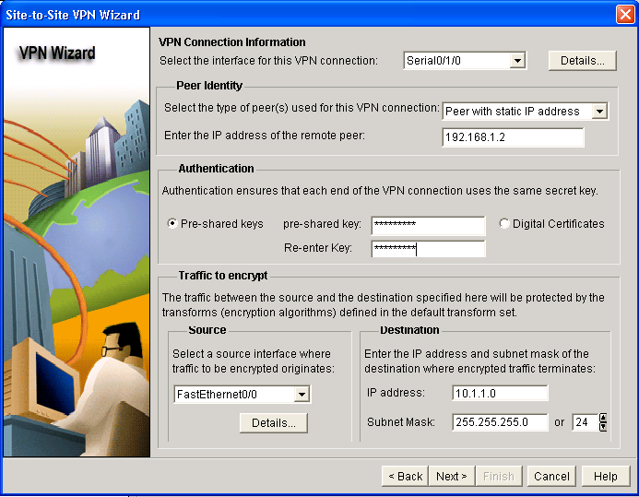
Quick Setup

Slide 14
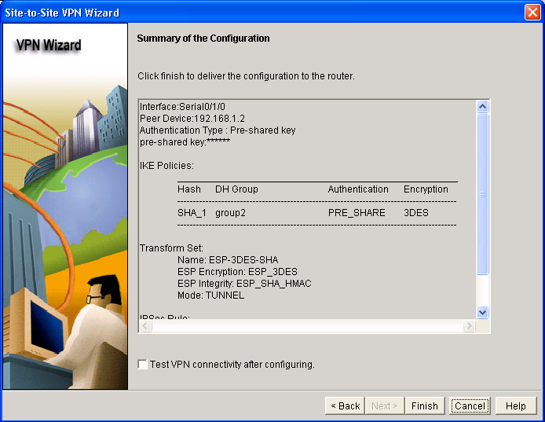
Quick Setup (Cont.)

Slide 15
Step-by-Step Setup
Multiple steps are used to configure the VPN connection:
  Defining connection settings: Outside interface, peer address, authentication credentials
  Defining IKE proposals: Priority, encryption algorithm, HMAC, authentication type, Diffie-Hellman group, lifetime
  Defining IPsec transform sets: Encryption algorithm, HMAC, mode of operation, compression
  Defining traffic to protect: Single source and destination subnets, ACL
  Reviewing and completing the configuration

Slide 16
Connection Settings

Slide 17
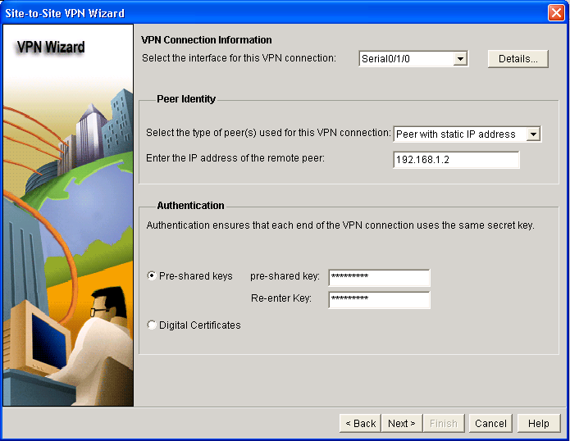
Connection Settings
1.
2.
3.
4.

Slide 18
IKE Proposals

Slide 19
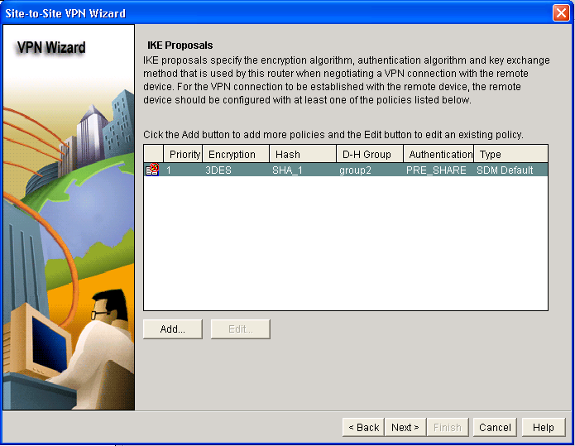
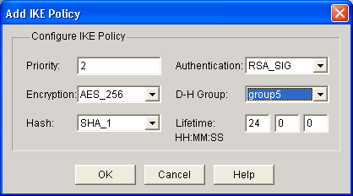
IKE Proposals
1.
2.
3.

Slide 20
Transform Set

Slide 21
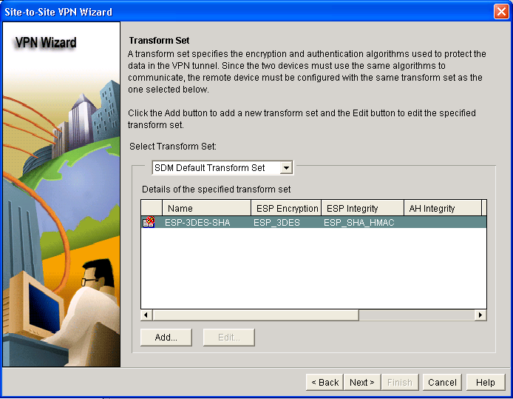
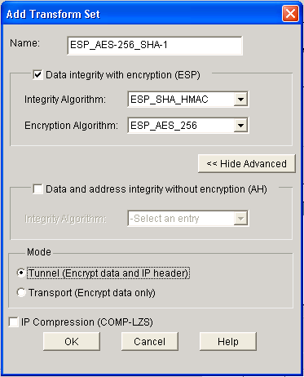
Transform Set
1.
2.
3.

Slide 22
Defining What Traffic to Protect

Slide 23
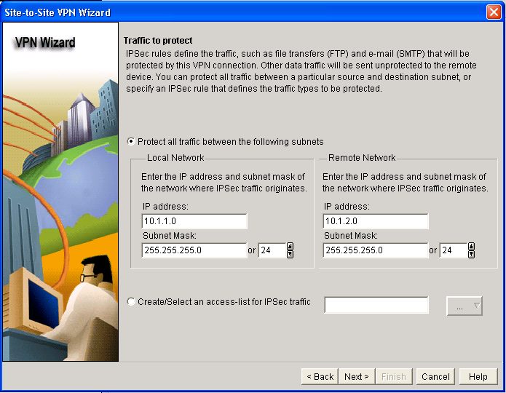
Option 1: Single Source and Destination Subnet
1.
2.
3.

Slide 24
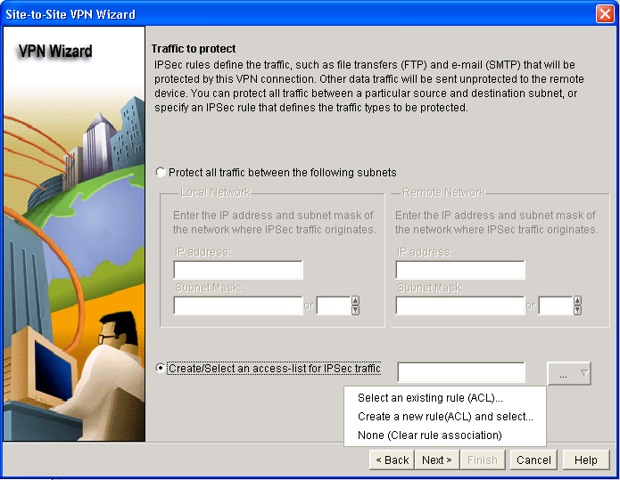
Option 2: Using an ACL
1.
2.
3.

Slide 25
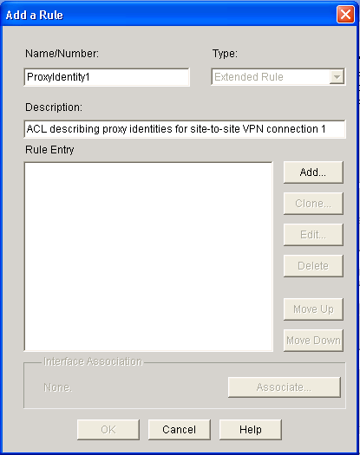
Option 2: Using an ACL (Cont.)
1.
2.

Slide 26
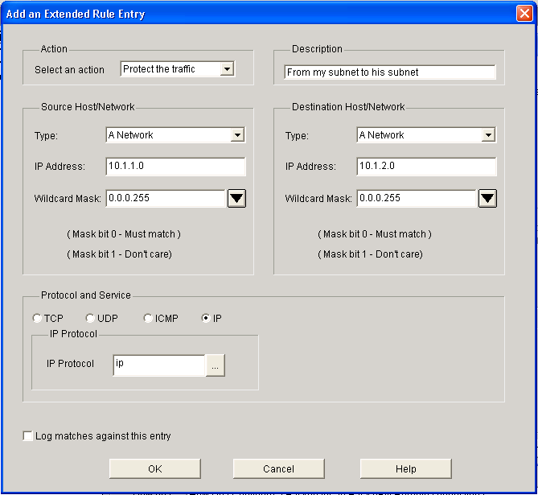
Option 2: Using an ACL (Cont.)
1.
2.
3.

Slide 27
Completing the Configuration

Slide 28
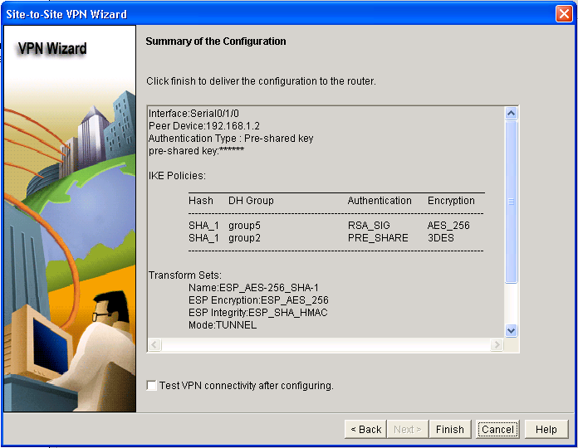
Review the Generated Configuration

Slide 29
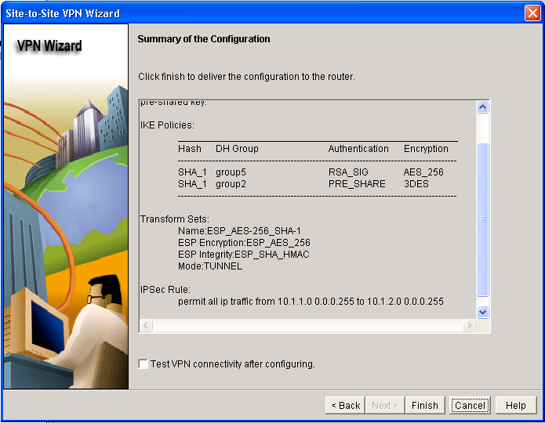
Review the Generated Configuration (Cont.)

Slide 30
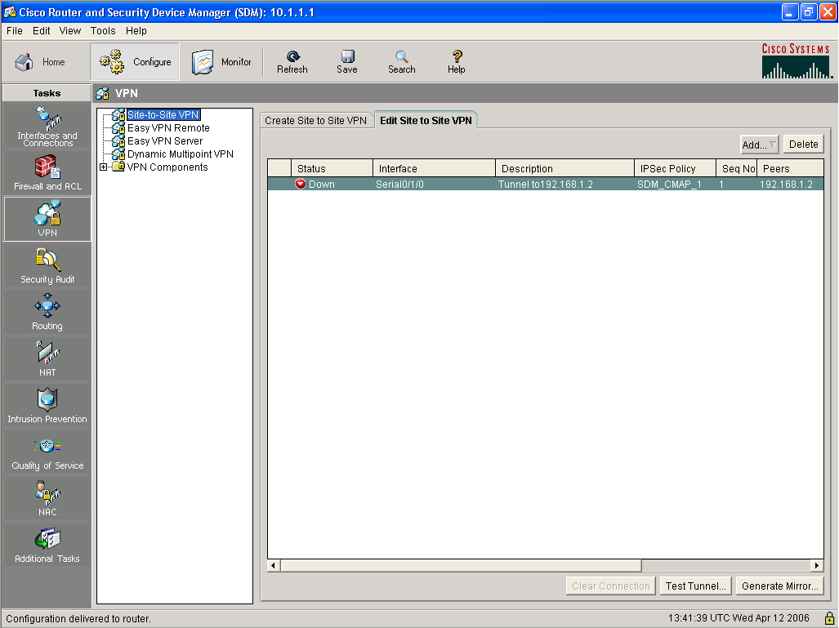
Test Tunnel Configuration and Operation
~
~
~
~

Slide 31
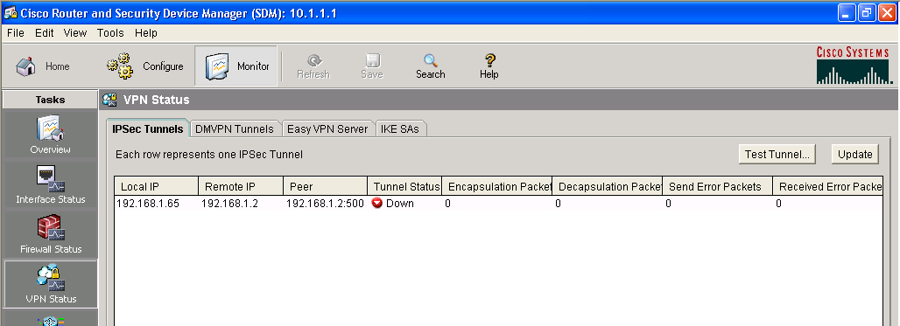
Monitor Tunnel Operation
1.
3.
2.

Slide 32
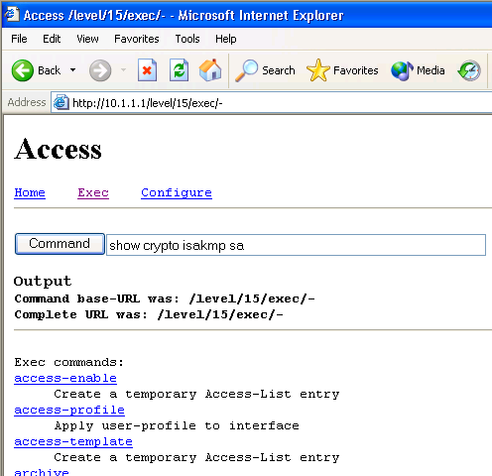
Advanced Monitoring
router#
show crypto isakmp sa
Lists active IKE sessions
router#
show crypto ipsec sa
Lists active IPsec security associations
Advanced monitoring can be performed using the default Cisco IOS HTTP server interface.
Requires knowledge of Cisco IOS CLI commands.

Slide 33
Troubleshooting
router#
debug crypto isakmp
Debugs IKE communication
Advanced troubleshooting can be performed using the Cisco IOS CLI
Requires knowledge of Cisco IOS CLI commands

Slide 34
Summary
  SDM is a GUI and one of its features is to provide simplified management of security mechanisms on Cisco IOS routers.
  SDM can manage various types of site-to-site VPNs.
  SDM can be used to implement a simple site-to-site VPN in three ways:
    Using the quick setup wizard
    Using the step-by-step wizard
    Configuring individual VPN components
  Upon completing the configuration, the SDM converts the configuration into the Cisco IOS CLI format.

Slide 35
