Slide 1
IPsec VPNs
Configuring GRE Tunnels over IPsec

Slide 2

Generic Routing Encapsulation

Slide 3
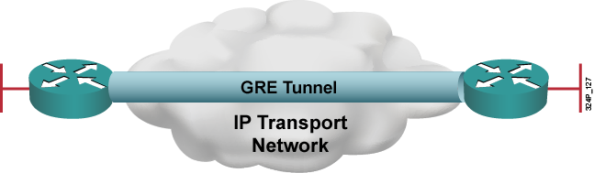
Generic Routing Encapsulation
OSI Layer 3 tunneling protocol:
  Uses IP for transport
  Uses an additional header to support any other OSI Layer 3 protocol as payload (e.g., IP, IPX, AppleTalk)

Slide 4
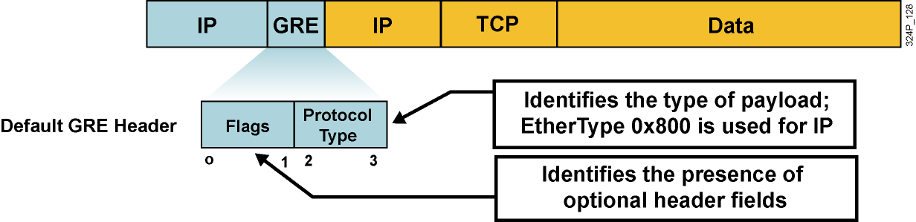
Default GRE Characteristics
  Tunneling of arbitrary OSI Layer 3 payload is the primary goal of GRE
  Stateless (no flow control mechanisms)
  No security (no confidentiality, data authentication, or integrity assurance)
  24-byte overhead by default (20-byte IP header and 4-byte GRE header)

Slide 5
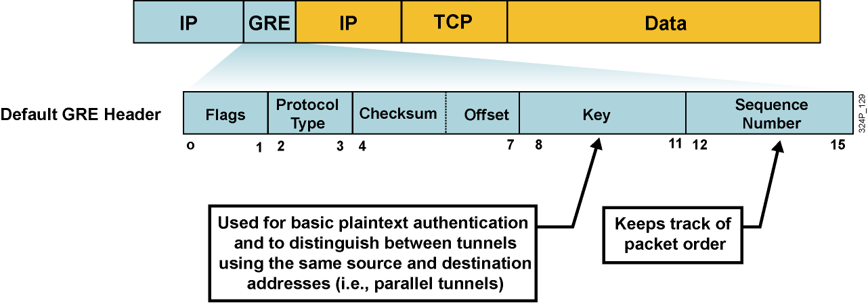
Optional GRE Extensions
  GRE can optionally contain any one or more of these fields:
    Tunnel checksum
    Tunnel key
    Tunnel packet sequence number
  GRE keepalives can be used to track tunnel path status.

Slide 6
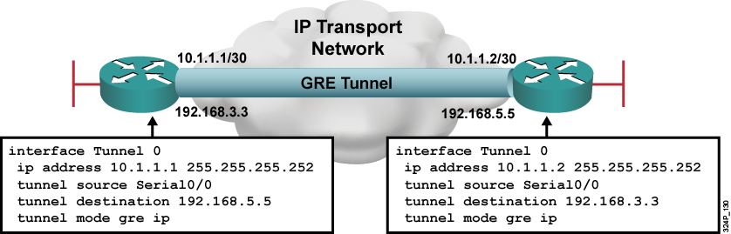
GRE Configuration Example
  GRE tunnel is up and protocol up if:
    Tunnel source and destination are configured
    Tunnel destination is in routing table
    GRE keepalives are received (if used)
  GRE is the default tunnel mode.

Slide 7
Introducing Secure GRE Tunnels

Slide 8
Introducing Secure GRE Tunnels
  GRE is good at tunneling:
    Multiprotocol support
    Provides virtual point-to-point connectivity, allowing routing protocols to be used
  GRE is poor at security—only very basic plaintext authentication can be implemented using the tunnel key (not very secure)
  GRE cannot accommodate typical security requirements:
    Confidentiality
    Data source authentication
    Data integrity

Slide 9
IPsec Characteristics
  IPsec provides what GRE lacks:
    Confidentiality through encryption using symmetric algorithms (e.g., 3DES or AES)
    Data source authentication using HMACs (e.g., MD5 or SHA-1)
    Data integrity verification using HMACs
  IPsec is not perfect at tunneling:
    Older Cisco IOS software versions do not support IP multicast over IPsec
    IPsec was designed to tunnel IP only (no multiprotocol support)
    Using crypto maps to implement IPsec does not allow the usage of routing protocols across the tunnel
    IPsec does not tunnel IP protocols; GRE does

Slide 10
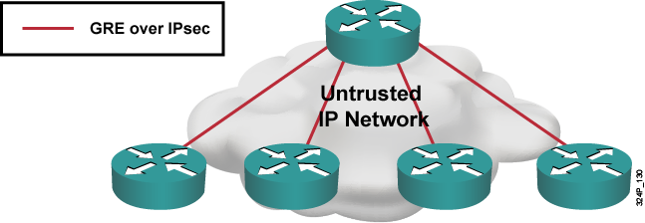
GRE over IPsec
GRE over IPsec is typically used to do the following:
  Create a logical hub-and-spoke topology of virtual point-to-point connections
  Secure communication over an untrusted transport network (e.g., Internet)

Slide 11
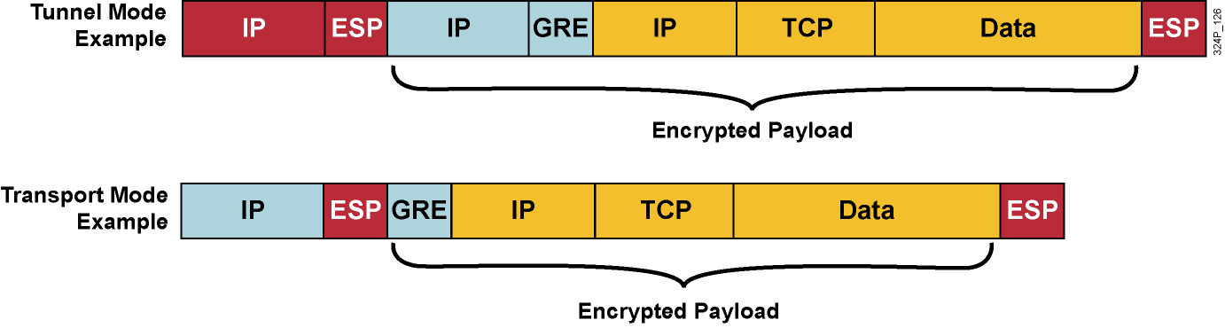
GRE over IPsec Characteristics
  GRE encapsulates arbitrary payload.
  IPsec encapsulates unicast IP packet (GRE):
    Tunnel mode (default): IPsec creates a new tunnel IP packet
    Transport mode: IPsec reuses the IP header of the GRE (20 bytes less overhead)

Slide 12
Configuring GRE over IPsec Site-to-Site Tunnel Using SDM

Slide 13
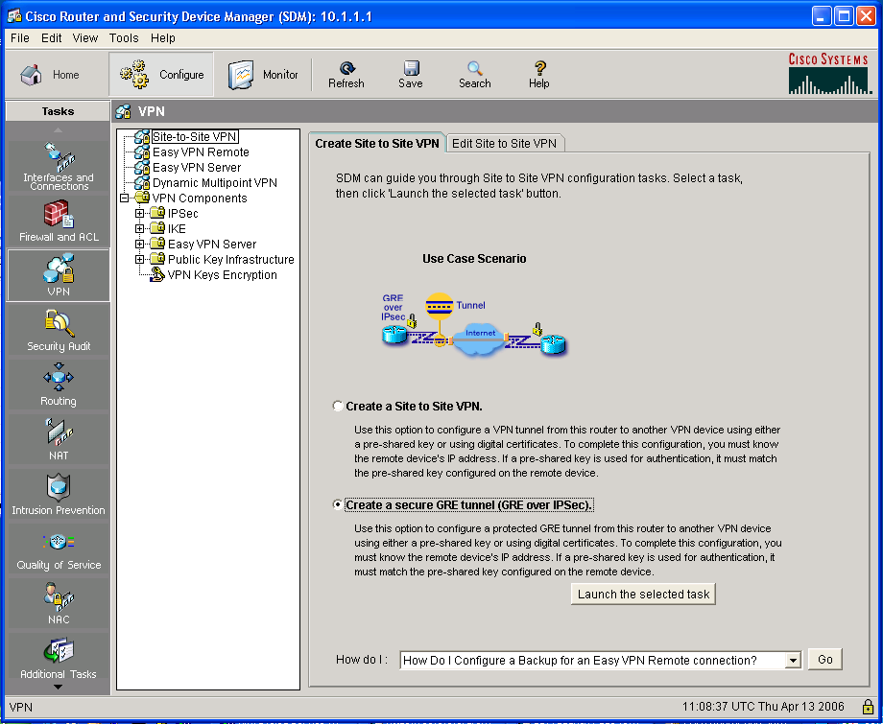
Configuring GRE over IPsec
Site-to-Site Tunnel Using SDM
1.
3.
4.
2.
5.
6.

Slide 14
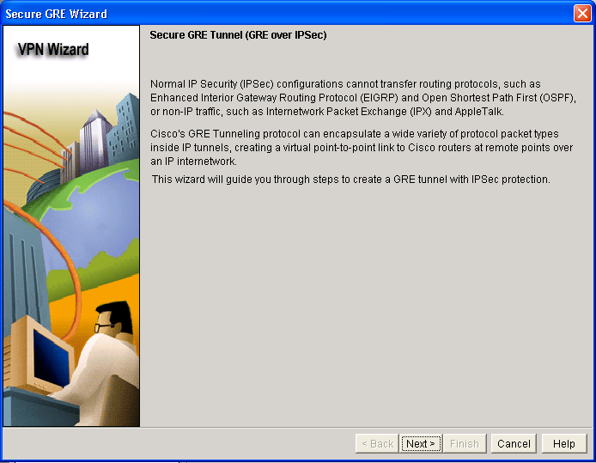
Configuring GRE over IPsec
Site-to-Site Tunnel Using SDM (Cont.)

Slide 15
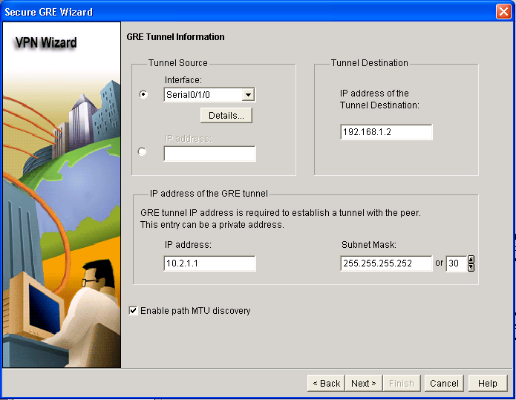
Configuring GRE over IPsec
Site-to-Site Tunnel Using SDM (Cont.)
1.
2.
3.
4.

Slide 16
Backup GRE Tunnel Information

Slide 17
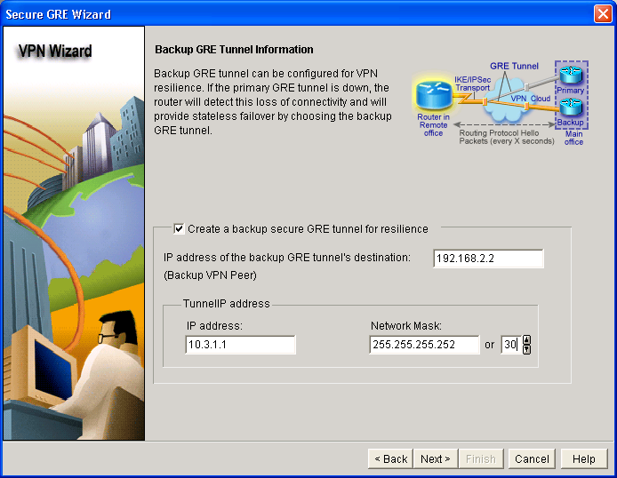
Backup GRE Tunnel Information
1.
2.
3.
4.

Slide 18
VPN Authentication Information

Slide 19

VPN Authentication Information
1A
1B
2.

Slide 20
IKE Proposals

Slide 21
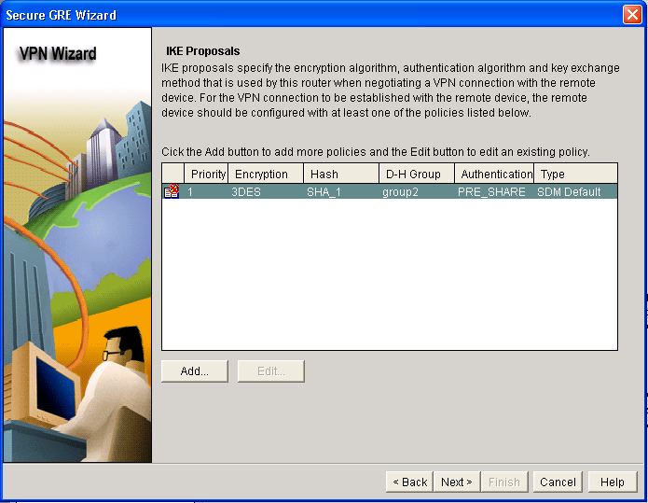
IKE Proposals

Slide 22
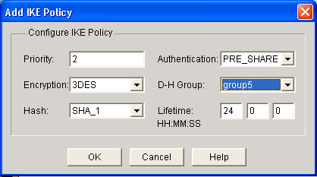
Creating a Custom IKE Policy
Define all IKE policy parameters:
  Priority
  Encryption algorithm: DES, 3DES, AES
  HMAC: SHA-1 or MD5
  Authentication method: preshared secrets or digital certificates
  Diffie-Hellman group: 1, 2, or 5
  IKE lifetime

Slide 23
Transform Set

Slide 24
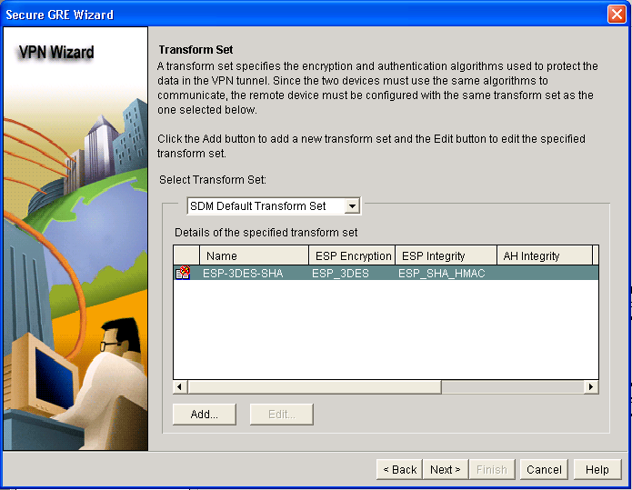
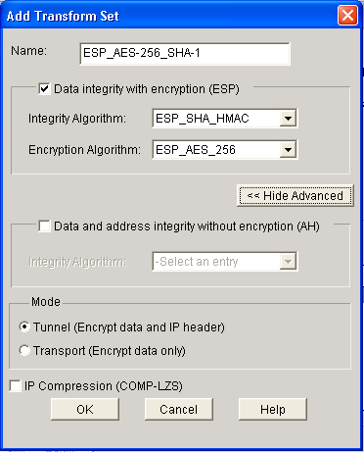
Transform Set
1.
2.
3.

Slide 25
Routing Information

Slide 26
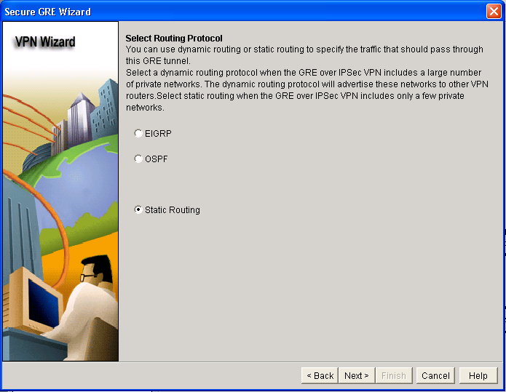
Routing Information

Slide 27
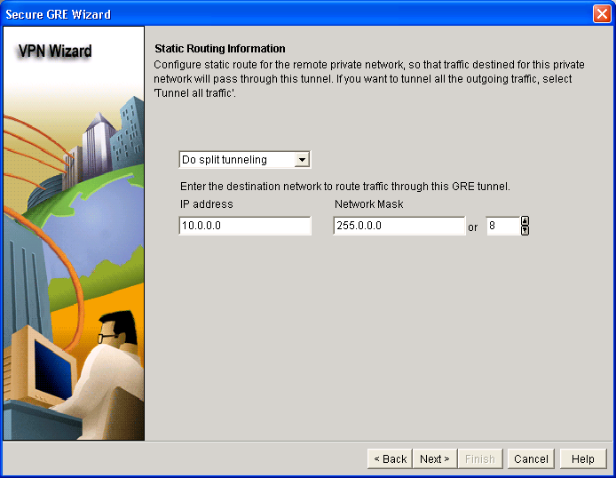
Option 1: Static Routing

Slide 28
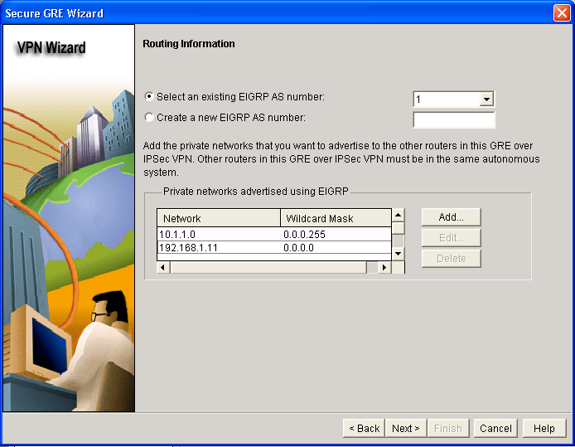
Option 2: Dynamic Routing Using EIGRP
1.
2.

Slide 29
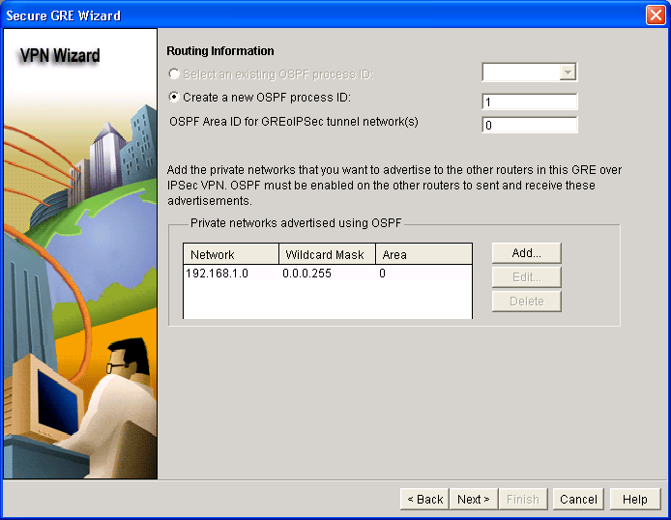
Option 3: Dynamic Routing Using OSPF
1.
2.
3.

Slide 30
Completing the Configuration

Slide 31
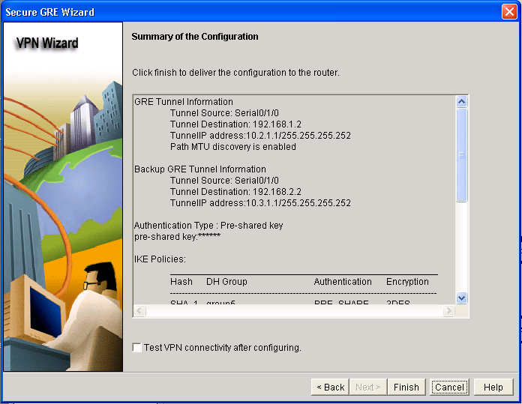
Review the Generated Configuration

Slide 32
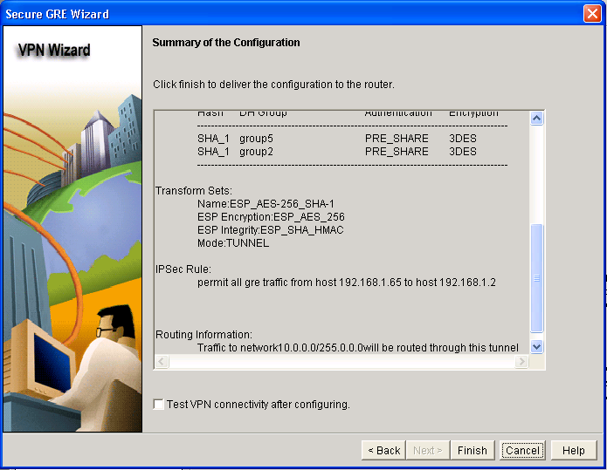
Review the Generated Configuration (Cont.)

Slide 33
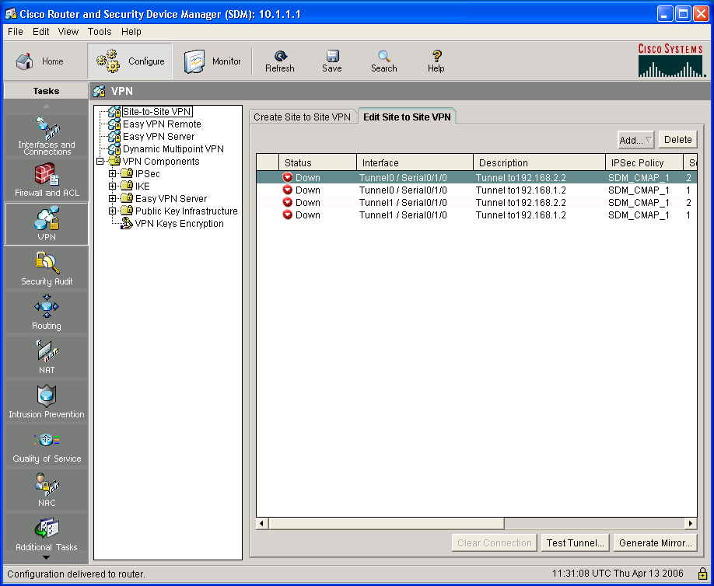
Test Tunnel Configuration and Operation
1.
3.
4.
5.
2.
6.

Slide 34
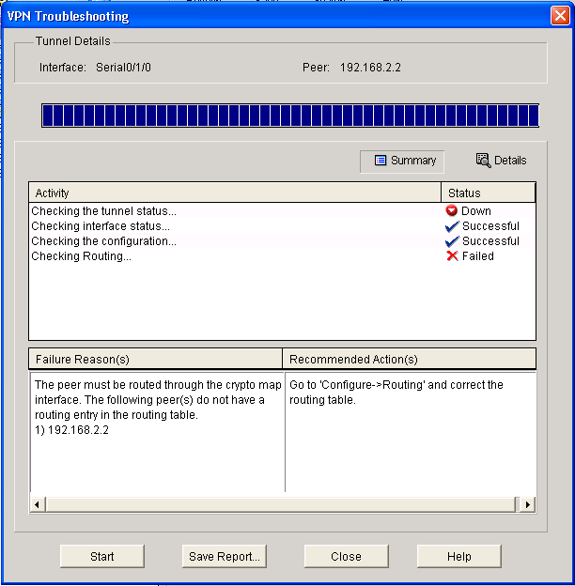
Test Tunnel Configuration and Operation (Cont.)
7.

Slide 35
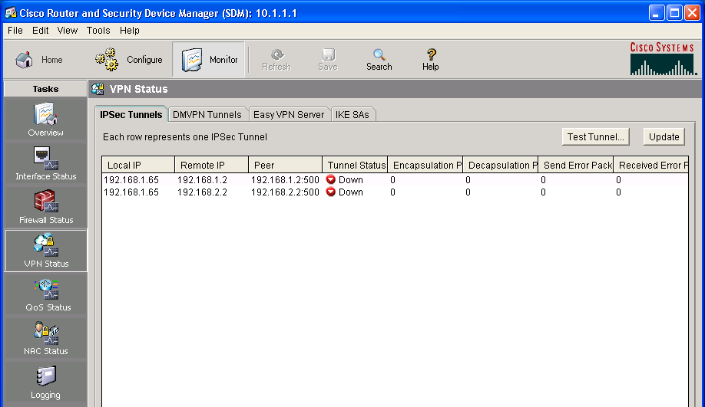
Monitor Tunnel Operation
1.
3.
2.

Slide 36
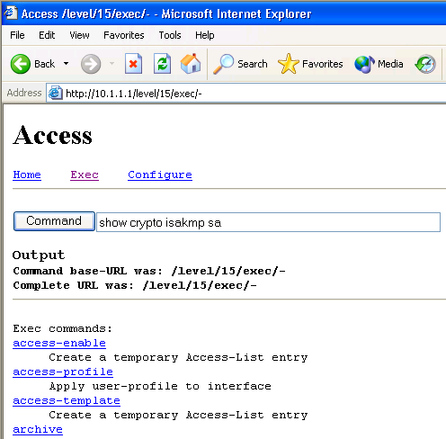
Advanced Monitoring
router#
show crypto isakmp sa
Lists active IKE sessions
router#
show crypto ipsec sa
Lists active IPsec security associations
router#
show interfaces
Lists interface and the statistics including the statistics of tunnel interfaces
Advanced monitoring can be performed using the default Cisco IOS HTTP server interface.
Requires knowledge of Cisco IOS CLI commands.

Slide 37
Troubleshooting
router#
debug crypto isakmp
Debugs IKE communication
Advanced troubleshooting can be performed using the Cisco IOS CLI
Requires knowledge of Cisco IOS CLI commands

Slide 38
Summary
  GRE is a multiprotocol tunneling technology.
  SDM can be used to implement GRE over IPsec site-to-site VPNs.
  Backup tunnels can be configured in addition to one primary tunnel.
  Routing can be configured through the tunnel interfaces:
    Static for simple sites
    OSPF or EIGRP for more complex sites (more networks, multiple tunnels)
  Upon completing the configuration, the SDM converts the configuration into the Cisco IOS CLI format.

Slide 39


