Slide 1
IPsec VPNs
Cisco High Availability Options

Slide 2

High Availability for Cisco IOS IPsec VPNs

Slide 3
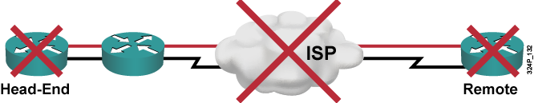
Failures
  IPsec VPNs can experience any one of a number of different types of failures:
    Access link failure
    Remote peer failure
    Device failure
    Path failure
  IPsec should be designed and implemented with redundancy and high-availability mechanisms to mitigate these failures.

Slide 4
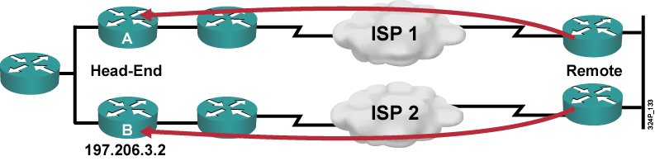
Redundancy
Common solutions using one or more of these options:
  Two access links to mitigate access-link failures
  Multiple peers to mitigate peer failure
  Two local VPN devices to mitigate device failures
  Multiple independent paths to mitigate all path failures

Slide 5
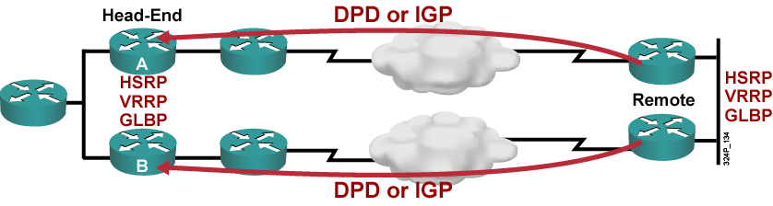
Failure Detection
Native IPsec uses DPD to detect failures in the path and remote peer failure.
Any form of GRE over IPsec typically uses a routing protocol to detect failures (hello mechanism).
HSRP is typically used to detect failures of local devices. VRRP and GLBP have similar failure-detection functionality.

Slide 6
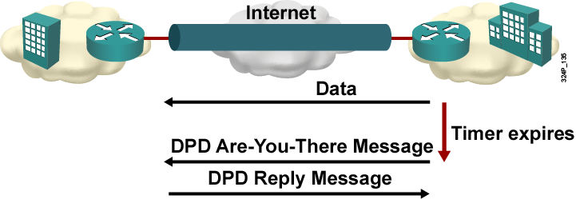
Dead Peer Detection
  IKE keepalives:
    Keepalives in periodic intervals
  DPD:
    Keepalives in periodic intervals if no data transmitted
    On-demand option

Slide 7
IPsec Backup Peer

Slide 8
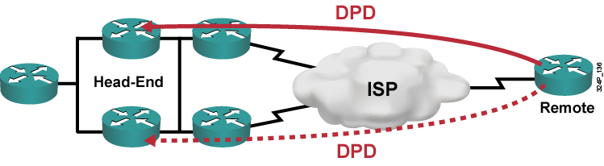
IPsec Backup Peer
One HA design option is to use native IPsec and its HA mechanisms:
  DPD to detect failures
  Backup peers to take over new tunnels when primary peer becomes unavailable

Slide 9
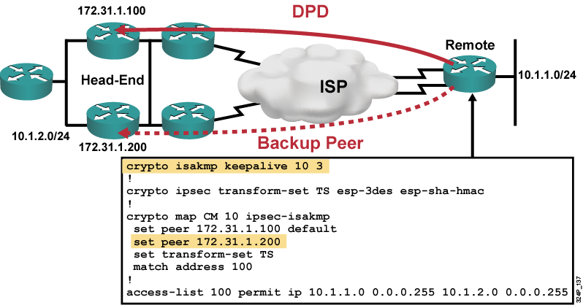
Configuration Example
  Router will first try primary peer.
  If primary peer is not available or becomes unavailable (DPD failure detection), the router tries backup peers in order as listed in the crypto map.

Slide 10
Hot Standby Routing Protocol

Slide 11
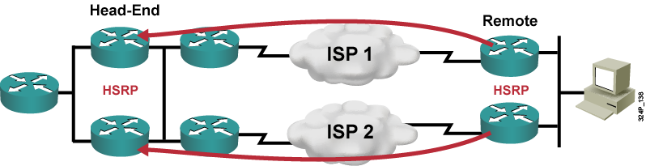
Hot Standby Routing Protocol
  HSRP can be used at:
    Headend: Two head-end IPsec devices appear as one to remote peers
    Remote site: Two IPsec gateways appear as one to local devices
  Active HSRP device uses a virtual IP and MAC address.
  Standby HSRP device takes over virtual IP and MAC address when active HSRP device goes down.

Slide 12
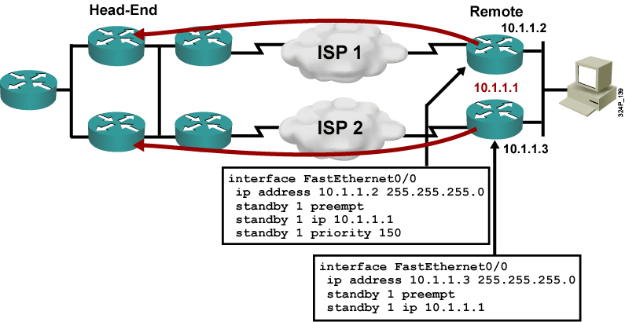
HSRP for Default Gateway at Remote Site
  All remote devices use virtual IP as default gateway.
  Backup router is only used when primary router is down.

Slide 13
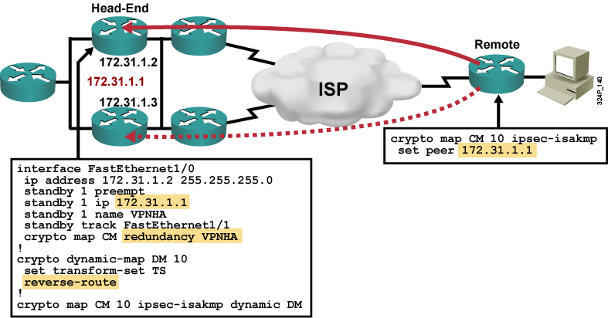
HSRP for Head-End IPsec Routers
  Remote sites peer with virtual IP address (HSRP) of the headend.
  RRI or HSRP can be used on inside interface to ensure proper return path.

Slide 14
IPsec Stateful Failover

Slide 15
IPsec Stateful Failover
  IPsec VPNs using DPD, HSRP, or IGPs to mitigate failures only provide stateless failover.
  IPsec stateful failover requires:
    Identical hardware and software configuration of IPsec on active and standby device
    Exchange of IPsec state between active and standby device (i.e., complete SA information)

Slide 16
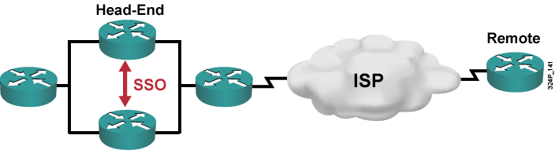
IPsec Stateful Failover (Cont.)
  IPsec stateful failover works in combination with HSRP and SSO.
  SSO is responsible to synchronize ISAKMP and IPsec SA database between HSRP active and standby routers.
  RRI is optionally used to inject the routes into the internal network.

Slide 17
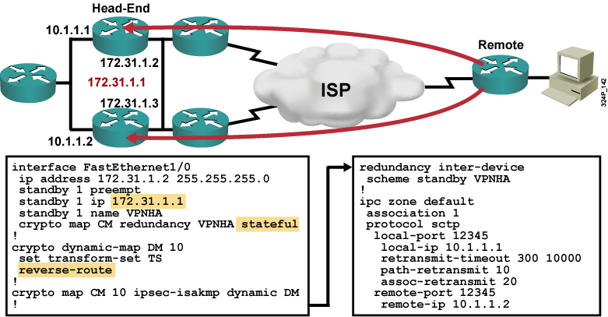
IPsec Stateful Failover Example
  Configure IPC to exchange state information between head-end devices.
  Enable stateful redundancy.

Slide 18
Backing Up a WAN Connection with an IPsec VPN

Slide 19
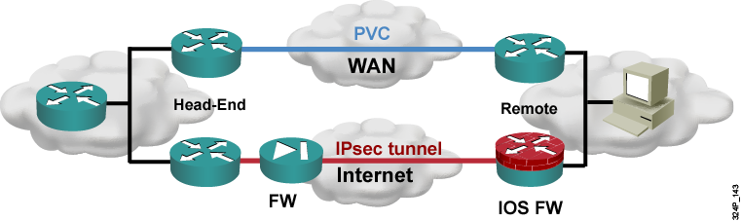
Backing Up a WAN Connection with an IPsec VPN
  IPsec VPNs can be used as cost-effective and fast backups for an existing WAN.
  Switchover options:
    Using an IGP (e.g., GRE over IPsec or VTI):
      Use IGP metrics to influence primary path selection
      Optionally, use HSRP to track PVC status on remote site
    Using floating static routes for VPN destinations

Slide 20
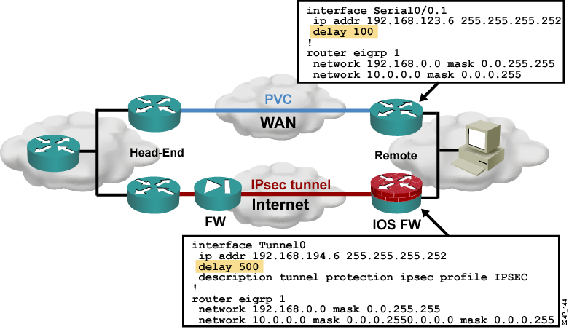
Backing Up a WAN Connection with an IPsec VPN: Example Using GRE over IPsec
  IGP used to detect PVC failures
  Reroute to GRE over IPsec tunnel

Slide 21
Summary
  High availability requires two components:
    Redundant device, links, or paths
    High availability mechanisms to detect failures and reroute
  Native IPsec can be configured with backup peers in crypto maps in combination with DPD.
  HSRP can be used instead of backup peers.
  IPsec stateful failover can augment HSRP to minimize downtime upon head-end device failures.
  IPsec VPNs can be used as a backup for other types of networks.

Slide 22


