Slide 1
IPsec VPNs
Configuring Cisco Easy VPN and Easy VPN Server Using SDM

Slide 2

Introducing Cisco Easy VPN

Slide 3
Introducing Cisco Easy VPN
  Cisco Easy VPN has two main functions:
    Simplify client configuration
    Centralize client configuration and dynamically push the configuration to clients
  How are these two goals achieved?
    IKE Mode Config functionality is used to download some configuration parameters to clients.
    Clients are preconfigured with a set of IKE policies and IPsec transform sets.

Slide 4
Cisco Easy VPN Components
  Easy VPN Server: Enables Cisco IOS routers, Cisco PIX Firewalls, and Cisco VPN Concentrators to act as VPN head-end devices in site-to-site or remote-access VPNs, in which the remote office devices are using the Cisco Easy VPN Remote feature
  Easy VPN Remote: Enables Cisco IOS routers, Cisco PIX Firewalls, and Cisco VPN Hardware Clients or Software Clients to act as remote VPN clients

Slide 5
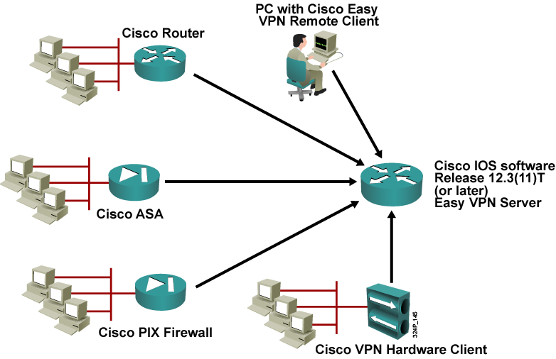
Remote Access Using Cisco Easy VPN

Slide 6
Describe Easy VPN Server and Easy VPN Remote

Slide 7
Cisco Easy VPN Remote
Connection Process
  The VPN client initiates the IKE Phase 1 process.
  The VPN client establishes an ISAKMP SA.
  The Easy VPN Server accepts the SA proposal.
  The Easy VPN Server initiates a username and password challenge.
  The mode configuration process is initiated.
  The RRI process is initiated.
  IPsec quick mode completes the connection.

Slide 8
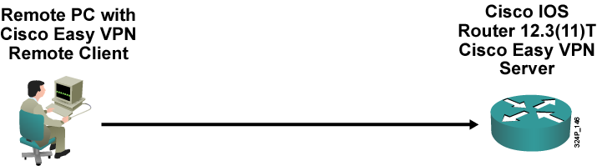
Step 1: The VPN Client Initiates the IKE Phase 1 Process
  Using pre-shared keys? Initiate aggressive mode.
  Using digital certificates? Initiate main mode.

Slide 9
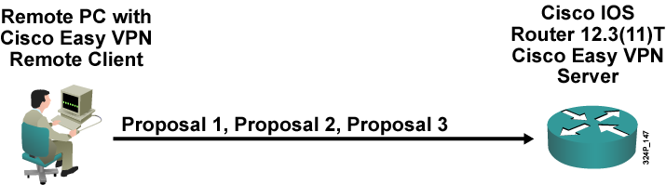
Step 2: The VPN Client Establishes an ISAKMP SA
  The VPN client attempts to establish an SA between peer IP addresses by sending multiple ISAKMP proposals to the Easy VPN Server.
  To reduce manual configuration on the VPN client, these ISAKMP proposals include several combinations of the following:
    Encryption and hash algorithms
    Authentication methods
    Diffie-Hellman group sizes

Slide 10
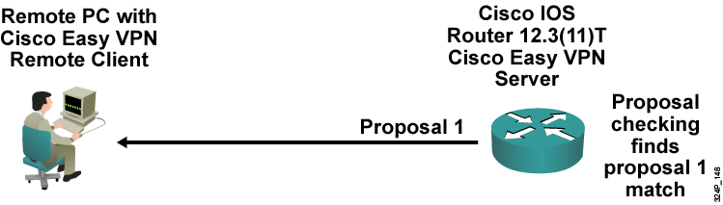
Step 3: The Cisco Easy VPN Server
Accepts the SA Proposal
  The Easy VPN Server searches for a match:
    The first proposal to match the server list is accepted (highest-priority match).
    The most secure proposals are always listed at the top of the Easy VPN Server proposal list (highest priority).
  The ISAKMP SA is successfully established.
  Device authentication ends and user authentication begins.

Slide 11
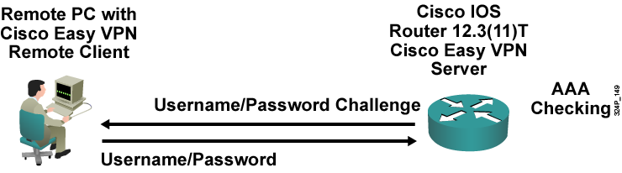
Step 4: The Cisco Easy VPN Server Initiates a Username and Password Challenge
  If the Easy VPN Server is configured for Xauth, the VPN client waits for a username/password challenge:
    The user enters a username/password combination.
    The username/password information is checked against authentication entities using AAA.
  All Easy VPN Servers should be configured to enforce user authentication.

Slide 12
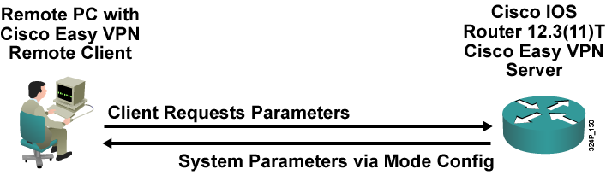
Step 5: The Mode Configuration
Process Is Initiated
  If the Easy VPN Server indicates successful authentication, the VPN client requests the remaining configuration parameters from the Easy VPN Server:
    Mode configuration starts.
    The remaining system parameters (IP address, DNS, split tunneling information, and so on) are downloaded to the VPN client.
  Remember that the IP address is the only required parameter in a group profile; all other parameters are optional.

Slide 13
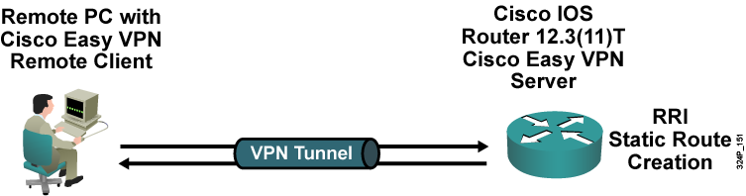
Step 6: The RRI Process Is Initiated
  RRI should be used when the following conditions occur:
    More than one VPN server is used
    Per-client static IP addresses are used with some clients (instead of using per-VPN-server IP pools)
  RRI ensures the creation of static routes.
  Redistributing static routes into an IGP allows the servers site routers to find the appropriate Easy VPN Server for return traffic to clients.

Slide 14
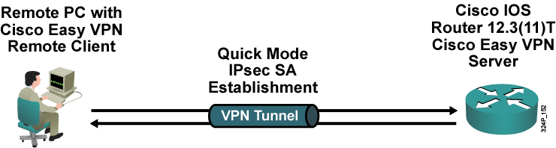
Step 7: IPsec Quick Mode
Completes the Connection
  After the configuration parameters have been successfully received by the VPN client, IPsec quick mode is initiated to negotiate IPsec SA establishment.
  After IPsec SA establishment, the VPN connection is complete.

Slide 15
Cisco Easy VPN Server Configuration Tasks

Slide 16
Cisco Easy VPN Server
Configuration Tasks Using SDM
Configuring the Easy VPN Server requires these tasks:
  Configuring a privileged user
  Configuring enable secret
  Enabling AAA using the local database
  Configuring the Easy VPN Server using a configuration wizard

Slide 17
Cisco Easy VPN Server Configuration Tasks for the Easy VPN Server Wizard
The Easy VPN server wizard includes these tasks:
  Selecting the interface on which to terminate IPsec
  IKE policies
  Group policy lookup method
  User authentication
  Local group policies
  IPsec transform set

Slide 18
Configuring Easy VPN Server

Slide 19
Configuring Easy VPN Server
  Use a browser to connect to the Easy VPN Server router.
  Click on the link to the SDM.
  Prepare a design before implementing the VPN server:
    IKE authentication method
    User authentication method
    IP addressing and routing for clients
  Install all prerequisite services (depending on the chosen design), for example:
    RADIUS/TACACS+ server
    CA and enrollment with the CA
    DNS resolution for the VPN server addresses

Slide 20
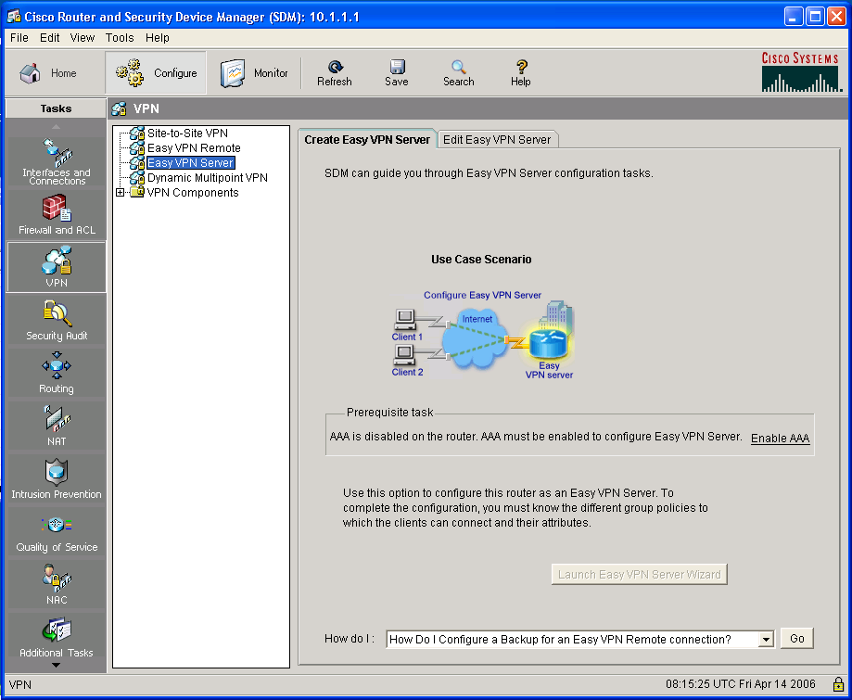
VPN Wizards
1.
3.
2.

Slide 21
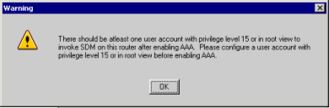
Enabling AAA
2.
1.

Slide 22
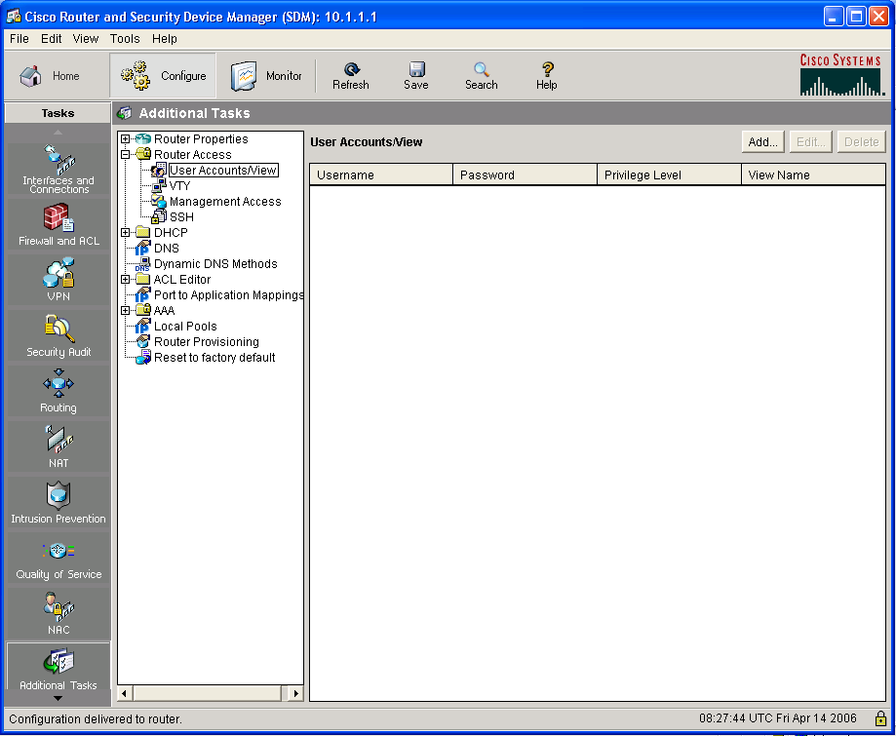
Local User Management
3.
2.
1.

Slide 23
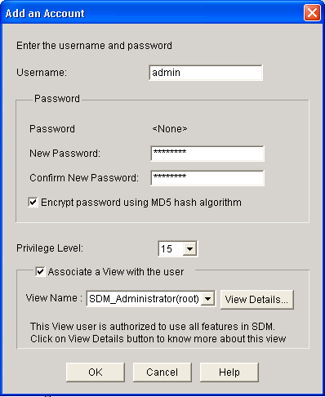
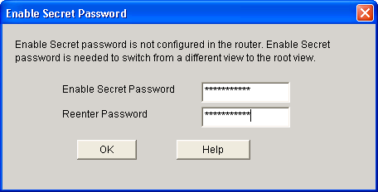
Creating Users
1.
2.
7.
3.
8.
4.
5.
6.

Slide 24
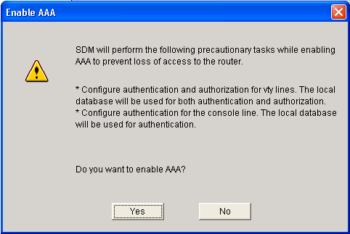
Enabling AAA
1.
2.

Slide 25
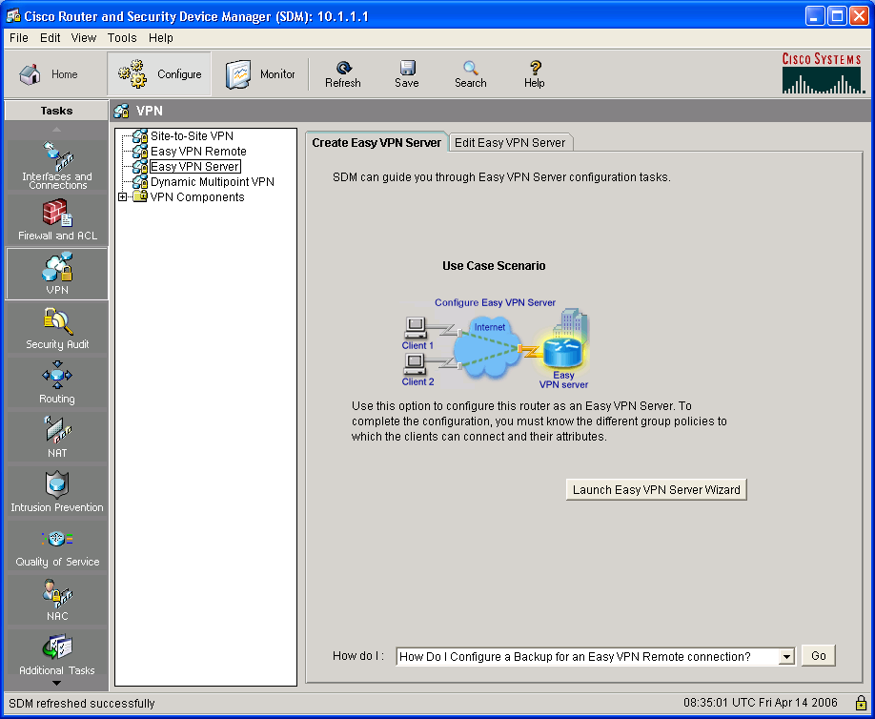
Starting the Easy VPN Server Wizard

Slide 26
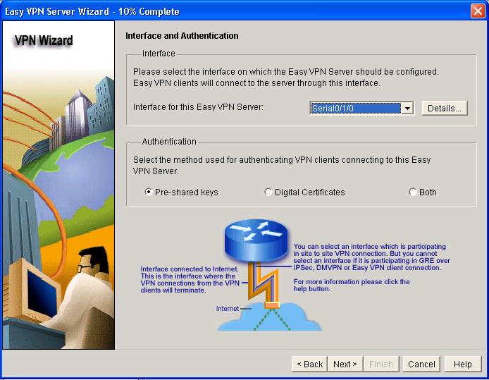
Select Interface for Terminating IPsec
1.
2.

Slide 27
IKE Proposals

Slide 28
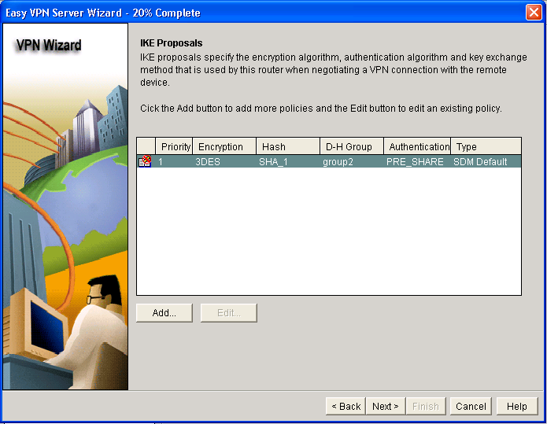
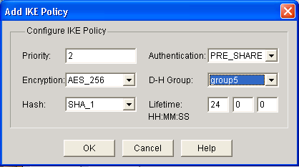
IKE Proposals
2.
1.
3.

Slide 29
Transform Set

Slide 30
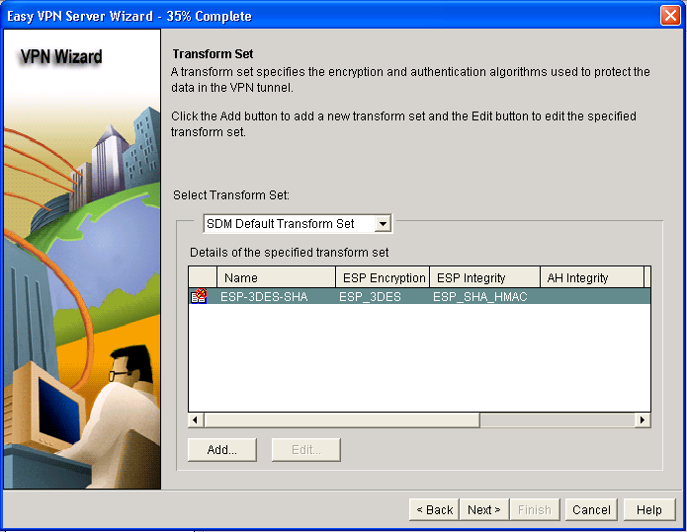
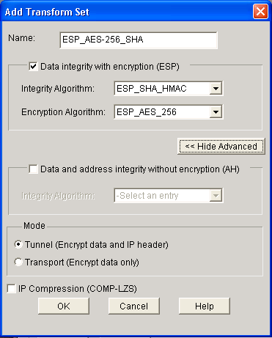
Transform Set
3.
1.
2.
4.

Slide 31
Group Policy Configuration Location

Slide 32
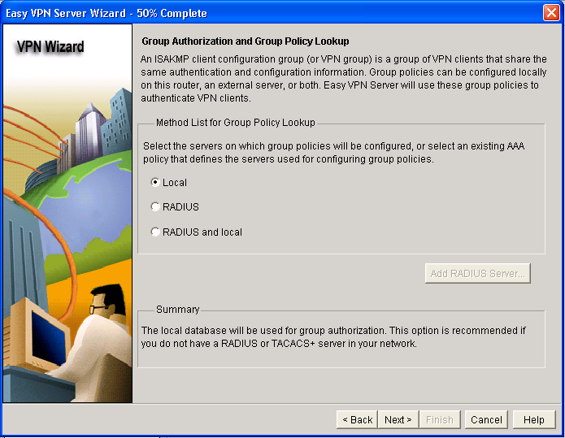
Option 1: Local Router Configuration
1.
2.

Slide 33
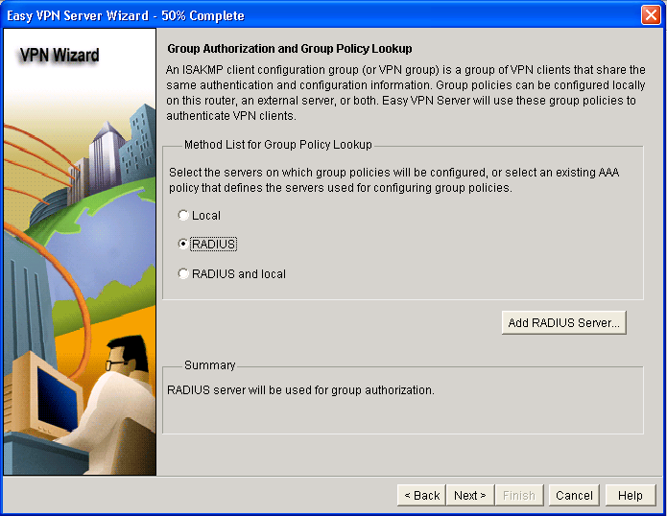
Option 2: External Location via RADIUS
1.
2.

Slide 34
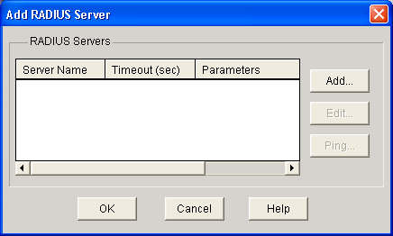
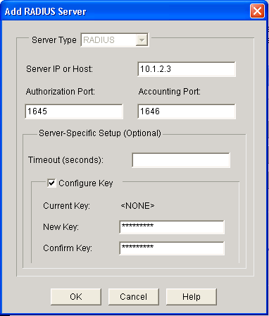
Option 2: External Location via RADIUS (Cont.)
1.
2.
3.
4.

Slide 35
User Authentication

Slide 36
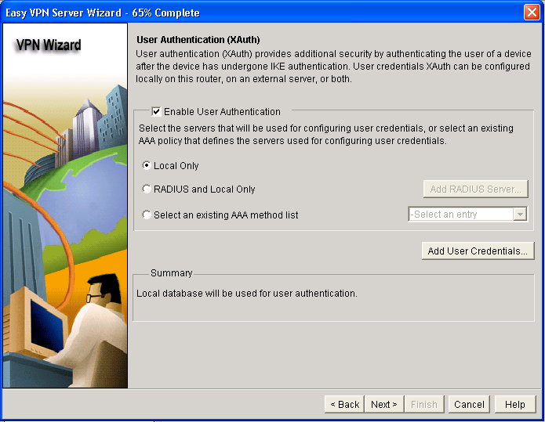
Option 1: Local User Database
1.
2.
3.

Slide 37
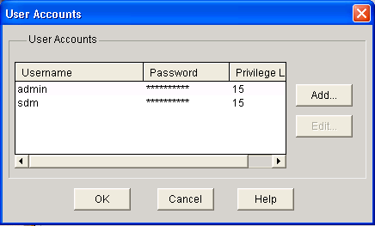
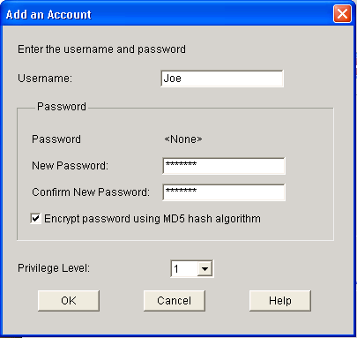
Local User Database—Adding Users
1.
6.
2.
3.
4.
5.

Slide 38

Option 2: External User
Database via RADIUS
1.
2.
3.

Slide 39
Local Group Policies

Slide 40
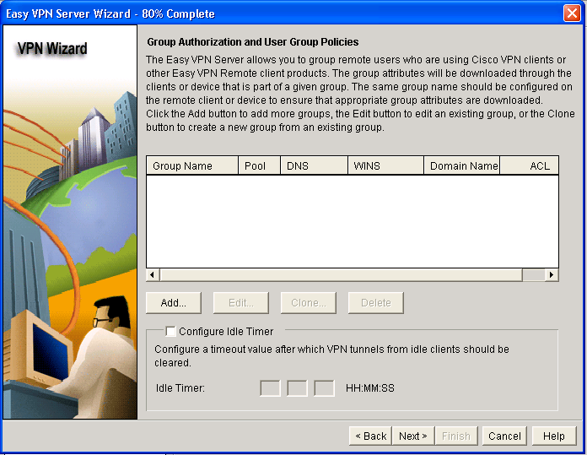
Local Group Policies

Slide 41
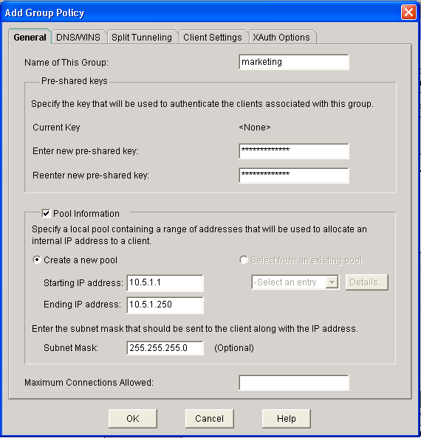
General Parameters
1.
2.
3A.
3B.

Slide 42
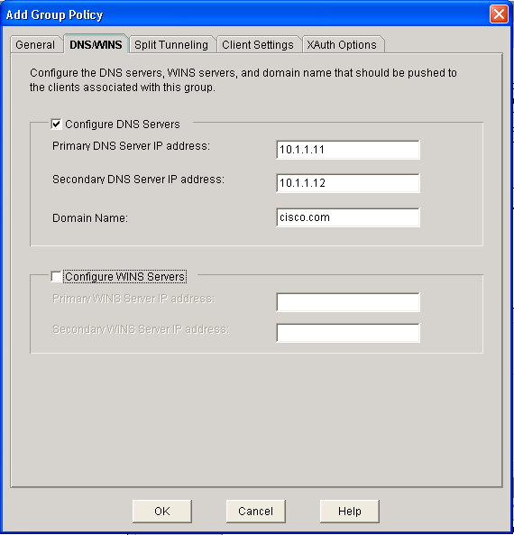
Domain Name System
1.
2.

Slide 43
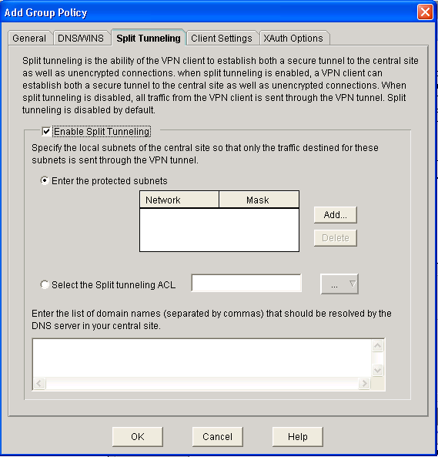
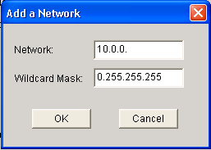
Split Tunneling
1.
4.
2.
3.
5.

Slide 44
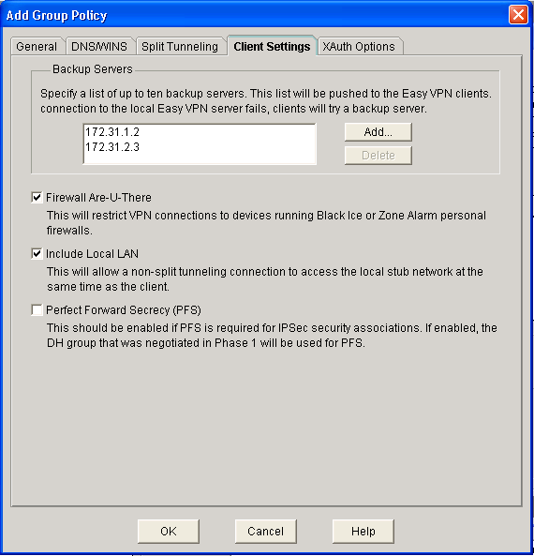
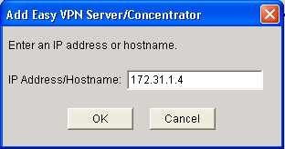
Advanced Options
1.
3.
4.
2.

Slide 45
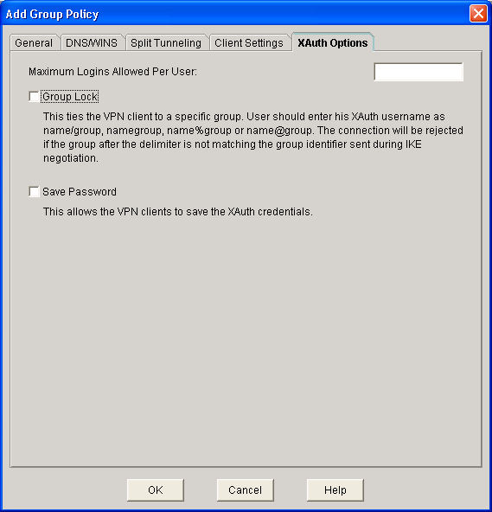
Xauth Options
3.
1.
2.
4.

Slide 46
Completing the Configuration

Slide 47
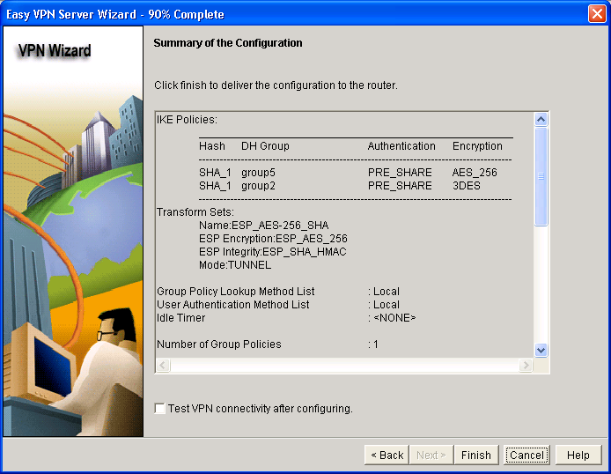
Review the Generated Configuration

Slide 48
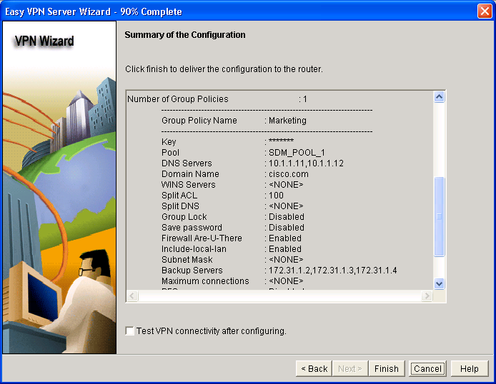
Review the Generated Configuration (Cont.)

Slide 49
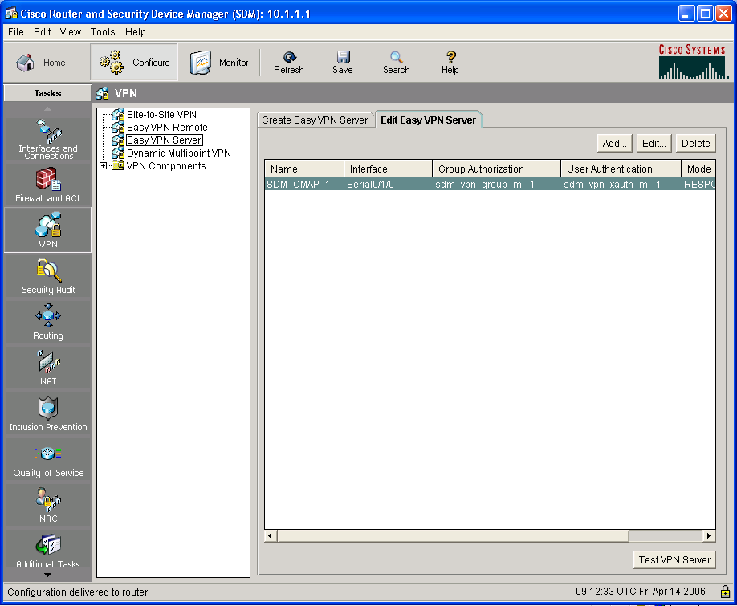
Verify the Easy VPN Server Configuration
1.
2.
3.

Slide 50
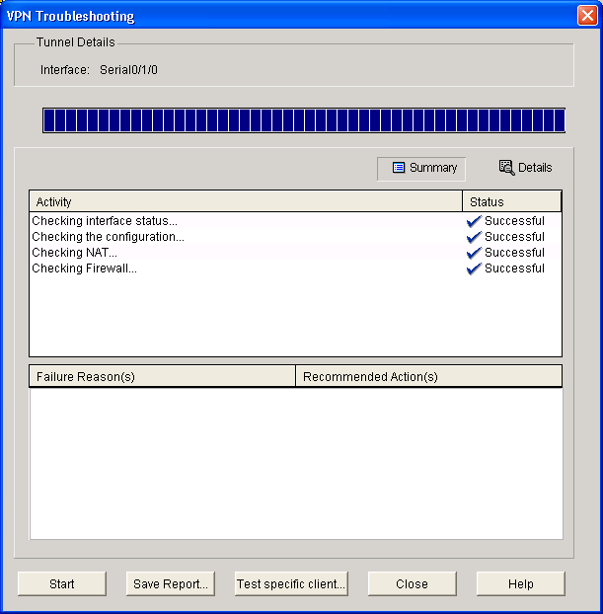
Verify the Easy VPN
Server Configuration (Cont.)

Slide 51
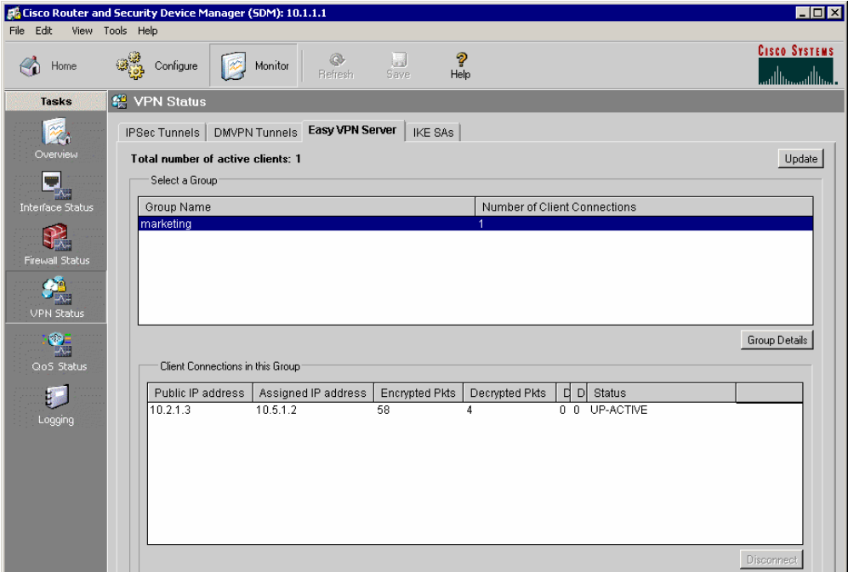
Monitoring Easy VPN Server
1.
3.
4.
2.
5.

Slide 52
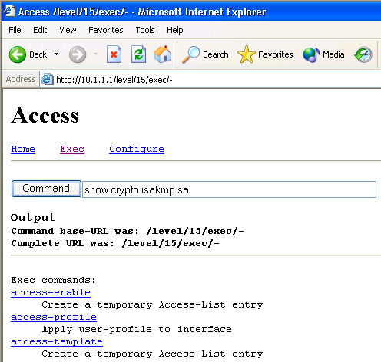
Advanced Monitoring
router#
show crypto isakmp sa
Lists active IKE sessions
router#
show crypto ipsec sa
Lists active IPsec security associations
Advanced monitoring can be performed using the default Cisco IOS HTTP server interface.
Requires knowledge of Cisco IOS CLI commands.

Slide 53
Troubleshooting
router#
debug crypto isakmp
Debugs IKE communication
router#
debug aaa authentication
Debugs user authentication via local user database or RADIUS
router#
debug aaa authorization
Debugs IKE Mode Config
router#
debug radius
Debugs RADIUS communication
Advanced troubleshooting can be performed using the Cisco IOS CLI.
Requires knowledge of Cisco IOS CLI commands.

Slide 54
Summary
  Cisco Easy VPN consists of two components: Easy VPN Server and Easy VPN Remote.
  Cisco Easy VPN Server can be configured using SDM.
  If you are using a local IP address pool, you need to configure that pool for use with Easy VPN.
  AAA is enabled for policy lookup.
  ISAKMP policies are configured for VPN clients.

Slide 55
Summary (Cont.)
  The steps for defining group policy include configuring the following:
    Policy profile of the group that will be defined
    Preshared key
    DNS servers
    WINS servers
    DNS domain
    Local IP address pool
  Verify the Easy VPN operation.

Slide 56


