Slide 1
IPsec VPNs
Implementing the Cisco VPN Client

Slide 2

Cisco VPN Client Configuration Tasks

Slide 3
Cisco VPN Client Configuration Tasks
  Install Cisco VPN Client.
  Create a new client connection entry.
  Configure the client authentication properties.
  Configure transparent tunneling.
  Enable and add backup servers.
  Configure a connection to the Internet through dial-up networking.

Slide 4
Use the Cisco VPN Client to Establish an RA VPN Connection and Verify the Connection Status

Slide 5
Use the Cisco VPN Client to Establish a VPN Connection and Verify the Connection Status
  Installation process:
    Download the latest version of the Cisco VPN Client from the CCO.
    Remove any previous versions of the Cisco VPN Client.
    Start the setup process that will guide you through the installation steps.
  Configuration process:
    Start the VPN Client.
    Create and configure VPN connections.
    Test VPN connections.

Slide 6
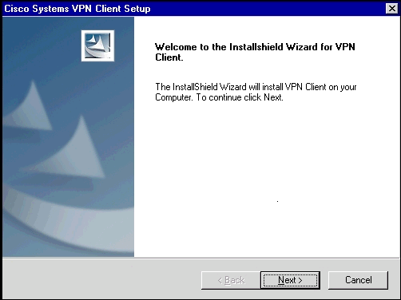
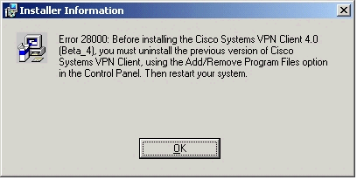
Task 1: Install Cisco VPN Client

Slide 7
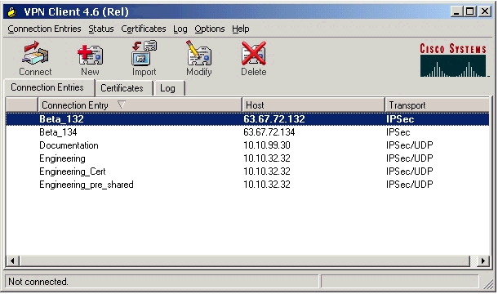
Task 2: Create a New Client
Connection Entry
1.
2.

Slide 8
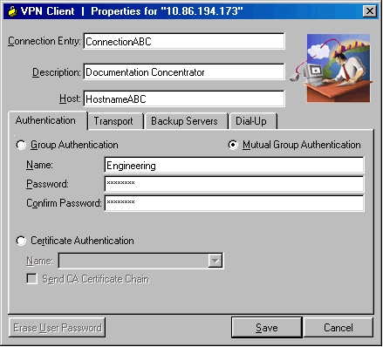
Task 2: Create a New Client
Connection Entry (Cont.)
3.
4.
5.
6.

Slide 9
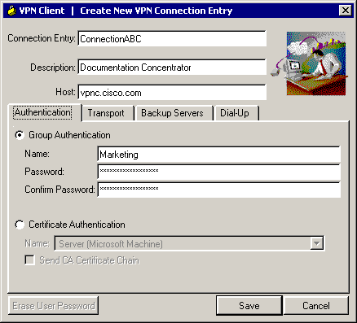
Task 3: Configure Client
Authentication Properties
1.
2.
3.
4.
Authentication options:
  Group preshared secrets (group name and group secret)
  Mutual authentication (import CA certificate first; group name and secret)
  Digital certificates (enroll with the CA first; select the certificate)

Slide 10

Mutual Group Authentication
1.
2.
  Mutual authentication should be used instead of group preshared secrets.
  Group preshared secrets are vulnerable to man-in-the-middle attacks if the attacker knows the group preshared secret.

Slide 11
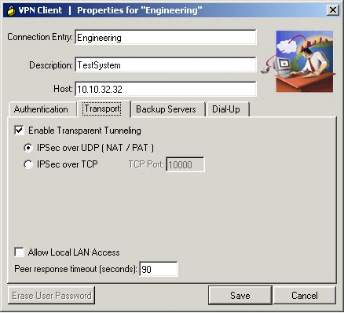
Task 4: Configure Transparent Tunneling
1.
2.
  On by default.
  NAT-T enables IPsec and IKE over a standard UDP port 4500, allowing the VPN Client to be behind a NAT or PAT device.

Slide 12
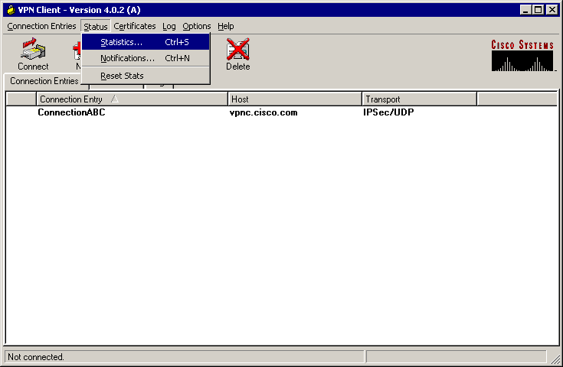
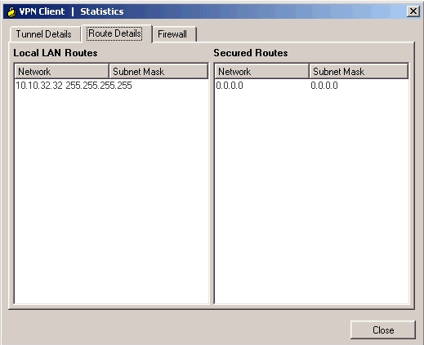
Routing Table
2.
1.
  The Statistics window provides information about tunnel details, routing table, and personal firewall.

Slide 13
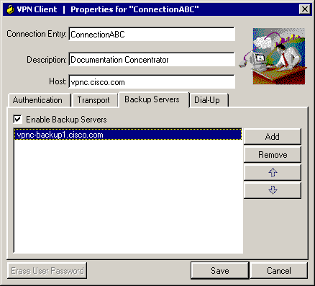
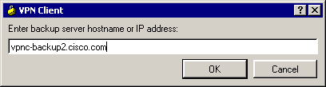
Task 5: Enable and Add Backup Servers
1.
2.
3.
  List backup VPN servers to be used in case the primary VPN server is not reachable.

Slide 14
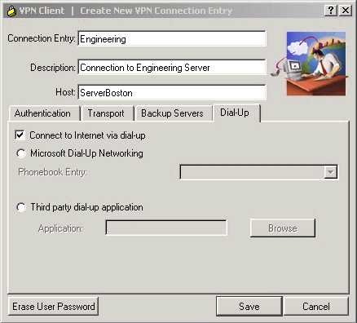
Task 6: Configure Connection to the Internet Through Dial-Up Networking
  Optionally, tie a VPN connection to a dial-up connection defined in the Networking section of Windows.

Slide 15
Summary
  You can install the VPN Client on your system through either of two different applications: InstallShield and MSI.
  Connection entries include:
    The VPN device (the remote server) to access
    Preshared keys
    Certificates
    Optional parameters
  Authentication methods include:
    Group authentication
    Mutual group authentication
    Certificate authentication

Slide 16
Summary (Cont.)
  Transparent tunneling allows secure transmission through a router serving as a firewall, which may also be performing NAT or PAT.
  Access to local LAN resources can be made available.
  The private network may include one or more backup VPN servers to use if the primary server is not available.
  You can connect to the Internet using the VPN Client application in either of the following ways:
    Microsoft Dial-Up Networking
    A third-party dial-up program, usually from your ISP

Slide 17


