Slide 1
Cisco Device Hardening
Mitigating Network Attacks

Slide 2

Cisco Self-Defending Network

Slide 3
Cisco Self-Defending Network
  Cisco strategy to dramatically improve the network ability to identify, prevent, and adapt to threats
  There are three categories:
    Secure connectivity:
      VPN solutions including VPN concentrators, VPN-enabled routers, and firewall VPNs
    Threat defense:
      Appliance and Cisco IOS-based firewalls
      Cisco IDSs and IPSs
    Trust and identity:
      NAC, Cisco Secure ACS, and 802.1x technology

Slide 4
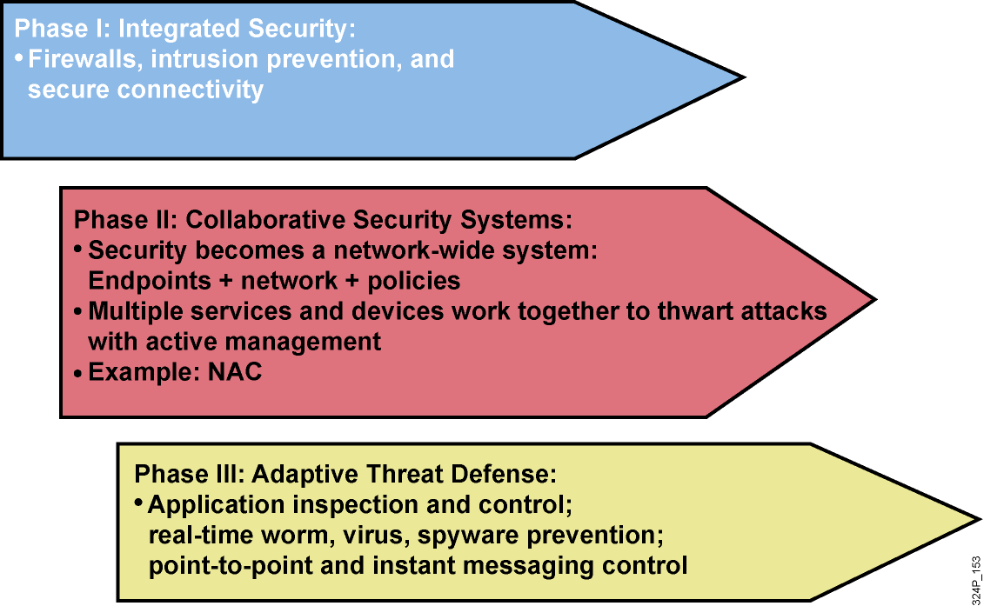
Evolution of Cisco Self-Defending Network

Slide 5
Types of Network Attacks

Slide 6
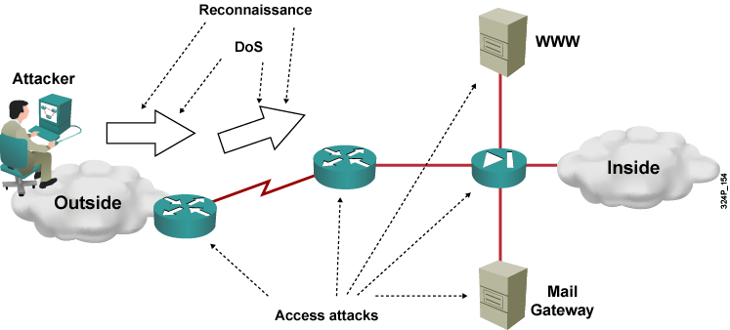
Types of Network Attacks
Attacks that require less intelligence about the target network:
  Reconnaissance
  Access attacks
  DoS and distributed DoS

Slide 7
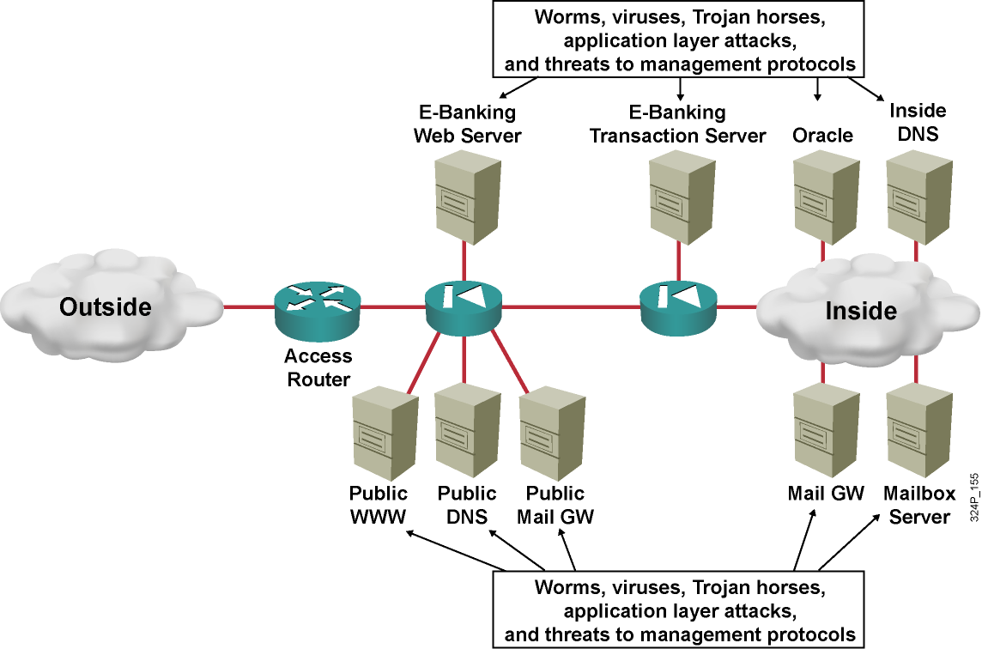
Types of Network Attacks (Cont.)
Attacks that typically require more intelligence or insider access:
  Worms, viruses, and Trojan horses
  Application layer attacks
  Threats to management protocols

Slide 8
Reconnaissance Attacks and Mitigation

Slide 9
Reconnaissance Attacks and Mitigation
  Reconnaissance refers to the overall act of learning information about a target network by using readily available information and applications.
  Reconnaissance attacks include:
    Packet sniffers
    Port scans
    Ping sweeps
    Internet information queries

Slide 10
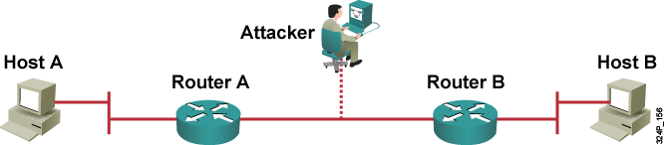
Packet Sniffers
  A packet sniffer is a software application that uses a network adapter card in promiscuous mode to capture all network packets.
  Packet sniffers:
    Exploit information passed in plaintext. Protocols that pass information in plaintext are Telnet, FTP, SNMP, POP, and HTTP.
    Must be on the same collision domain.
    Used legitimately, or can be designed specifically for attack.

Slide 11
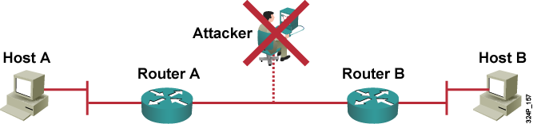
Packet Sniffer Mitigation
The mitigation techniques and tools include:
  Authentication
  Cryptography
  Antisniffer tools
  Switched infrastructure

Slide 12
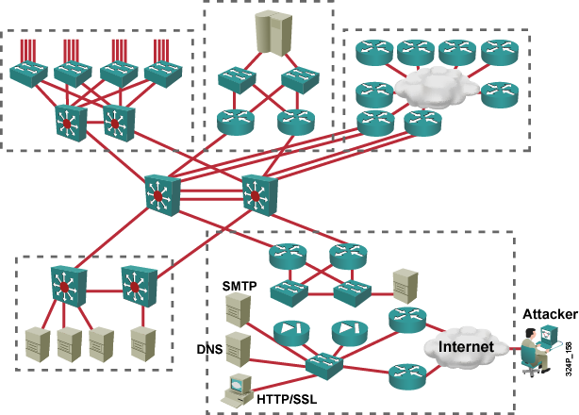
Port Scans and Ping Sweeps
Port scans and ping sweeps attempt to identify:
  All services
  All hosts and devices
  The operating systems
  Vulnerabilities

Slide 13
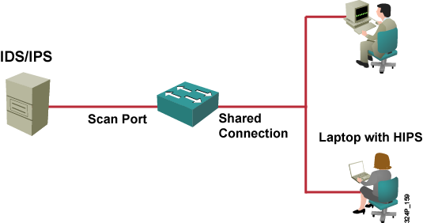
Port Scan and Ping Sweep Mitigation
  Port scans and ping sweeps cannot be prevented without compromising network capabilities.
  However, damage can be mitigated using intrusion prevention systems at network and host levels.

Slide 14
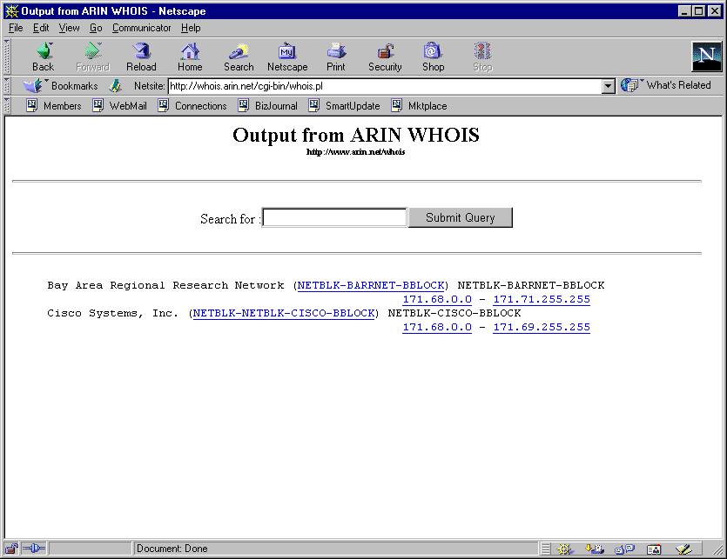
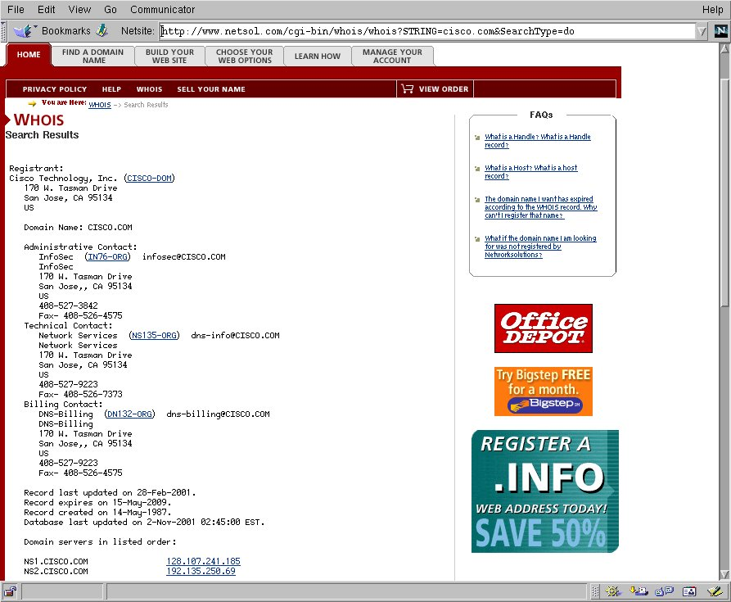
Internet Information Queries
Sample IP address query
  Attackers can use Internet tools such as “WHOIS” as weapons.

Slide 15
Access Attacks and Mitigation

Slide 16
Access Attacks
  Intruders use access attacks on networks or systems for these reasons:
    Retrieve data
    Gain access
    Escalate their access privileges
  Access attacks include:
    Password attacks
    Trust exploitation
    Port redirection
    Man-in-the-middle attacks
    Buffer overflow

Slide 17
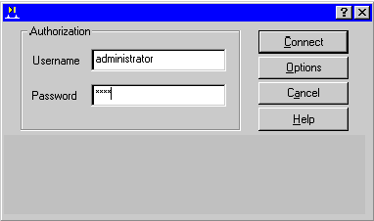
Password Attacks
Hackers implement password attacks using the following:
  Brute-force attacks
  Trojan horse programs
  IP spoofing
  Packet sniffers

Slide 18
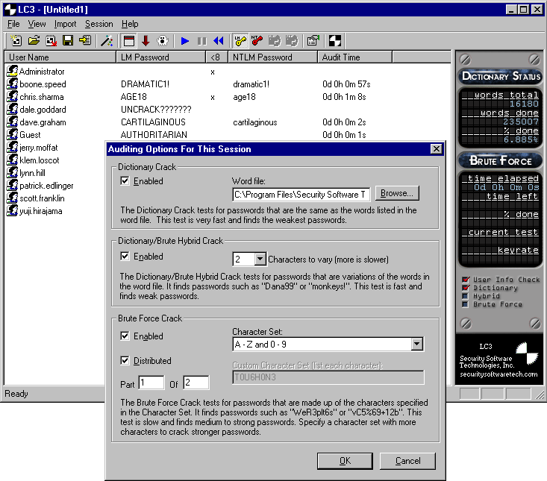

Password Attack Example
  L0phtCrack takes the hashes of passwords and generates the plaintext passwords from them.
  Passwords are compromised using one of two methods:
    Dictionary cracking
    Brute-force computation

Slide 19
Password Attack Mitigation
Password attack mitigation techniques:
  Do not allow users to use the same password on multiple systems.
  Disable accounts after a certain number of unsuccessful login attempts.
  Do not use plaintext passwords.
  Use “strong” passwords. (Use “mY8!Rthd8y” rather than “mybirthday”)

Slide 20
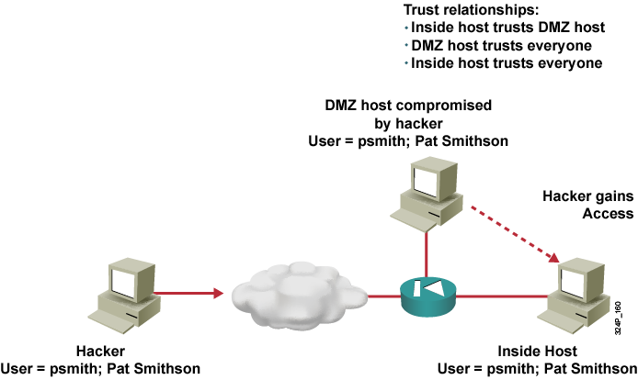
Trust Exploitation
  A hacker leverages existing trust relationships.
  Several trust models exist:
    Windows:
      Domains
      Active directory
    Linux and UNIX:
      NIS
      NIS+

Slide 21
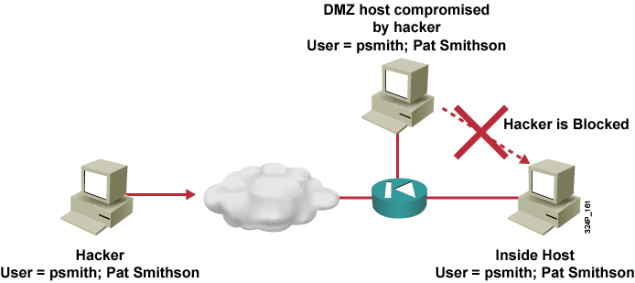
Trust Exploitation Attack Mitigation

Slide 22
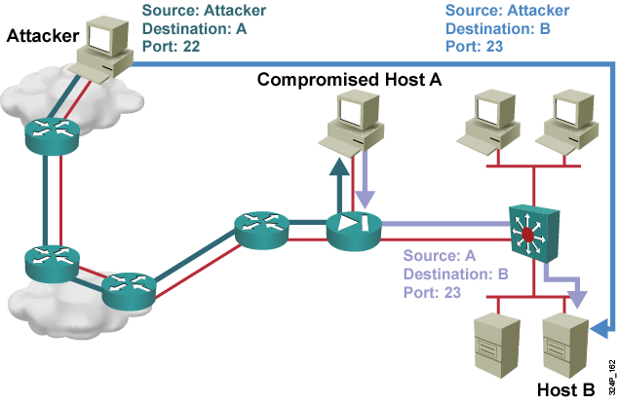
Port Redirection

Slide 23
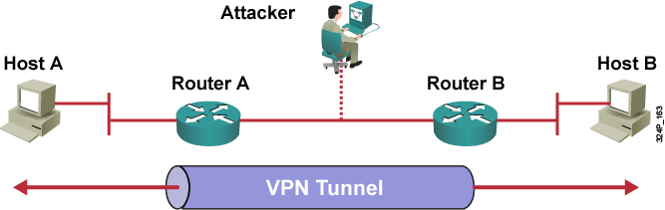
Man-in-the-Middle Attacks and Their Mitigation
  A man-in-the-middle attack requires that the hacker have access to network packets that come across a network.
  A man-in-the-middle attack is implemented using the following:
    Network packet sniffers
    Routing and transport protocols
  Man-in-the-middle attacks can be effectively mitigated only through the use of cryptographic encryption.

Slide 24
DoS Attacks and Mitigation

Slide 25
DoS Attacks and Mitigation
  A DoS attack damages or corrupts your computer system or denies you and others access to your networks, systems, or services.
  Distributed DoS technique performs simultanous attacks from many distributed sources.
  DoS and Distributed DoS attacks can use IP spoofing.

Slide 26
Distributed DoS Attacks
  DoS and distributed DoS attacks focus on making a service unavailable for normal use.
  DoS and distributed DoS attacks have these characteristics:
    Generally not targeted at gaining access to your network or the information on your network
    Require very little effort to execute
    Difficult to eliminate, but their damage can be minimized

Slide 27
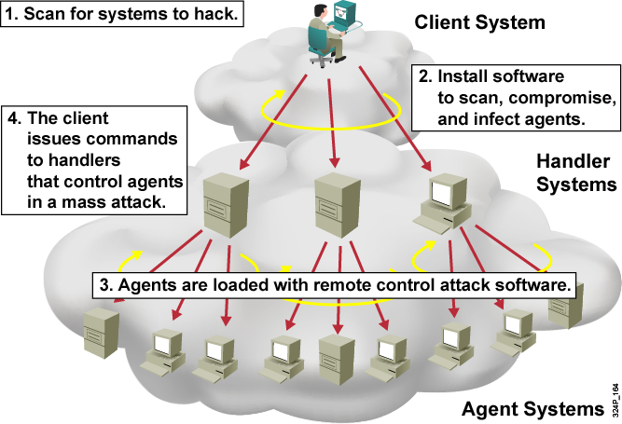
Distributed DoS Example

Slide 28
DoS and Distributed DoS Attack Mitigation
The threat of DoS attacks can be reduced using:
  Anti-spoof features on routers and firewalls
  Anti-DoS features on routers and firewalls
  Traffic rate limiting at the ISP level

Slide 29
IP Spoofing in DoS and Distributed DoS
  IP spoofing occurs when a hacker inside or outside a network impersonates the conversations of a trusted computer.
  IP spoofing can use either a trusted IP address in the network or a trusted external IP address.
  Uses for IP spoofing include:
    Injecting malicious data or commands into an existing data stream
    Diverting all network packets to the hacker who can then reply as a trusted user by changing the routing tables
  IP spoofing may only be one step in a larger attack.

Slide 30
IP Spoofing Attack Mitigation
The threat of IP spoofing can be reduced, but not eliminated, using these measures:
  Access control configuration
  Encryption
  RFC 3704 filtering
  Additional authentication requirement that does not use IP address-based authentication; examples are:
    Cryptographic (recommended)
    Strong, two-factor, one-time passwords

Slide 31
Worm, Virus, and Trojan Horse Attacks and Mitigation

Slide 32
Worm, Virus, and Trojan Horse
Attacks and Mitigation
The primary vulnerabilities for end-user workstations are:
  Worms
  Viruses
  Trojan horse attacks

Slide 33
Virus and Trojan Horse Attack Mitigation
Viruses and Trojan horses can be contained by:
  Effective use of antivirus software
  Keeping up-to-date with the latest developments in these methods of attacks
  Keeping up-to-date with the latest antivirus software and application versions
  Implementing host-based intrusion prevention systems (e.g., CSA)

Slide 34

The Anatomy of a Worm Attack
  The enabling vulnerability
  Propagation mechanism
  Payload

Slide 35
Mitigating Worm Attacks
Four steps to mitigate worm attacks:
  Contain
  Inoculate
  Quarantine
  Treat

Slide 36
Application Layer Attacks and Mitigation

Slide 37
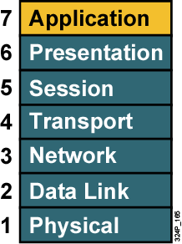
Application Layer Attacks
Application layer attacks have these characteristics:
  Exploit well-known weaknesses, such as those in protocols, that are intrinsic to an application or system (e.g., sendmail, HTTP, and FTP)
  Often use ports that are allowed through a firewall (e.g., TCP port 80 used in an attack against a web server behind a firewall)
  Can never be completely eliminated, because new vulnerabilities are always being discovered

Slide 38
Netcat
#nc -h
connect to somewhere: nc [-options] hostname port[s] [ports] ...
listen for inbound: nc -l -p port [-options] [hostname] [port]
options:
-g gateway source-routing hop point[s], up to 8
-G num source-routing pointer: 4, 8, 12, ...
-i secs delay interval for lines sent, ports scanned
-l listen mode, for inbound connects
-n numeric-only IP addresses, no DNS
-o file hex dump of traffic
-p port local port number
-r randomize local and remote ports
-s addr local source address
-u UDP mode
-v verbose [use twice to be more verbose]
port numbers can be individual or ranges: lo-hi [inclusive]
  Netcat is a tool that reads or writes data on any TCP/UDP connections, relays TCP connections, and can act as a TCP/UDP server

Slide 39
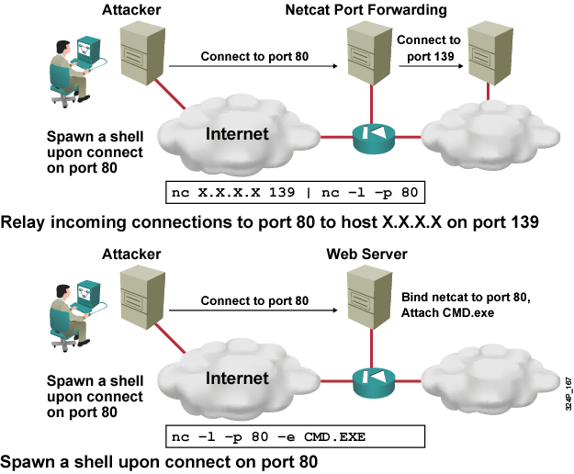
Netcat Example

Slide 40
Mitigation of Application Layer Attacks
Measures you can take to reduce your risks include:
  Read operating system and network log files, or have them analyzed by log analysis applications.
  Subscribe to mailing lists that publicize vulnerabilities.
  Keep your operating system and applications current with the latest patches.
  Use IDS/IPS that can scan for known attacks, monitor and log attacks, and, in some cases, prevent attacks.

Slide 41
Management Protocols and Vulnerabilities

Slide 42
Configuration Management
  Configuration management protocols include SSH, SSL, and Telnet.
  Telnet issues include:
    The data within a Telnet session is sent as plaintext.
    The data may include sensitive information.

Slide 43
Configuration Management Recommendations
These practices are recommended:
  Use IPSec, SSH, SSL, or any other encrypted and authenticated transport.
  ACLs should be configured to allow only management servers to connect to the device. All attempts from other IP addresses should be denied and logged.
  RFC 3704 filtering at the perimeter router should be used to mitigate the chance of an outside attacker spoofing the addresses of the management hosts.

Slide 44
Management Protocols
These management protocols can be compromised:
  SNMP: The community string information for simple authentication is sent in plaintext.
  syslog: Data is sent as plaintext between the managed device and the management host.
  TFTP: Data is sent as plaintext between the requesting host and the TFTP server.
  NTP: Many NTP servers on the Internet do not require any authentication of peers.

Slide 45
Management Protocol Best Practices
Management Protocol | Recommendations
SNMP | Configure SNMP with only read-only community strings. Set up access control on the device you wish to manage. Use SNMP version 3.
Syslog | Encrypt syslog traffic within an IPsec tunnel. Implement RFC 3704 filtering. Set up access control on the firewall.
TFTP | Encrypt TFTP traffic within an IPsec tunnel.
NTP | Implement your own master clock. Use NTP version 3 or above. Set up access control that specifies which network devices are allowed to synchronize with other network devices.

Slide 46
Determining Vulnerabilities and Threats

Slide 47
Determining Vulnerabilities and Threats
The following tools are useful when determining general network vulnerabilities:
  Blue’s PortScanner
  Ethereal
  Microsoft Baseline Security Analyzer
  Nmap

Slide 48
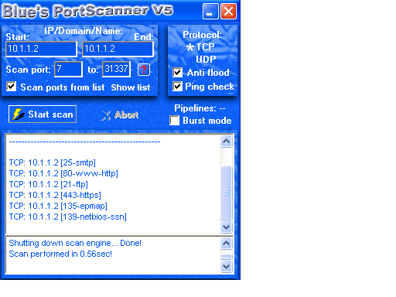
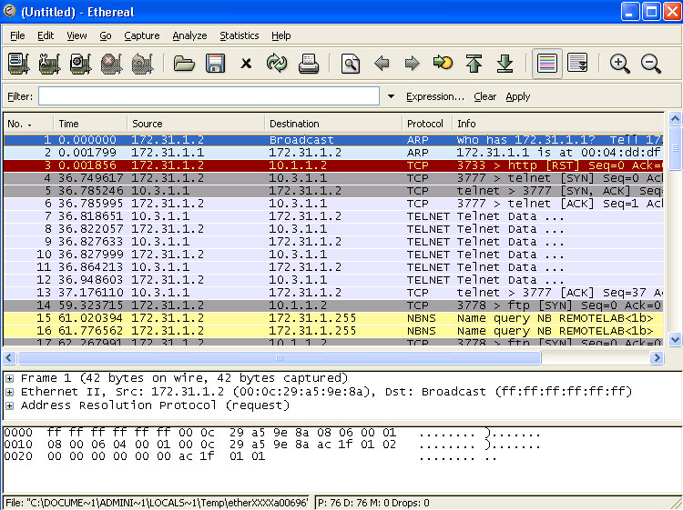
Blue’s Port Scanner and Ethereal
Blue’s
PortScanner
Ethereal

Slide 49
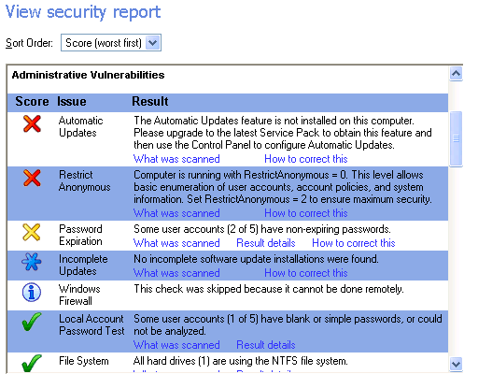
Microsoft Baseline Security Analyzer

Slide 50
Summary
  The Cisco Self-Defending Network initiative provides a comprehensive approach to network security.
  Packet sniffer attacks can be mitigated by cryptography, switched infrastructure, and antisniffer tools.
  Port scans and ping sweeps are mitigated by network and host IPS.
  Password attacks can be mitigated by strong password rules, disabling accounts after unsuccessful logins, and never sending passwords in plaintext.
  Trust exploitation and port redirection are defended against by a proper use of trust model.
  Man-in-the-middle attacks can be mitigated through cryptography.
  IP spoofing attacks can be defended against by access control, RFC 3704 filtering, and additional authentication.
  DoS and distributed DoS attacks can be mitigated through antispoof features, anti-DoS features and traffic rate limiting.

Slide 51
Summary (Cont.)
  Worm attacks can be mitigated by containment, inoculation, quarantine, and treatment.
  Viruses and Trojan horse attacks can be defended against using up-to-date antivirus software.
  Application layer attacks can be mitigated by IPS, as well as operating system and application hardening.
  Management protocol attacks can be mitigated by selecting secure protocols and filtering the management traffic.
  The following tools help discover network vulnerabilities:
    Netcat
    Blue’s PortScanner
    Ethereal
    Microsoft Baseline Security Analyzer
    Nmap

Slide 52
