Slide 1
Cisco Device Hardening
Disabling Unused Cisco Router Network Services and Interfaces

Slide 2

Vulnerable Router Services and Interfaces

Slide 3
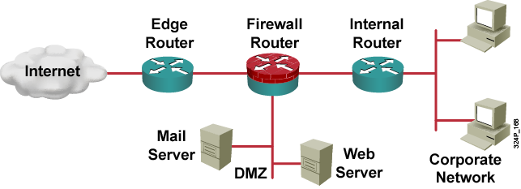
Vulnerable Router Services and Interfaces
  Cisco IOS routers can be used as:
    Edge devices
    Firewalls
    Internal routers
  Default services that create potential vulnerabilities (e.g., BOOTP, CDP, FTP, TFTP, NTP, Finger, SNMP, TCP/UDP minor services, IP source routing, and proxy ARP).
  Vulnerabilities can be exploited independently of the router placement.

Slide 4
Vulnerable Router Services
  Disable unnecessary services and interfaces (BOOTP, CDP, FTP, TFTP, NTP, PAD, and TCP/UDP minor services)
  Disable commonly configured management services (SNMP, HTTP, and DNS)
  Ensure path integrity (ICMP redirects and IP source routing)
  Disable probes and scans (finger, ICMP unreachables, and ICMP mask replies)
  Ensure terminal access security (ident and TCP keepalives)
  Disable gratuitous and proxy ARP
  Disable IP directed broadcast

Slide 5
Router Hardening Considerations
  Attackers can exploit unused router services and interfaces.
  Administrators do not need to know how to exploit the services, but they should know how to disable them.
  It is tedious to disable the services individually.
  An automated method is needed to speed up the hardening process.

Slide 6
Locking Down Routers with AutoSecure

Slide 7
What is AutoSecure?
AutoSecure helps secure Cisco IOS networks by performing these router functions:
  Disables insecure global services
  Enables security-based global services
  Disables insecure interface services
  Enables appropriate security logging
  Secures router administrative access
  Secures the router management plane
  Secures the router forwarding plane

Slide 8
AutoSecure Operation Modes
AutoSecure can be deployed using one of the following two modes of operation:
  Interactive mode: Prompts the user with options to enable and disable services and other security-related features
  Noninteractive mode: Automatically executes the auto secure command using recommended default settings

Slide 9
AutoSecure Functions
  AutoSecure can selectively lock down:
  Management plane services and functions:
    Finger, PAD, UDP & TCP small servers, password encryption, TCP keepalives, CDP, BOOTP, HTTP, source routing, gratuitous ARP, proxy ARP, ICMP (redirects, mask-replies), directed broadcast, MOP, banner
    Also provides password security and SSH access
  Forwarding plane services and functions:
    CEF, traffic filtering with ACLs
  Firewall services and functions:
    Cisco IOS Firewall inspection for common protocols
  Login functions:
    Password security
  NTP protocol
  SSH access
  TCP Intercept services

Slide 10
AutoSecure Failure Scenarios
If AutoSecure fails to complete its operation, your running configuration may be corrupt:
  In 12.3(8)T and later releases
    Pre-autosecure configuration snapshot is stored in the flash under filename pre_autosec.cfg
    Roll-back reverts the router to its pre-autosecure configuration
    Command: configure replace flash:pre_autosec.cfg
  Prior to 12.3(8)T, you should save the running configuration before running AutoSecure

Slide 11
AutoSecure Process Overview

Slide 12
AutoSecure Process Overview
router#
auto secure [management | forwarding] [no-interact | full] [ntp | login | ssh | firewall | tcp-intercept]
  Launches AutoSecure
  Main steps with the interactive full option:
    Identify outside interfaces.
    Secure the management plane.
    Create security banner.
    Configure passwords, AAA, and SSH.
    Secure the interface settings.
    Secure the forwarding plane.

Slide 13
Start and Interface Selection
Router#auto secure
--- AutoSecure Configuration ---
*** AutoSecure configuration enhances the security of the router but it will not make router absolutely secure from all security attacks ***
All the configuration done as part of AutoSecure will be shown here. For more details of why and how this configuration is useful, and any possible side effects, please refer to Cisco documentation of AutoSecure.
At any prompt you may enter '?' for help.
Use ctrl-c to abort this session at any prompt.
Gathering information about the router for AutoSecure
Is this router connected to internet? [no]: y
Enter the number of interfaces facing internet [1]: 1
Interface IP-Address OK? Method Status Protocol
Ethernet0/0 10.0.2.2 YES NVRAM up up
Ethernet0/1 172.30.2.2 YES NVRAM up up
Enter the interface name that is facing internet: Ethernet0/1

Slide 14
Securing Management Plane Services
Securing Management plane services..
Disabling service finger
Disabling service pad
Disabling udp & tcp small servers
Enabling service password encryption
Enabling service tcp-keepalives-in
Enabling service tcp-keepalives-out
Disabling the cdp protocol
Disabling the bootp server
Disabling the http server
Disabling the finger service
Disabling source routing
Disabling gratuitous arp

Slide 15
Creating Security Banner
Here is a sample Security Banner to be shown at every access to device. Modify it to suit your enterprise requirements.
Authorised Access only
This system is the property of So-&-So-Enterprise.
UNAUTHORISED ACCESS TO THIS DEVICE IS PROHIBITED.
You must have explicit permission to access this
device. All activities performed on this device
are logged and violations of of this policy result
in disciplinary action.
Enter the security banner {Put the banner between
k and k, where k is any character}:
%This system is the property of Cisco Systems, Inc.
UNAUTHORIZED ACCESS TO THIS DEVICE IS PROHIBITED.%

Slide 16
Passwords and AAA
Enable secret is either not configured or is same as enable password
Enter the new enable secret: Curium96
Configuration of local user database
Enter the username: student1
Enter the password: student1
Configuring aaa local authentication
Configuring console, Aux and vty lines for
local authentication, exec-timeout, transport
Securing device against Login Attacks
Configure the following parameters
Blocking Period when Login Attack detected: 300
Maximum Login failures with the device: 3
Maximum time period for crossing the failed login attempts: 60

Slide 17
SSH and Interface-Specific Services
Configure SSH server? [yes]: y
Enter the hostname: R2
Enter the domain-name: cisco.com
Configuring interface specific AutoSecure services
Disabling the following ip services on all interfaces:
no ip redirects
no ip proxy-arp
no ip unreachables
no ip directed-broadcast
no ip mask-reply
Disabling mop on Ethernet interfaces

Slide 18
Forwarding Plane, Verificaton and Deployment
Securing Forwarding plane services..
Enabling CEF (This might impact the memory requirements for your platform)
Enabling unicast rpf on all interfaces connected
to internet
Configure CBAC Firewall feature? [yes/no]: yes
This is the configuration generated:
no service finger
no service pad
no service udp-small-servers
no service tcp-small-servers
service password-encryption
.
.
Apply this configuration to running-config? [yes]: y

Slide 19
Locking Down Routers with the SDM

Slide 20
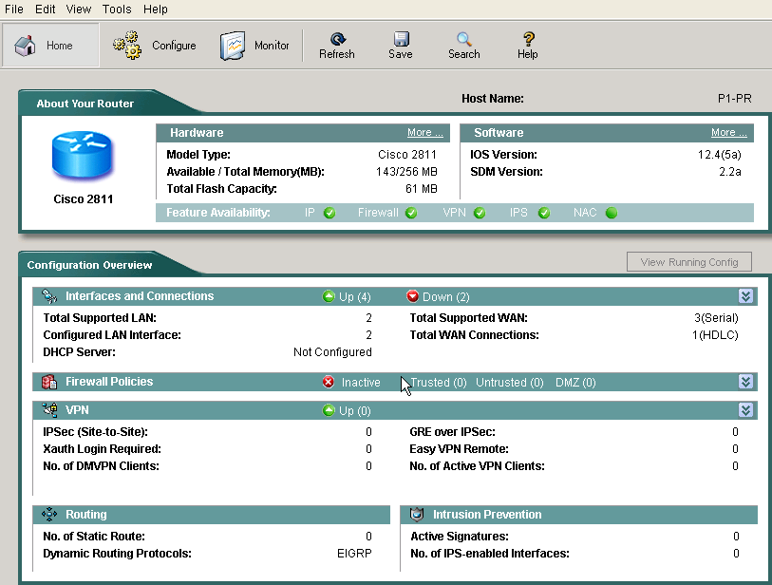
Security Device Manager
SDM automated hardening features:
  Security Audit
  One-Step Lockdown

Slide 21
SDM Security Audit Overview
  The security audit compares router configuration against recommended settings.
  Examples of the audit include:
    Shut down unneeded servers.
    Disable unneeded services.
    Apply the firewall to the outside interfaces.
    Disable or harden SNMP.
    Shut down unused interfaces.
    Check password strength.
    Enforce the use of ACLs.

Slide 22
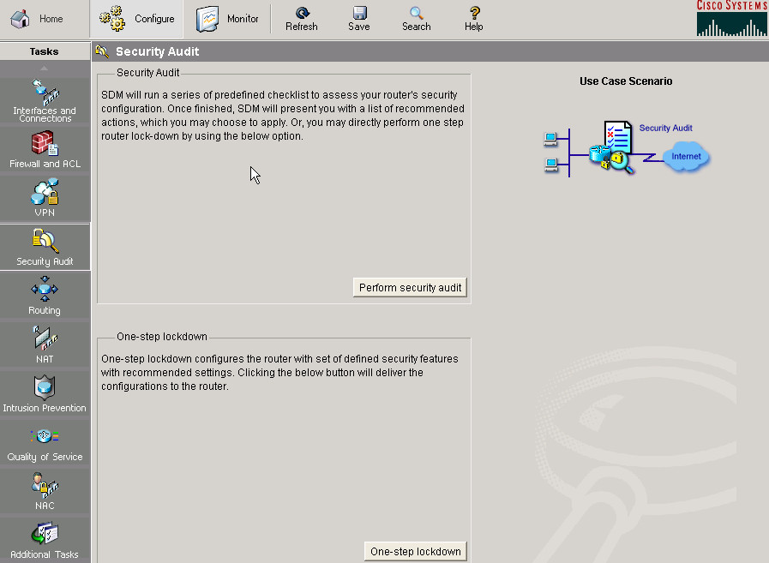
SDM Security Audit: Main Window
1.
2.
3.

Slide 23
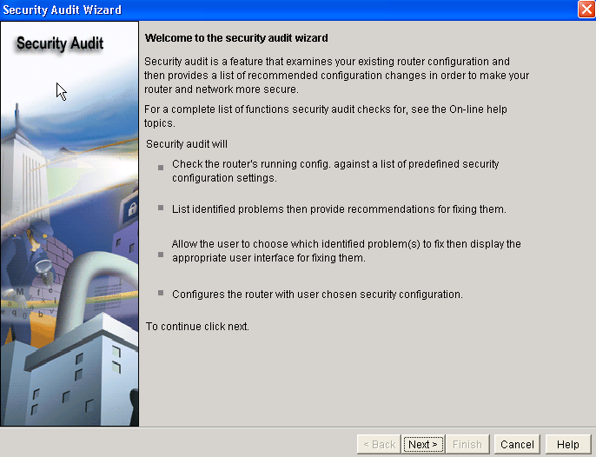
SDM Security Audit Wizard

Slide 24
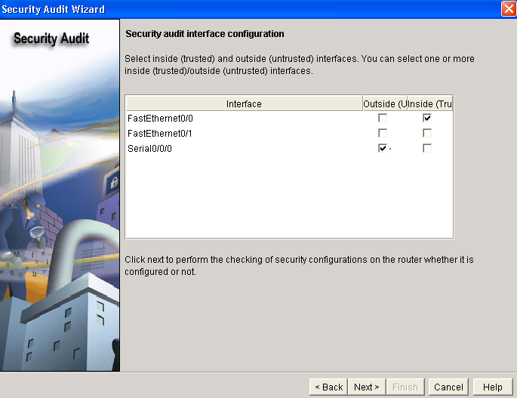
SDM Security Audit Interface Configuration

Slide 25
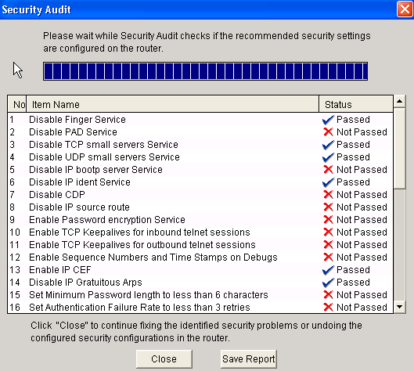
SDM Security Audit

Slide 26
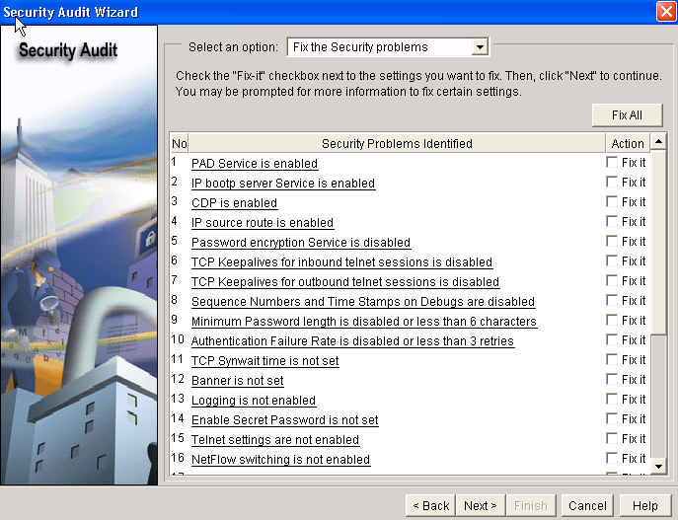
SDM Security Audit:
Fix the Security Problems

Slide 27
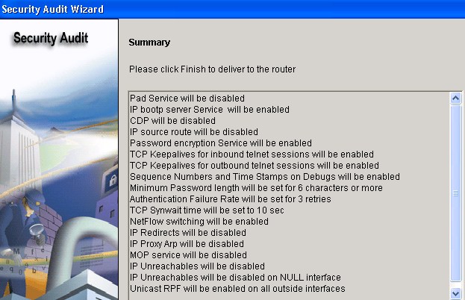
SDM Security Audit: Summary

Slide 28
SDM One-Step Lockdown: Main Window

Slide 29
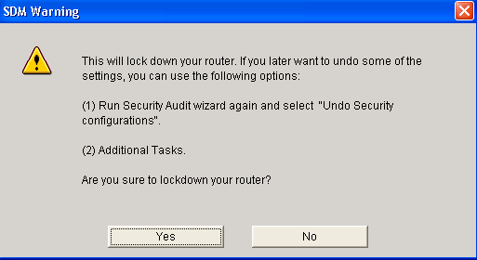
SDM One-Step Lockdown Wizard

Slide 30
Summary
  Unused router services and interfaces should be disabled.
  AutoSecure is a very efficient tool for securing Cisco routers.
  AutoSecure runs in an interactive and noninteractive mode.
  AutoSecure can selectively lock down the management or the forwarding plane, or other router functions such as login, firewall, SSH, NTP, and TCP Intercept.
  AutoSecure provides rollback functionality.
  Cisco SDM includes a Security Audit wizard that allows you to analyze the router configuration and selectively fix the security issues.
  Cisco SDM provides a One-Step Lockdown feature that tests the router configuration for any potential security problems and automatically makes the necessary corrections.

Slide 31


