Slide 1
Cisco Device Hardening
Mitigating Threats and Attacks with Access Lists

Slide 2

Cisco ACLs

Slide 3
Standard and Extended ACLs
Cisco routers support two basic types of IP ACLs:
  Standard IP ACL: Filters IP packets based on the source address only
  Extended IP ACL: Filters IP packets based on several attributes, including:
    Protocol type (IP, ICMP, UDP, TCP, or protocol number)
    Source and destination IP addresses
    Source and destination TCP and UDP ports
access-list 10 permit 192.168.3.0 0.0.0.255
access-list 101 permit tcp 172.31.9.0 0.0.0.255 any eq 80

Slide 4
Identifying ACLs
Cisco routers can identify ACLs using two methods:
  ACL number: The number of the ACL determines which protocol it is filtering:
    1 to 99 and 1300 to 1999: Standard IP ACLs
    100 to 199 and 2000 to 2699: Extended IP ACLs
  ACL name: You provide the name of the ACL:
    Names contain alphanumeric characters.
    Names cannot contain spaces or punctuation and must begin with an alphabetic character.

Slide 5
Guidelines for Developing ACLs
  Base ACLs on the security policy.
  Write ACL out:
    Write out what you want this ACL to accomplish.
    This is the time to think about potential problems.
  Set up a development system:
    This allows you to copy and paste statements easily.
    It also allows you to develop a library of ACLs.
    Store the files as ASCII text files.
  Apply ACL to a router and test:
    If at all possible, run your ACLs in a test environment before placing them into production.

Slide 6
Applying ACLs to Router Interfaces

Slide 7
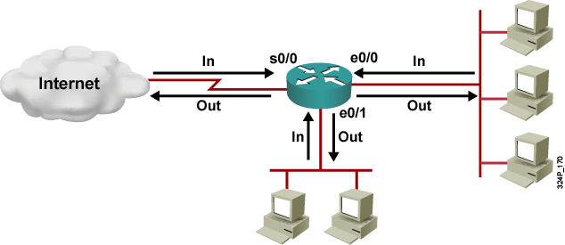
Applying ACLs to Router Interfaces
  Inbound (in): Data flows toward router interface
  Outbound (out): Data flows away from router interface

Slide 8
Using Traffic Filtering with ACLs

Slide 9
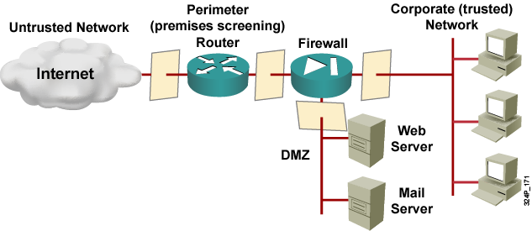
Traffic Filtering
  Use ACLs to filter ingress and egress from routers and firewall appliances.
  Use ACLs to disable and limit services, ports, and protocols.

Slide 10
Filtering Network Traffic to Mitigate Threats

Slide 11

IP Address Spoofing Mitigation: Inbound
R2(config)#access-list 150 deny ip 10.2.1.0 0.0.0.255 any log
R2(config)#access-list 150 deny ip 127.0.0.0 0.255.255.255 any log
R2(config)#access-list 150 deny ip 0.0.0.0 0.255.255.255 any log
R2(config)#access-list 150 deny ip 172.16.0.0 0.15.255.255 any log
R2(config)#access-list 150 deny ip 192.168.0.0 0.0.255.255 any log
R2(config)#access-list 150 deny ip 224.0.0.0 15.255.255.255 any log
R2(config)#access-list 150 deny ip host 255.255.255.255 any log
R2(config)#access-list 150 permit ip any 10.2.1.0 0.0.0.255
R2(config)#interface e0/0
R2(config-if)#ip access-group 150 in
R2(config-if)#exit

Slide 12
IP Address Spoofing Mitigation: Outbound
R2(config)#access-list 105 permit ip 10.2.1.0 0.0.0.255 any
R2(config)#access-list 105 deny ip any any log
R2(config)#interface e0/1
R2(config-if)#ip access-group 105 in
R2(config-if)#end
“Be a good citizen and prevent your network from being spoofed.”

Slide 13
DoS TCP SYN Attack Mitigation:
Blocking External Access
R2(config)#access-list 109 permit tcp any 10.2.1.0 0.0.0.255 established
R2(config)#access-list 109 deny ip any any log
R2(config)#interface e0/0
R2(config-if)#ip access-group 109 in
R2(config-if)#end

Slide 14
DoS TCP SYN Attack Mitigation:
Using TCP Intercept
R2(config)#ip tcp intercept list 110
R2(config)#access-list 110 permit tcp any 10.2.1.0 0.0.0.255
R2(config)#access-list 110 deny ip any any
R2(config)#interface e0/0
R2(config-if)#ip access-group 110 in
R2(config-if)#end

Slide 15
DoS Smurf Attack Mitigation
R2(config)#access-list 111 deny ip any host 10.2.1.255 log
R2(config)#access-list 111 permit ip any 10.2.1.0 0.0.0.255 log
R2(config)#access-list 112 deny ip any host 10.1.1.255 log
R2(config)#access-list 112 permit ip any 10.1.1.0 0.0.0.255 log
R2(config)#interface e0/0
R2(config-if)#ip access-group 111 in
R2(config-if)#end
R2(config)#interface e0/1
R2(config-if)#ip access-group 112 in
R2(config-if)#end

Slide 16
Filtering Inbound ICMP Messages
R2(config)#access-list 112 deny icmp any any echo log
R2(config)#access-list 112 deny icmp any any redirect log
R2(config)#access-list 112 deny icmp any any mask-request log
R2(config)#access-list 112 permit icmp any 10.2.1.0 0.0.0.255
R2(config)#interface e0/0
R2(config-if)#ip access-group 112 in
R2(config-if)#end

Slide 17
Filtering Outbound ICMP Messages
R2(config)#access-list 114 permit icmp 10.2.1.0 0.0.0.255 any echo
R2(config)#access-list 114 permit icmp 10.2.1.0 0.0.0.255 any parameter-problem
R2(config)#access-list 114 permit icmp 10.2.1.0 0.0.0.255 any packet-too-big
R2(config)#access-list 114 permit icmp 10.2.1.0 0.0.0.255 any source-quench
R2(config)#access-list 114 deny icmp any any log
R2(config)#interface e0/1
R2(config-if)#ip access-group 114 in
R2(config-if)#end

Slide 18
Filtering UDP Traceroute Messages
R2(config)#access-list 120 deny udp any any range 33400 34400 log
R2(config)#access-list 120 permit ip any 10.1.1.0 0.0.0.255 log
R2(config)#interface e0/1
R2(config-if)#ip access-group 120 in
R2(config-if)#end

Slide 19
Mitigating Distributed DoS with ACLs

Slide 20
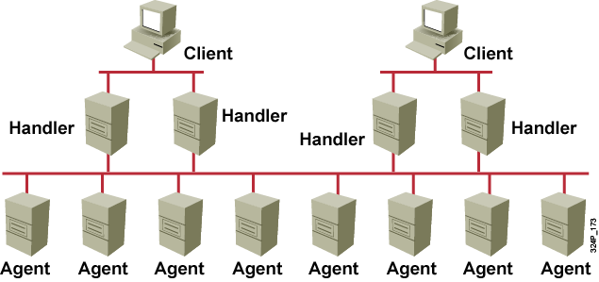
Basics of Distributed DoS Attacks
  Distributed DoS attacks exploit specific ports.
  ACLs can control access on a port-by-port basis.

Slide 21
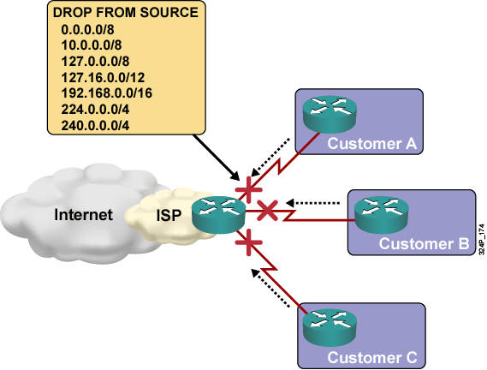
Mitigate Distributed DoS Using Martian Filters
  RFC 3704 is update to RFC 2827

Slide 22
Distributed DoS Attack Mitigation: TRIN00
R2(config)#access-list 190 deny tcp any any eq 1524 log
R2(config)#access-list 190 deny tcp any any eq 27665 log
R2(config)#access-list 190 deny udp any any eq 31335 log
R2(config)#access-list 190 deny udp any any eq 27444 log
R2(config)#interface e0/0
R2(config-if)#ip access-group 190 in
R2(config-if)#end
R2(config)#interface e0/1
R2(config-if)#ip access-group 190 in
R2(config-if)#end

Slide 23
Distributed DoS Attack Mitigation: Stacheldraht
R2(config)#access-list 190 deny tcp any any eq 16660 log
R2(config)#access-list 190 deny tcp any any eq 65000 log
R2(config)#interface e0/0
R2(config-if)#ip access-group 190 in
R2(config-if)#end
R2(config)#interface e0/1
R2(config-if)#ip access-group 190 in
R2(config-if)#end

Slide 24
Distributed DoS Attack Mitigation: Trinity v3
R2(config)#access-list 190 deny tcp any any eq 39168 log
R2(config)#interface e0/0
R2(config-if)#ip access-group 190 in
R2(config-if)#end
R2(config)#interface e0/1
R2(config-if)#ip access-group 190 in
R2(config-if)#end

Slide 25
Distributed DoS Attack Mitigation: SubSeven
R2(config)#access-list 190 deny tcp any any eq 1243 log
R2(config)#access-list 190 deny tcp any any eq 2773 log
R2(config)#access-list 190 deny tcp any any range 6711 6713 log
R2(config)#access-list 190 deny tcp any any eq 6776 log
R2(config)#access-list 190 deny tcp any any eq 7000 log
R2(config)#access-list 190 deny tcp any any eq 7215 log
R2(config)#access-list 190 deny tcp any any eq 27374 log
R2(config)#access-list 190 deny tcp any any eq 27573 log
R2(config)#access-list 190 deny tcp any any eq 54283 log
R2(config)#interface e0/0
R2(config-if)#ip access-group 190 in
R2(config-if)#end
R2(config)#interface e0/1
R2(config-if)#ip access-group 190 in
R2(config-if)#end

Slide 26
Combining Access Functions

Slide 27
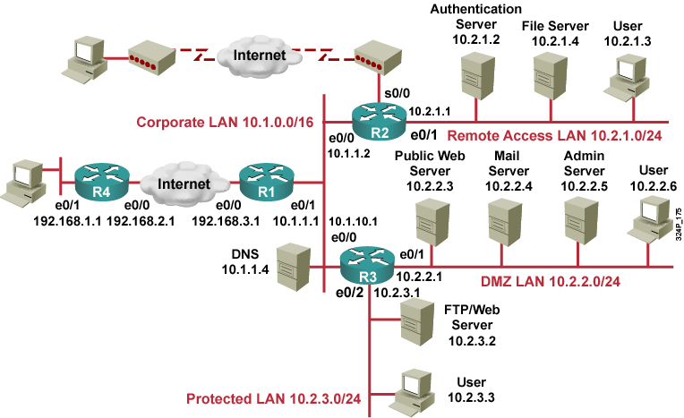
Combining Access Functions

Slide 28
Caveats

Slide 29
ACL Caveats
Statement | Caveat
Implicit deny all | You may not see this statement but it does exist.
Standard ACL limitation | You may need to create extended ACLs to implement security policies.
Statement evaluation order | ACL statements are evaluated from top down, so always consider the order of the statements.
Order of ACL statements | Place more specific ACL statements higher in the ACL. Ensure that statements at the top of the ACL do not negate any statements found lower in the list.
Directional filtering | Always double-check the direction (inbound or outbound) of data that your ACL is filtering.

Slide 30
ACL Caveats (Cont.)
Statement | Caveat
Modifying numbered ACLs | Adding new statements may require a new ACL to be created.
Special packets | If filtering router-generated packets is part of the security policy, they must be acted upon by inbound ACLs on adjacent routers or through other router filter mechanisms using ACLs.
Extended ACL placement | Always consider placing extended ACLs on routers as close as possible to the source being filtered.
Standard ACL placement | Always place standard ACLs as close to the destination as possible.

Slide 31
Summary
  Standard, extended, enhanced, named, and numbered ACLs can be created.
  Simple rules should be followed when creating ACLs.
  ACLs must be applied based on the direction of the data flow.
  ACLs can be used to filter traffic to mitigate security threats.
  ACLs can be used to mitigate distributed DoS attacks.
  Packets with source IP address within 0.0.0.0/8, 10.0.0.0/8, 127.0.0.0/8, 172.16.0.0/12, 192.168.0.0/16, 224.0.0.0/4, or 240.0.0.0/4, should be denied on the ISP edge.
  Many ACL functions can be combined into two or three larger ACLs.
  Several caveats should be considered when creating ACLs.

Slide 32


