Slide 1
Cisco Device Hardening
Securing Management and Reporting Features

Slide 2

Secure Management and Reporting Planning Considerations

Slide 3
Secure Management and Reporting Planning Considerations
  Which are the most important logs?
  How are important messages separated from routine notifications?
  How do you prevent tampering with logs?
  How do you make sure time stamps match?
  What log data is needed in criminal investigations?
  How do you deal with the volume of log messages?
  How do you manage all the devices?
  How can you track changes when attacks or network failures occur?

Slide 4
Secure Management and Reporting Architecture

Slide 5
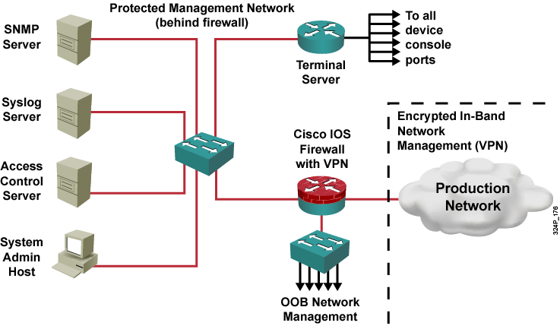
Secure Management and
Reporting Architecture

Slide 6
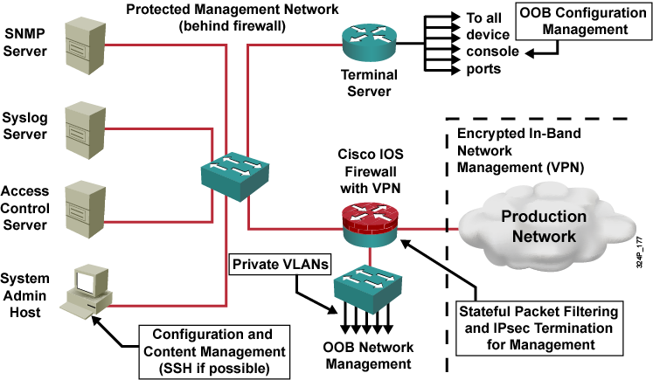
Information Paths

Slide 7
In-Band Management Considerations
  Which management protocols does each device support?
  Does the management channel need to be active at all times?
  Is SNMP necessary?

Slide 8
Secure Management and
Reporting Guidelines
  In-band management guidelines:
    Apply only to devices needing to be managed or monitored.
    Use IPsec when possible.
    Use SSH or SSL instead of Telnet.
    Decide whether the management channel needs to be open at all times.
    Keep clocks on hosts and network devices synchronized.
    Record changes and archive configurations.
  OOB management guidelines:
    Provide highest level of security and mitigate the risk of passing insecure management protocols over the production network.
    Keep clocks on hosts and network devices synchronized.
    Record changes and archive configurations.

Slide 9
Configuring an SSH Server for Secure Management and Reporting

Slide 10
Configuring an SSH Server for
Secure Management and Reporting
Austin2#configure terminal
Austin2(config)#ip domain-name cisco.com
Austin2(config)#crypto key generate rsa general-keys modulus 1024
Sept 22 13:20:45: %SSH-5-ENABLED: SSH 1.5 has been enabled
Austin2(config)#ip ssh timeout 120
Austin2(config)#ip ssh authentication-retries 4
Austin2(config)#line vty 0 4
Austin2(config-line)#no transport input telnet
Austin2(config-line)#transport input ssh
Austin2(config-line)#end
  Configure the IP domain name
  Generate the RSA keys
  Configure the SSH timeout interval
  Configure the SSH retries
  Disable vty inbound Telnet sessions
  Enable vty inbound SSH sessions

Slide 11
Using Syslog Logging for Network Security

Slide 12
Implementing Log Messaging for Security
  Routers should be configured to send log messages to one or more of these:
    Console
    Terminal lines
    Memory buffer
    SNMP traps
    Syslog
  Syslog logging is a key security policy component.

Slide 13
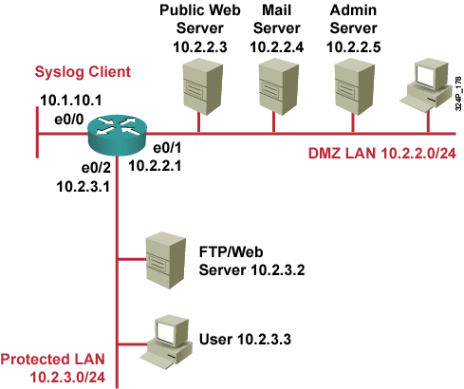
Syslog Systems
  Syslog server: A host that accepts and processes log messages from one or more syslog clients.
  Syslog client: A host that generates log messages and forwards them to a syslog server.

Slide 14
Cisco Log Severity Levels
Level
Name
Description
0
Emergencies
Router unusable
1
Alerts
Immediate action required
2
Critical
Condition critical
3
Errors
Error condition
4
Warnings
Warning condition
5
Notifications
Normal but important event
6
Informational
Informational message
7
Debugging
Debug message

Slide 15
Log Message Format
Time Stamp
Message Text
Oct 29 10:00:01 EST: %SYS-5-CONFIG_I: Configured from console by vty0 (10.2.2.6)
Log Message Name and Severity Level

Slide 16
Configuring Syslog Logging

Slide 17
Configuring Syslog
Router(config)#
logging [host-name | ip-address]
  Sets the destination logging host
Router(config)#
logging trap level
  (Optional) Sets the log severity (trap) level
Router(config)#
logging facility facility-type
  (Optional) Sets the syslog facility

Slide 18
Configuring Syslog (Cont.)
Router(config)#
logging source-interface interface-type interface-number
  (Optional) Sets the source interface
Router(config)#
logging on
  Enables logging

Slide 19
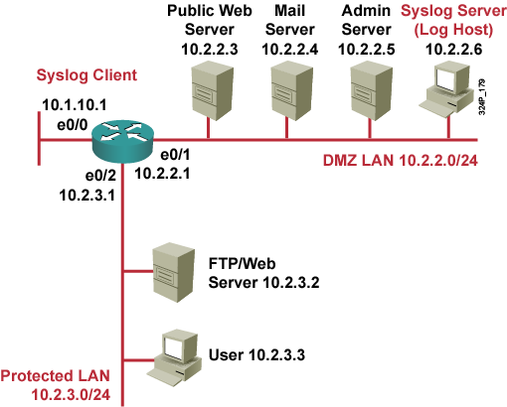
Syslog Implementation Example
R3(config)#logging 10.2.2.6
R3(config)#logging trap informational
R3(config)#logging source-interface loopback 0
R3(config)#logging on

Slide 20
SNMP Version 3

Slide 21
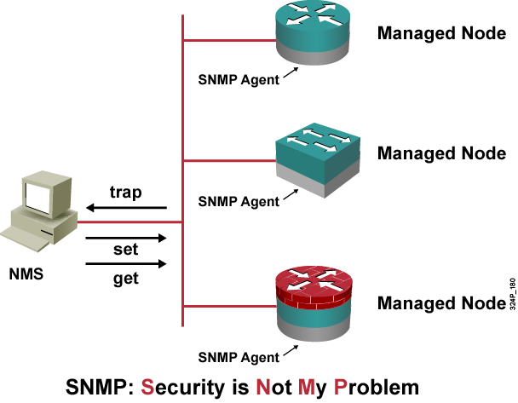
SNMPv1 and SNMPv2 Architecture
  The SNMP NMS asks agents embedded in network devices for information, or tells the agents to do something.

Slide 22
Community Strings
Used to authenticate messages between a management station, and an SNMPv1 or SNMPv2 engine:
  Read only community strings can get information, but can not set information in an agent.
  Read-write community strings can get and set information in the agent.
  Having read-write access is like having the enable password for the device.

Slide 23
SNMP Security Models and Levels
Definitions:
  Security model is a security strategy used by the SNMP agent
  Security level is the permitted level of security within a security model
Model | Level | Authentication | Encryption | What Happens
v1 | noAuthNoPriv | Community String | No | Authenticates with a community string match
v2 | noAuthNoPriv | Community String | No | Authenticates with a community string match
v3 | noAuthNoPriv | Username | No | Authenticates with a username
 | authNoPriv | MD5 or SHA | No | Provides HMAC MD5 or SHA algorithms for authentication
 | authPriv | MD5 or SHA | DES | Provides HMAC MD5 or SHA algorithms for authentication Provides DES 56-bit encryption in addition to authentication based on the CBC-DES (DES-56) standard

Slide 24
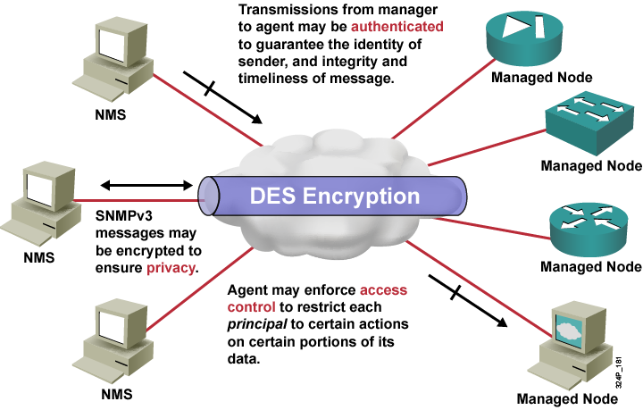
SNMPv3 Architecture

Slide 25
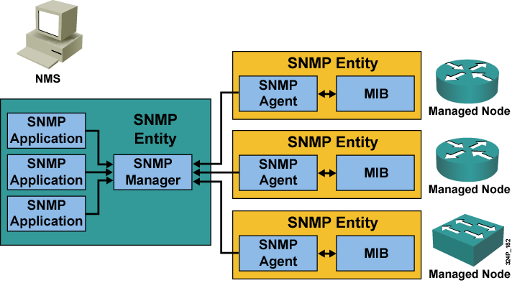
SNMPv3 Operational Model

Slide 26
SNMPv3 Features and Benefits
Features | Message integrity: Ensures that a packet has not been tampered with intransit. Authentication: Determines that the message is from a valid source. Encryption: Scrambles the contents of a packet to prevent it from being seen by an unauthorized source.
Benefits | Data can be collected securely from SNMP devices without fear of the data being tampered with or corrupted. Confidential information, such as, SNMP Set command packets that change a router configuration, can be encrypted to prevent its contents from being exposed on the network.

Slide 27
Configuring an SNMP Managed Node

Slide 28
SNMPv3 Configuration Task List
Cisco IOS SNMPv3 server configuration tasks:
  Configuring the SNMP-server engine ID
  Configuring the SNMP-server group names
  Configuring the SNMP-server users
  Configuring the SNMP-server hosts

Slide 29
Configuring the SNMP-Server Engine ID
Router(config)#
snmp-server engineID [local engineid-string] | [remote ip-address udp-port port-number engineid-string]
Configures names for both the local and remote SNMP engine (or copy of SNMP) on the router
PR1(config)#snmp-server engineID local 1234

Slide 30
Configuring the SNMP-Server Group Names
Router(config)#
snmp-server group groupname {v1 | v2c | v3 {auth | noauth | priv}} [read readview] [write writeview] [notify notifyview] [access access-list]
Configures a new SNMP group, or a table that maps SNMP users to SNMP views
PR1(config)#snmp-server group johngroup v3 auth
PR1(config)#snmp-server group billgroup v3 auth priv

Slide 31
Configuring the SNMP-Server Users
Router(config)#
snmp-server user username groupname [remote ip-address [udp-port port]] {v1 | v2c | v3 [encrypted] [auth {md5 | sha} auth-password [priv des56 priv-password]]} [access access-list]
Configures a new user to an SNMP group
PR1(config)#snmp-server user John johngroup v3 auth md5 john2passwd
PR1(config)#snmp-server user Bill billgroup v3 auth md5 bill3passwd des56 password2
PR1(config)#snmp-server group johngroup v3 auth
PR1(config)#snmp-server group billgroup v3 auth priv

Slide 32
Configuring the SNMP-Server Hosts
Router(config)#
snmp-server host host-address [traps | informs] [version {1 | 2c | 3 [auth | noauth | priv]}] community-string [udp-port port] [notification-type]
Configures the recipient of an SNMP trap operation.
PR1(config)#snmp-server engineID remote 10.1.1.1 1234
PR1(config)#snmp-server user bill billgroup remote 10.1.1.1 v3
PR1(config)#snmp-server group billgroup v3 noauth
PR1(config)#snmp-server enable traps
PR1(config)#snmp-server host 10.1.1.1 inform version 3 noauth bill
PR1(config)#snmp-server manager

Slide 33
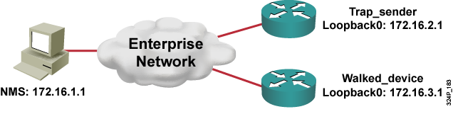
SNMPv3 Configuration Example
Trap_sender(config)#snmp-server group snmpgroup v3 auth
Trap_sender(config)#snmp-server group snmpgroup v3 priv
Trap_sender(config)#snmp-server user snmpuser snmpgroup v3 auth md5 authpassword priv des56 encryptpassword
Trap_sender(config)#snmp-server enable traps cpu
Trap_sender(config)#snmp-server enable traps config
Trap_sender(config)#snmp-server enable traps snmp
Trap_sender(config)#snmp-server host 11.11.11.11 traps version 3 priv snmpuser
Trap_sender(config)#snmp-server source-interface traps loopback 0
Walked_device(config)#snmp-server group snmpgroup v3 auth
Walked_device(config)#snmp-server group snmpgroup v3 priv
Walked_device(config)#snmp-server user snmpuser snmpgroup v3 auth md5 authpassword priv des56 encrypt password

Slide 34
Configuring NTP Client

Slide 35
Understanding NTP
  NTP is used to synchronize the clocks in the entire network.
  System clock is set by the battery system calendar during bootup.
  System clock can then be modified manually or via NTP.
  NTP runs over UDP port 123; current version is 4.
  Only NTP up to version 3 has been documented in RFCs.
  Stratum describes how many “NTP hops” away a machine is from authoritative time source.
  NTP establishes associations to synchronize time.

Slide 36
Configuring NTP Authentication
Router(config)#
ntp authenticate
Enables the authentication feature
Router(config)#
ntp authentication-key number md5 value
Defines the authentication keys
Used for both peer and server associations
Router(config)#
ntp trusted-key key-number
Defines the trusted authentication keys
Required to synchronize to a system (server association)
R1(config)#ntp authentication
R1(config)#ntp authentication-key 1 md5 NeVeRgUeSs
R1(config)#ntp trusted-key 1

Slide 37
Configuring NTP Associations
Router(config)#
ntp server {ip-address | hostname} [version number] [key keyid] [source interface] [prefer]
Forms a server association with another system
Router(config-if)#
ntp broadcast client
Receives NTP broadcast packets
R1(config)#ntp server 10.1.1.1 key 1
R1(config)#ntp server 10.2.2.2 key 2 prefer
R1(config)#interface Fastethernet 0/1
R1(config-if)#ntp broadcast client

Slide 38
Configuring Additional NTP Options
Router(config)#
ntp access-group {query-only | serve-only | serve | peer} access-list-number
Controls NTP message exchange
Router(config)#
ntp source interface
Modifies the source IP address of NTP packets
R1(config)#access-list 1 permit host 10.1.1.1
R1(config)#ntp access-group peer 1
R1(config)#ntp source loopack 0

Slide 39
Configuring NTP Server

Slide 40
Implementing NTP Server
  Cisco IOS routers work as an NTP server by default.
  As soon as a router is synchronized to an authoritative time source, it will allow peers with lower stratum to synchronize to that router:
    Requires a peer association
  You can make a router an authoritative NTP server, even if the system is not synchronized to an outside time source.
  Two options to establish a peer association:
    Unicast
    Broadcast
  Same exchange control methods as with client:
    Packet authentication
    Access group filtering

Slide 41
Configuring NTP Server
Router(config)#
ntp peer ip-address [normal-sync][version number] [key keyid] [source interface] [prefer]
Forms a peer association with another system
Router(config)#
ntp master [stratum]
Makes the system an authoritative NTP server
Router(config-int)#
ntp broadcast [version number][destination address][key keyid]
Configures an interface to send NTP broadcast packets
R2(config)#ntp peer 10.1.1.1 key 1
R2(config)#ntp master 3
R2(config)#interface Fastethernet0/0
R2(config-int)#ntp broadcast

Slide 42
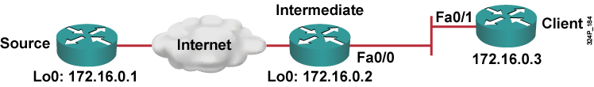
NTP Configuration Example
Source(config)#ntp master 5
Source(config)#ntp authentication-key 1 md5 secretsource
Source(config)#ntp peer 172.16.0.2 key 1
Source(config)#ntp source loopback 0
Intermediate(config)#ntp authentication-key 1 md5 secretsource
Intermediate(config)#ntp authentication-key 2 md5 secretclient
Intermediate(config)#ntp trusted-key 1
Intermediate(config)#ntp server 172.16.0.1
Intermediate(config)#ntp source loopback 0
Intermediate(config)#interface Fastethernet0/0
Intermediate(config-int)#ntp broadcast
Client(config)#ntp authentication-key 1 md5 secretclient
Client(config)#ntp trusted-key 1
Client(config)#interface Fastethernet0/1
Client(config-int)#ntp broadcast client

Slide 43
Summary
  Since OOB management provides higher levels of security and performance than in-band, the decision to use an in-band solution must be considered carefully.
  Management communications should use SSH rather than Telnet.
  Implementing a router logging facility is an important part of any network security policy.
  Syslog is implemented on your Cisco router using syslog router commands.
  Network management will be greatly enhanced by implementing the security features of SNMPv3 rather than earlier versions.
  Cisco IOS SNMPv3 server configuration tasks include configuring SNMP-server engine ID, group names, users, and hosts.
  Cisco routers can be configured as NTP servers or clients.
  Packet authentication and filtering should be used to protect NTP exchange.

Slide 44


